Slide 1
Pseudo one-sided rectangular duals
Bettina Speckmann Kevin Verbeek
Sander Beekhuis
TU Eindhoven

Slide 2
Rectangular Layout
Rectangular Layout partition of a rectangle into finitely many interior-disjoint rectangles.

Slide 3
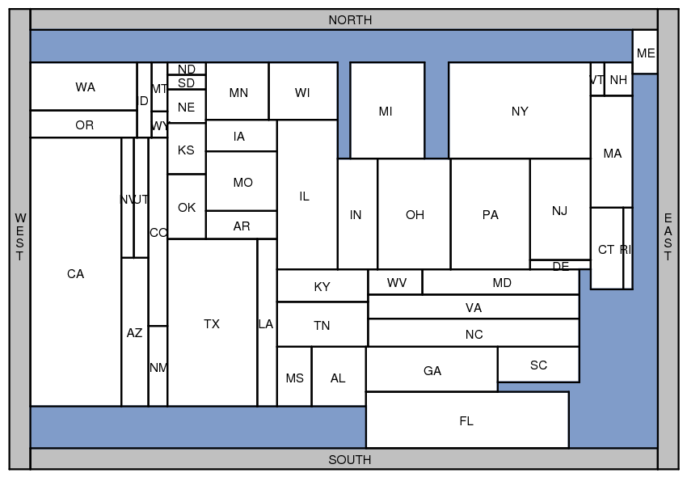
Applications
Rectangular Cartograms visualize statistical data about sets of regions; regions are rectangles; area proportional to some geographic variable

Slide 4
Applications
Rectangular Cartograms introduced by Raisz in 1934
Notes:
Population Limit 1, Aspect 12, zero error

Slide 5
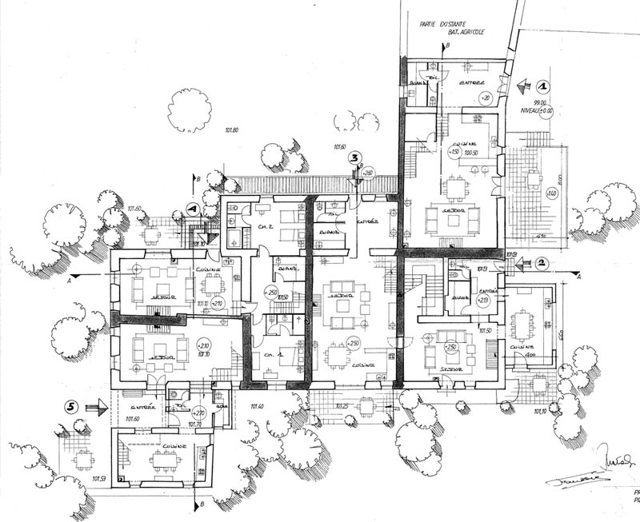
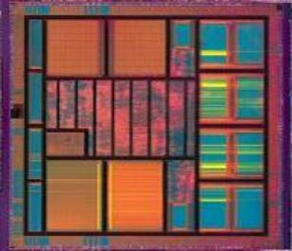
Applications
Floorplans building architecture or VLSI layout

Slide 6
Area-universal layouts
Area-universal layout L for every assignment of weights to the areas of L there is a layout L’ equivalent to L such that the areas of L’ have the correct weights.
Uses animations; morphs; layout first – function later

Slide 7
Area-universal layouts
Area-universal layout L for every assignment of weights to the areas of L there is a layout L’ equivalent to L such that the areas of L’ have the correct weights.
[Eppstein et al., 2012] A layout is area-universal, if an only if it is one-sided.

Slide 8
One-sided layouts
One-sided layout L every maximal line segment of L is the side of a single rectangle
maximal vertical segment
maximal horizontal segment

Slide 9
One-sided layouts
One-sided layout L every maximal line segment of L is the side of a single rectangle

Slide 10
Equivalent layouts
These layouts are not equivalent!

Slide 11
Assumption(TODO)
We assume that every graph has 4 vertices incident to the outer face. (poles)
Otherwise we can sometimes make this true
Sometimes in multiple ways
Often we don’t really care about adjacencies between these outer rectangles
The inside of the 4 outer rectangles is a rectangle (USEFULL FOR LATER SLIDE) (if the graph has at least 5 vertices)

Slide 12
What is a separating cycle

Slide 13
Rectangular duals
[Kozminski & Kinnen ’85] A planar graph G has a rectangular dual with 4 rectangles on the boundary if and only if
every interior face is a triangle and the exterior face is a quadrangle
G has no separating triangles
Notes:
Specify adjacencies of layout

Slide 14
Why does a sep 3-cycle not work

Slide 15
Rectangular duals
The rectangular dual is not unique
Notes:
Nonequivalent layouts!

Slide 16
Regular Edge Labelling
Notes:
Given a rectangular dual we get a REL
Equivalent duals same REL
We will use this a lot, so properties …
A rel als determines a eq. class of layouts (by def of layout equivalence)

Slide 17
Exterior vertex condition
Notes:
A rel corresponds to an equivalence class of layouts
We will use this a lot, so properties …

Slide 18
Interior vertex condition
Notes:
A rel corresponds to an equivalence class of layouts
We will use this a lot, so properties …

Slide 19
Separating 4-cycle
Notes:
As soon as one is determined, the rest follows
“The space not occupied by any of the 4 rectangles is again a rectangle. At least one rectangle must border on each side of this rectangle and no rectangle can border it on two sides. Because we have only 4 rectangles every sided is borderded by exacly one rectangle. So if we, for example know which rectangle lies above the interior we also know the orientation of all other rectangles with respect to the intrior rectangle.”
We can do a vertex flip here (might show it, probably distracting.)

Slide 20
Separating 4-cycle
Notes:
We can see ext vertex as special case of this condition

Slide 21
Acyclic flows

Slide 22
No mono-colored triangles
?

Slide 23
One-sided duals?
[Rinsma ’87] There exists an outer-planar triangulated graph that does have rectangular duals, but no one-sided dual.
Notes:
Logical question in our quest for area-universal duals
Via enumeration

Slide 24
k-sided duals
k-sided dual
Every maximal segment is the boundary of at most k rectangles all on the same side of the segment
2-sided
3-sided
Do graphs without an 1-sided dual admit a k-sided dual for some k?
Notes:
Hopfully small k

Slide 25
k-sided REL
Face with at most k+2 vertices on one of it’s boundary paths

Slide 26
∞-sided duals
Exterior vertices
Seperating 4-cycles
W
N
S
E

Slide 27
∞-sided duals
Exterior vertices
Seperating 4-cycles
No monocolored triangles
W
N
S
E

Slide 28
∞-sided duals
Exterior vertices
Seperating 4-cycles
No monocolored triangles
Problem!
W
N
S
E

