Slide 1
Area-Universal Rectangular Layouts
David Eppstein
University of California, Irvine
Elena Mumford Bettina Speckmann Kevin Verbeek
TU Eindhoven

Slide 2
Rectangular Layout
Rectangular Layout partition of a rectangle into finitely many interior-disjoint rectangles.

Slide 3
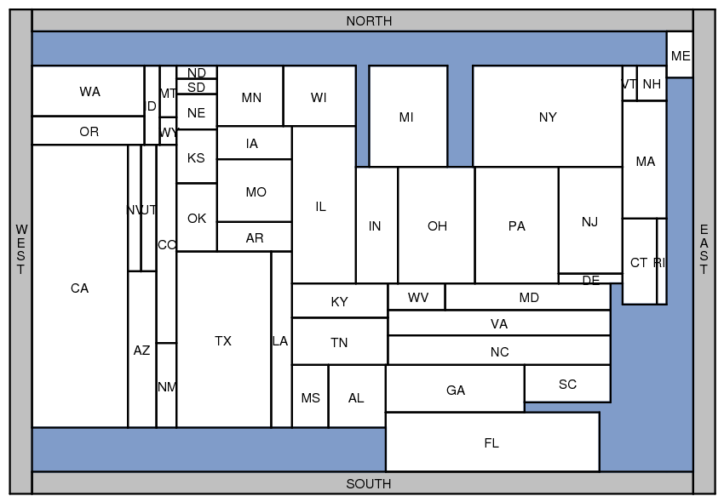
Applications
Rectangular Cartograms visualize statistical data about sets of regions; regions are rectangles; area proportional to some geographic variable

Slide 4
Applications
Rectangular Cartograms introduced by Raisz in 1934
Notes:
Population Limit 1, Aspect 12, zero error

Slide 5
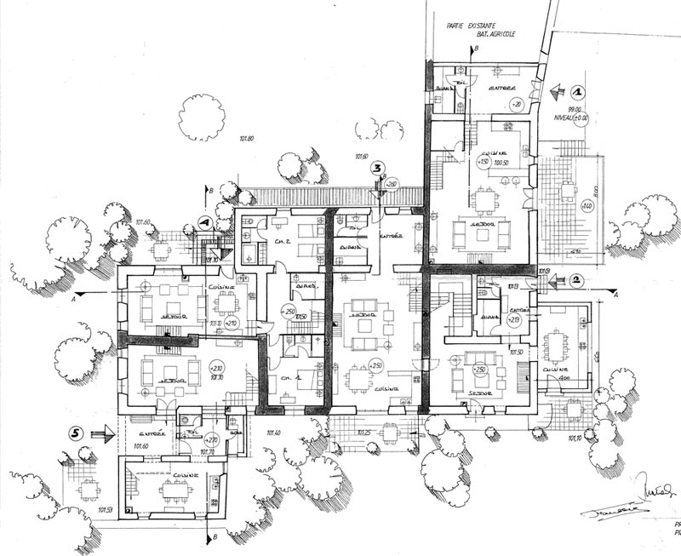
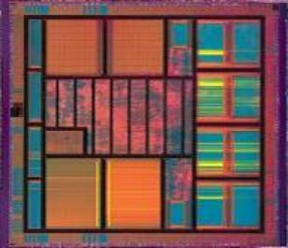
Applications
Floorplans building architecture or VLSI layout

Slide 6
Area-universal layouts
Area-universal layout L for every assignment of weights to the areas of L there is a layout L’ equivalent to L such that the areas of L’ have the correct weights.
Uses animations; morphs; layout first – function later

Slide 7
Area-universal layouts
Area-universal layout L for every assignment of weights to the areas of L there is a layout L’ equivalent to L such that the areas of L’ have the correct weights.
Theorem A layout is area-universal, if an only if it is one-sided.

Slide 8
One-sided layouts
One-sided layout L every maximal line segment of L must be the side of a least one rectangle
maximal vertical segment
maximal horizontal segment

Slide 9
One-sided layouts
One-sided layout L every maximal line segment of L must be the side of a least one rectangle

Slide 10
One-sided layouts
One-sided layout L every maximal line segment of L must be the side of a least one rectangle
Theorem A layout is area-universal, if an only if it is one-sided.
Area-universal layout L for every assignment of weights to the areas of L there is a layout L’ equivalent to L such that the areas of L’ have the correct weights.

Slide 11
Equivalent layouts
These layouts are not equivalent!

Slide 12
Equivalent layouts

Slide 13
Equivalent layouts

Slide 14
Equivalent layouts

Slide 15
Equivalent layouts

Slide 16
Equivalent layouts

Slide 17
Equivalent layouts
These two layouts are not equivalent …

Slide 18
Order-equivalent layouts
These two layouts are not equivalent … but they are order-equivalent.

Slide 19
Order-equivalent layouts
Order-equivalent layouts two layouts are order-equivalent if their rectangles and maximal segments correspond one-for-one such that the partial orders match.
Define a partial order on the vertical maximal segments
Define a symmetric order on the horizontal maximal segments

Slide 20
There can be only one …
[Wimer, Koren, and Cederbaum ‘88] For any layout L and any assignment of weights to the areas of L there is at most one layout L’ order-equivalent to L such that the areas of L’ have the correct weights.

Slide 21
… and there always is one.
[Wimer, Koren, and Cederbaum ‘88] For any layout L and any assignment of weights to the areas of L there is at most one layout L’ order-equivalent to L such that the areas of L’ have the correct weights.
[Wimer, Koren, and Cederbaum ‘88] For any layout L and any assignment of weights to the areas of L there exists one layout L’ order-equivalent to L such that the areas of L’ have the correct weights.

Slide 22
Area-universality and one-sidedness
Theorem The following three properties of a layout L are equivalent:
L is area-universal
Every layout that is order-equivalent to L is equivalent to L
L is one-sided
Given a set of adjacency requirements, can we find a one-sided layout that fulfills these requirements?
adjacency requirements are often specified via planar graphs …

Slide 23
Rectangular duals
[Kozminski & Kinnen ’85] A planar graph G has a rectangular dual with 4 rectangles on the boundary if and only if
every interior face is a triangle and the exterior face is a quadrangle
G has no separating triangles

Slide 24
Rectangular duals
The rectangular dual is not unique

Slide 25
One-sided duals?
[Rinsma ’87] There exists an outer-planar triangulated graph that does have rectangular duals, but no one-sided dual.

Slide 26
Finding one-sided layouts
Partition graph on separating four-cycles
Represent family of all layouts as distributive lattice [Fusy ’06]
Represent elements of distributive lattice as partitions of a partial order according to Birkhoff’s theorem
Characterize the ordered partitions that correspond to one-sided layouts
Search in the partial order for partitions of this type
Fixed-parameter tractable algorithm …

Slide 27
Remove non-trivial separating four-cycles

Slide 28
Remove non-trivial separating four-cycles

Slide 29
Regular edge labeling

Slide 30
Regular edge labeling

Slide 31
Regular edge labeling
[Kant and He ’97] Every regular edge labeling uniquely defines an equivalence class of rectangular duals.

Slide 32
Layouts that are not one-sided …
search for regular edge labelings without these patterns…

Slide 33
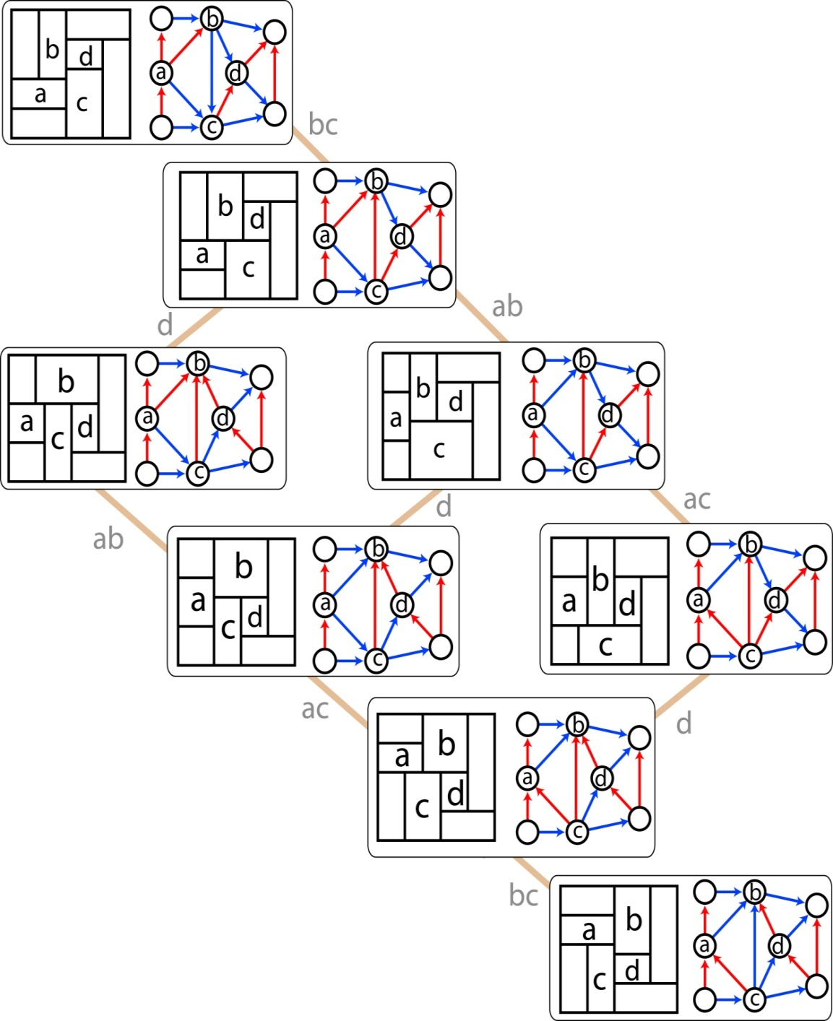
Distributive lattice of RELs
b
a
d
c
[Fusy ’05]

Slide 34
Distributive lattice of RELs
edge move
vertex move
[Fusy ’05]

Slide 35
Finding one-sided layouts
Partition graph on separating four-cycles
Represent family of all layouts as distributive lattice [Fusy ’06]
Represent elements of distributive lattice as partitions of a partial order according to Birkhoff’s theorem
Characterize the ordered partitions that correspond to one-sided layouts
Search in the partial order for partitions of this type
Fixed-parameter tractable algorithm …

Slide 36
Finding one-sided layouts
Theorem
We can find an area-universal layout (if it exists) in O(2^{O(K )} n^{O(1)}) time. K = # degree-four vertices in adjacency graph
Open problems
Polynomial time algorithm to find area-universal layouts
Can a given area assignment be realized if adjacency graph has no area-universal layout?
2

