Slide 1
k-sided rectangular duals
Bettina Speckmann Kevin Verbeek
Sander Beekhuis
TU Eindhoven
Notes:
-TODO reorder names and add committee

Slide 2
Rectangular Layout
Rectangular Layout partition of a rectangle into finitely many interior-disjoint rectangles.
Notes:
-definition rectangular layout

Slide 3
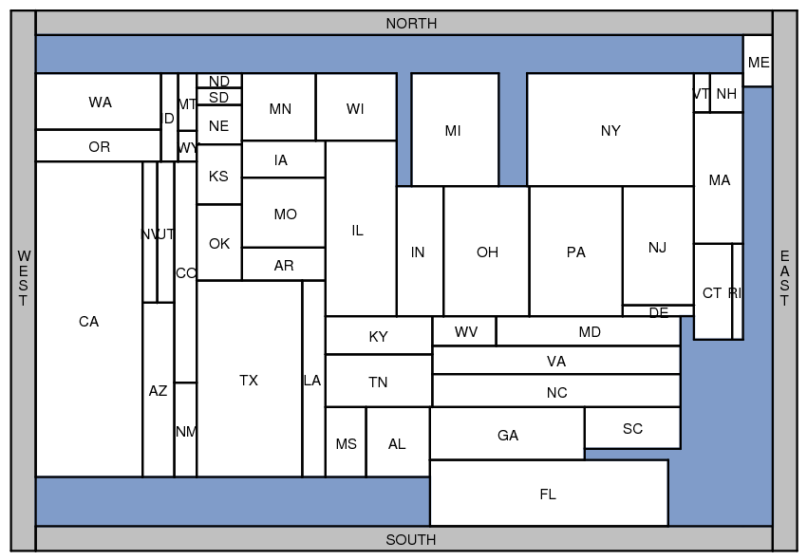
Applications
Rectangular Cartograms visualize statistical data about sets of regions; regions are rectangles; area proportional to some geographic variable
Notes:
-in use by map makers; statisctics

Slide 4
Applications
Rectangular Cartograms introduced by Raisz in 1934
Notes:
-mountains and rivers as segments

Slide 5
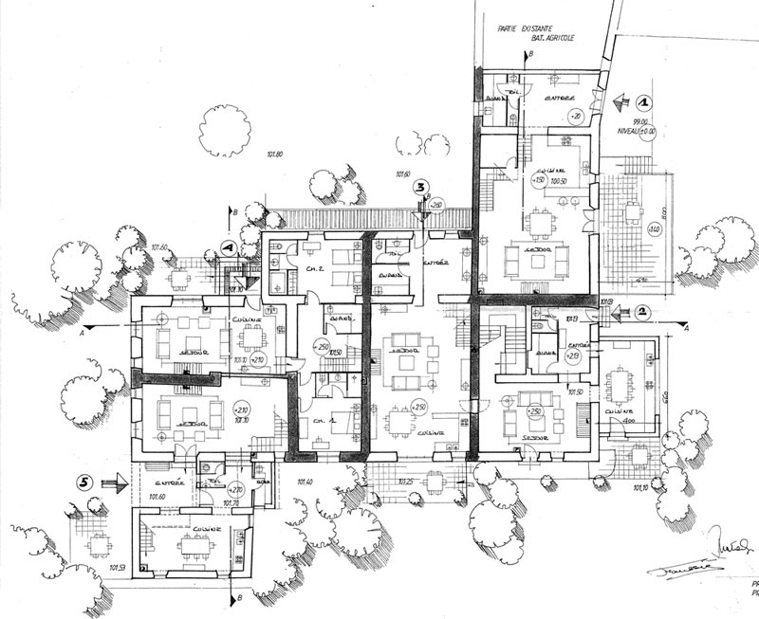
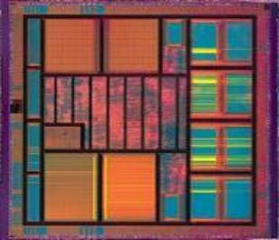
Applications
Floorplans building architecture or VLSI layout
Notes:
-architecture
-chips

Slide 6
Equivalent layouts
These layouts are not equivalent!
Notes:
-def equivalent layouts
-tell why these are not equivalent layouts

Slide 7
What is a rectangular dual

Slide 8
Rectangular duals
[Kozminski & Kinnen ’85] A planar graph G has a rectangular dual with 4 rectangles on the boundary if and only if
every interior face is a triangle and the exterior face is a quadrangle
G has no separating triangles
Notes:
-why? Describe adjacencies as a graph
-def rectangular layout
-two requirements
-why is no sep tri necessary?
TODO –animatie goedzetten

Slide 9
Rectangular duals
For the rest of the talk will only consider graphs fulfilling these requirements
The area bounded by these 4 outer rectangles is a rectangle (if the graph has at least 5 vertices)
N
W
E
S
ADD FIGURE-standard gaph form
-rectangle boundry
Notes:
-only consider graphs fullfiling the requirements; def poles
-we can sometimes make them
-area surrounded by poles is a rectangle
-convention naming of poles
-adjacencies between poles don’t matter

Slide 10
Rectangular duals are not unique
Notes:
-nonunique

Slide 11
Area-universal layouts
Area-universal layout L for every assignment of weights to the areas of L there is a layout L’ equivalent to L such that the areas of L’ have the correct weights.
Uses layout first – function later; animations; morphs
Notes:
-def. area-universal layouts
-usefull; building desing; chip design; stats over tie

Slide 12
Maximal segments
TODO

Slide 13
One-sided layouts
One-sided layout L every maximal line segment of L is the side of a single rectangle
maximal vertical segment
maximal horizontal segment
Notes:
-def maximal segment
-def one-sided
-this one is not one-sided

Slide 14
One-sided layouts
One-sided layout L every maximal line segment of L is the side of a single rectangle
Notes:
-is this one-sided?
-no!

Slide 15
Area-universal layouts
[Eppstein et al., 2012] A layout is area-universal, if an only if it is one-sided.
TODO JOIN with slide above
Notes:
-same as onesided

Slide 16
One-sided duals?
[Rinsma ’87] There exists a graph that does have a rectangular dual, but no one-sided dual.
Notes:
- Logical question in our quest for area-universal duals
- Not true, Via enumeration of rels

Slide 17
What comes close?
Wat is het problem met diengen die niet one-sided zijn? Wat komt er dan in de buurt

Slide 18
k-sided layouts
k-sided layout
Every maximal segment is the boundary of at most k rectangles all on the same side of the segment
2-sided
3-sided
Do graphs without a one-sided dual admit a k-sided dual for some k?
Notes:
-next best thing?
-k-sided segment
-k-sided layout
-examples
-research question

Slide 19
Separating 4-cycles
Notes:
-soon; introduce graphs as describing adjacencies
-def separating cycle

Slide 20
Results
For any k ∈ ℕ there are graphs that are not k-sided.
Graphs G without separating 4-cycles are d−1-sided, where d is the maximal degree of the non-polar vertices of G.
d = 5
Notes:
TODO: polar vertices expliciet op presentatie

Slide 21
Regular Edge Labelling
Notes:
-uniquely determined by a equivalence class of layouts (and turns out reverse)
-first how to make using a dual
-when blue edge
-when red edge
-ignore outer face
-we will show 5 properties

Slide 22
Exterior vertex condition
Notes:
-outer vertices are frame
-top one all red incoming
-right one all blue incoming
-same arg for other two

Slide 23
Interior vertex condition
Notes:
-surrounded on all sides by rectangles
- These two properties are sufficient; algorithm by Kant and He

Slide 24
Acyclic flows
Notes:
-three more props
-clear in dual: no leftmost rectangle
-in rel; cycle in cyle arg

Slide 25
No mono-colored triangles
?
Notes:
Clear in dual; three rects all hor adjacent to each other
Clear in REL; skip red part of interior vertex condition

Slide 26
Separating 4-cycle
Notes:
-state
-due to rectangular frame (one single rectangle must be above etc.)
-similar to exterior vertex condion (but degree of re

Slide 27
Separating 4-cycle
Notes:
-another example
-pole, so no degree of freedom

Slide 28
k-sided regular edge labeling
Face with at most k+2 vertices on one of it’s boundary paths
Notes:
-merge split and bot top path of face
-k-sided segment is type of face

Slide 29
∞-sided duals
Exterior vertices
W
N
S
E
Notes:
-imposible for graphs containing 4-cycles
-using properties just now shown
-step trough steps

Slide 30
∞-sided duals
Exterior vertices
Seperating 4-cycles
No monocolored triangles
W
N
S
E
Notes:
-step trough steps

Slide 31
∞-sided duals
Exterior vertices
Separating 4-cycles
No monocolored triangles
Problem!
W
N
S
E
Notes:
-step trough steps

Slide 32
Results/recap

Slide 33
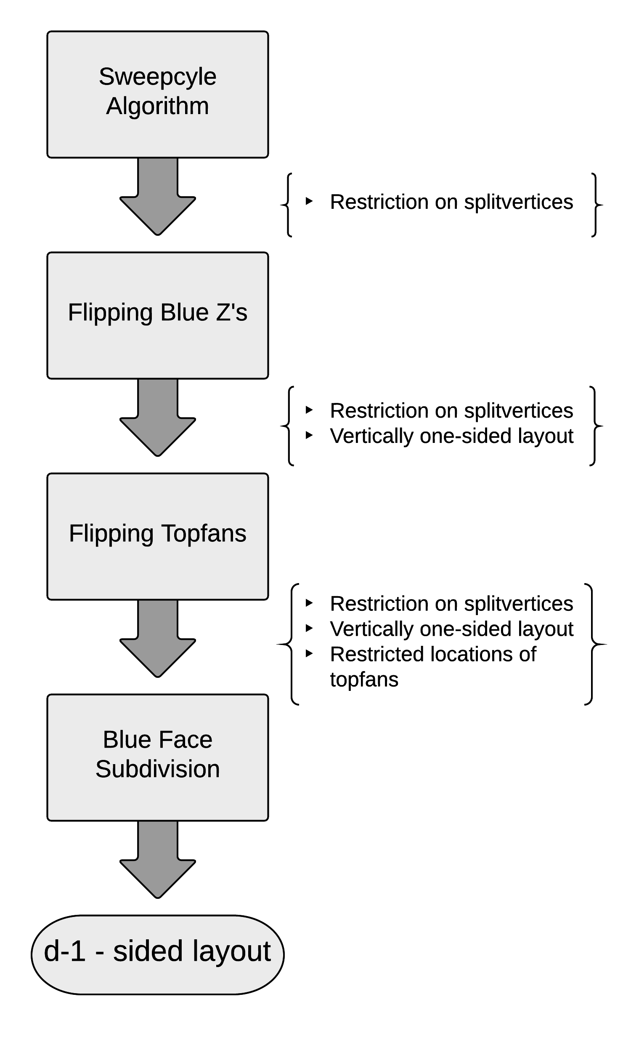
Algorithm
Multistep approach
Each step solves a problem
Obtain more and more properties
d-1 sided layout

Slide 34
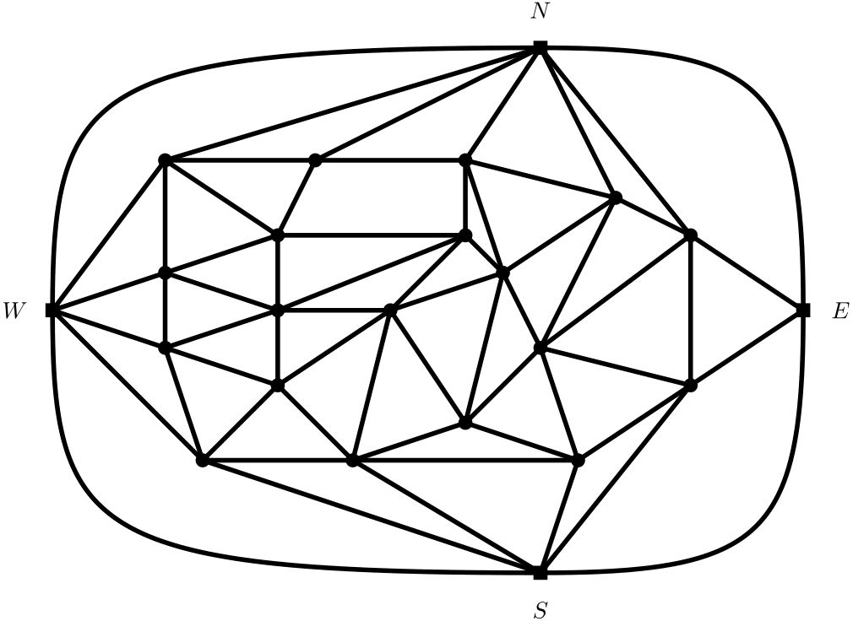
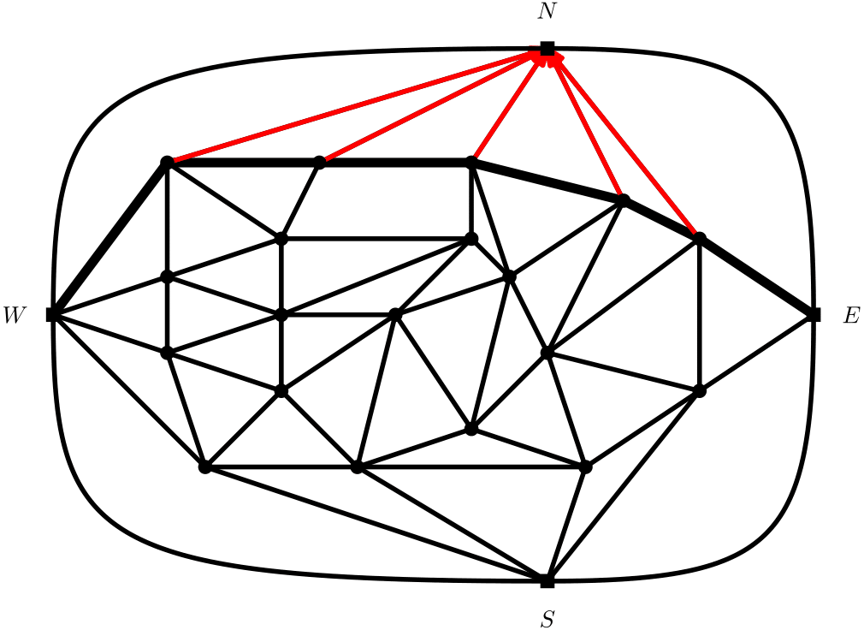
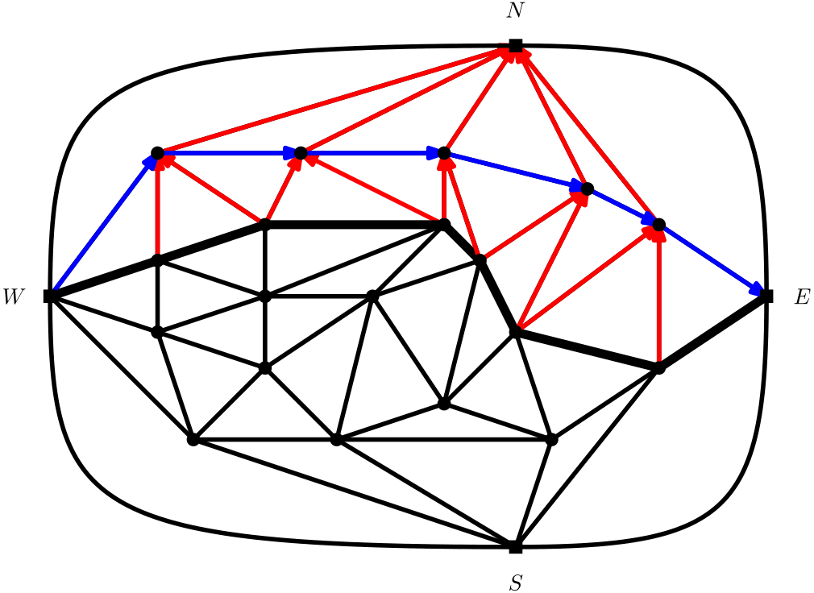
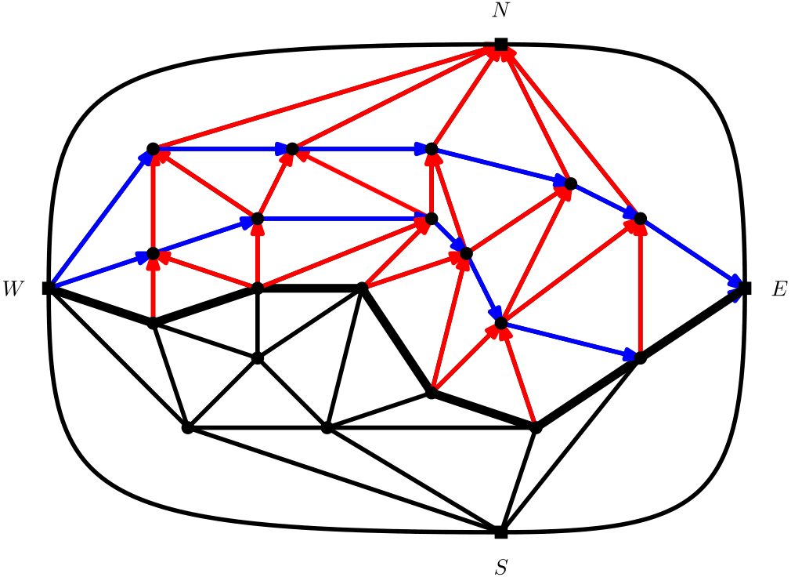
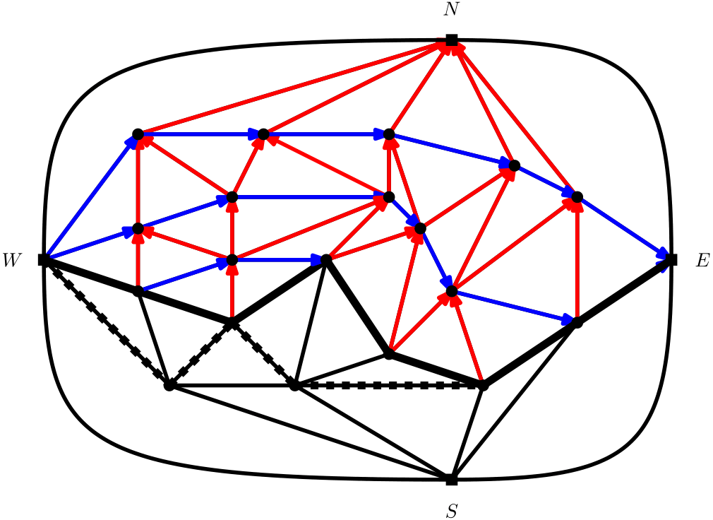
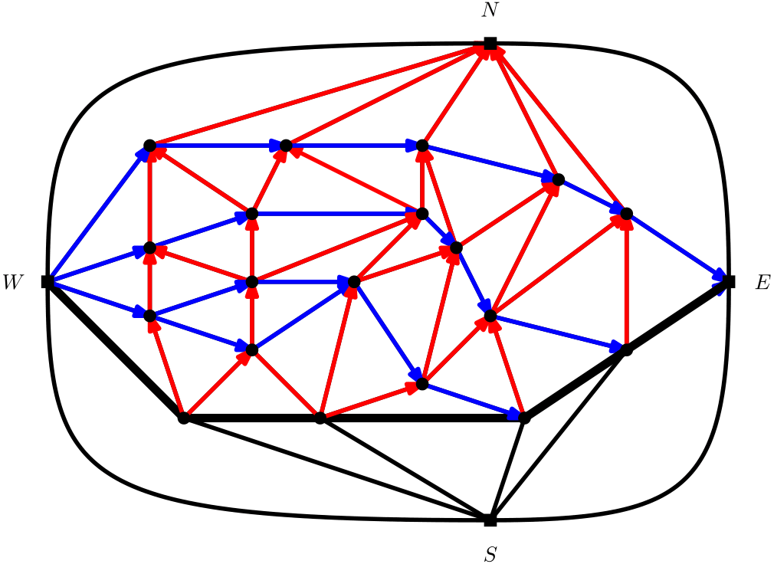
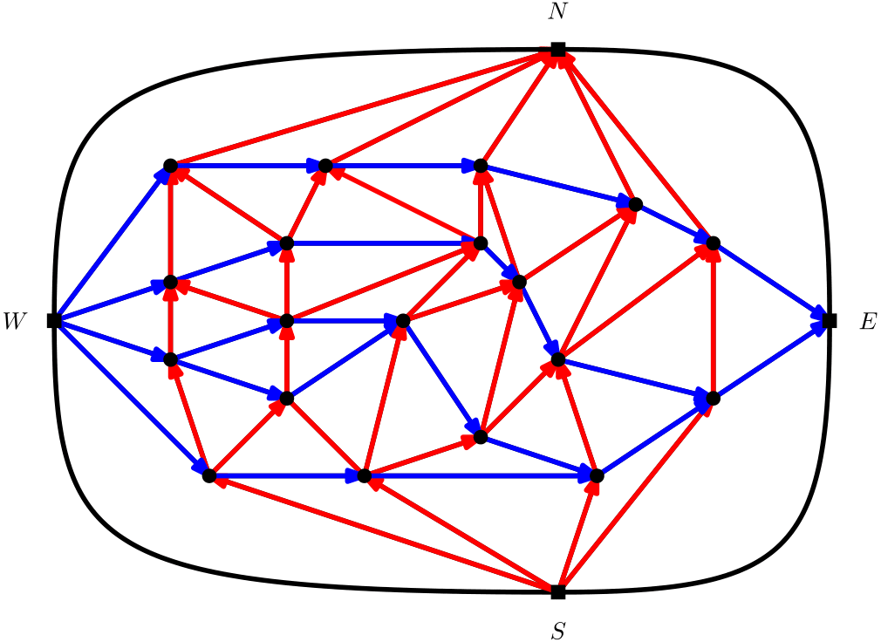
Step 1: Sweepcycle algorithm
Fusy [2006]
Rubber band
Invariants
Notes:
Compare to rubber band
-TODO Vertellen over hoe groot de faces nu zijn
-Red genrally small, blue large
-First make sure red is very small
-TODO extra eigenschap

Slide 35
Problem: Not vertically one-sided
Later steps will connect red faces. So they should be as small as possible.
Might not occur

Slide 36
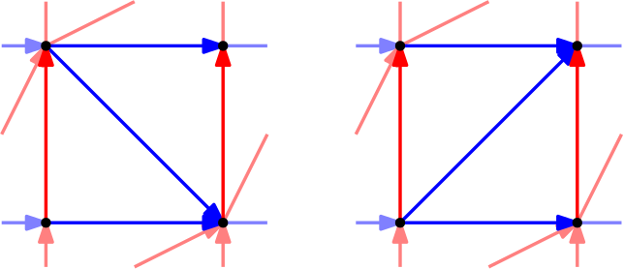
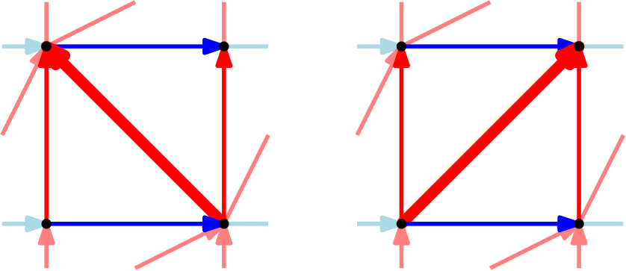
Step 2: Flip blue Z’s
Notes:
Wat hoort bij elkaar?

Slide 37
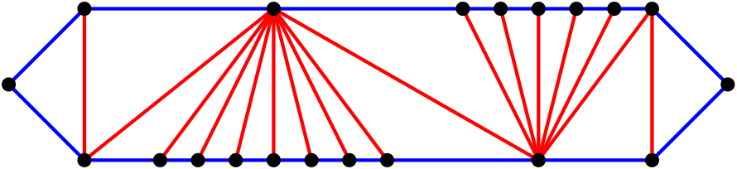
Problem: Large blue faces
Faces consist of top and bottom fans
Notes:
TODO intro topfan

Slide 38
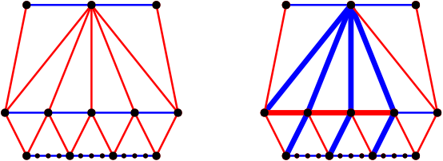
Step 3: Flip Topfans

Slide 39
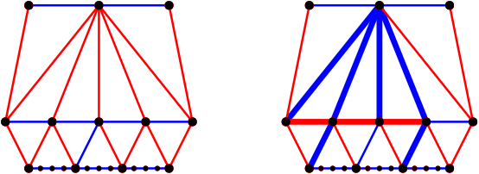
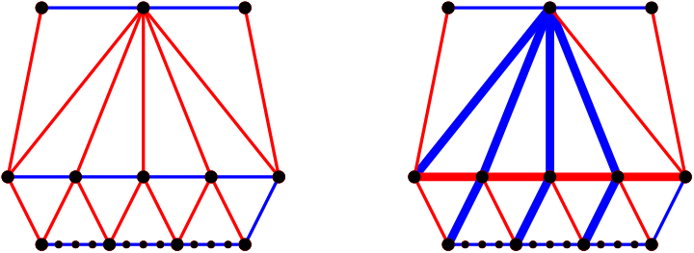
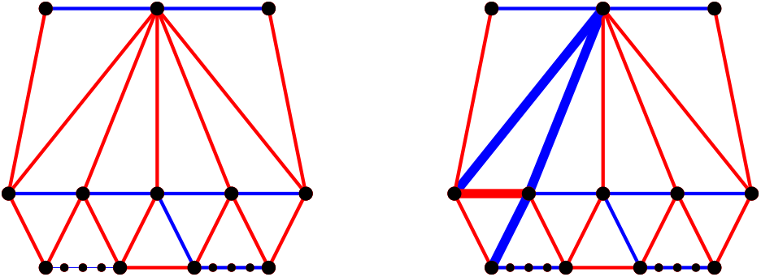
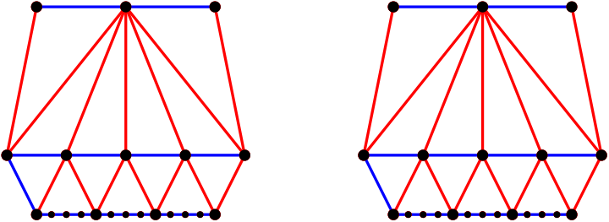
Step 3: Flip topfans
Notes:
-conslusie red face blue faces

Slide 40
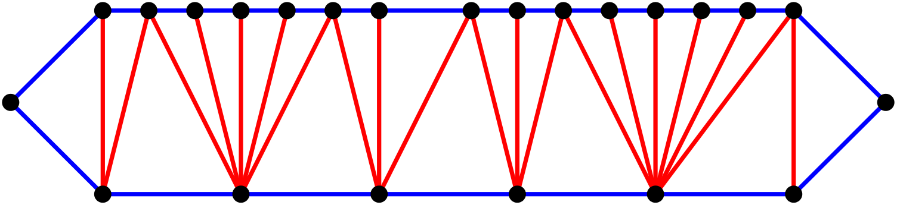
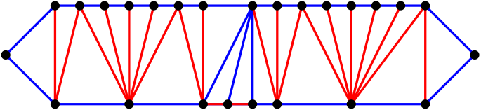
Problem: Blue faces without topfans
There are some exceptions but we won’t go into them
Rest of the faces are large but without large topfan

Slide 41
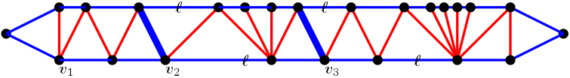
Step 4: Subdivide blue faces
With loads
Try to not flip above loads
Flip above second edge if it’s unloaded
Otherwise above the third edge
Not next to the “end”
Notes:
TODO simler, uitlegen wat je probeert te doen ipv hoe
TODO animatie

Slide 42
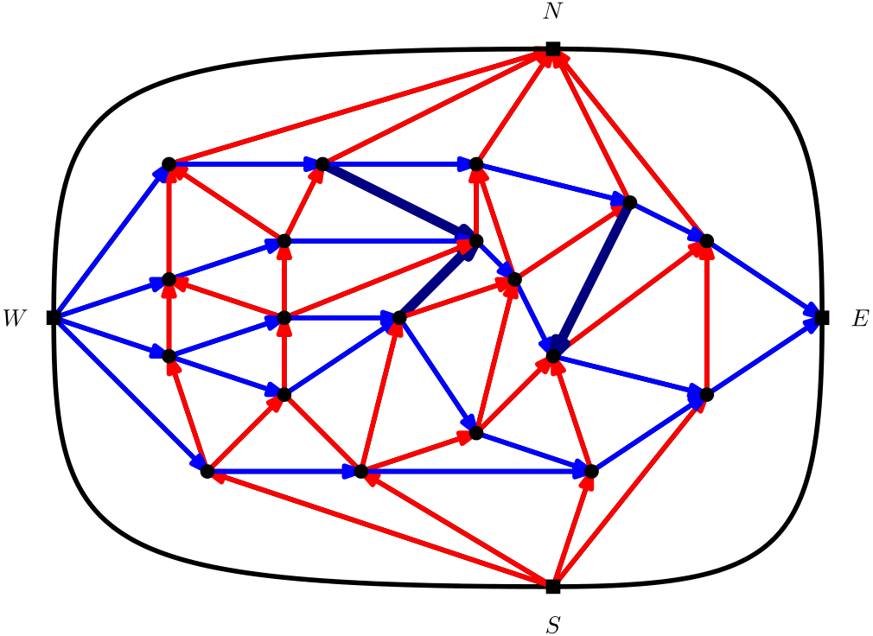
Step 4: Subdivide blue faces

Slide 43
Example Execution

Slide 44
Conclusion
Conclusion
Graphs without separating 4-cycles
None are 1-sided
All are 2-sided
Notes:
-none are 1-sided; Eppstein 1-sided == unique rel, but interior vertices of deg 5 gives freedom
-all are 2 sideds; no counterexample
-short idea of algo
-thank listeners

