Slide 1
k-sided rectangular duals
Sander Beekhuis
TU Eindhoven
Committee:
Bettina Speckmann Kevin Verbeek
Jesper Nederlof
Rudi Pendavingh

Slide 2
Rectangular Layout
Rectangular Layout partition of a rectangle into finitely many interior-disjoint rectangles.
Notes:
-definition rectangular layout

Slide 3
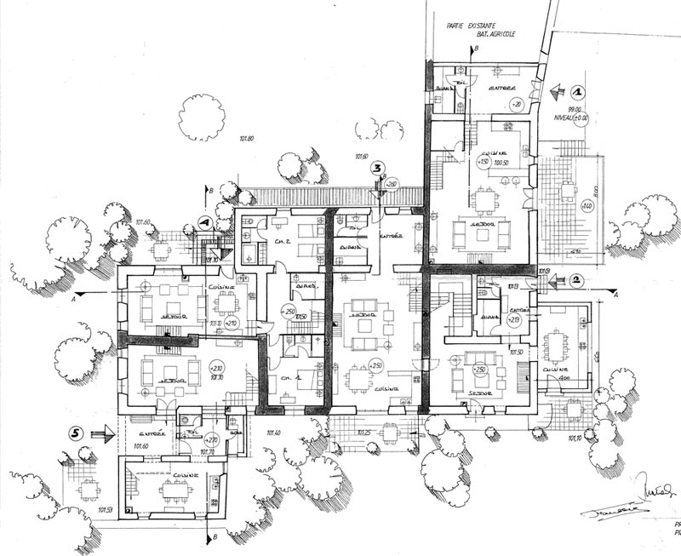
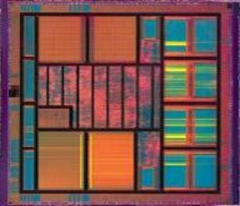
Applications
Floorplans building architecture or VLSI layout
Notes:
-architecture; floorplans
-chips, layouts

Slide 4
Applications
Rectangular Cartograms visualize statistical data about sets of regions; regions are rectangles; area proportional to some geographic variable
Notes:
-in use by map makers; statiscticans
-mountains and rivers as segments

Slide 5
Rectangular duals
Rectangular dual (of a graph G)
Rectangular layout with the same adjacencies as G
Notes:
-often adjacencies are important (map, jumbled; bedroom, bathroom, living room)
-we can repsente adajacencies by a graph
-rect dual is layout with these adjacencies

Slide 6
Valid graphs
[Kozminski & Kinnen ’85] A planar graph G has a rectangular dual with 4 rectangles on the boundary if and only if
every interior face is a triangle and the exterior face is a quadrangle
G has no separating triangles
Notes:
-does every graph have such a rectangular dual
-two requirements
-why is no sep tri necessary?
-such a graph is valid

Slide 7
Polar vertices
Pole
One of the four outer vertices
N
W
E
S
The area bounded by the 4 outer rectangles is a rectangle (if the graph has at least 5 vertices)
ADD FIGURE-standard gaph form
-rectangle boundry
Notes:
-def poles
-naming of poles
-adjacencies between poles don’t matter
-area surrounded by poles is a rectangle

Slide 8
Rectangular duals are not unique
B
B
B
A
A
A
Notes:
-nonunique
-a below b
-a lef

Slide 9
Area-universal layouts
Area-universal layout L for every choice of rectangle sizes L has the same adjacencies with the same orientation.
Uses cartogram animations; one chip design – multiple editions
Notes:
-def. area-universal layouts
-usefull; building desing; chip design; stats over tie

Slide 10
Maximal segments
maximal vertical segment
maximal horizontal segment
Notes:
Before we can characterize area-universal graphs we need the concept of maximal segments
-def maximal segment

Slide 11
One-sided layouts
One-sided layout L every maximal line segment of L is the side of a single rectangles
maximal vertical segment
maximal horizontal segment
Notes:
-def one-sided segment
-def one-sided layout
-this one is not one-sided

Slide 12
One-sided layouts
One-sided layout L every maximal line segment of L is the side of a single rectangle
[Eppstein et al., 2012] A layout is area-universal, if an only if it is one-sided.
Notes:
-is this one-sided?
-no!
-Eppstein

Slide 13
One-sided duals?
[Rinsma ’87] There exists a graph that does have a rectangular dual, but no one-sided dual.
Notes:
- Logical question in our quest for area-universal duals
- Not true, Via enumeration of rels

Slide 14
One-sided duals
Not every graph has a one-side dual
Not every graph has an area-universal dual
We still want duals that work for a lot of area choices
And few changes of adjacencies if necessary

Slide 15
k-sided duals
k-sided layout
Every maximal segment is the boundary of at most k rectangles all on the same side of the segment
2-sided
3-sided
Do graphs without a one-sided dual admit a k-sided dual for some k?
Notes:
-next best thing?
-k-sided segment
-k-sided layout
-examples
-research question
-k as low as possible

Slide 16
Are they better?
2-sided
3-sided
Notes:
-in general; yes
-effect becomes only stonger for higher k

Slide 17
Separating 4-cycles
Notes:
-soon; introduce graphs as describing adjacencies
-def separating cycle

Slide 18
Results
For any k ∈ ℕ there is a valid graph that has no k-sided dual.
Graphs G without separating 4-cycles are d−1-sided, where d is the maximal degree of the non-polar vertices of G.
d = 5

Slide 19
Regular Edge Labelings
Notes:
-not duals, we work with regular edge labbeling
-a col. + or. of graph that corresponds to a rect dual of that same graph
-bijection between rel’s and different layouts (i.e. hor vert)

Slide 20
Regular Edge Labelling
Notes:
-graph with poles
-blue edge
-red edge
-has 2 condiotns
- 2 conditions -> rect layout

Slide 21
Exterior vertex condition
Notes:
-outer vertices are frame (pole 4 vertices contain a rectangle)
-top one all red incoming
-right one all blue incoming

Slide 22
Interior vertex condition
Notes:
- surrounded on all sides by rectangles
- These two cond. are sufficient; algorithm by Kant and He

Slide 23
No mono-colored triangles
?
Notes:
One vertex has incoming and outgoing
skips red part of interior vertex condition

Slide 24
Separating 4-cycle
Notes:
-state sep 4-cycle
-due to rectangular frame (one single rectangle must be above etc.)
-similar to exterior vertex condion (but degree of re

Slide 25
Separating 4-cycle
Notes:
-another example
-pole, so no degree of freedom

Slide 26
Blue graph
Notes:
-frequently look a blue subgraph
-blue face
-interior are trinagles

Slide 27
Red graph
Notes:
-same for red

Slide 28
k-sided regular edge labeling
Face with at most k+2 vertices on one of it’s boundary paths
Notes:
-horizontal maximal segment
-blue face
-size of bot top path of face
-k-sided segment is type of face (same for vert and red face)
- So we want avoid faces with double long boundary paths

Slide 29
Result 1
For any k ∈ ℕ there is a valid graph that has no k-sided dual.
Notes:
-we prove result 1
-we make forced colorings using the props we just showed

Slide 30
Dual that is not k-sided
Exterior vertices
W
N
S
E
Notes:
-step trough steps

Slide 31
Dual that is not k-sided
Exterior vertices
Seperating 4-cycles
No monocolored triangles
W
N
S
E
Notes:
-step trough steps

Slide 32
Dual that is not k-sided
Exterior vertices
Separating 4-cycles
No monocolored triangles
Problem!
W
N
S
E
Notes:
-step trough steps

Slide 33
Result 2
Graphs G without separating 4-cycles are d−1-sided, where d is the maximal degree of the non-polar vertices of G.
Notes:
-just shown something using sep 4-cycles
-so if we assume no 4-cycles, -> show d-1 sided
-only highlevel overview

Slide 34
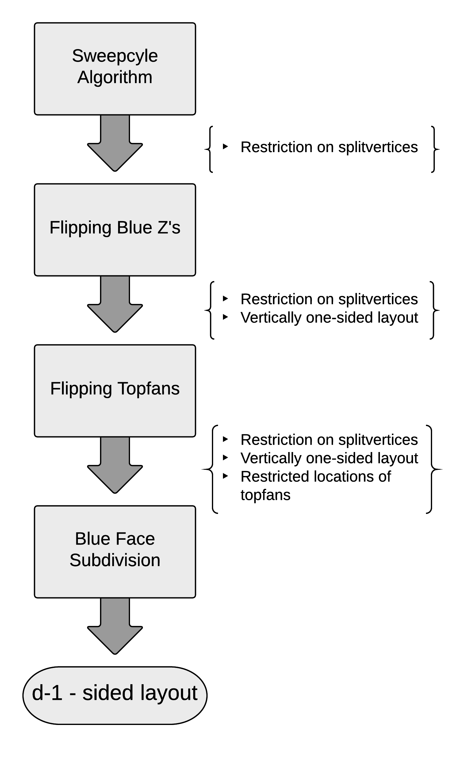
Algorithm
Multistep approach
Each step solves a problem
Obtain more and better properties
d-1 sided layout
Sweepcycle Algorithm
Magic property
Flipping Blue Z’s
Magic property
Vertically one-sided
Flipping Topfans
Magic property
Restricted topfan locations
Blue Face Subdivision

Slide 35
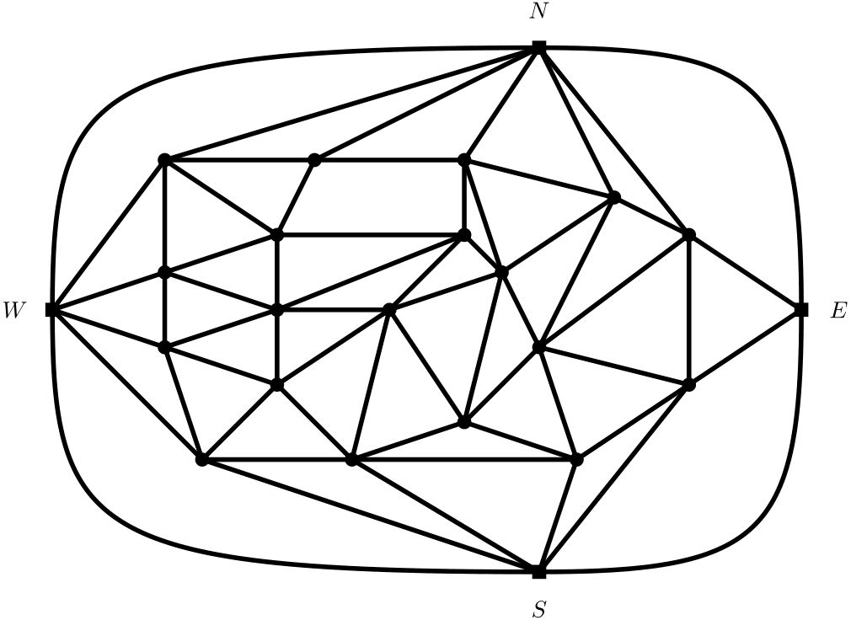
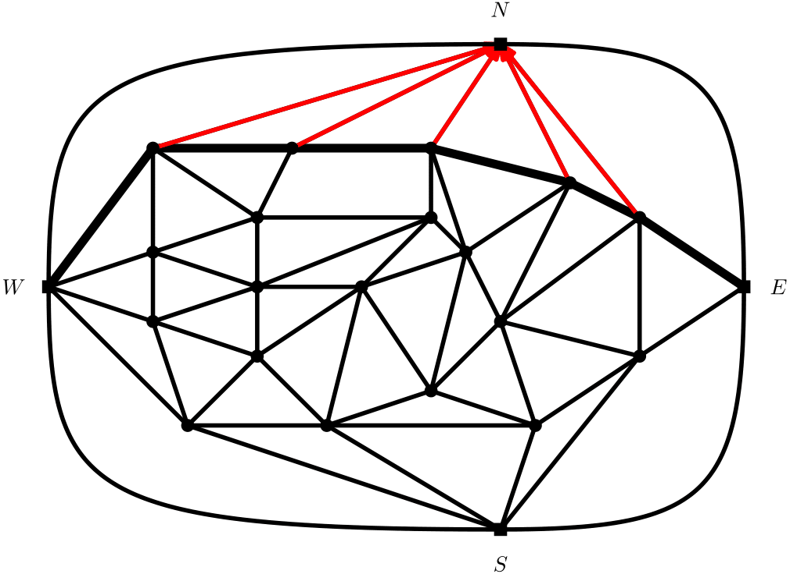
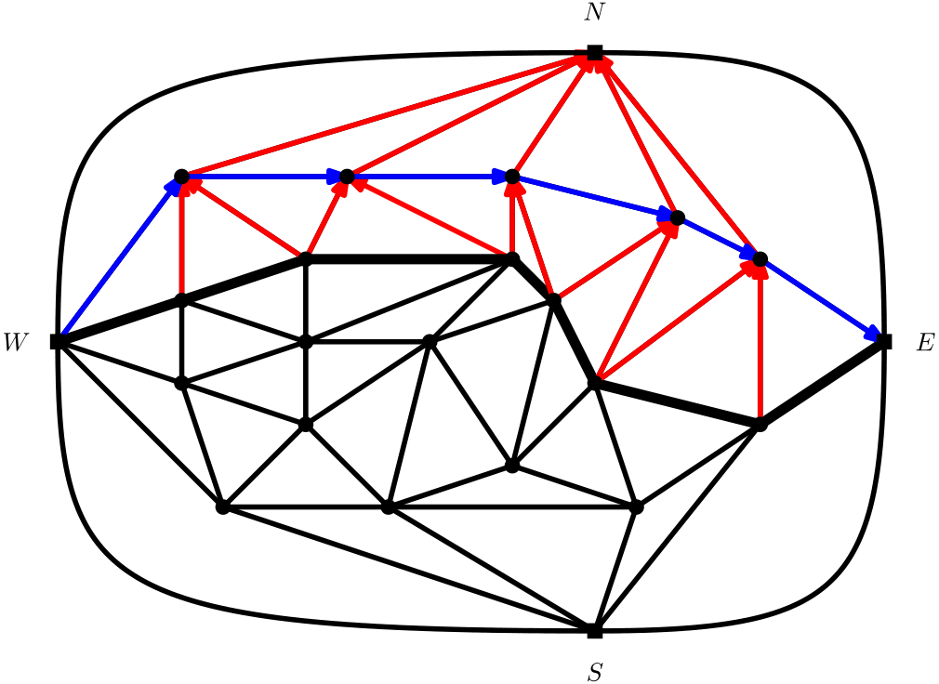
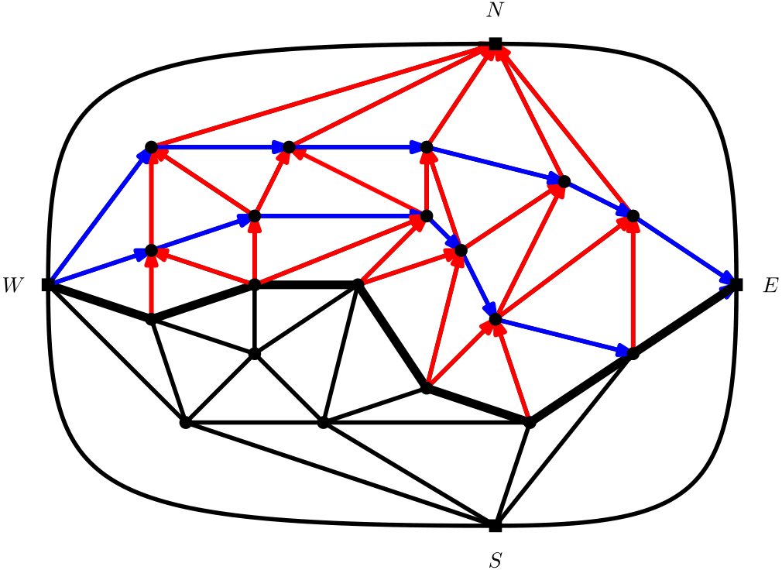
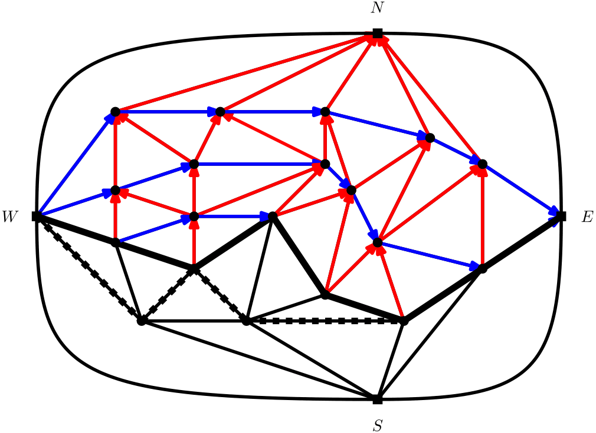
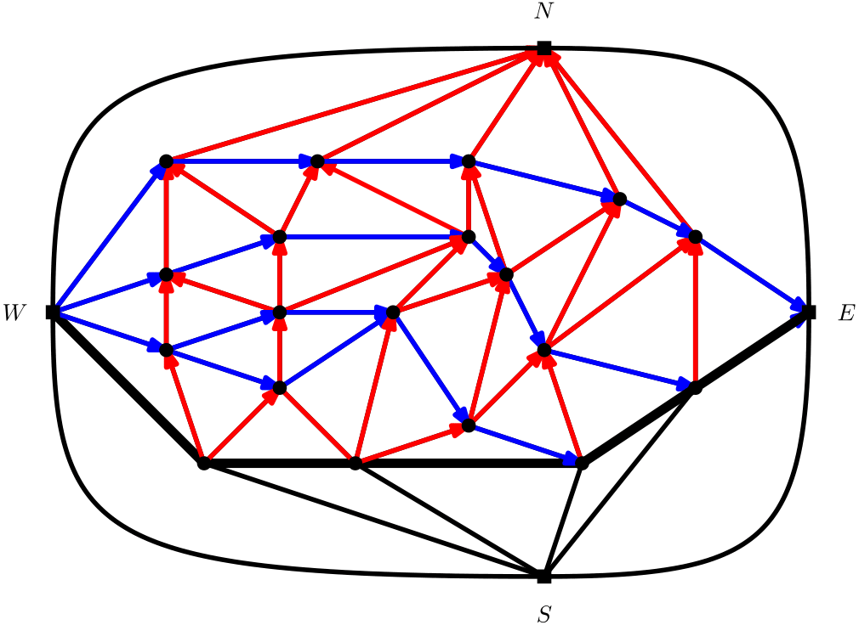
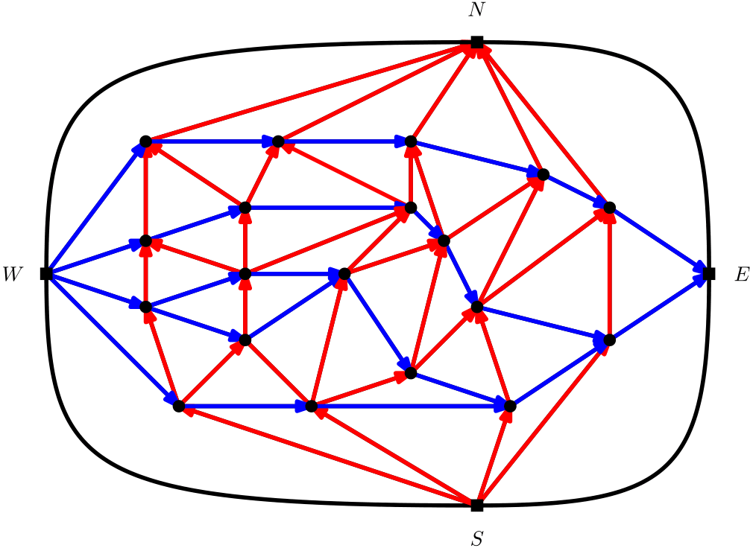
Step 1: Sweepcycle algorithm
Fusy [2006]
Rubber band
Sweepcycle Algorithm
Flipping
Blue Z’s
Flipping Topfans
Blue Face Subdivision
Notes:
-inspiration by Fusy
-sweepcyle is like rubber band
-Red faces generally small, blue face long
-First make sure red is very small
-magic property

Slide 36
Problem: Not vertically one-sided
Later steps will connect red faces.
Might not occur
Sweepcycle Algorithm
Flipping
Blue Z’s
Flipping Topfans
Blue Face Subdivision
Notes:
-make red faces smaller
-every red face that is not one-sided has a Z

Slide 37
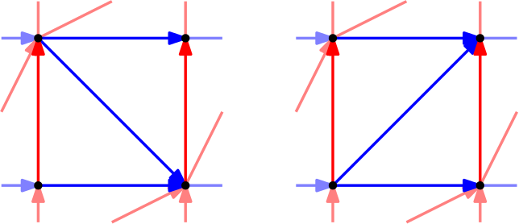
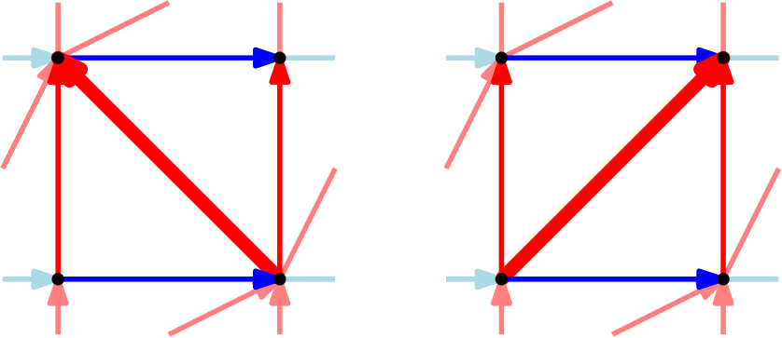
Step 2: Flip blue Z’s
Sweepcycle Algorithm
Flipping
Blue Z’s
Flipping Topfans
Blue Face Subdivision
Notes:
-so we flip
-blue faces even longer and red face ver short

Slide 38
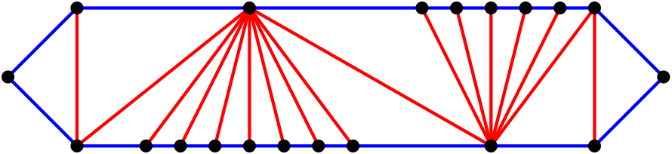
Problem: Large blue faces
Faces consist of top and bottom fans
Sweepcycle Algorithm
Flipping
Blue Z’s
Flipping Topfans
Blue Face Subdivision
Notes:
-What does a blue face look like
-what is a topfan, when is it large

Slide 39
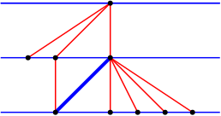
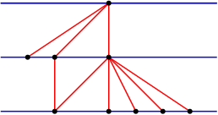
Step 3: Flip Topfans
Sweepcycle Algorithm
Flipping
Blue Z’s
Flipping Topfans
Blue Face Subdivision
Notes:
-we prevent topfans starting a face
-example

Slide 40
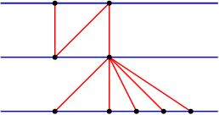
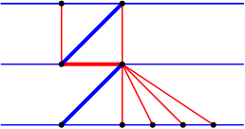
Step 3: Flip topfans
Sweepcycle Algorithm
Flipping
Blue Z’s
Flipping Topfans
Blue Face Subdivision
Notes:
--example

Slide 41
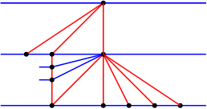
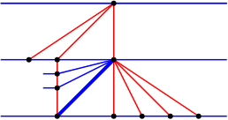
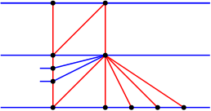
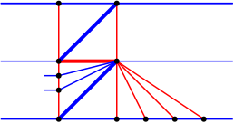
Step 3: Flip Topfans
Sweepcycle Algorithm
Flipping
Blue Z’s
Flipping Topfans
Blue Face Subdivision
Notes:
-when joins
-conclusion red face (slightly longer) blue faces (without topfans in the midlle)

Slide 42
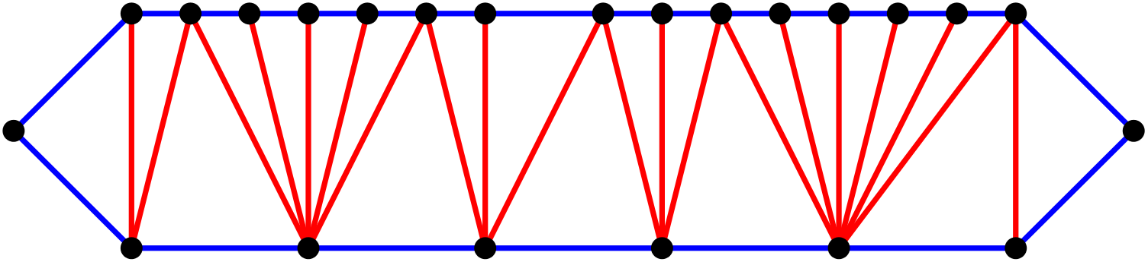
Problem: Blue faces without topfans
Remaining blue faces without large topfans
Sweepcycle Algorithm
Flipping
Blue Z’s
Flipping Topfans
Blue Face Subdivision

Slide 43
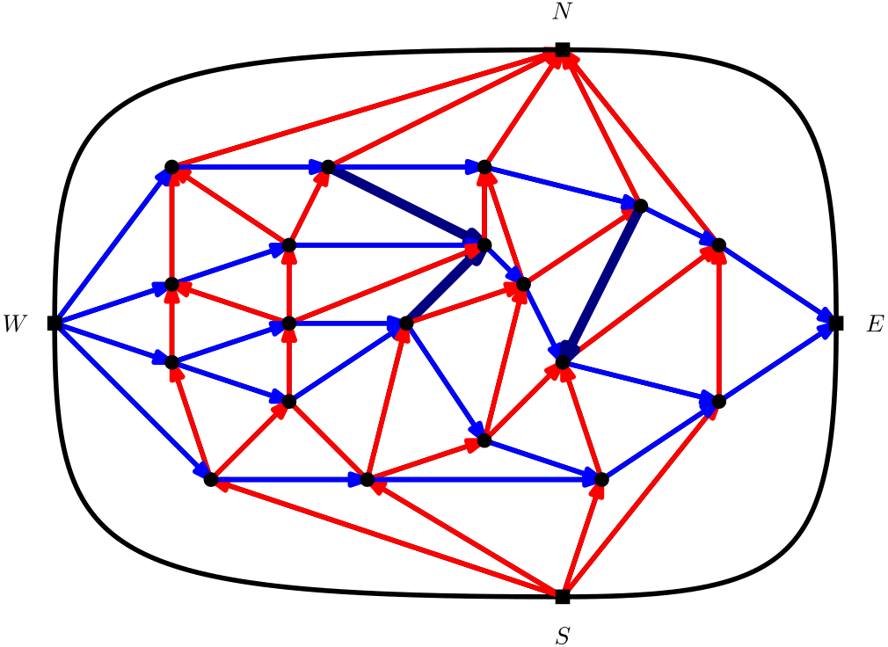
Step 4: Subdivide blue faces
Change color of edges in long blue faces
Not above each other or edges from previous step
We use all properties
Result: d-1 – sided layout
Sweepcycle Algorithm
Flipping
Blue Z’s
Flipping Topfans
Blue Face Subdivision

Slide 44
Conclusion
Results
For any k ∈ ℕ there is a valid graph that has no k-sided dual.
Graphs G without separating 4-cycles are d−1-sided, where d is the maximal degree of the non-polar vertices of G.
Conjecture
All graphs without separating 4-cycles are 2-sided

Slide 45
Example Execution
Sweepcycle Algorithm
Flipping
Blue Z’s
Flipping Topfans
Blue Face Subdivision

Slide 46
Try out for small grpahic
Sweepcycle Algorithm
Flipping
Blue Z’s
Flipping Topfans
Blue Face Subdivision

