Slide 1
Pseudo one-sided rectangular duals
By Sander Beekhuis

Slide 2
Structure
Problem
Results
Conjecture

Slide 3
Rectangular layout
Rectangular layout L
Partition of a rectangle into finitely many interior disjoint rectangles
Layouts are equivalent when they have the same adjacencies with the same orientation (horizontal/vertical)

Slide 4
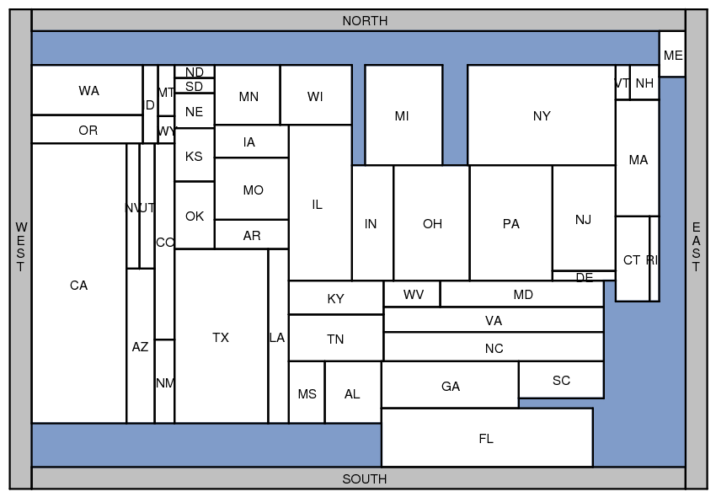
Applications
Rectangular Cartograms visualize statistical data about sets of regions; regions are rectangles; area proportional to some geographic variable

Slide 5
Applications
Rectangular Cartograms introduced by Raisz in 1934

Slide 6
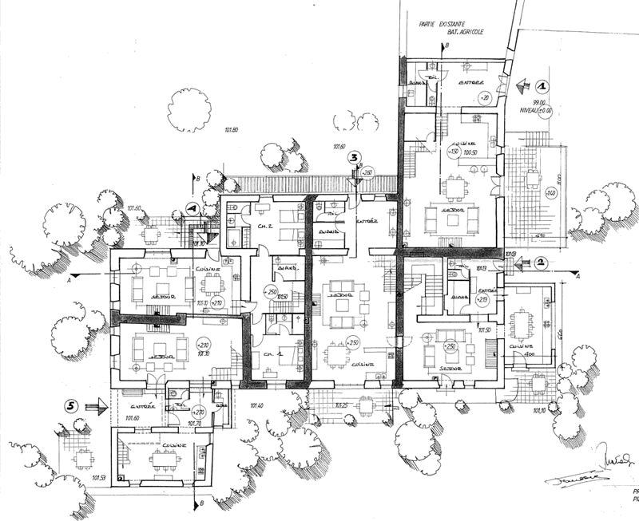
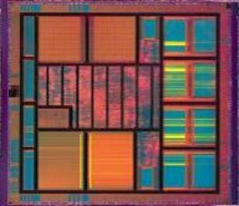
Applications
Floorplans building architecture or VLSI layout

Slide 7
Area-Universal
Area-universal layout L
For every assignment of sizes to the areas of L there is a equivalent layout realizing these sizes
Uses
Animations; layout first – function later

Slide 8
One-sided
One-sided layout L
Every maximal line segment in L is the side of a rectangle
maximal vertical segment
maximal horizontal segment

Slide 9
One-sided
One-sided layout L
Every maximal line segment in L is the side of a rectangle

Slide 10
Comparison
Area-Universal
The same layout fits any area assignment
One-sided
Every maximal segment is the side of a rectangle
These are equivalent [Eppstein et al. , 2012]
Not all graphs have an area-universal/one-sided dual [Rinsma , 1987]
Notes:
One-sided → area-universal is not that hard. Start with the slice and then etc. etc. Should I tell this

Slide 11
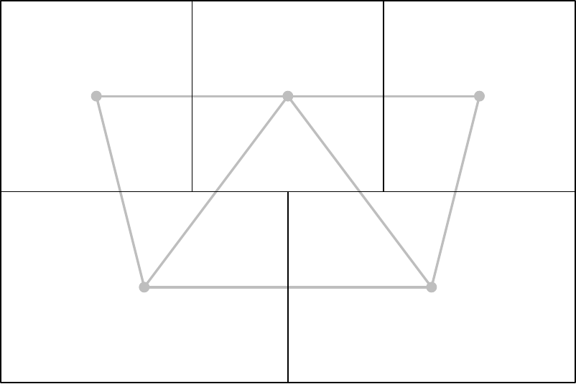
Rectangular dual
Rectangular dual of a graph G
Rectangular layout
Same adjacencies as G
Notes:
<number>

Slide 12
Rectangular dual
[Kozminski & Kinnen ’85] A planar graph G has a rectangular dual with 4 rectangles on the boundary if and only if
every interior face is a triangle and the exterior face is a quadrangle
G has no separating triangles

Slide 13
Extended Graph
Bring other graphs in this form
Do this by adding 4 vertices (poles)
Without creating a separating triangle
A extended graph corresponds to a certain corner assignment

Slide 14
Extended Graphs do not fix layout

Slide 15
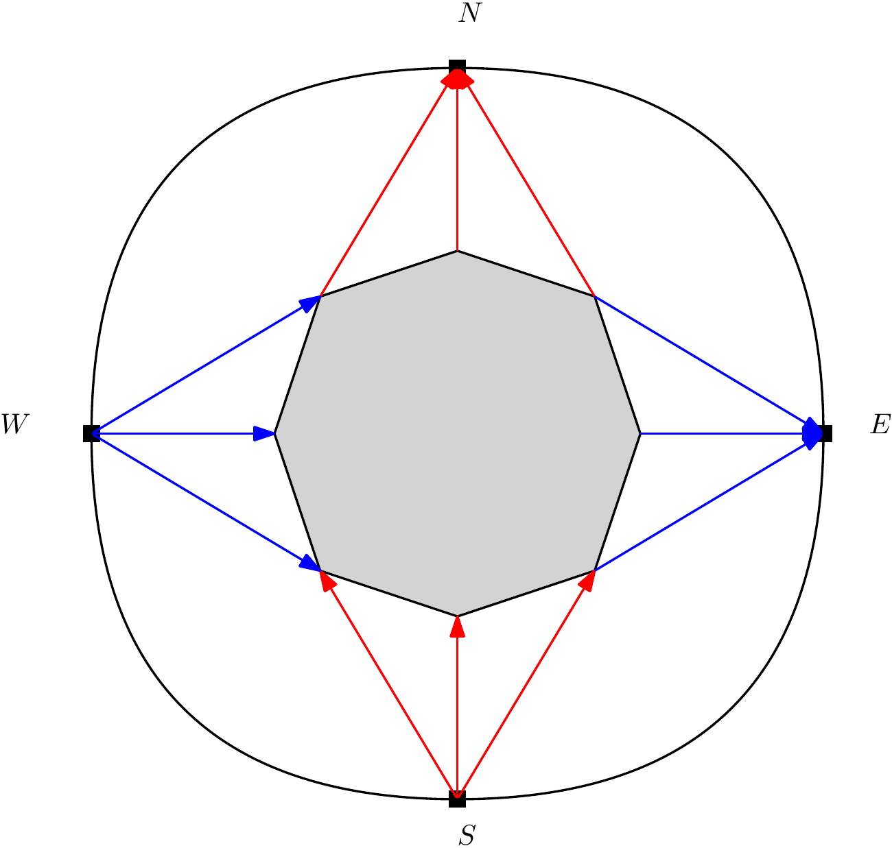
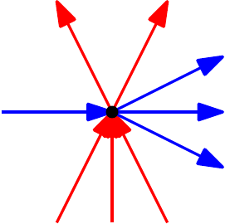
Regular edge labeling
Oriented coloring of the extended graph
Exterior vertex condition
Interior vertex condition

Slide 16
Regular edge labeling
Corresponds to a equivalence class of layouts
Red: Vertical adjacency
Blue: Horizontal adjacency

Slide 17
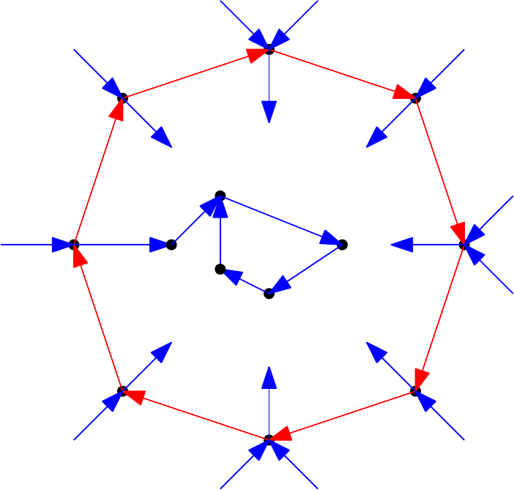
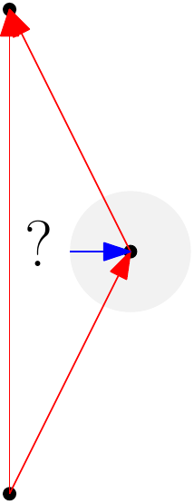
Properties of a REL
Two acyclic flows
Inside a cycle there is another cycle
No mono-colored triangles

Slide 18
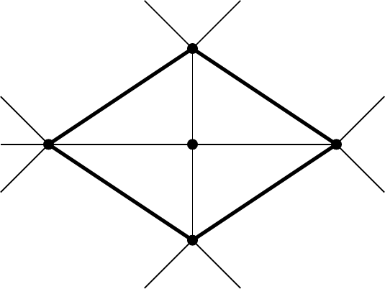
Separating k-cycle
A separating k-cycle is a cycle whose removal disconnects the graph
A separating 4-cycle

Slide 19
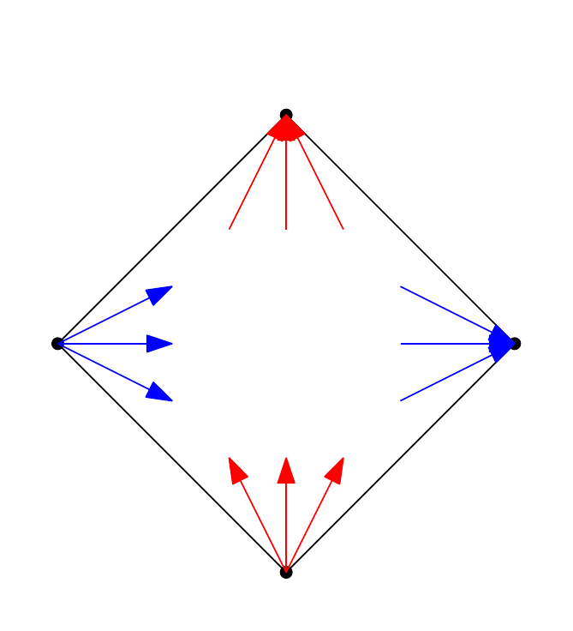
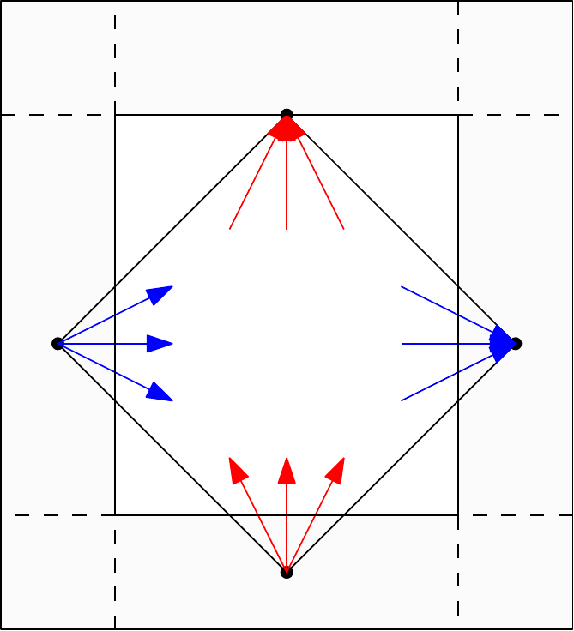
Properties of a REL
Interior of a separating 4-cycle
The color and orientation of a single interior edge adjacent to a cycle vertex determines the color and orientation of all edges adjacent to a cycle vertex

Slide 20
Not all graphs are one-sided
We can show this by enumerating all possible REL's
In the results section we will show for some graphs that they are not one-sided

Slide 21
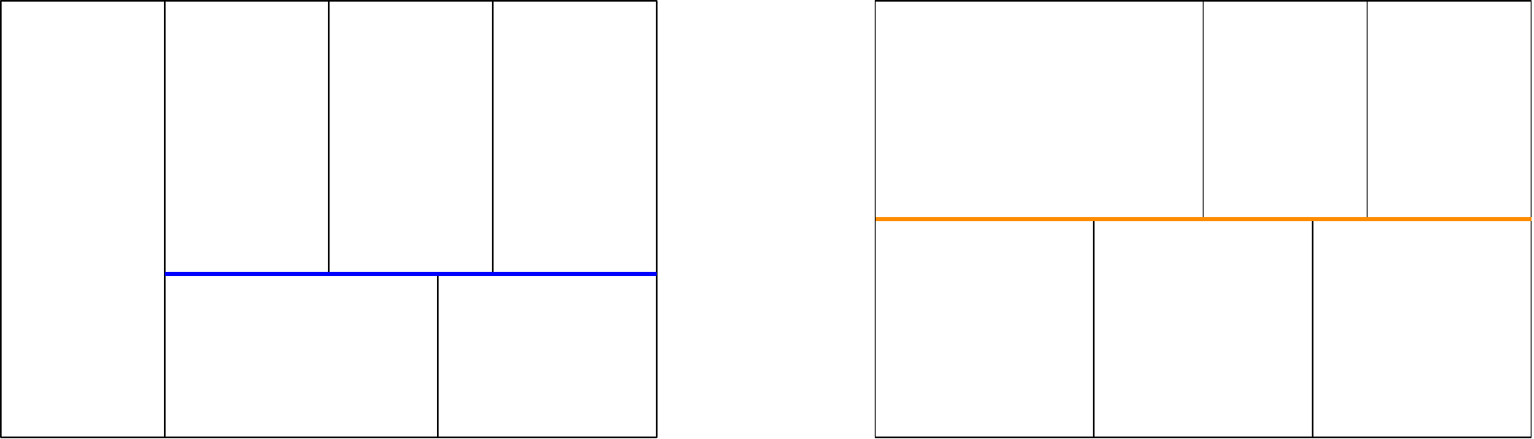

So what can we do?
We will call our dual k-sided if every maximal segment is the boundary of at most k adjacent rectangles all on the same side of the line
2-sided
3-sided
Do graphs without an one-sided dual admit a k-sided dual for some k? (hopefully small)

Slide 22
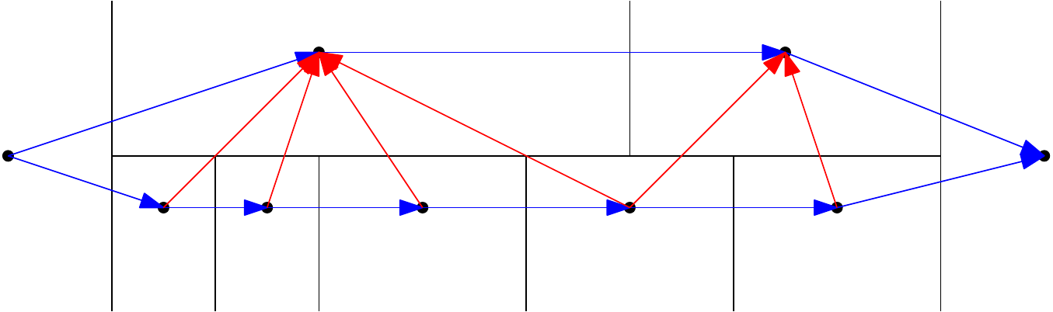
What does k-sided look like in the REL?
Red and blue faces with one of the two paths having at most k+1 vertices

Slide 23
Structure
Problem
Results
Conjecture

Slide 24
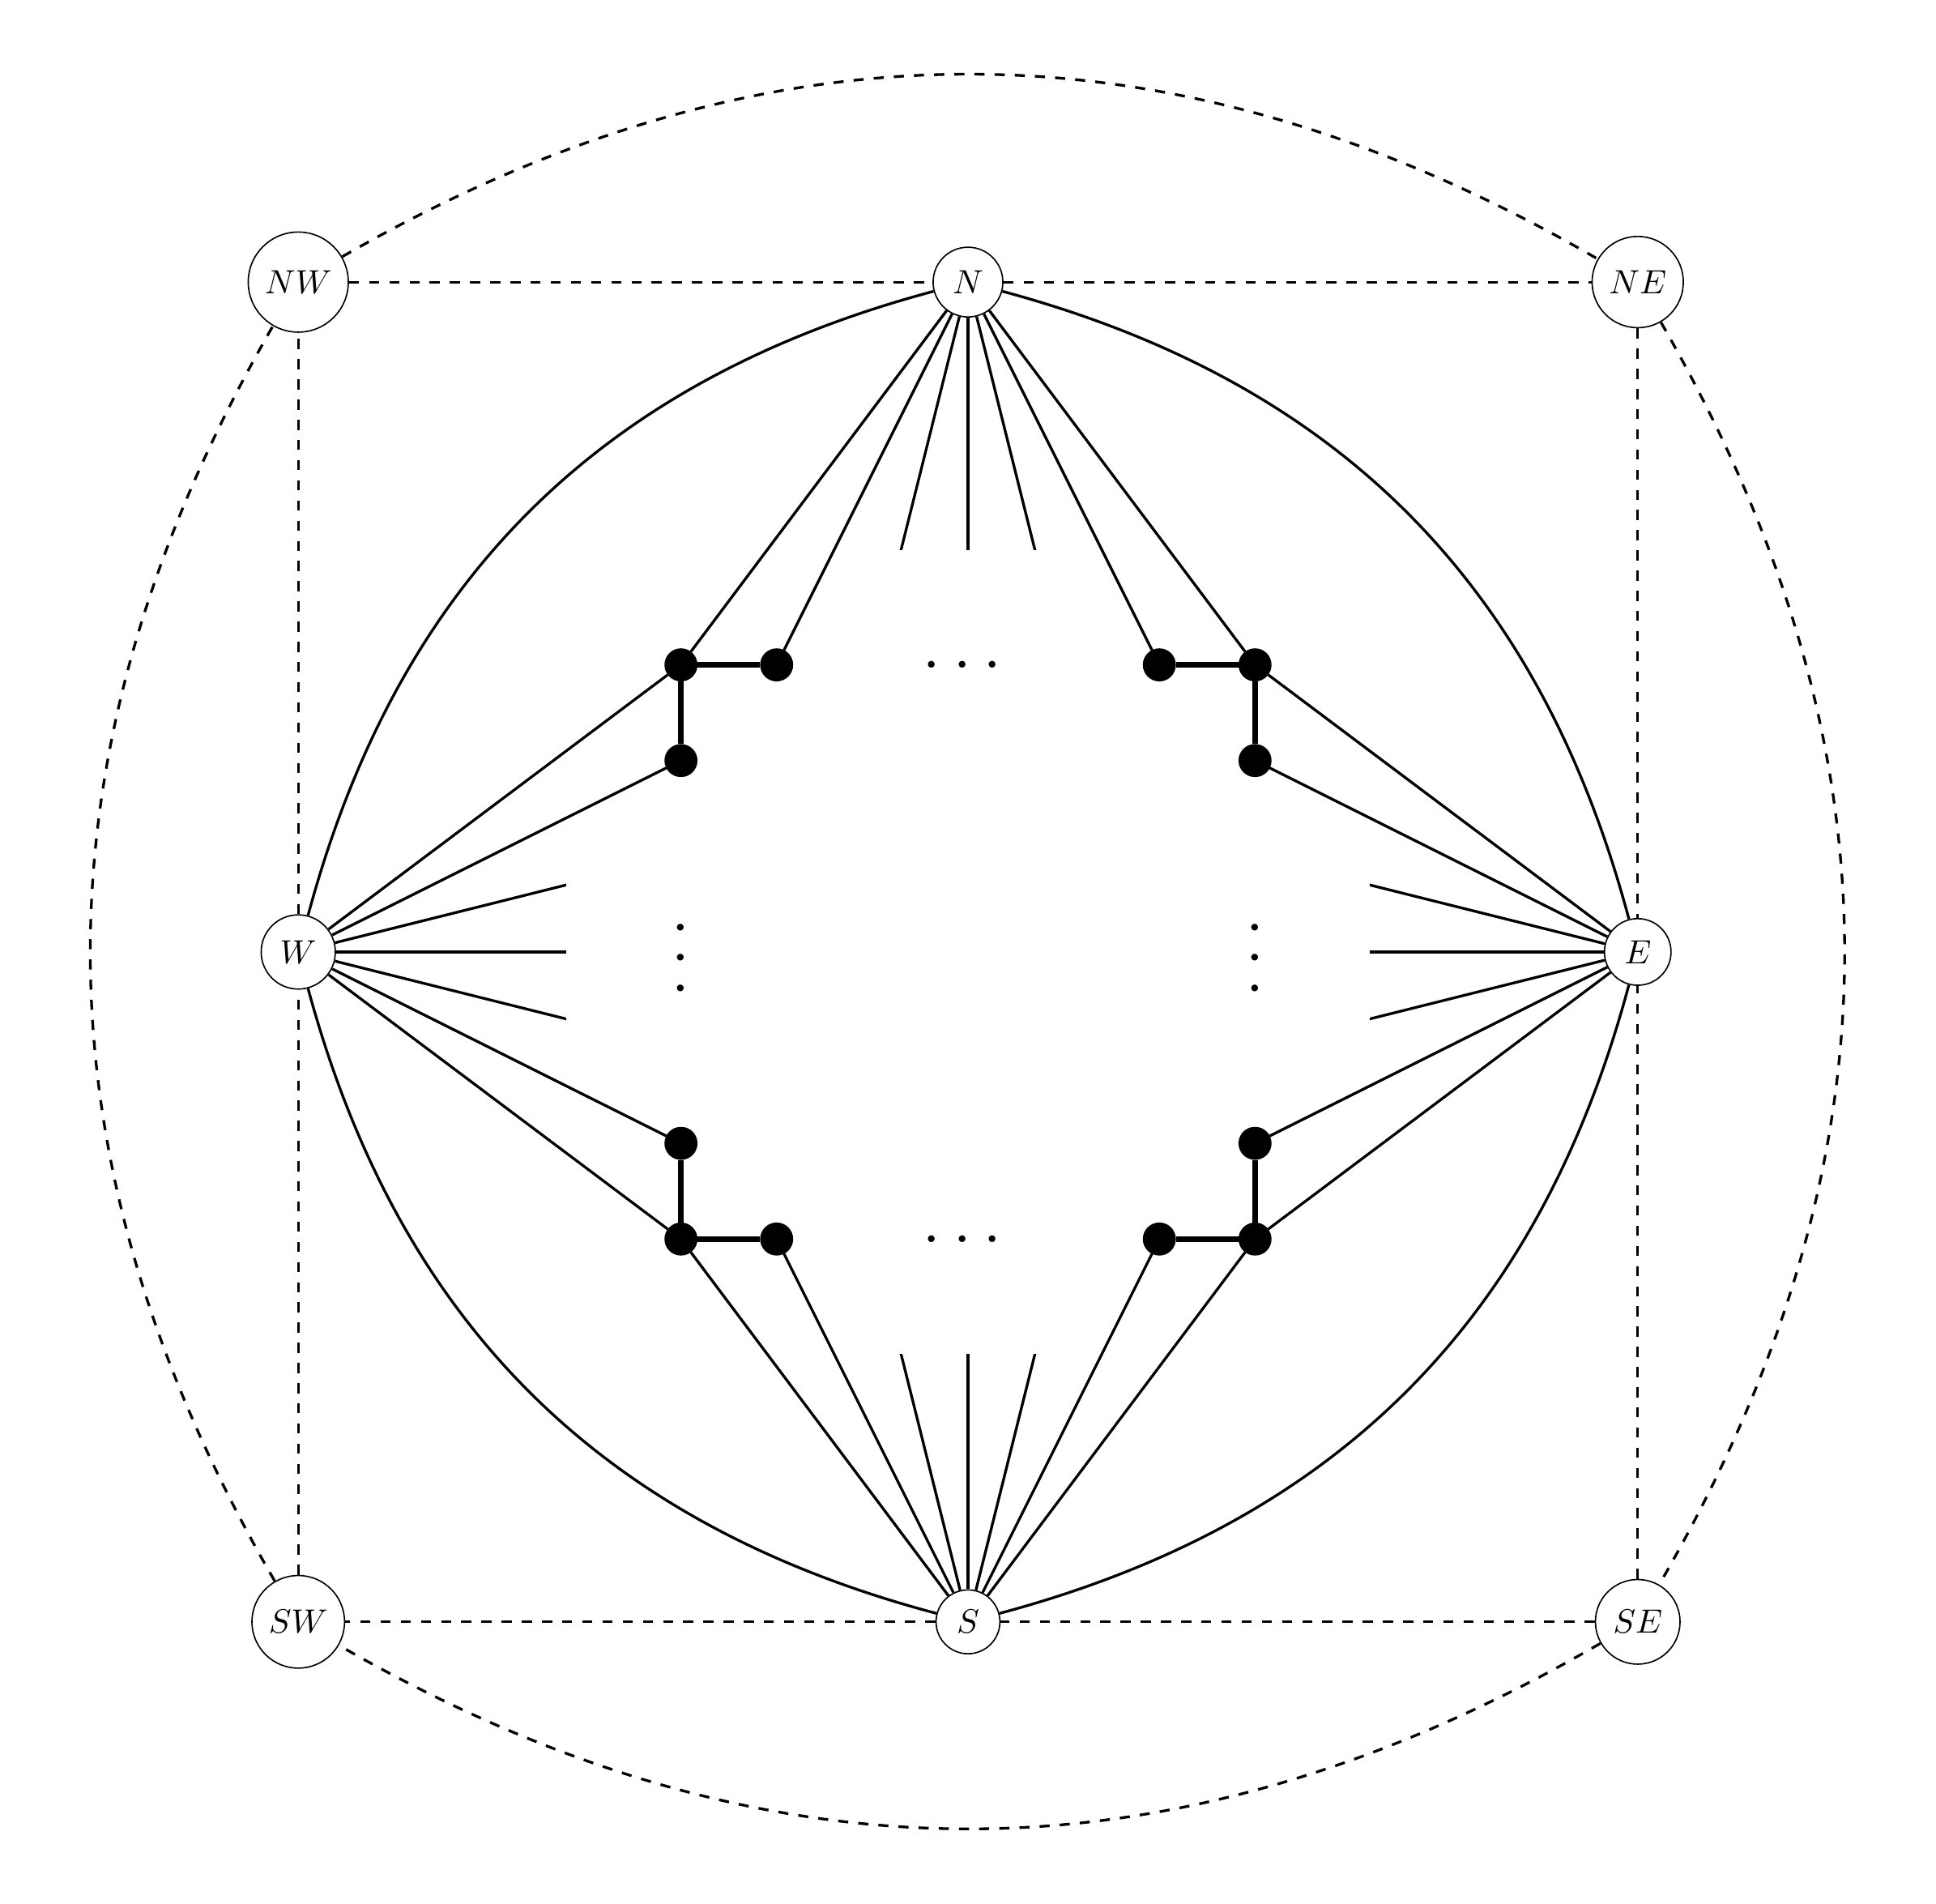
Fixing a extended graph
We can consider a single extended graph of G, E(G) = G’ …
by considering rectangular duals of G’
Because then there is only one choice for E(G’)
Note that this uses a separating 4-cycle

Slide 25
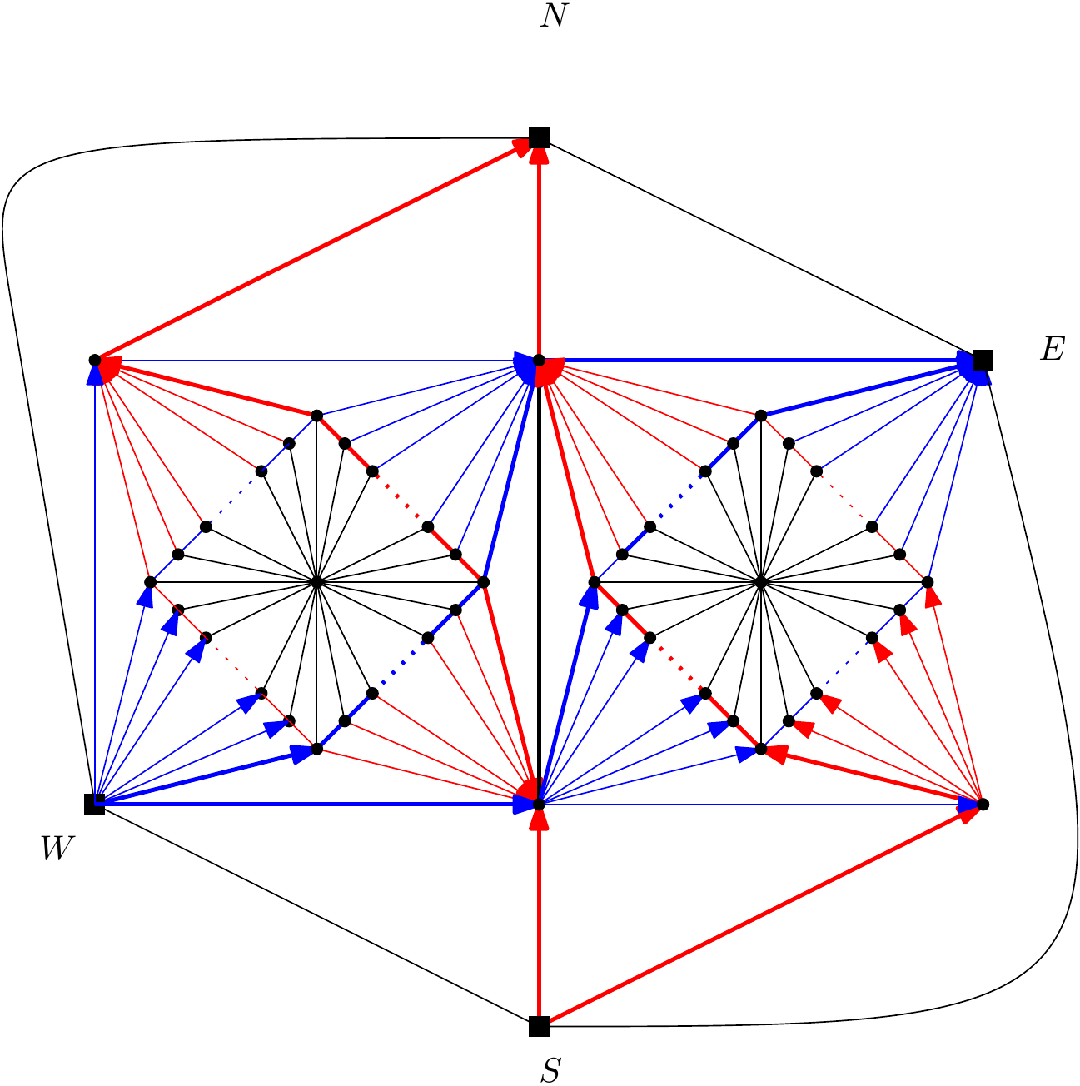
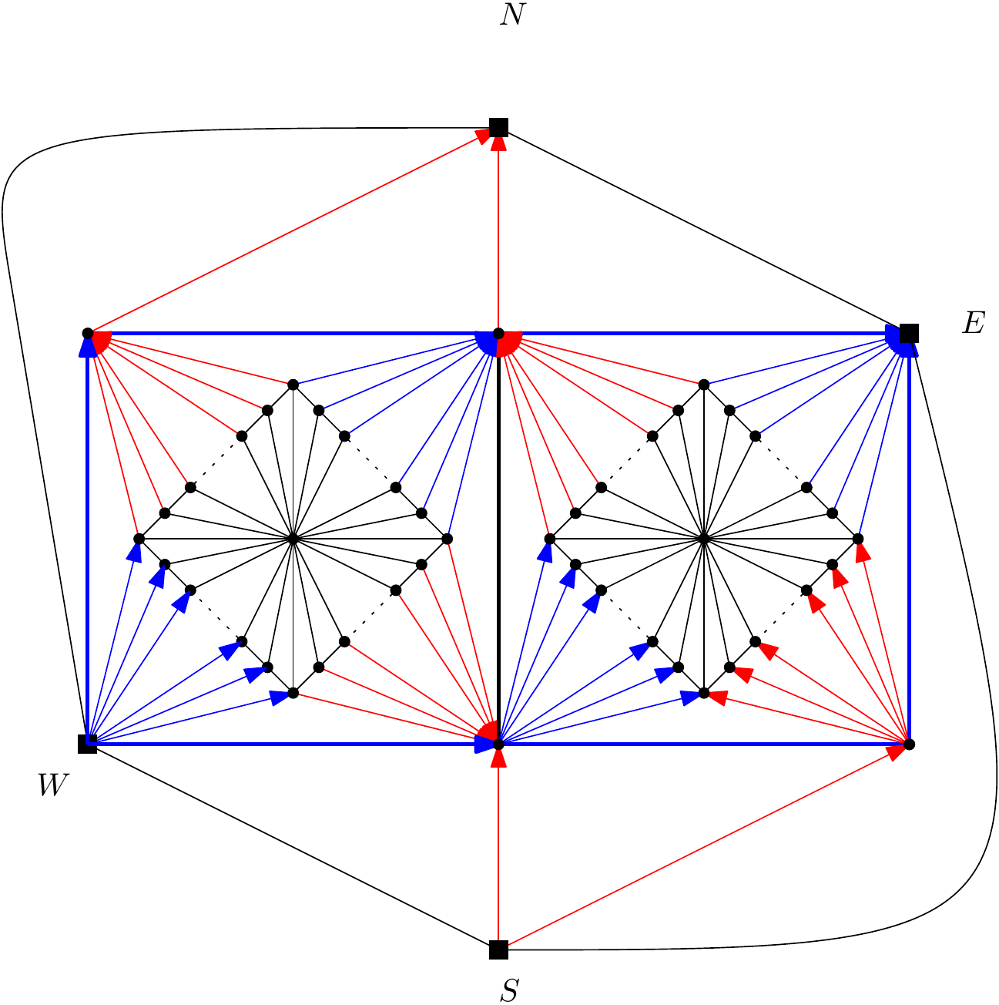
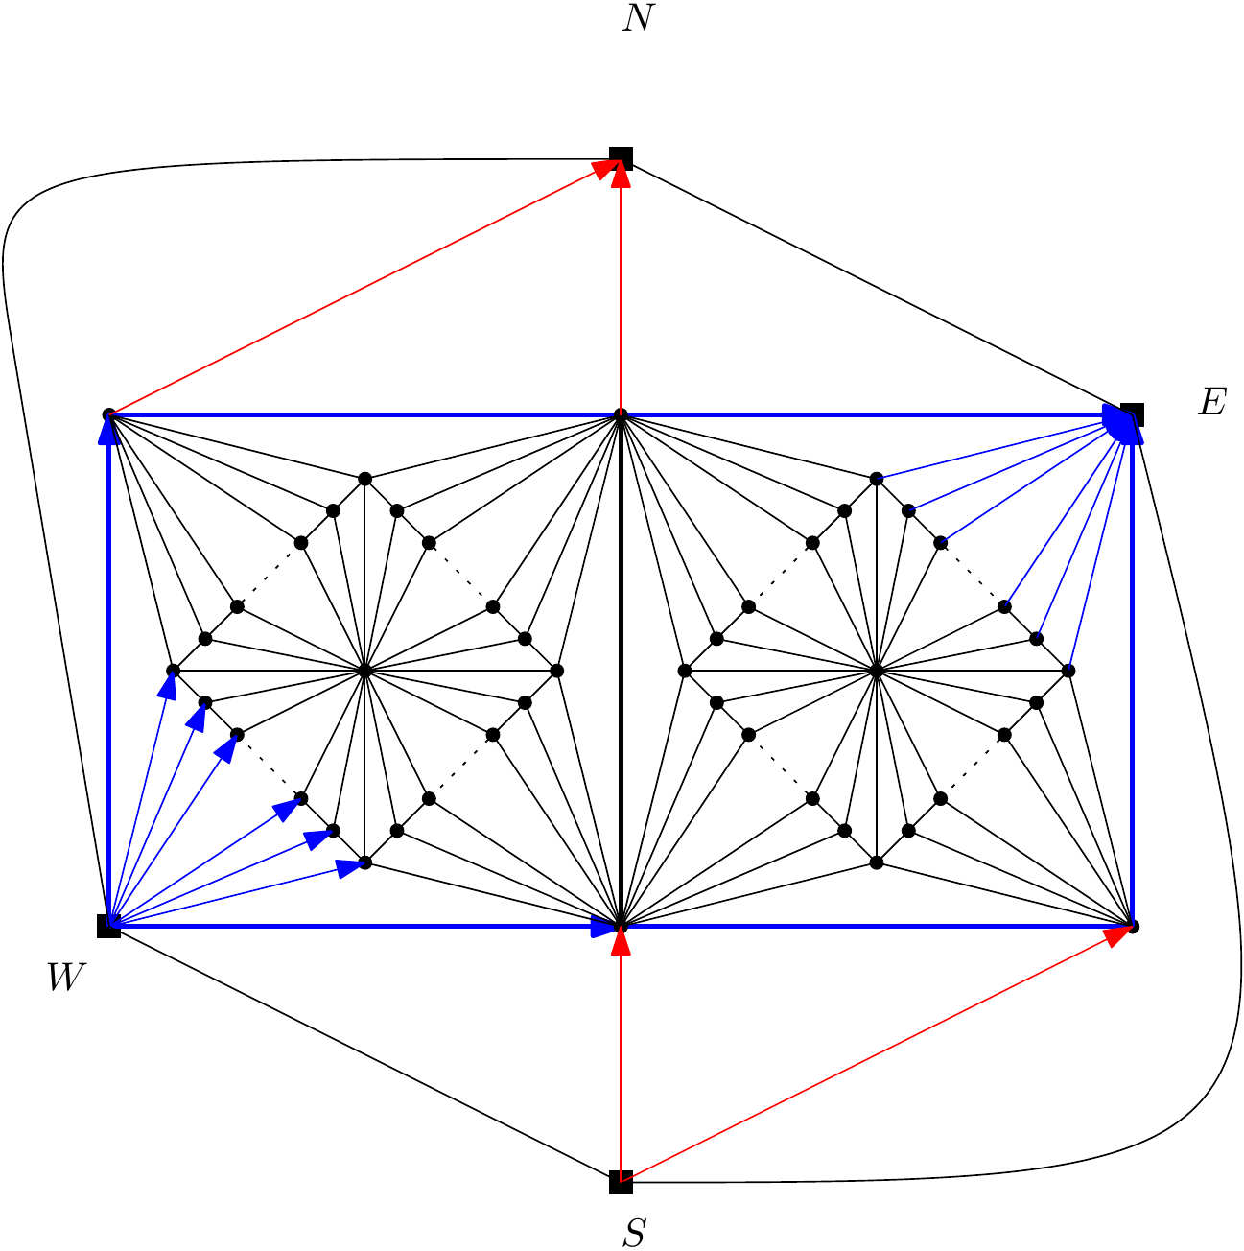
∞-sided graphs with 4-cycles
Exterior vertex condition and no mono-colored triangles
Interior of separating 4-cycles
Large red or large blue face

Slide 26
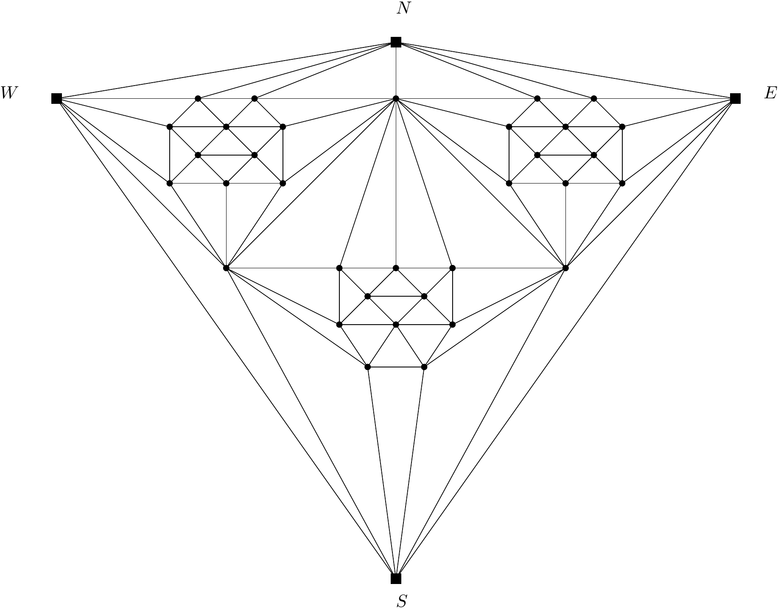
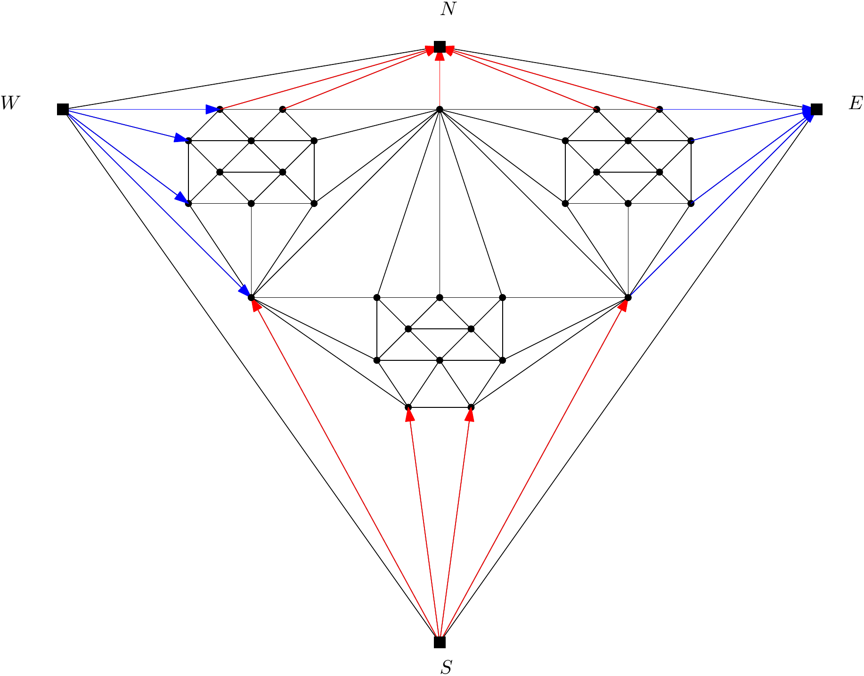
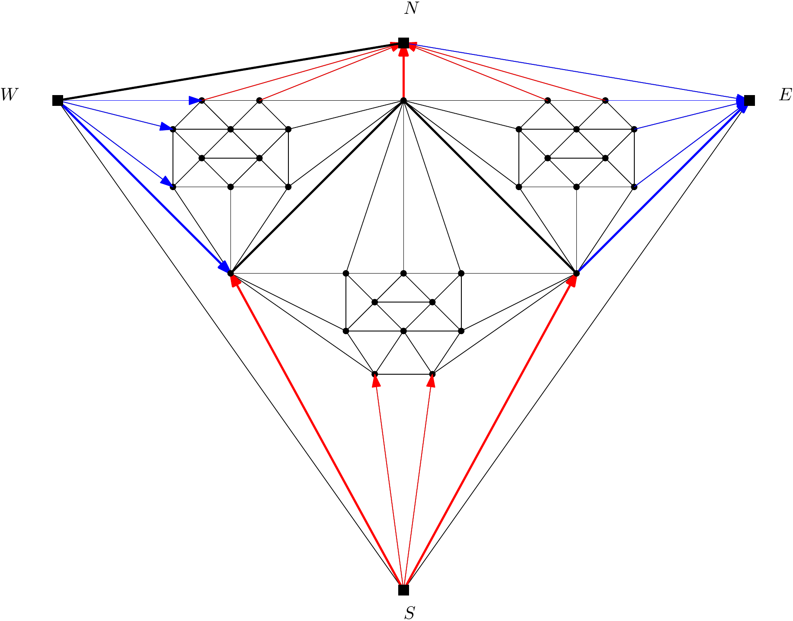
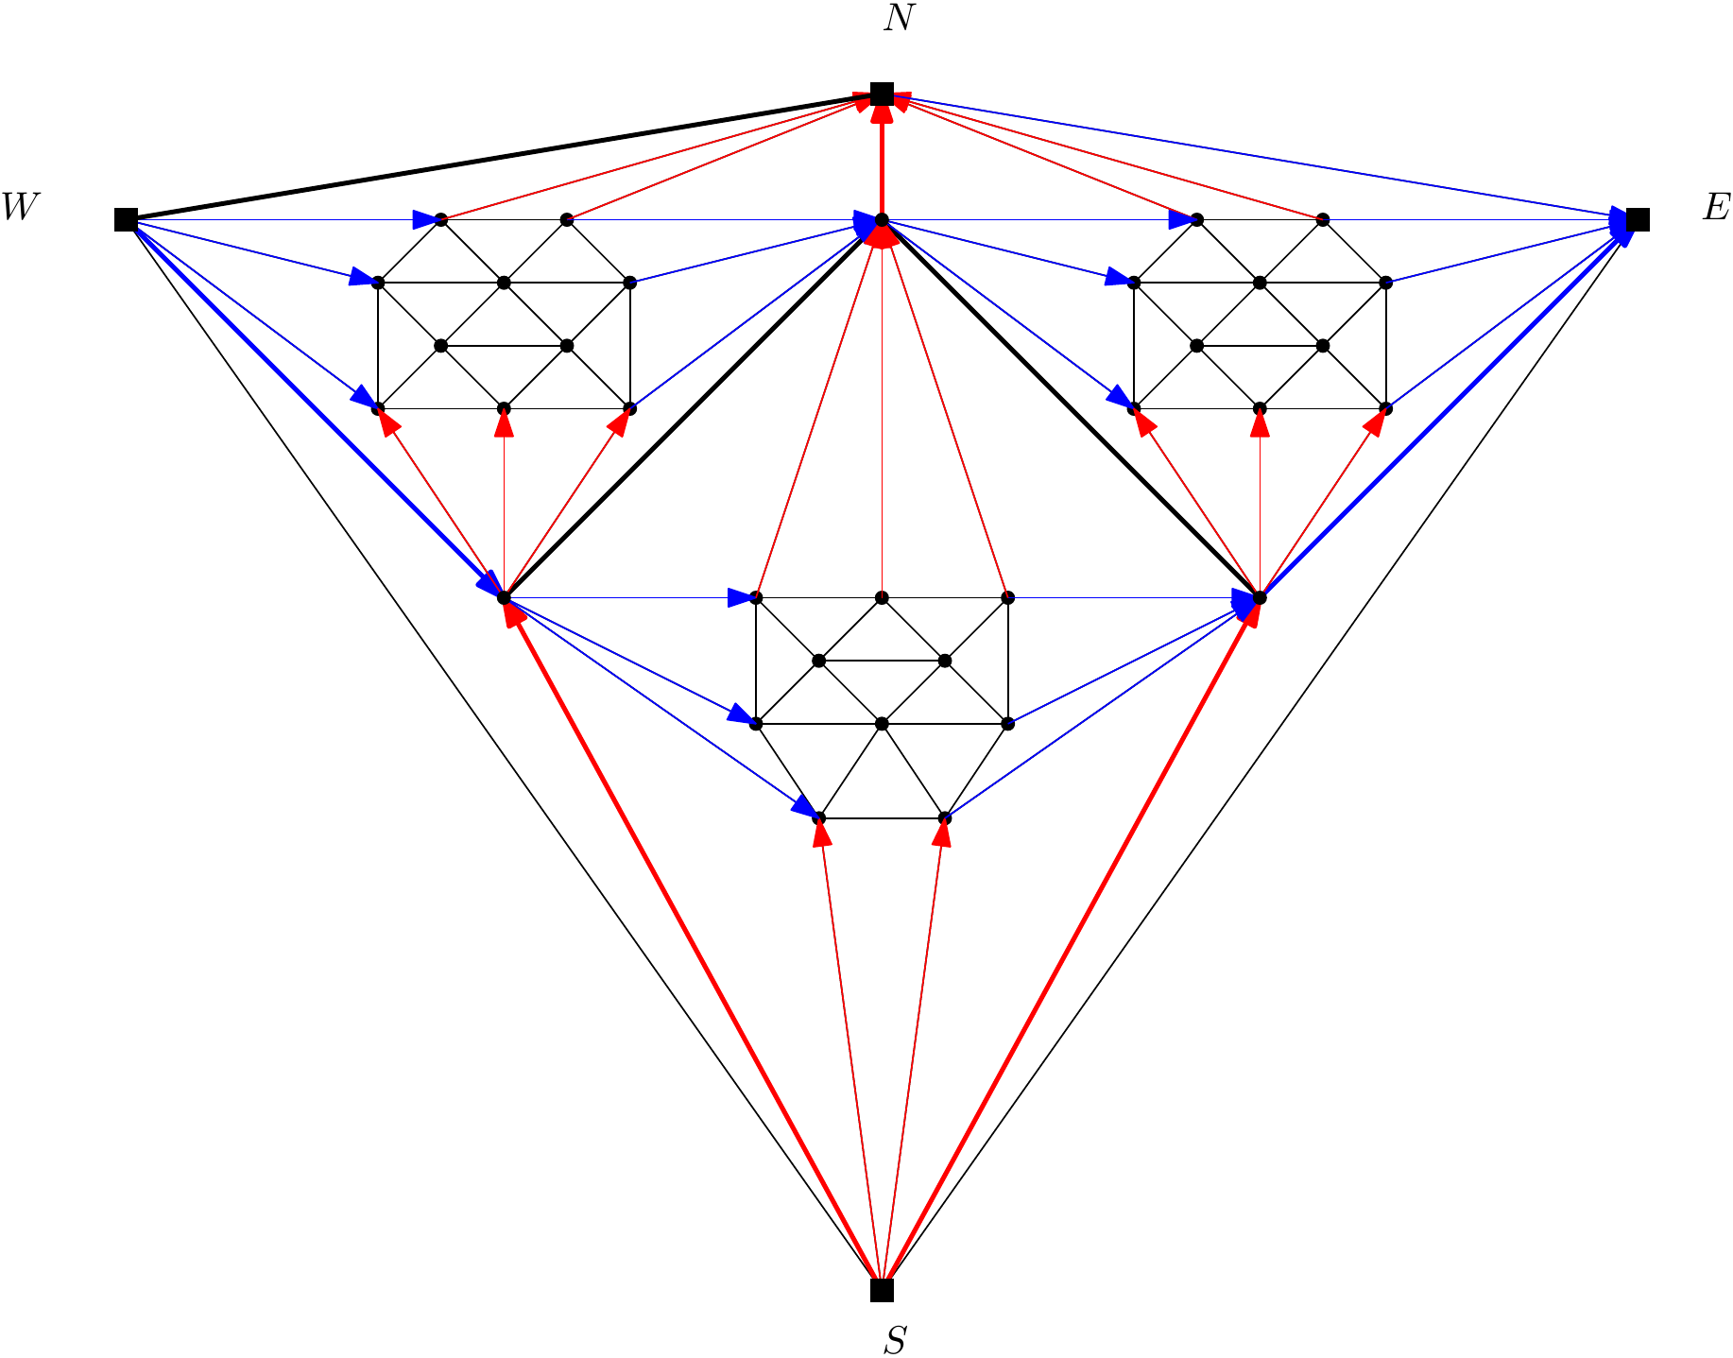
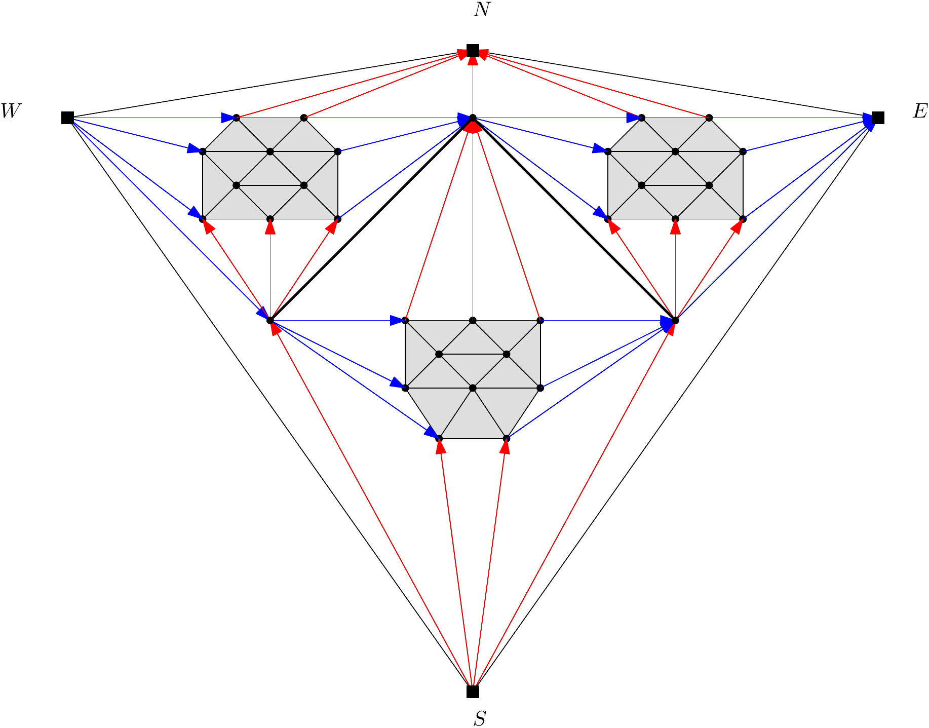
∞-sided graphs with 4-cycles
Any extended graph with separating 4 cycles can be ∞-sided, even if all these cycles go trough a pole.
Exterior vertex condition
4-cycles …
color inside
Problem!

Slide 27
Structure
Problem
Results
Conjecture

Slide 28
Conjecture
What about extended graphs without any separating 4-cycle?
Maybe they are all 2-sided!
The lack of 4-cycles gives a lot of freedom in most cases
But sometimes we can restrict this quite a lot

Slide 29
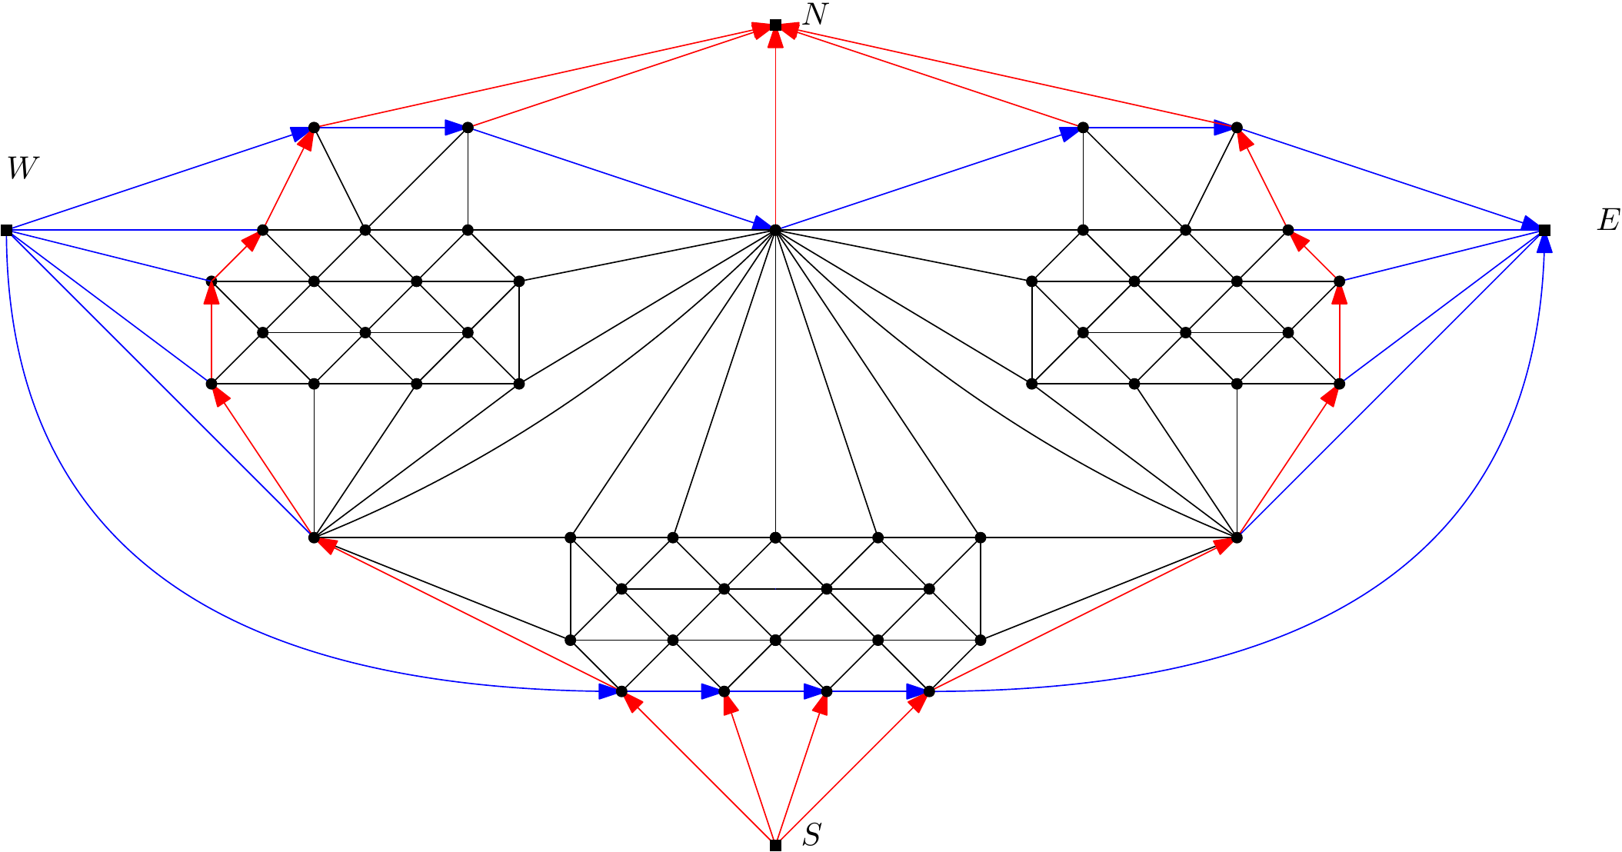
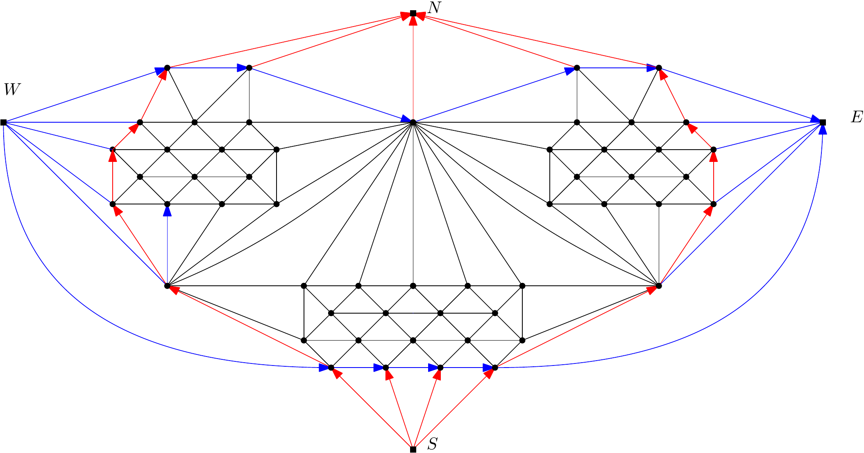
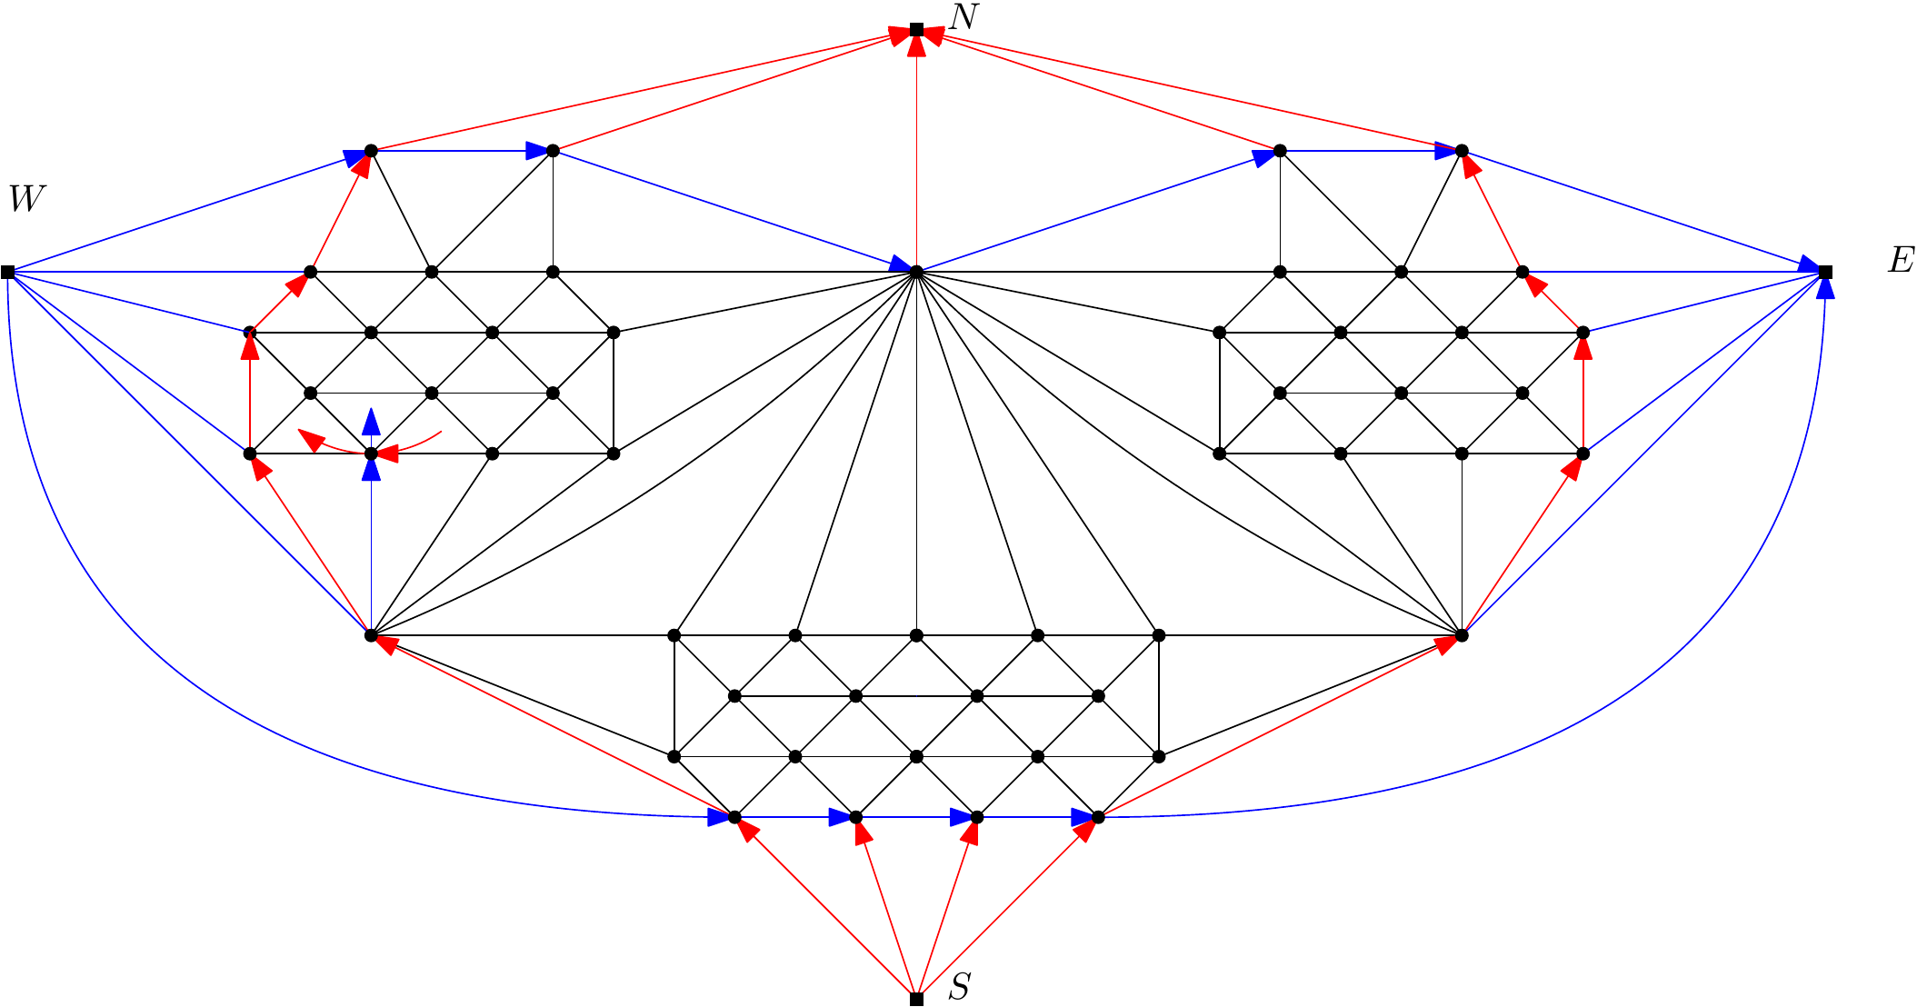
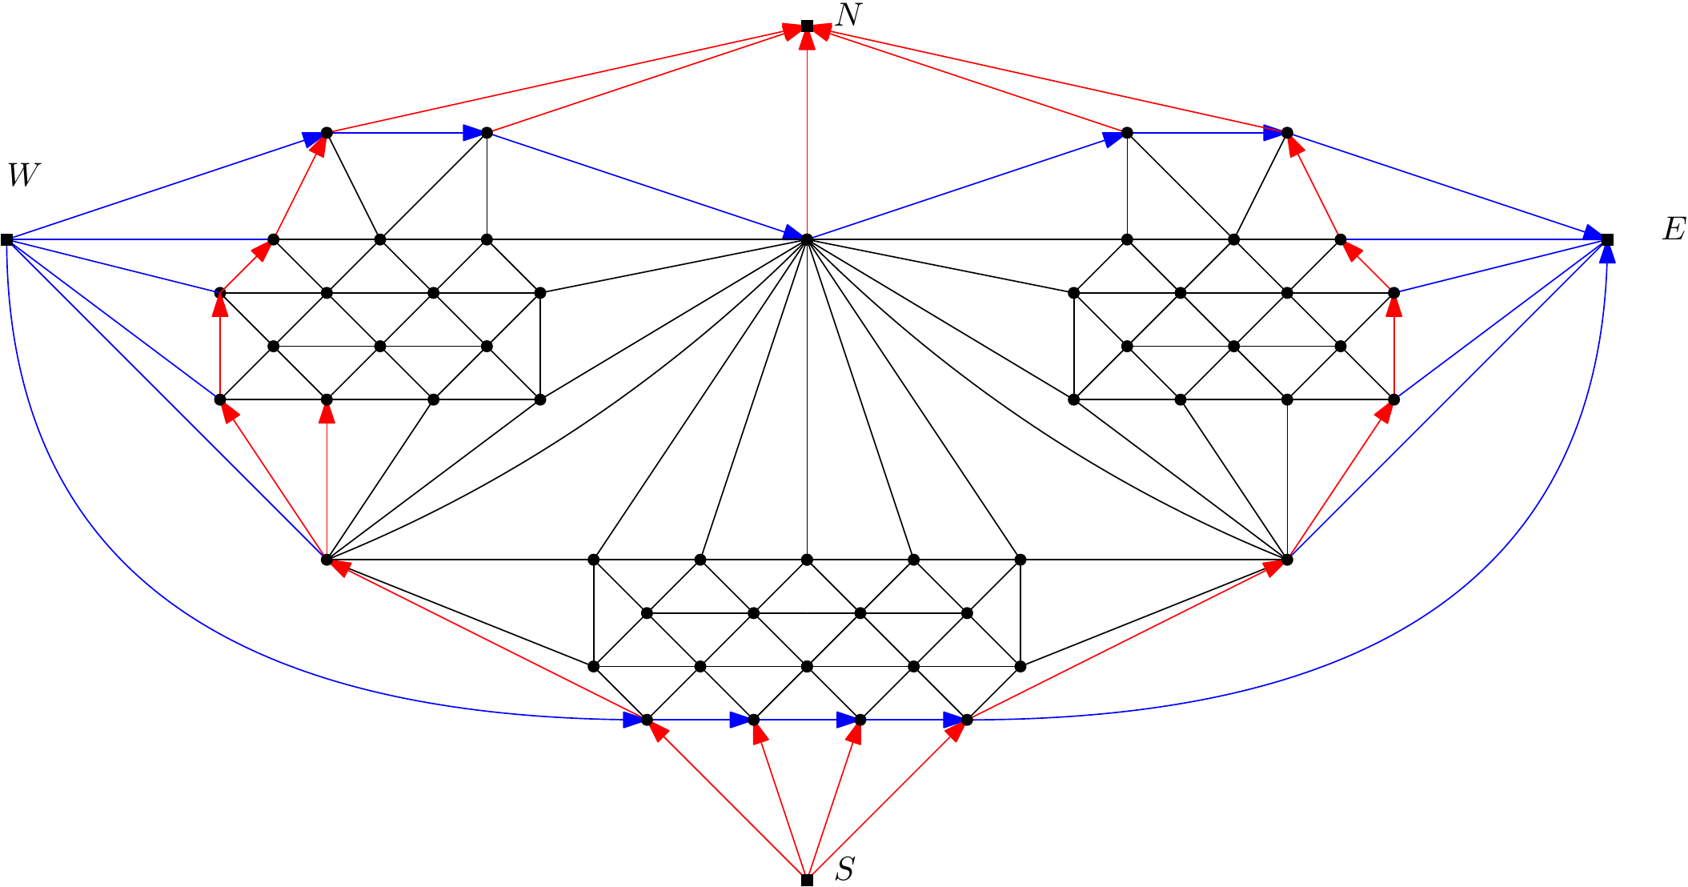
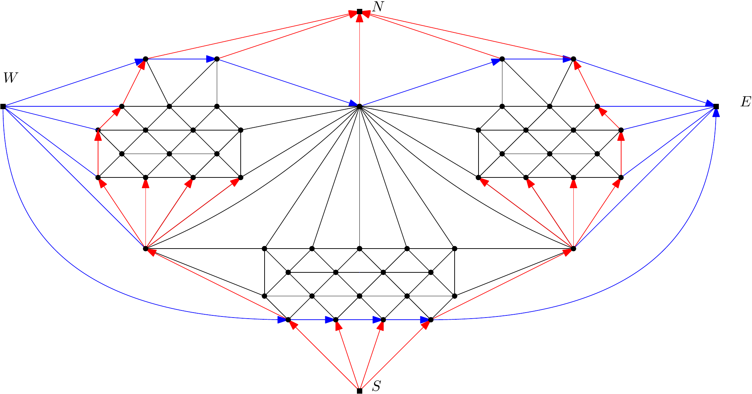
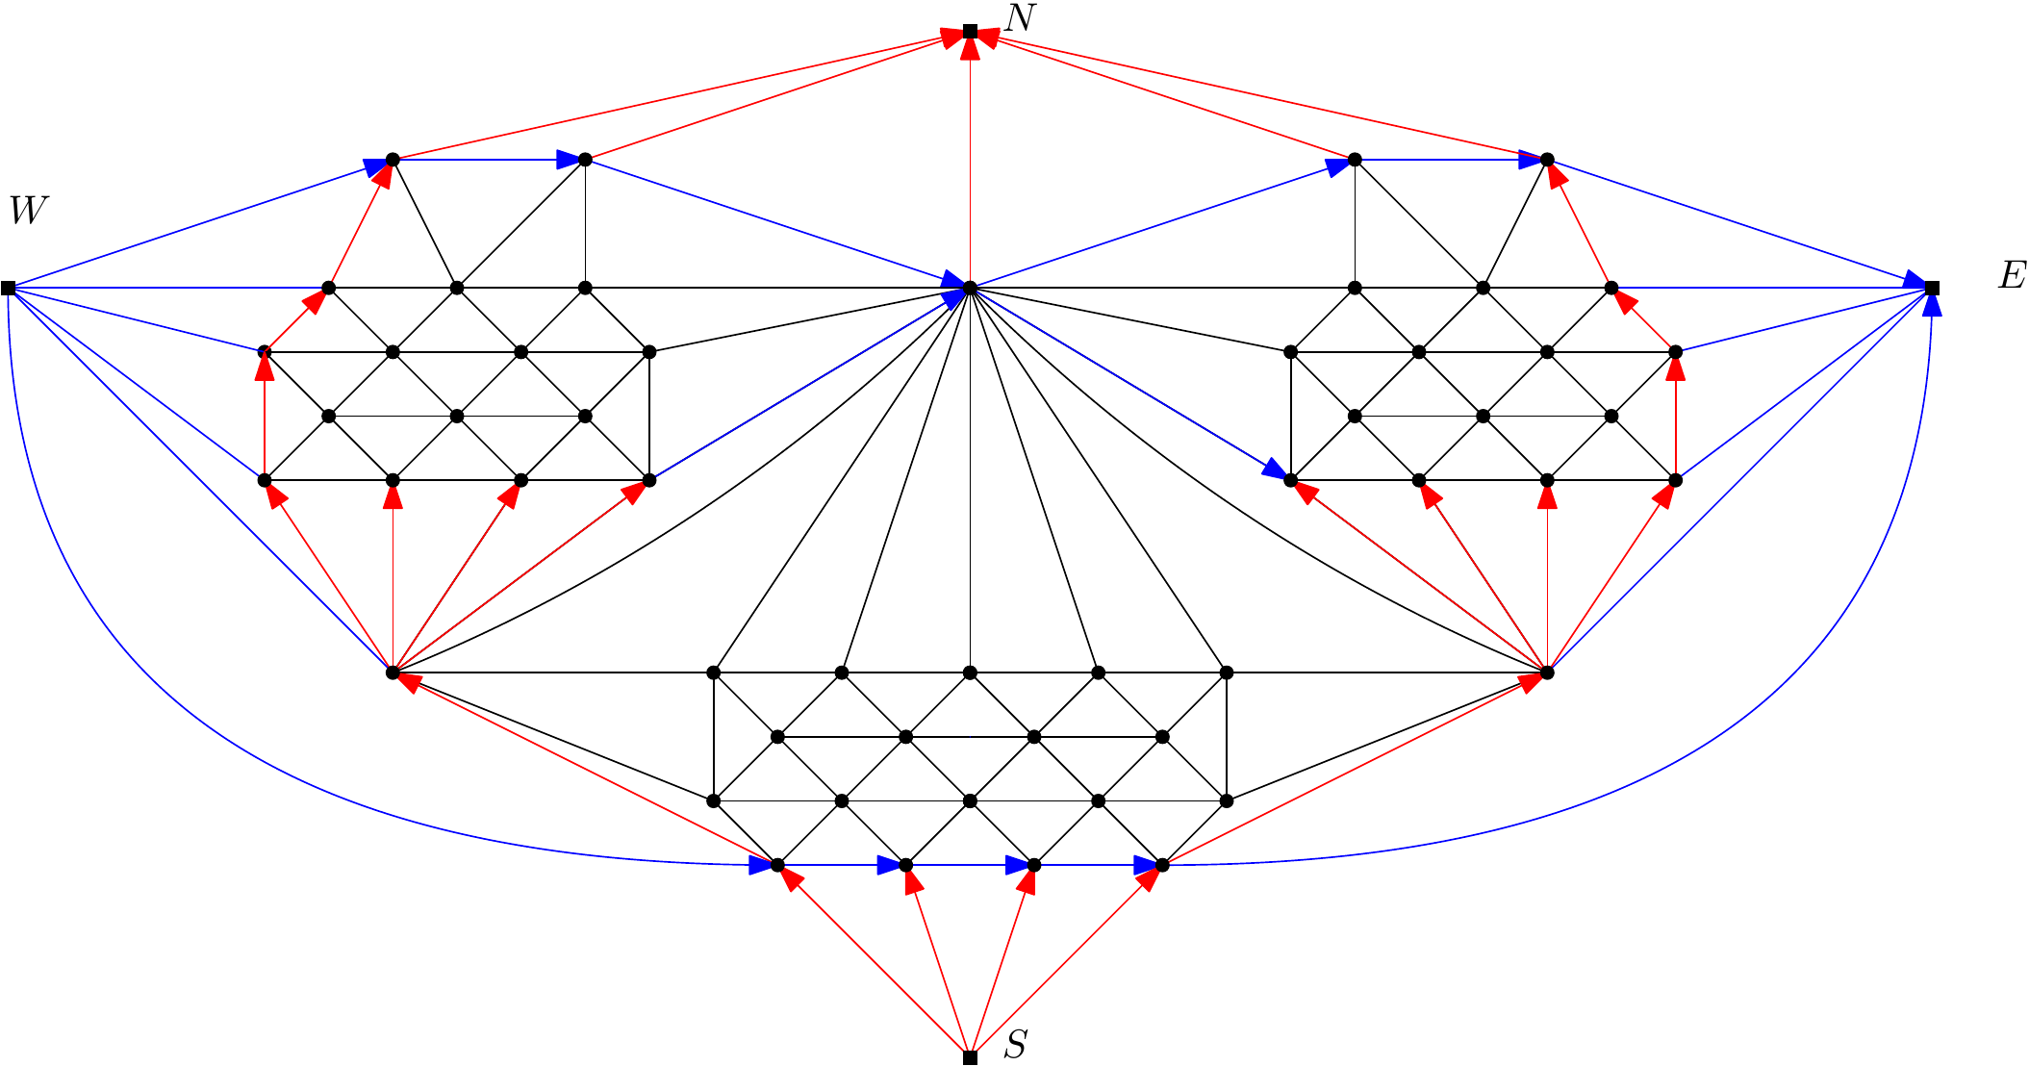
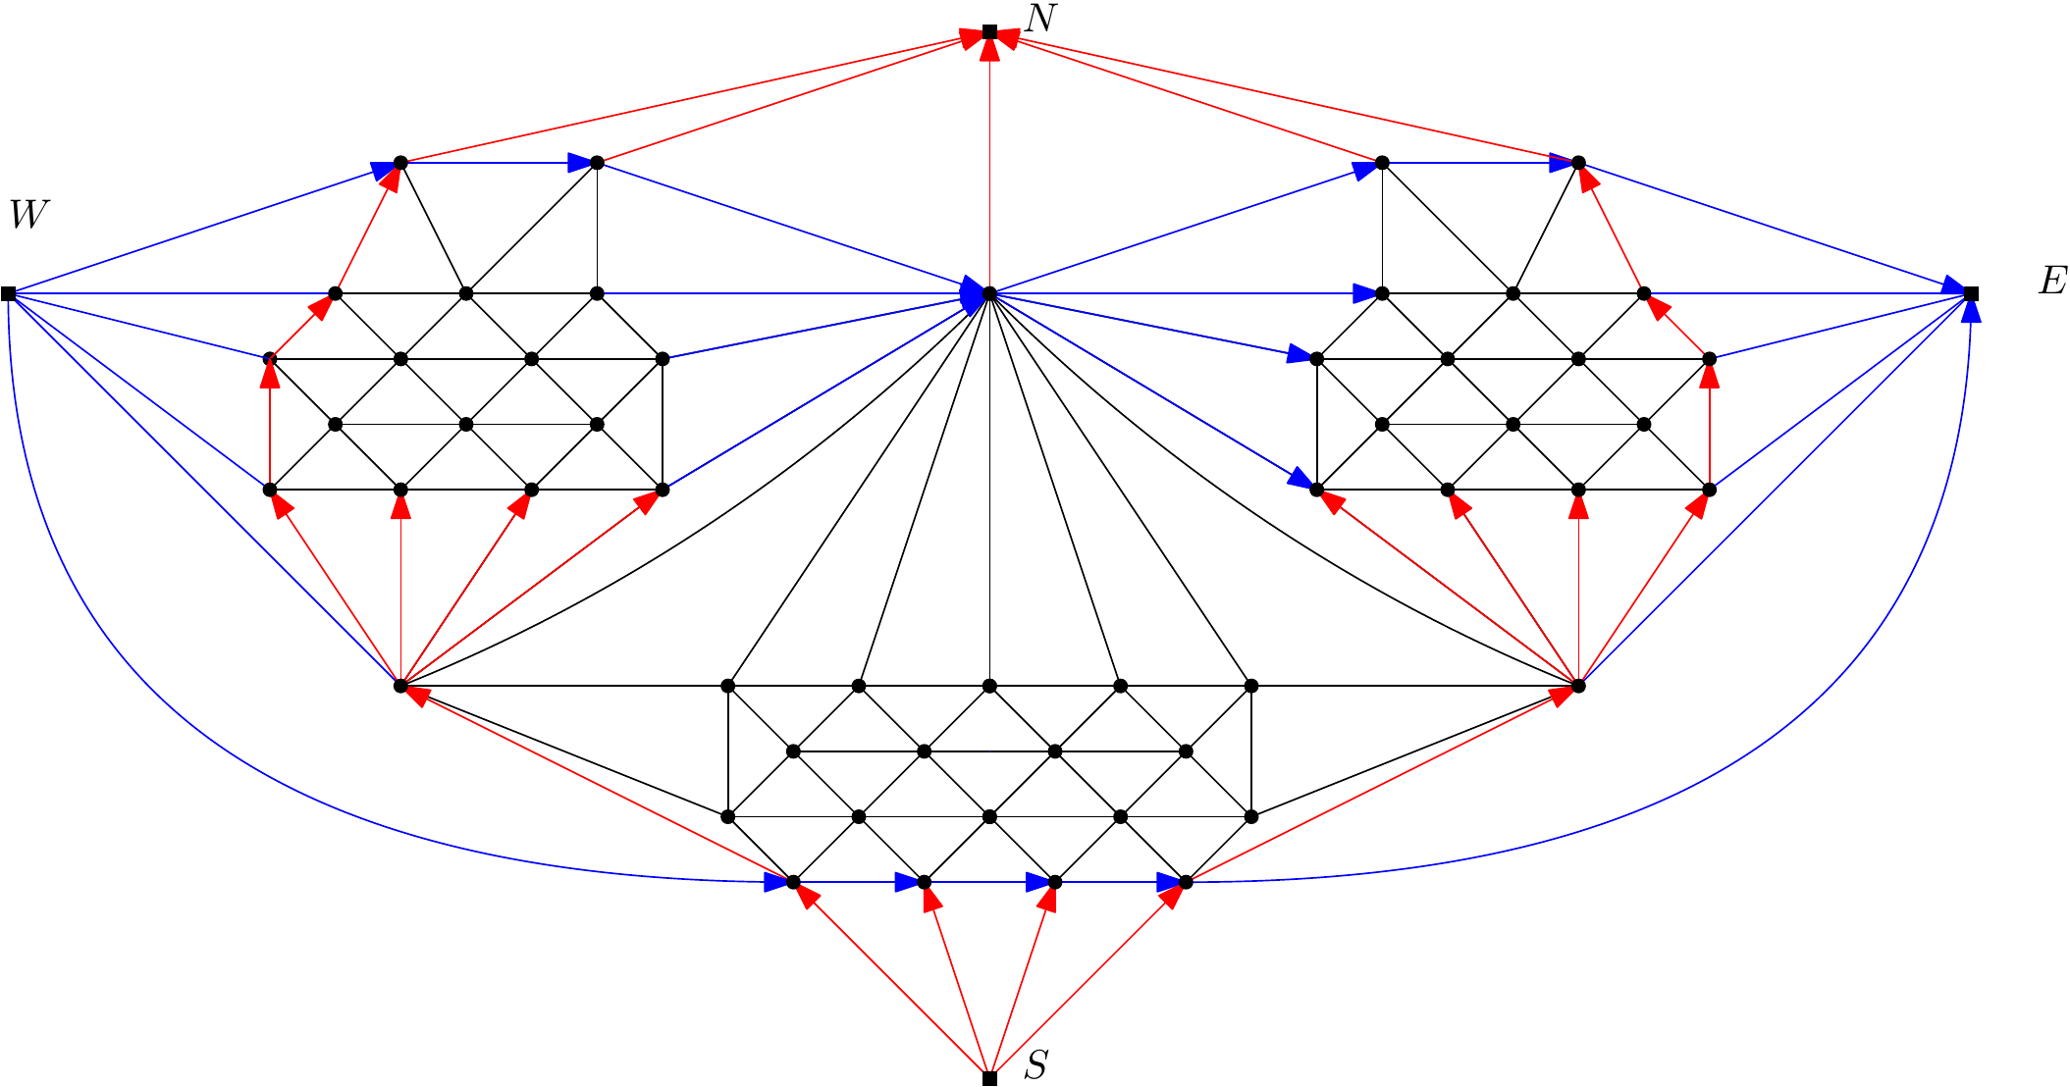
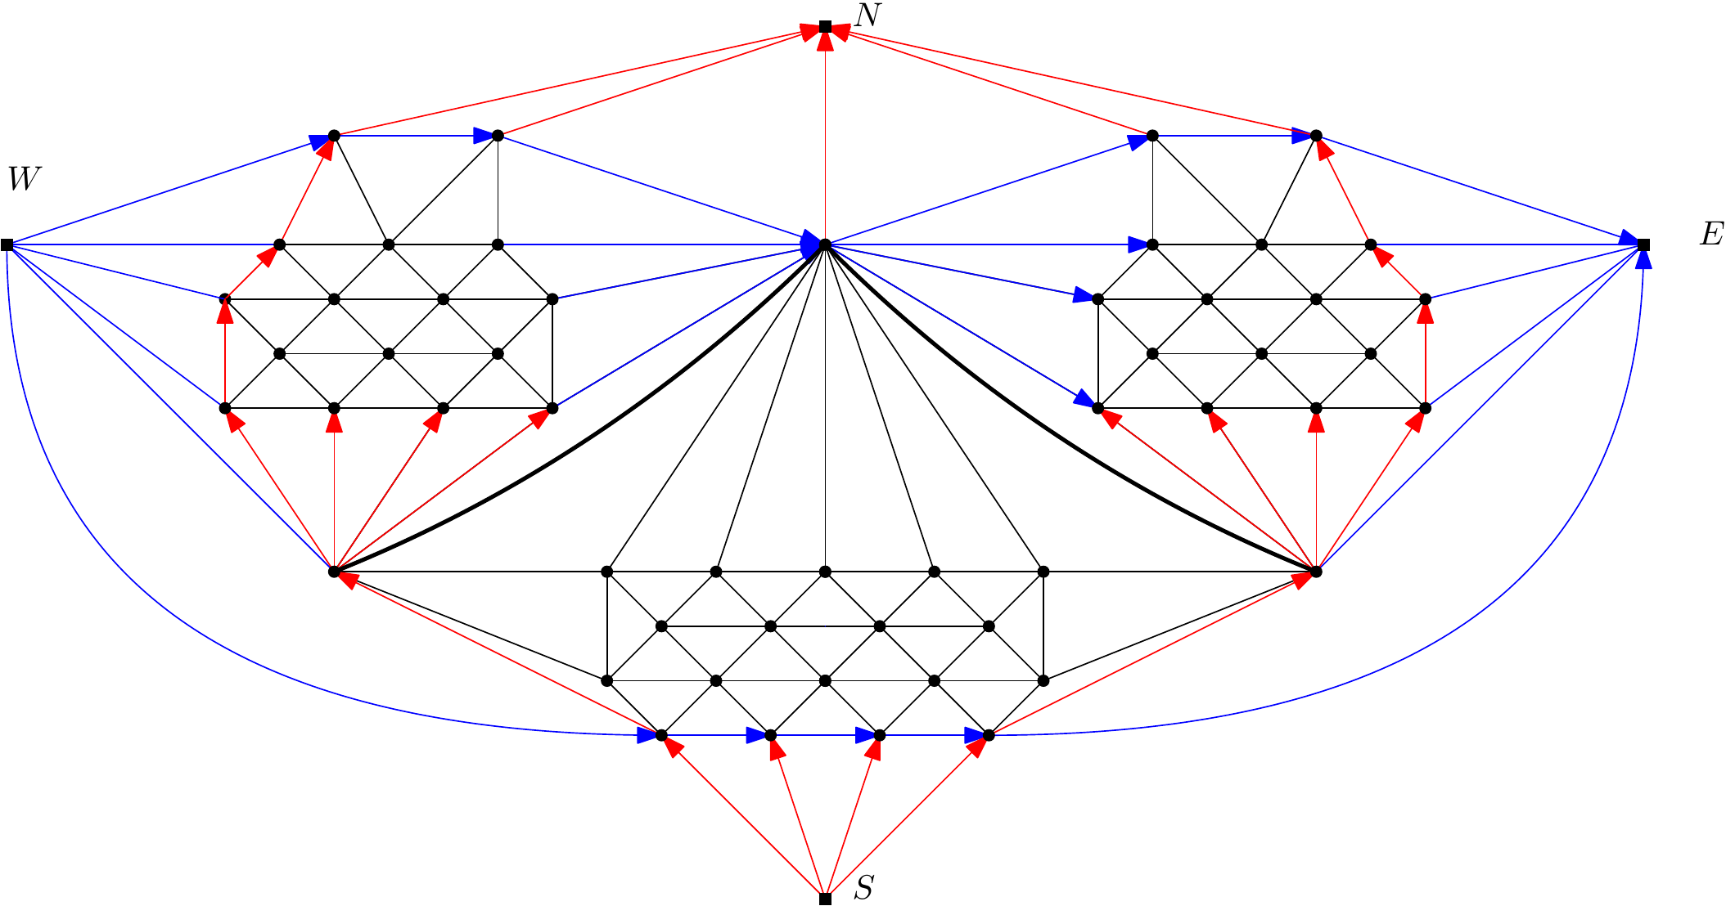
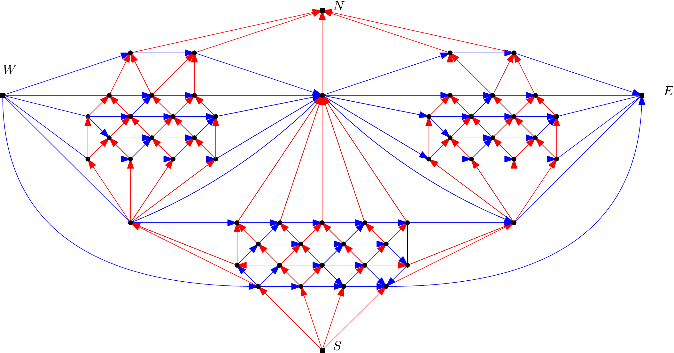
Tricky Example
Graph
Suppose blue …
Incoming red …
Contradiction
Repeat this argument
Color change at corner
Interior vertex condition
Problem …
Solution!

Slide 30
Conclusion
A graph has multiple extended graphs E(G)
If E(G) has a separating 3-cycle this corner assignment has no dual
If E(G) has a separating 4-cycle this corner assignment gives a rectangular dual of G. But it may be ∞-sided
If E(G) has neither we hopefully show that it is 2-sided
Current approach is with a constricting sweep-cycle
Has to do quite specific things, see previous example.
Questions?

