Slide 1
Pseudo one-sided rectangular duals
Bettina Speckmann Kevin Verbeek
Sander Beekhuis
TU Eindhoven

Slide 2
Rectangular Layout
Rectangular Layout partition of a rectangle into finitely many interior-disjoint rectangles.

Slide 3
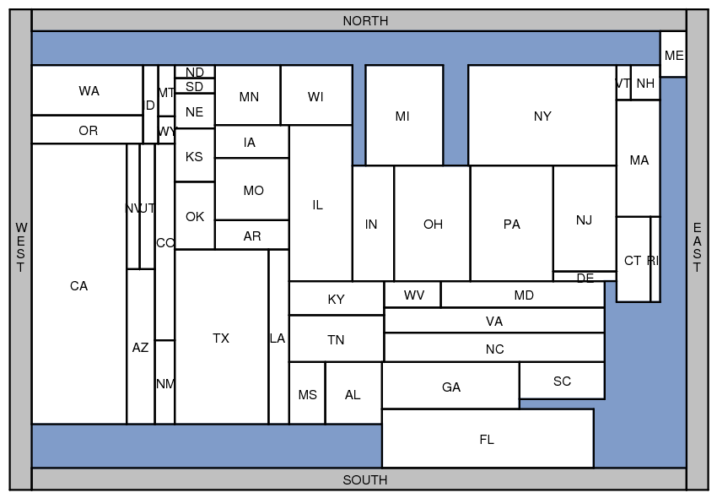
Applications
Rectangular Cartograms visualize statistical data about sets of regions; regions are rectangles; area proportional to some geographic variable

Slide 4
Applications
Rectangular Cartograms introduced by Raisz in 1934
Notes:
Population Limit 1, Aspect 12, zero error

Slide 5
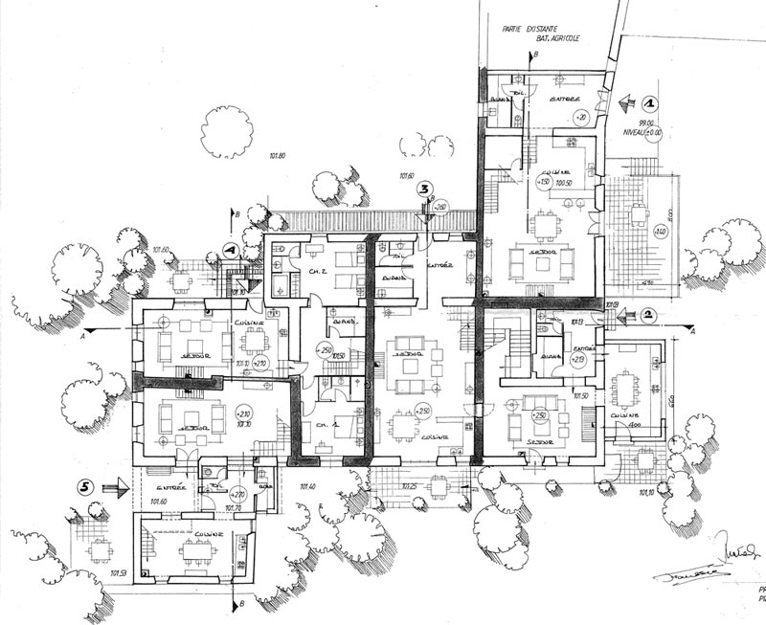
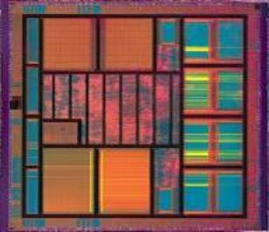
Applications
Floorplans building architecture or VLSI layout

Slide 6
Area-universal layouts
Area-universal layout L for every assignment of weights to the areas of L there is a layout L’ equivalent to L such that the areas of L’ have the correct weights.
Uses animations; morphs; layout first – function later

Slide 7
Area-universal layouts
Area-universal layout L for every assignment of weights to the areas of L there is a layout L’ equivalent to L such that the areas of L’ have the correct weights.
[Eppstein et al., 2012] A layout is area-universal, if an only if it is one-sided.

Slide 8
One-sided layouts
One-sided layout L every maximal line segment of L is the side of a single rectangle
maximal vertical segment
maximal horizontal segment

Slide 9
One-sided layouts
One-sided layout L every maximal line segment of L is the side of a single rectangle

Slide 10
Equivalent layouts
These layouts are not equivalent!

Slide 11
Assumption(TODO)
We assume that every graph we meet has 4 vertices incident to the outer face.
Otherwise we can sometimes make this true
Sometimes in multiple ways
Often we don’t really care about adjacencies between these outer faces
The inside of the 4 outer rectangles is a rectangle (USEFULL FOR LATER SLIDE) (if the graph has at least 5 vertices)

Slide 12
Rectangular duals
[Kozminski & Kinnen ’85] A planar graph G has a rectangular dual with 4 rectangles on the boundary if and only if
every interior face is a triangle and the exterior face is a quadrangle
G has no separating triangles
Notes:
Specify adjacencies of layout

Slide 13
Rectangular duals
The rectangular dual is not unique
Notes:
Nonequivalent layouts!

Slide 14
Regular Edge Labelling
Notes:
A rel corresponds to an equivalence class of layouts
We will use this a lot, so properties …

Slide 15
One-sided duals?
[Rinsma ’87] There exists an outer-planar triangulated graph that does have rectangular duals, but no one-sided dual.
Notes:
Via enumeration

