Slide 1
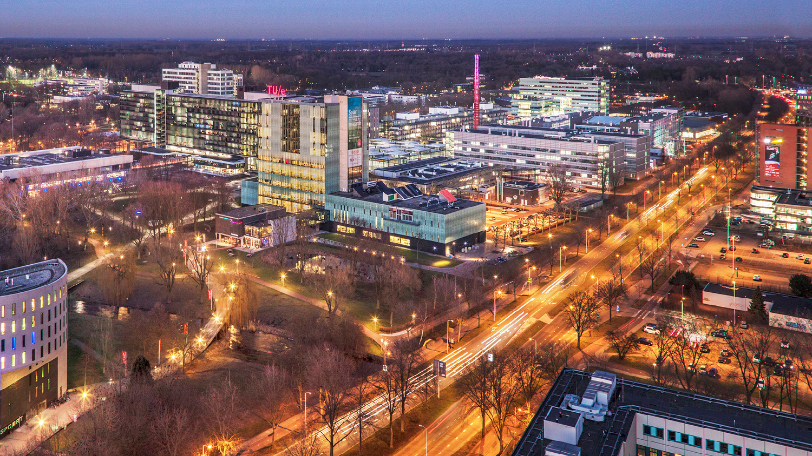
Progress Report
03-10-2022
Bos, Sander
Mathematics & Computer Sciences

Slide 2
Goal: Finish the implementation of standard Granger causality finding
Started at 26-09
Found a Blog[1] that goes over finding Vector autoregression models
Gas Price and Demand data [2]

Slide 3
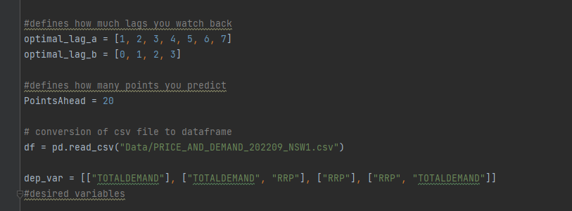
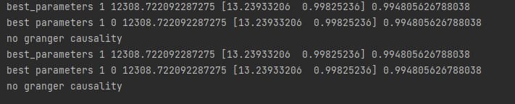
Goal: Finish the implementation of standard Granger causality finding
Implemented everything from scratch
Using a Class structure
Defined a train and test part

Slide 4
Next Time
Reading https://corrdetective.github.io/ & Flink
Reading on iterative algorithms
Finding Large enough time-series data
Start improving the speed

Slide 5
References
Ongko, G. C. (2022, February 9). Implementing vector autoregression (VAR) from scratch with python. Medium. Retrieved October 2, 2022, from https://blog.devgenius.io/implementing-vector-autoregression-from-scratch-with-python-b12eedbf35ad [1]
Aggregated price and Demand Data. AEMO. (n.d.). Retrieved October 2, 2022, from https://aemo.com.au/energy-systems/electricity/national-electricity-market-nem/data-nem/aggregated-data [2]

Slide 6
Progress Report
03-10-2022
Bos, Sander
Mathematics & Computer Sciences

