Slide 1

Gummer
Hunting advanced malware on a budget
Ernesto Corral Messía de la Cerda

Slide 2






Le me
Security Engineer by day
Malware/RE by night
Interests:
Malware
RE
Exploiting
@xgusix
xgusix.com

Slide 3
Agenda
Introduction
Hunting Malware
Hunting Advanced Malware
Gummer
Demo

Slide 4
Introduction – Hunting Malware
How do the AVs work?
HASH Signatures
String Signatures
Behavioral Analysis
Memory analysis…

Slide 5
Introduction – Hunting Malware
Crimeware vs. Targeted Attacks vs. Advanced Persistent Threats
 | Crimeware | TA | APT
Target | Not a specific target (People) | Companies/Institutions (Group) | Very specific target (Company/Institution/Facility)
Goal | Economic goals | Information theft | Different goals (Espionage, Info theft, Chernobyl, Live Free or Die Hard)
Detection | Noisy | Fast detection | Very slow detection (0-days, specific binaries)
 | Quickly known (HASH) | Known vulnerabilities (String sig.)
 | Exploit kits (String sigs.) | Known behavior

Slide 6
Introduction – Hunting Malware
With APTs
How do the AVs work?
HASH Signatures
String Signatures
Behavioral Analysis
Memory analysis…
OK, we have been compromised... now what?

Slide 7
Introduction – Hunting Advanced Malware
Anomalies
a·nom·a·ly
n. pl. a·nom·a·lies
1. Deviation or departure from the normal or common order, form, or rule.
Deviation or departure from the normal or common behavior of a system or network.

Slide 8
Introduction – Hunting Advanced Malware
Anomalies – A practical exercise
Malware sample connects to domain downloadmalware.com.
It downloads the file bad.exe and runs it.
Bad.exe creates a persistence mechanism by writing its path on the registry key HKCU\SOFTWARE\Microsoft\Windows\CurrentVersion\Run and connects every 13 minutes to commandandcontrol.xxx.

Slide 9
Introduction – Hunting Advanced Malware
Anomalies – A practical exercise
Malware sample connects to domain google.dyndns.com.
It downloads the file bad.exe and runs it.
Bad.exe creates a persistence mechanism by writing its path on the registry key HKCU\SOFTWARE\Microsoft\Windows\CurrentVersion\Run and connects to 192.210.30.12 at 19:37.

Slide 10
Gummer – What is Gummer?

Slide 11

Gummer – What Who is Gummer?

Slide 12
Gummer – What is Gummer?
“Host for plug-ins”
FRAMEWORK for hunting Advanced Malware based on anomalies
Based in a tool used in my previous job

Slide 13

Gummer – Motivation
It works... Seriously. It really works
Flexibility
Learn more about Python’s introspection
Excuse to keep myself updated

Slide 14
Gummer – Use cases
2 ways of working with Gummer:
Day-to-day detection
Post-mortem analysis
No real-time detection

Slide 15
Gummer – Structure
gummer.py
analyzers
DB connectors
outputs
collectors
Modules

Slide 16
Gummer – Modules
db
logs
analyzer
output

Slide 17
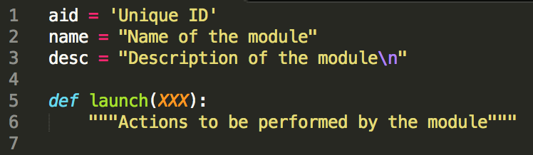
Gummer – Modules

Slide 18
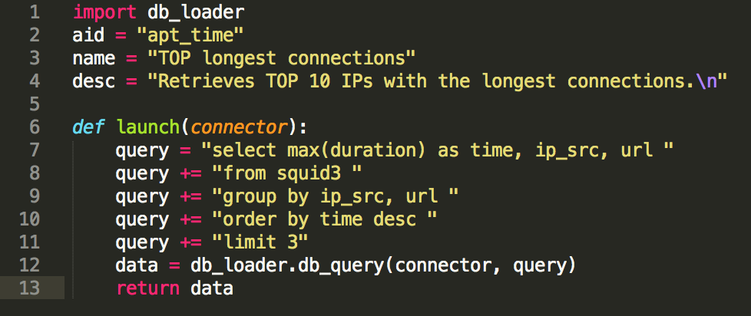
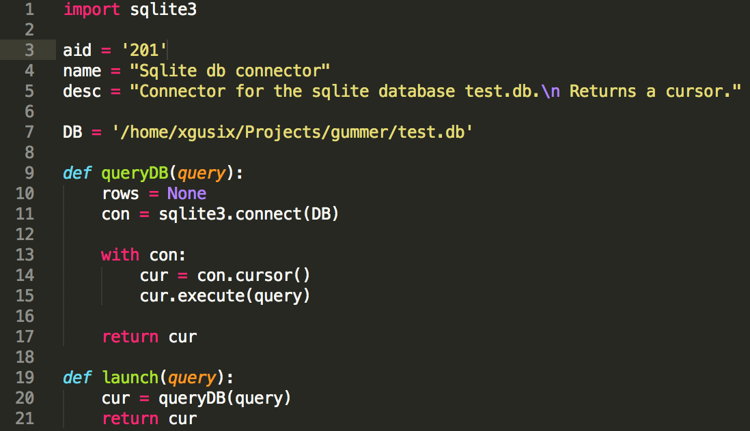
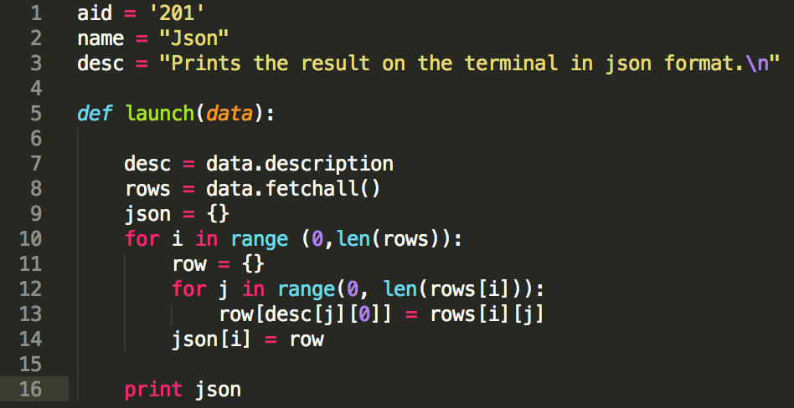
Gummer – Modules

Slide 19
Demo

Slide 20



Demo - Network
Squid
Interwebs

Slide 21
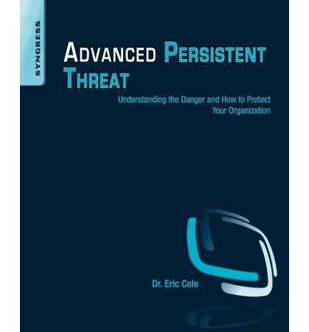

Demo - Anomalies
Three anomalies
Destination IP address
Length of connection
Amount of data

Slide 22
Acknowledgements
Antonio Villalón
Roberto Amado
Pablo Marín

Slide 23

Questions?
xgusix@xgusix.com

