Slide 1
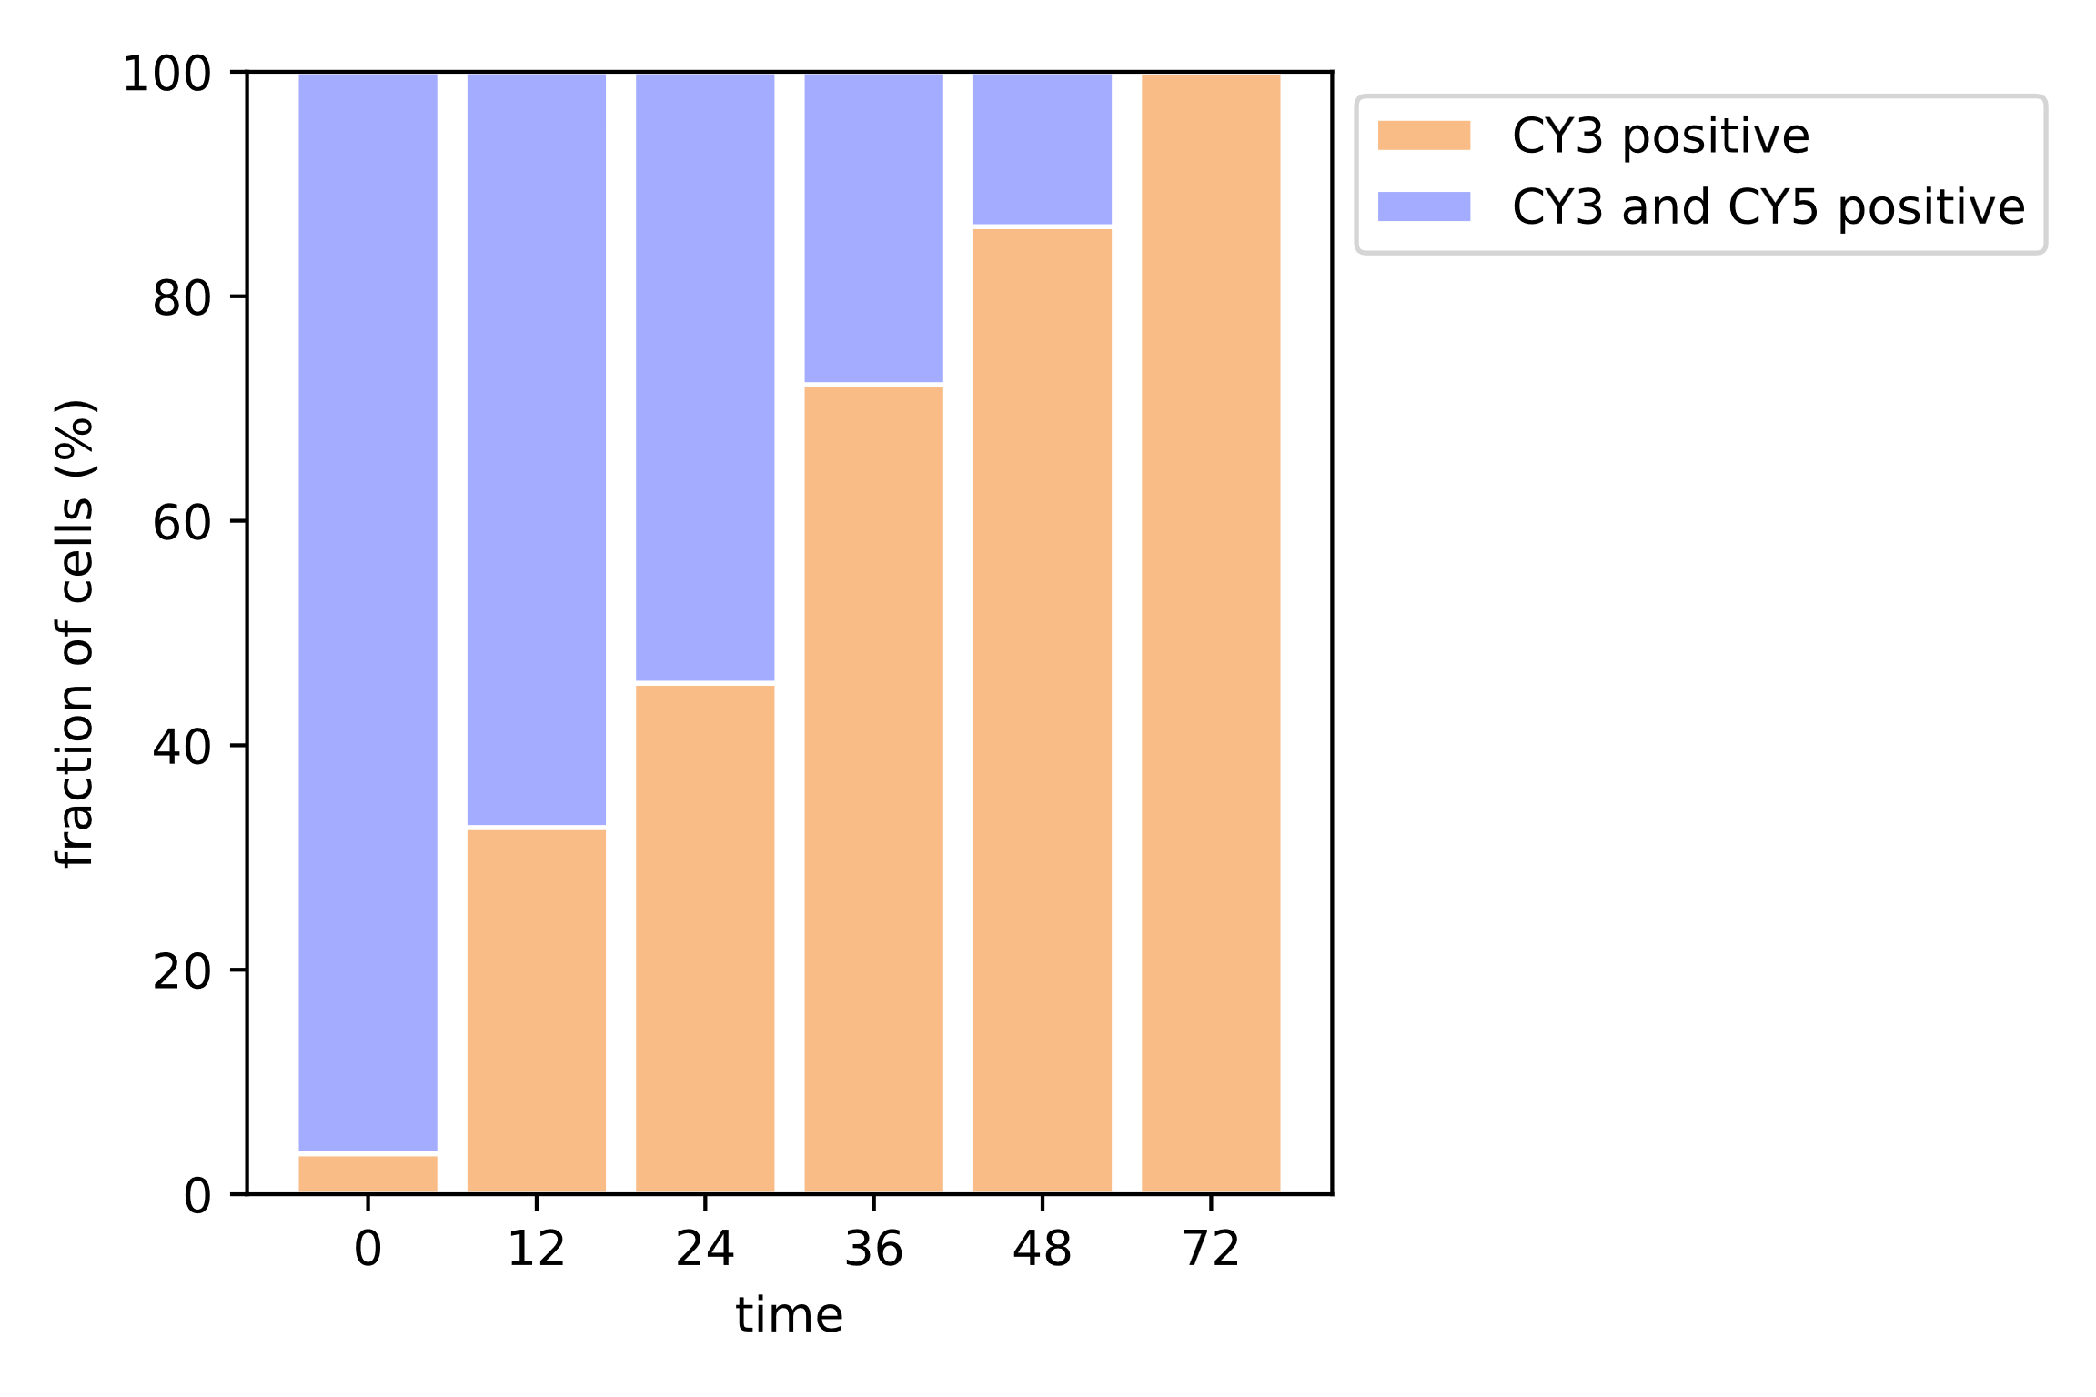
Fraction of CY3 and CY5 positive Bacteria over time

Slide 2
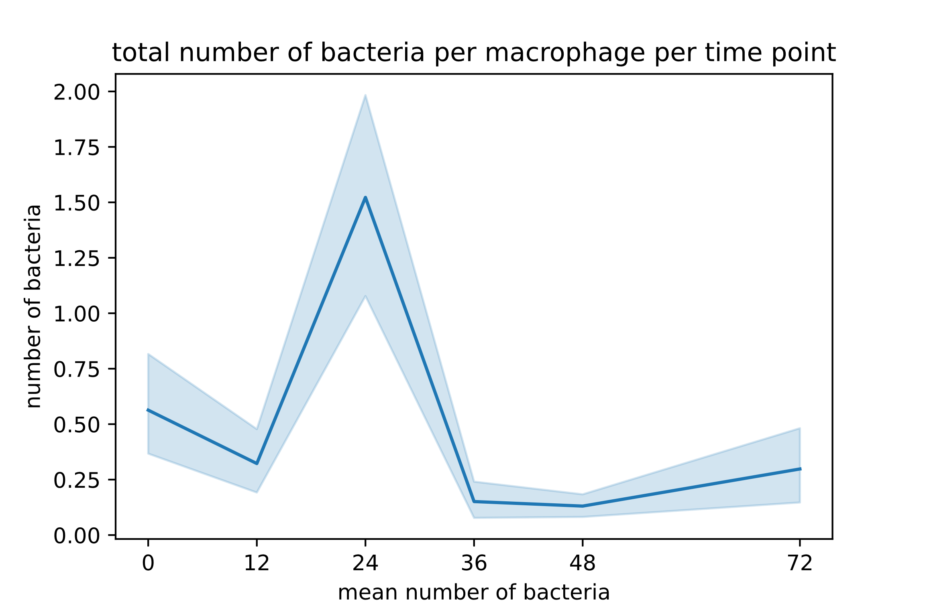

Slide 3
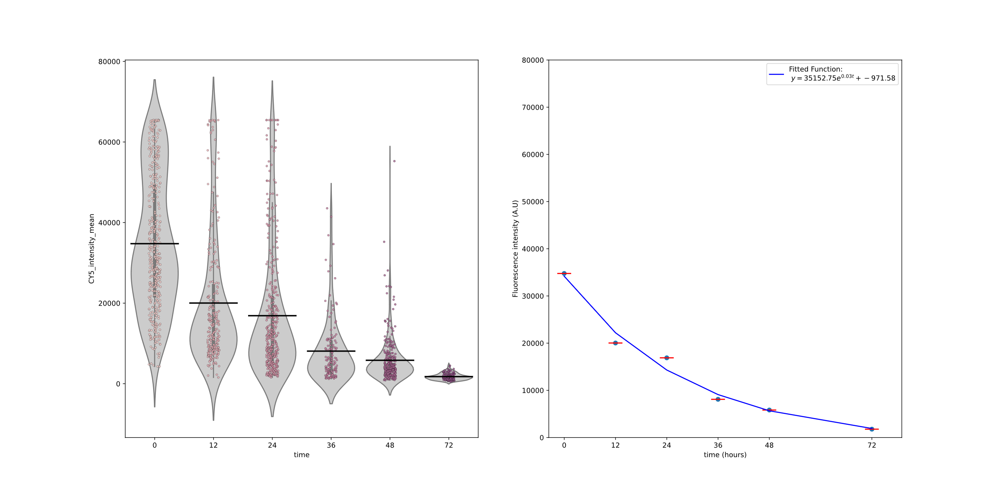
Fluorescence distribution CY5 of CY3-positive Bacteria
Fitted Decay curve to mean fluorescence intensities

Slide 4
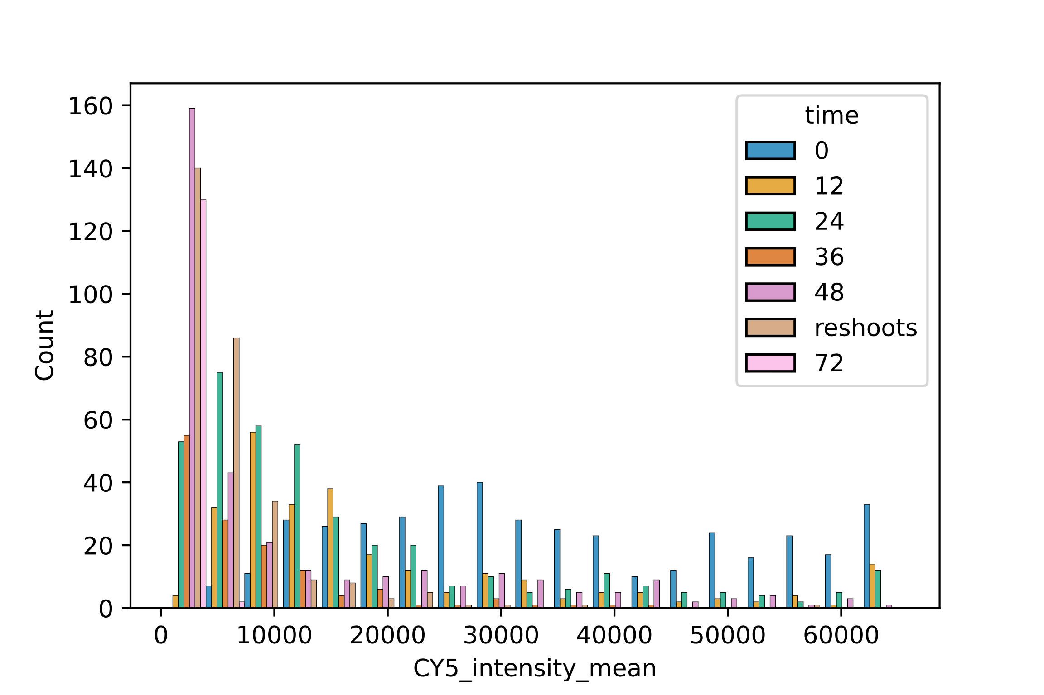
Shifting CY5 Fluorescence intensity distributions over time

