Slide 1
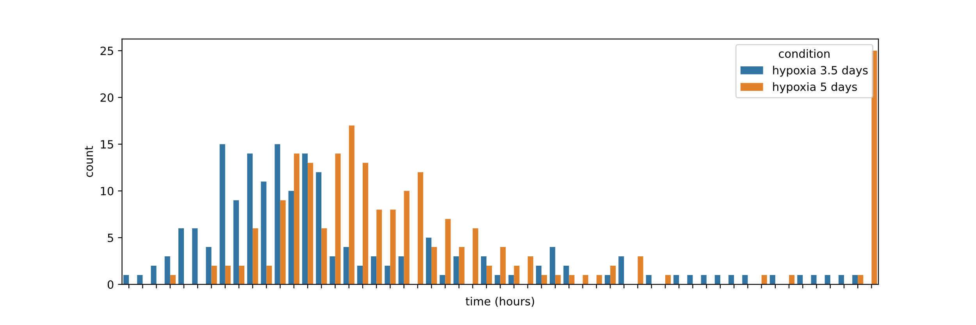
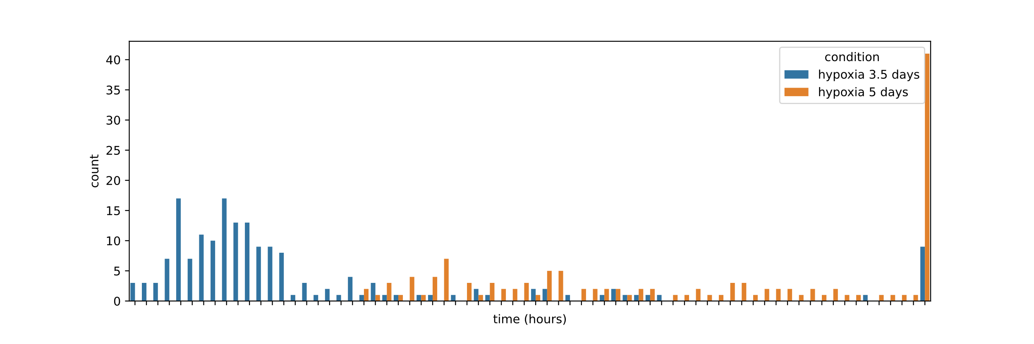
Timepoints until the first division for both replicates
Rep1
Rep2
36.15
36.15

Slide 2
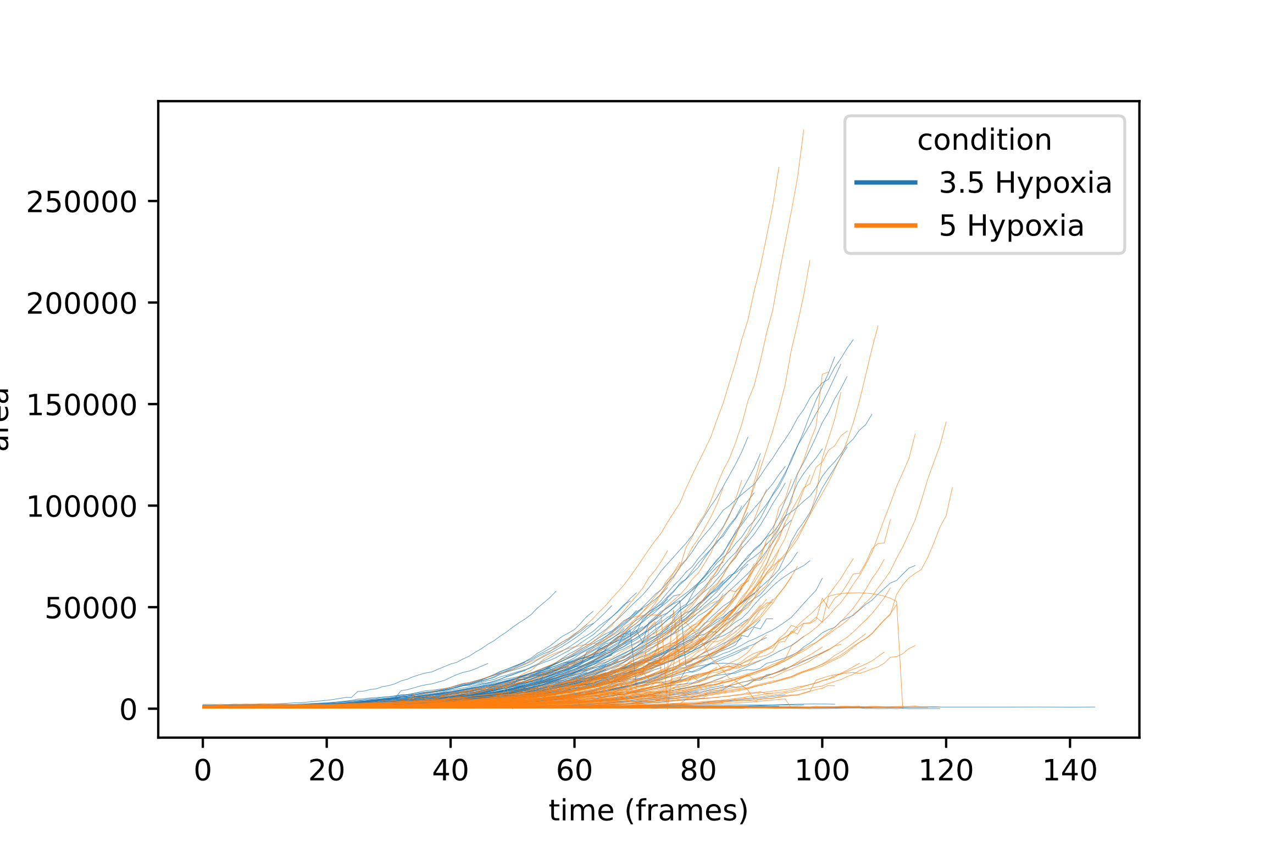
Single colony growth traces over time
Area

Slide 3
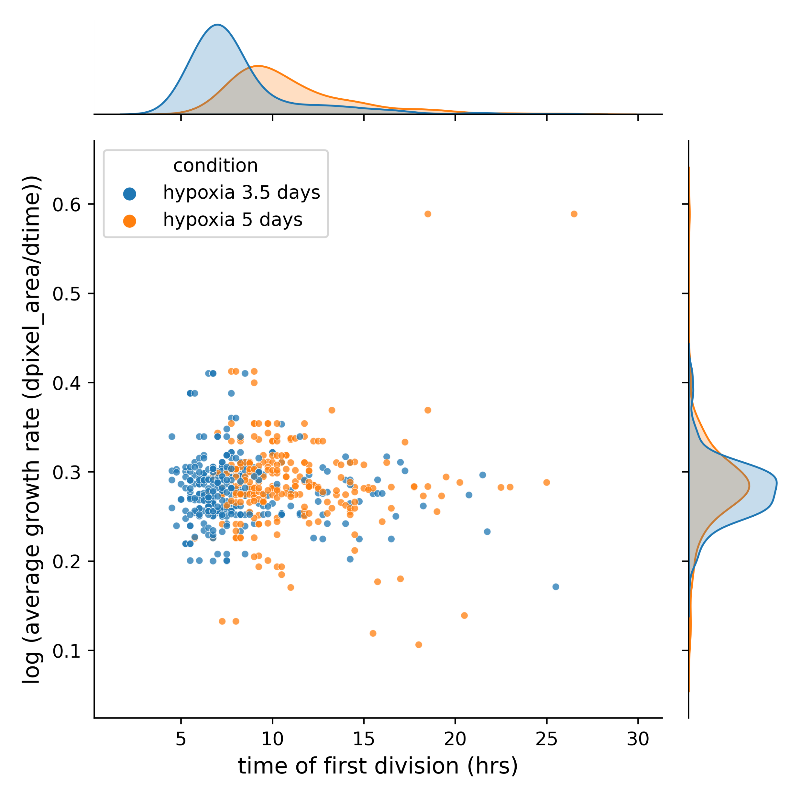
Colony growth rate vs. time of first division

