Slide 1


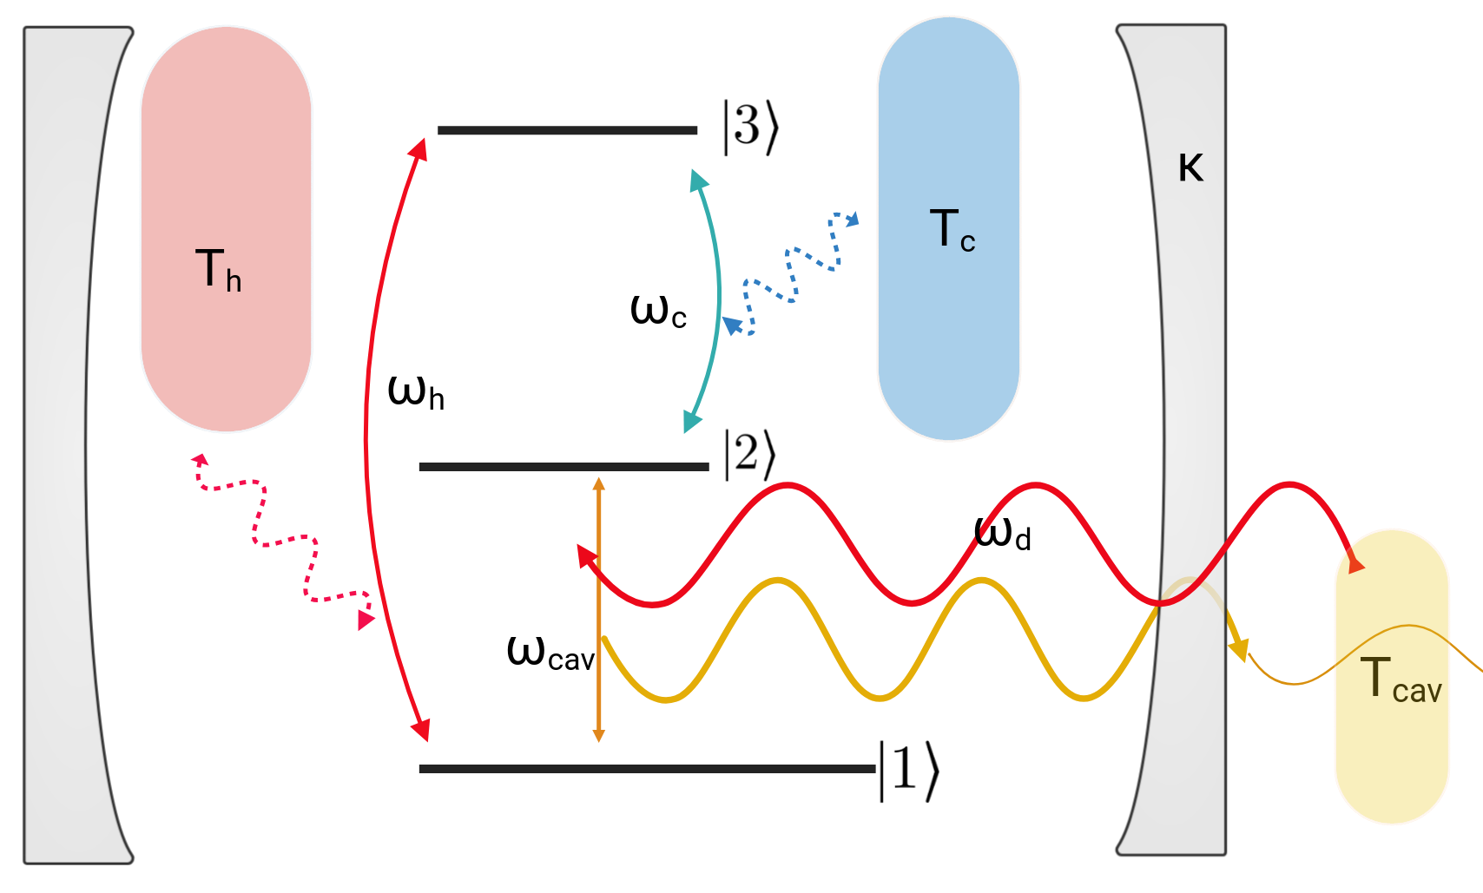
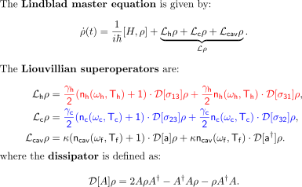
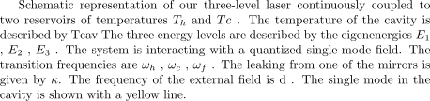
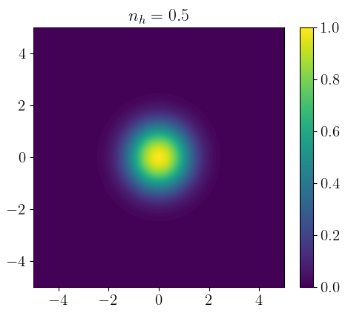
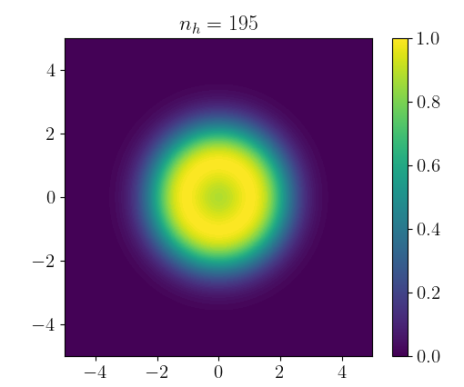
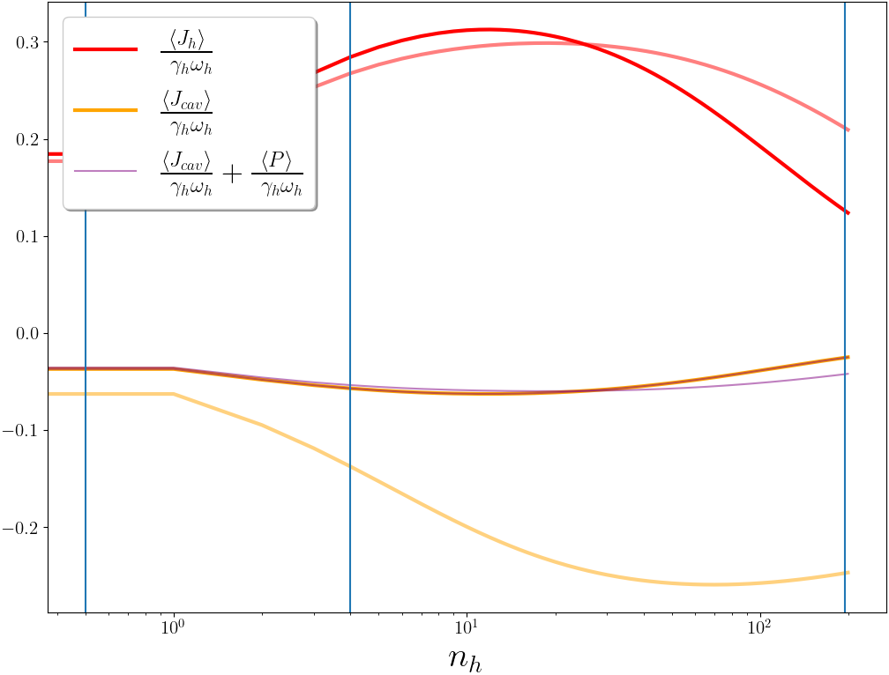

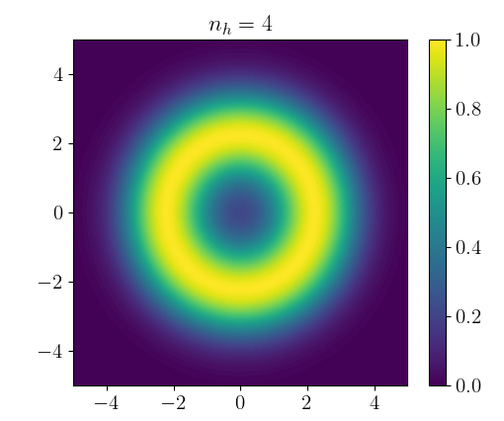
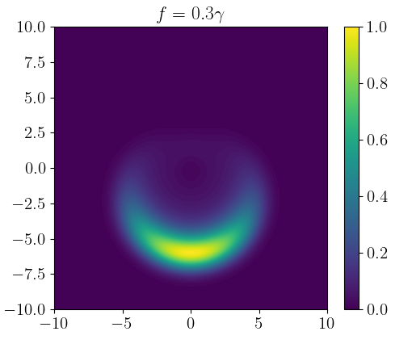
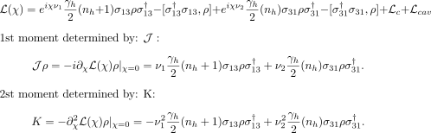
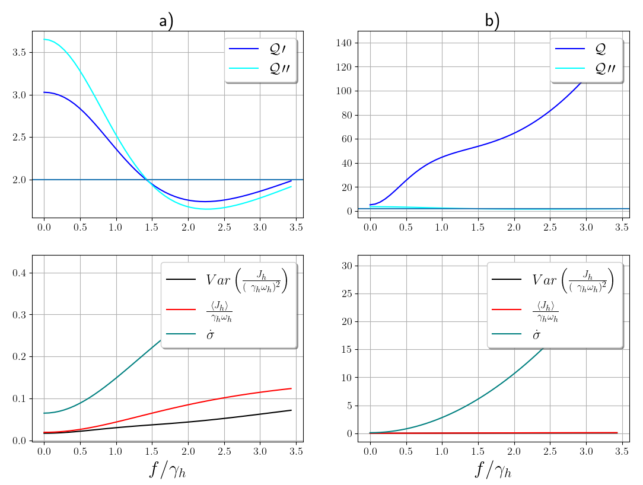
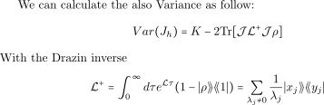
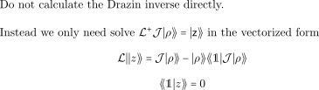
The thermodynamic uncertainty relation in the three-level laser
with a quantized field junction
Author: Sander Stammbach
Supervisors: Prof. Patrick Potts, Dr. Mateo Brunelli, Marcelo Janovitch,
*sander.stammbach@outlook.com
Three-level laser as a quantum heat engine: Conversion of thermal energy to coherent light [1]
We study a version inside a pumped optical cavity and investigate its operation regimes and heat current fluctuations
We observe a double threshold behaviour of operation; a lasing threshold and a theshold of diminishing output power
Surprisingly, we do not observe quantum violations of the thermodynamic uncertainty relation (TUR), contrary to previous studies without a cavity [3]
Three-level laser model
Hot Bath
[1]
Cold Bath
Cavity leaking
Cavity Bath
Solution:
Numerical simulation, truncated to n <= 30 cavity photons
Alternative: Heisenberg equations of motion for expectation values, truncated by factorizing moments higher than second order
Steady-state operation regimes
Thermodynamic uncertainty relation
Trade-off between relative current fluctuations, and entropy production rate.[2]
Quantum systems can violate TUR
Steady-state current variance obtained from full counting statistics
Double-threshold behavior describes heat current rises past the lasing threshold, and after peak decreasing again.
Second threshold in the Zeno regime explained by the jump rate gets suppressed by high population inversion.
A strong external field can counteract this by enhancing photon emission.
similar to phase-averaged coherent state
Full counting statistics [3]
TUR Results
Introduce auxiliary counting field chi for moment-generating function of heat current J_h
Without the entropy production rate of the cavity, the minimum of Q occurs in a completely different regime, and TUR violation is induced by the external coherent field. This behavior is similar to what is expected for a three-level system in a waveguide.
No TUR violation with respecting the total entropy production rate!
Contribtion of
The minimum of Q occurs only in the reverse regime of the heat current. Therefore, the variance of the heat current is low only when the heat current is not present anyway.
Entropy production rate increase quadraticlay as a function of f. Therefore also the Q increase as well
[1] H. E. Scovil and E. O. Schulz-Dubois, “Three-level masers as heat engines,” Physical Review Letters,
vol. 2, no. 6, pp. 262–263, Mar. 1959. [Online]. Available: https://link.aps.org/doi/10.1103/
PhysRevLett.2.262.
[3 ]G. T. Landi, M. J. Kewming, M. T. Mitchison, and P. P. Potts, “Current fluctuations in open
quantum systems: Bridging the gap between quantum continuous measurements and full counting
statistics,” pp. 1–59, 2023. [Online]. Available: http://arxiv.org/abs/2303.04270
[2] A. A. S. Kalaee, A. Wacker, and P. P. Potts, “Violating the thermodynamic uncertainty relation
in the three-level maser,” Physical Review E, vol. 104, no. 1, pp. 1–12, 2021

