Slide 1
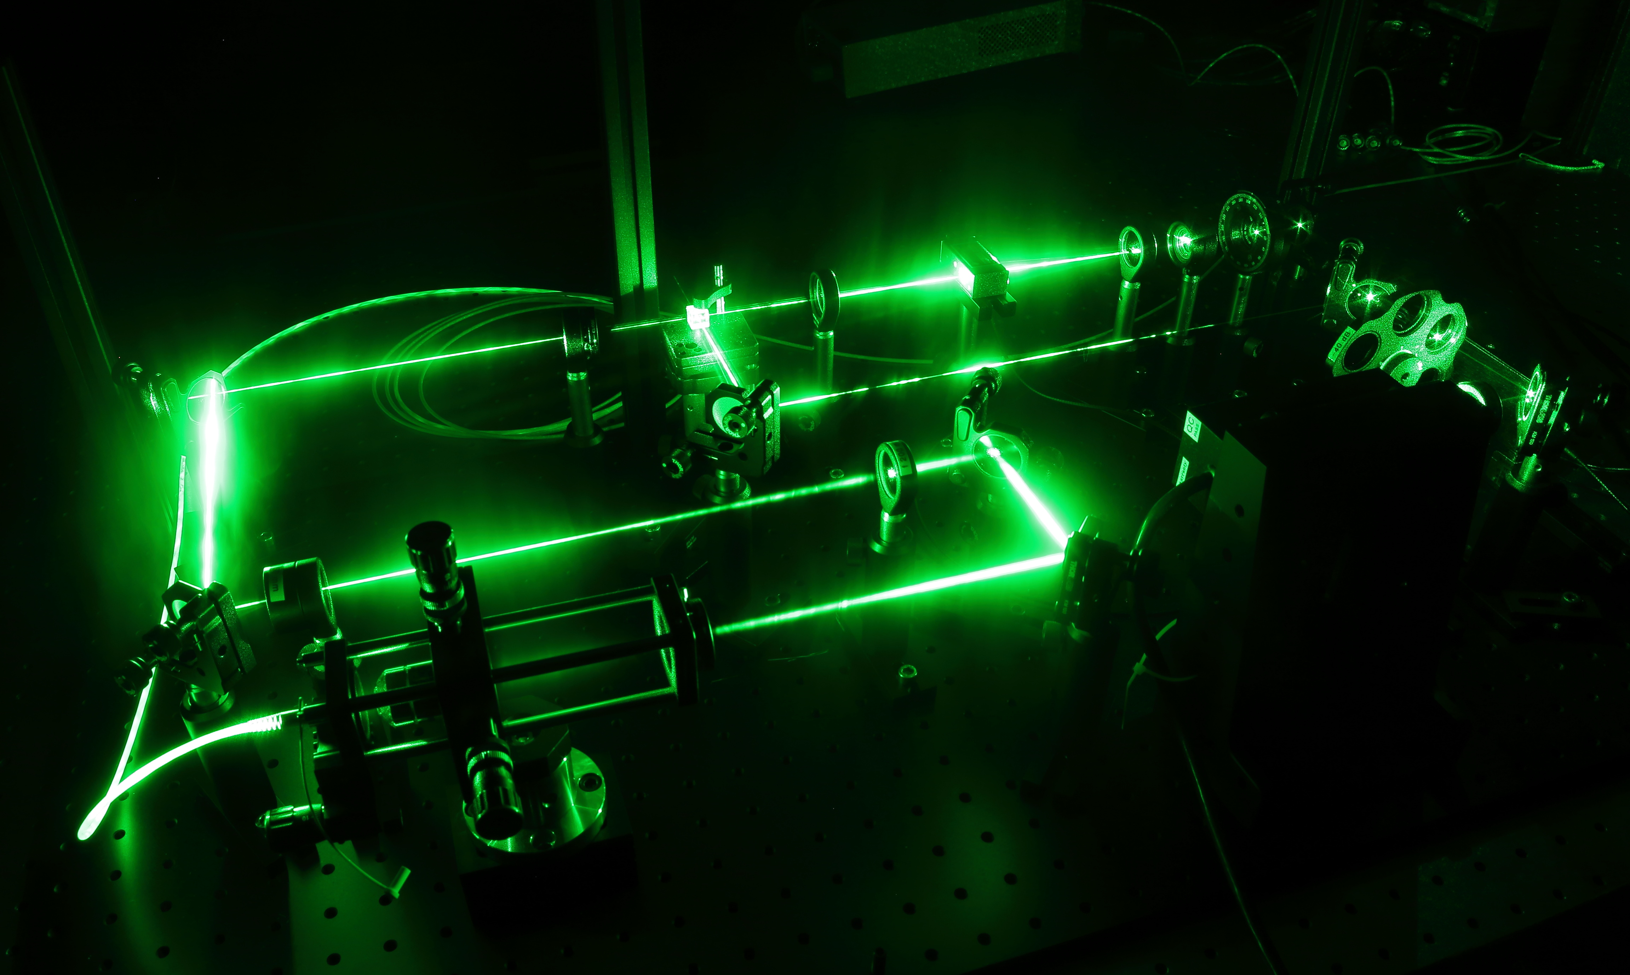
Fully quantum description of a three level maser, driven by a thermal bath
Sander Stammbach
Prof. Dr. Patrick Potts
Dr. Mateo Brunelli
Marcelo Janovitch
7.3.2023
Notes:
Hallo

Slide 2
Contents
Theory
3-level-system
Master equation
Lasing transition
PHAV state
Double threshold
Thermodynamics
Heat current
Entropy production
Conclusion

Slide 3
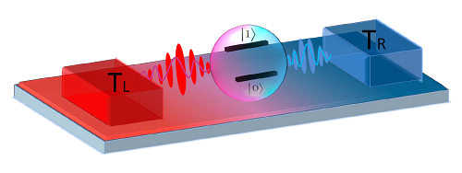
Introduction
Heat engine
Three-level maser
Scovil and Schulz-DuBois(1959)
Absorbtion , spontaneous and stimulated emission
http://web.mit.edu/jianshucaogroup/quther2015.html

Slide 4
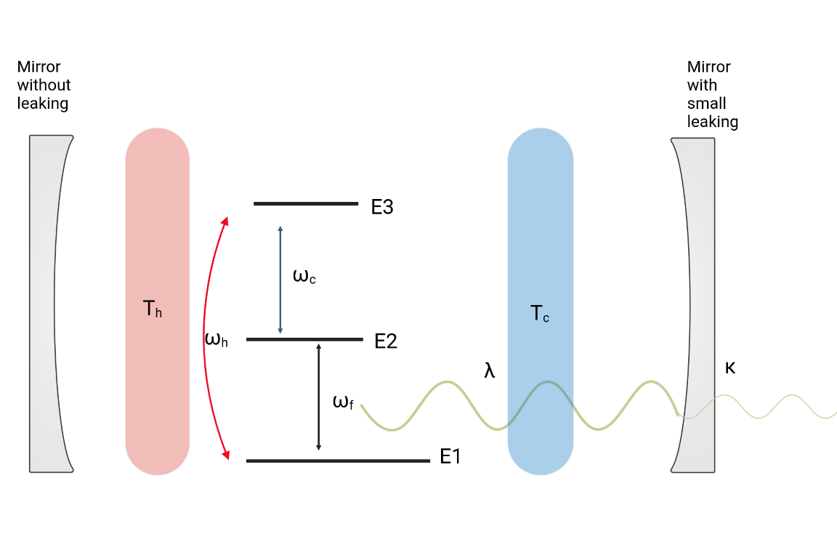

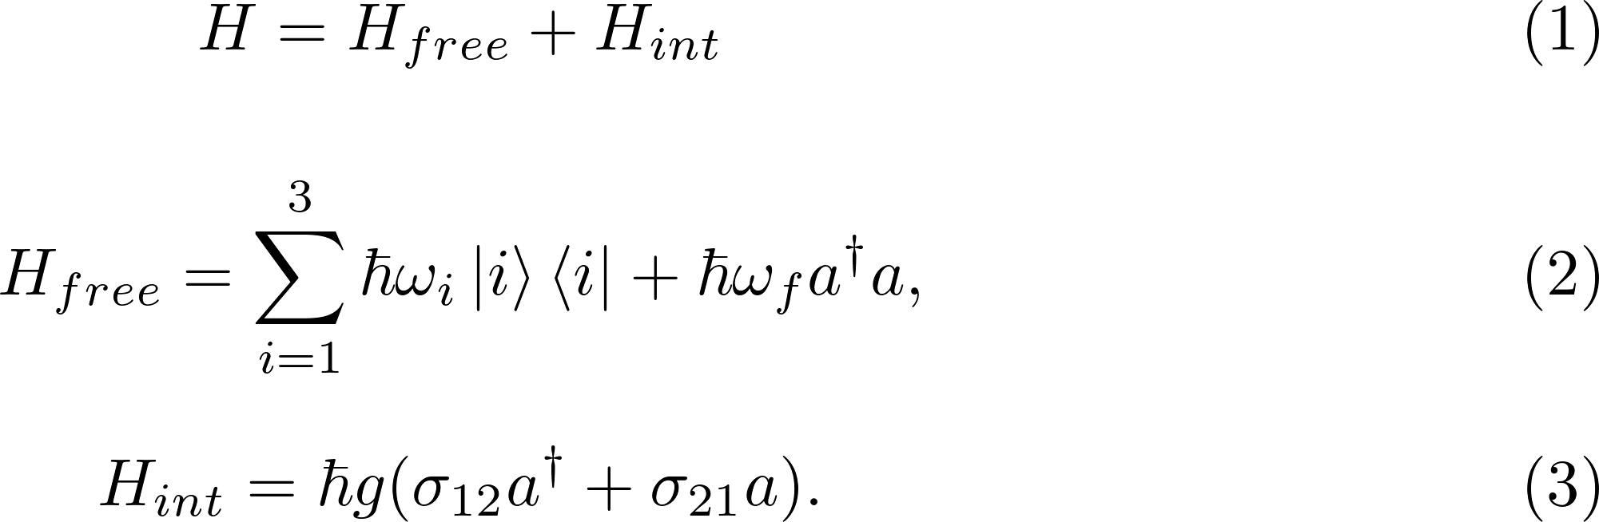
3-level-maser

Slide 5

Master equation
The hole calculations are made for steady-states, therefore no time dependency=>

Slide 6
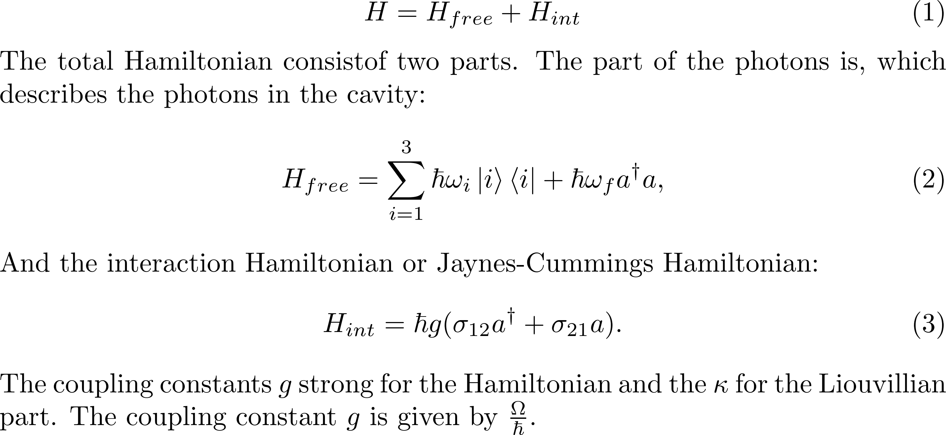
3-Level maser Hamiltons

Slide 7
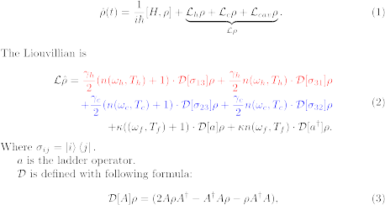
Master equation

Slide 8
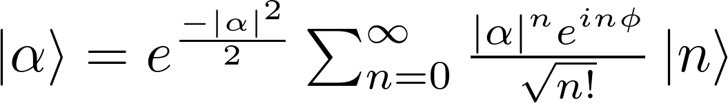

PHAV State

Slide 9
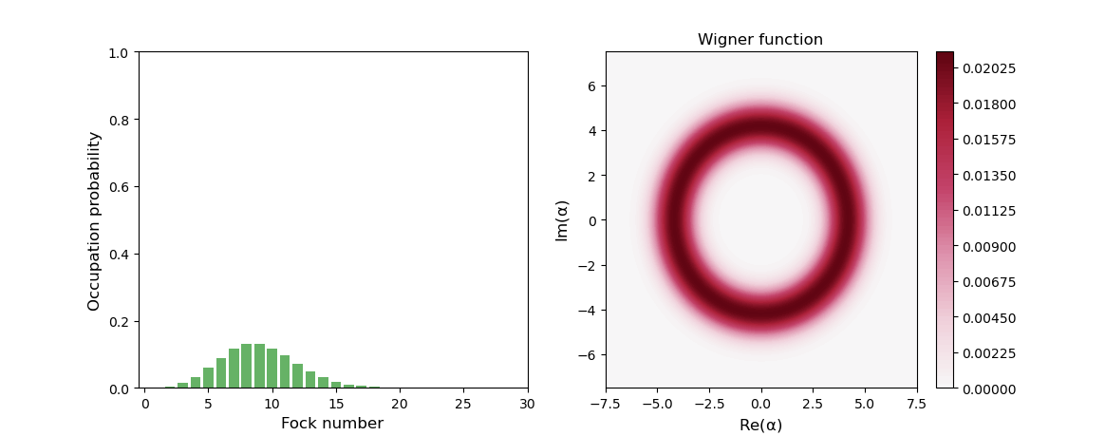
PHAV State
Wigner function and phase-averaged coherent states
Two ilustrations of a PHAV -state. Right one is done in qutip. The left one is the wignerfunction plotted in Mathematica

Slide 10
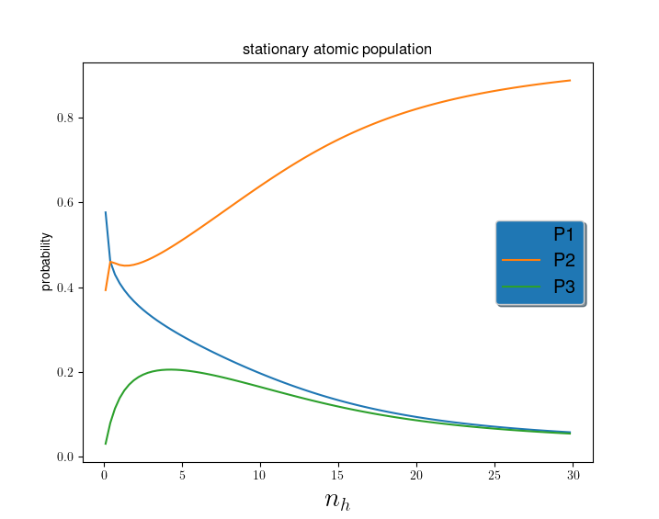
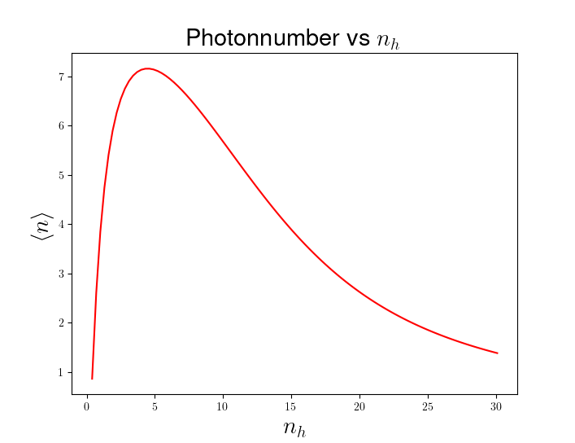

Double threshold behaviour
In Fig b) we see, that the lasing have a clear peak.

Slide 11
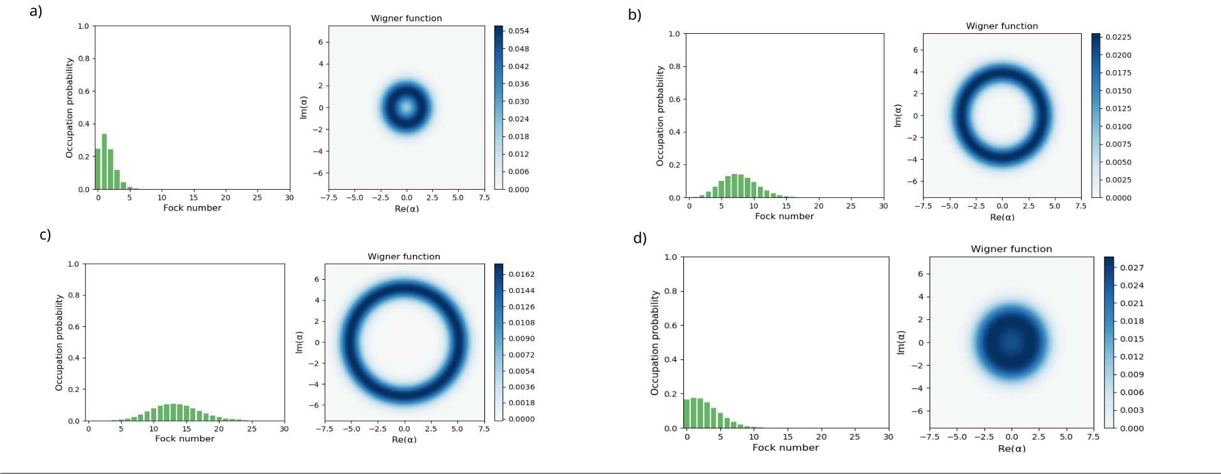
Double threshold behaviour

Slide 12
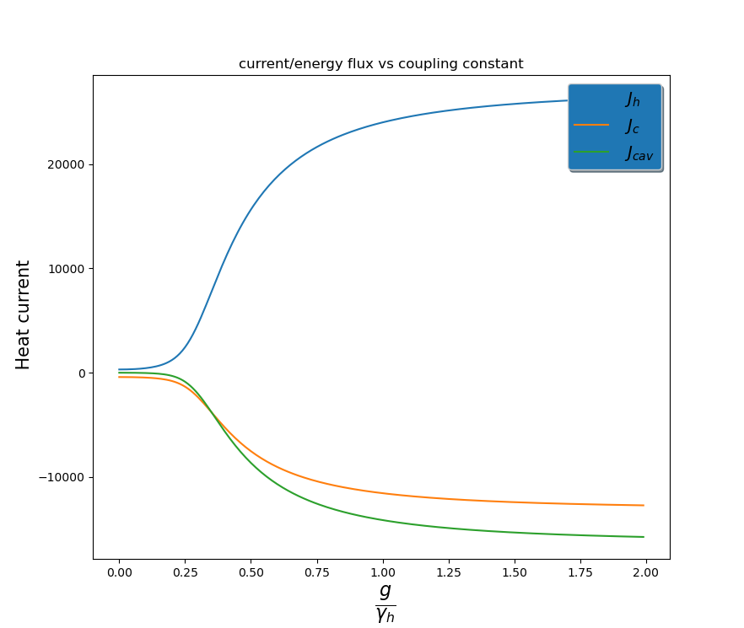
Heat currents

Slide 13

Entropy production

Slide 14
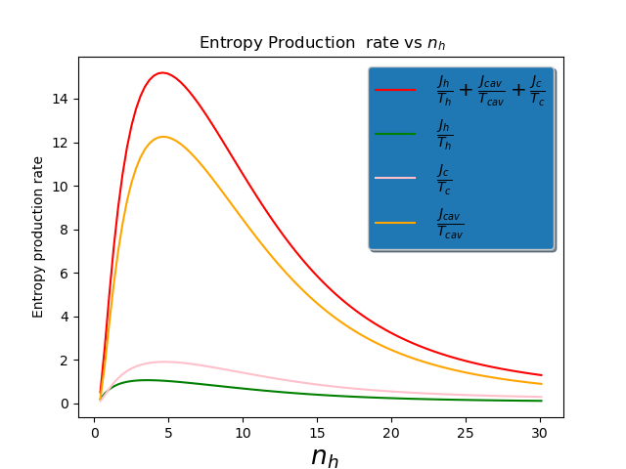
Entropy production

Slide 15
Contents
Verified states which look simular to PHAV state!
Double threshold behaviour in entropy production and photon number!
In future look for the TUR
https://link.
aps.org/doi/10.1103/PhysRevLett.2.262.

Slide 16
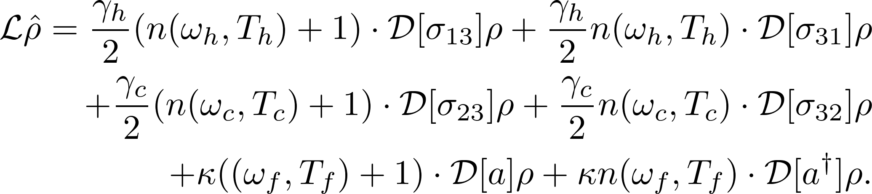
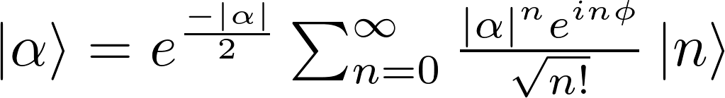
Questions?

