Slide 1
Hiracial Equations of Motion
Sander Stammbach
Notes:
In this talk, I would like to address how HEOM is derived, what the limitations of this
computational method are, and how we apply it.

Slide 2
Table of content
Motivation
Feynman-Vernon
Influence-functional
Correlation function
Expontential decomposition/Matsubara
Derivative of the density matrix
Structure of HEOM
Problems/Computational cost
Modifications

Slide 3
Motivation HEOM for open-quantum-systems
Lindblad, Redfield, Input-Output
Born-Markov-approx
Systematic Control of Accuracy
Applicability to Diverse Physical Systems
Accurate Description of Non-Markovian System-Bath Interactions
Notes:
In the world
-time evo density matrix-
It exist methods such as
But they use bornmarkovapprox
no memory effects/ flat specctral density
Tanimure use the feynam vernom influence

Slide 4
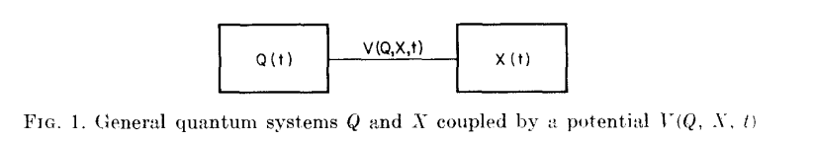

Feyman-Vernom 1963
Notes:
I do not want to delve into the depths of path integrals; I just want to give you a brief introduction to the Feynman-Vernon influence functional.
Bath and System coupled via potential

Slide 5
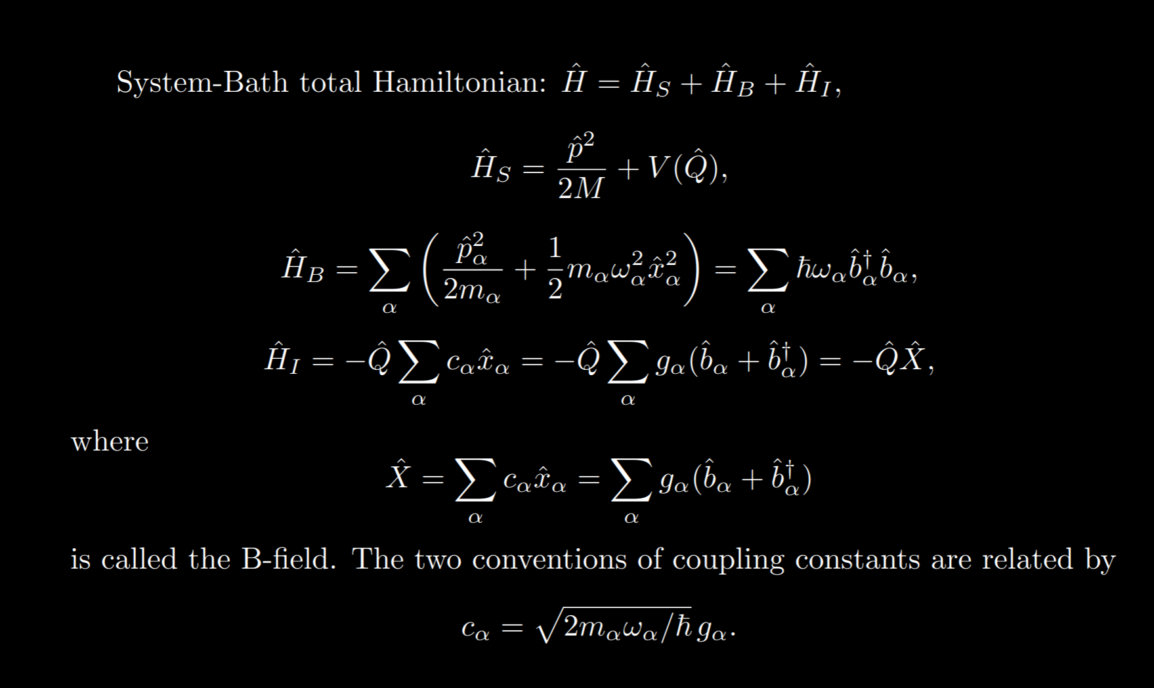
Hamilton

Slide 6
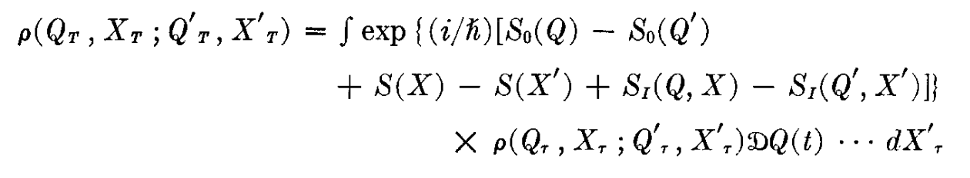
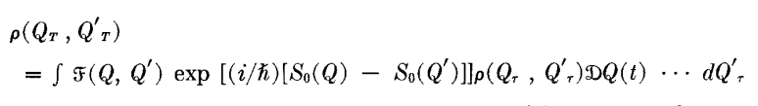
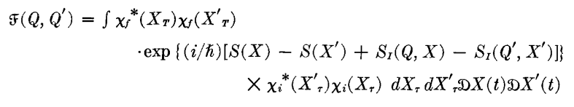
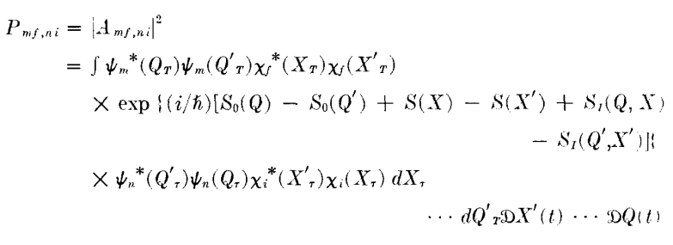
Density matrix representation
Assumption the two systems are initially independent !
Remember: Probability to reach state mf by given initial state ni

Slide 7
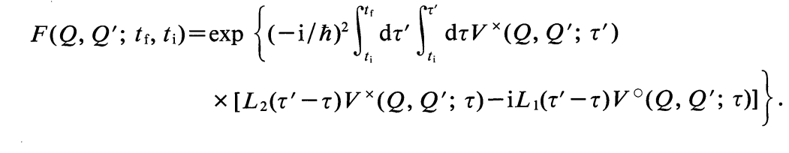
Influence functional
State of the system at time t.
Influence functional (from Feynmann Vernonn). Contains the info abuot the interaction with the envinronment
If the bath is in a thermal state and the coupling between the sysem is linear, via Wick theorem or just gaussian integrgation
Assume linear coupling and thermal state!

Slide 8
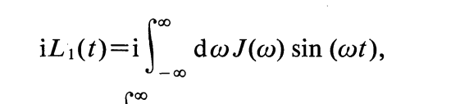
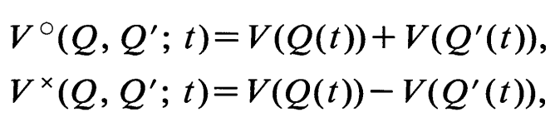
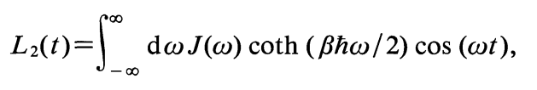
Two-point correlation function
write with two-point correlation function
Notes:
Unfortunately, such path integrals cannot be solved directly. Therefore, a method was developed to derive a set of coupled differential equations from this path integral formalism.

Slide 10
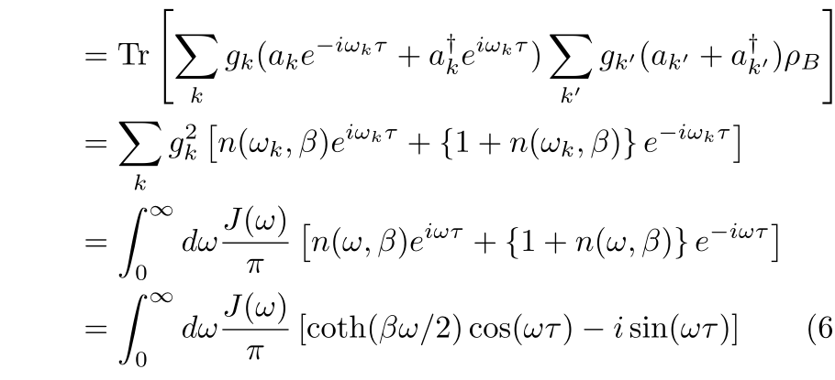
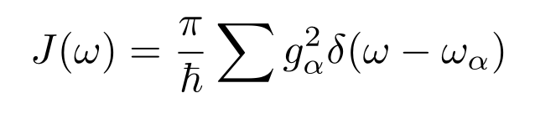
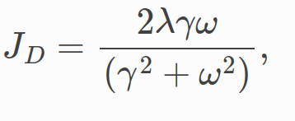
Correlationfunction
Assumption: the Bath is Boseeinstein distrubuted
Discrete to continuum limit
Assumption: the spectral density is a odd function to calculate the integral
arXiv:2010.10806v3
Notes:
Cuttoff und couplingparameter

Slide 11
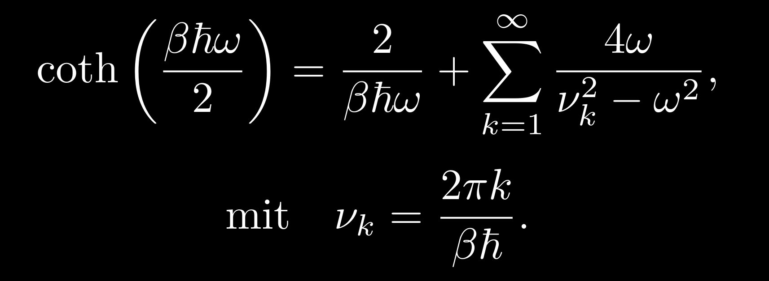
Matsubara
Decomposition of coth by matsubara frequencies

Slide 12
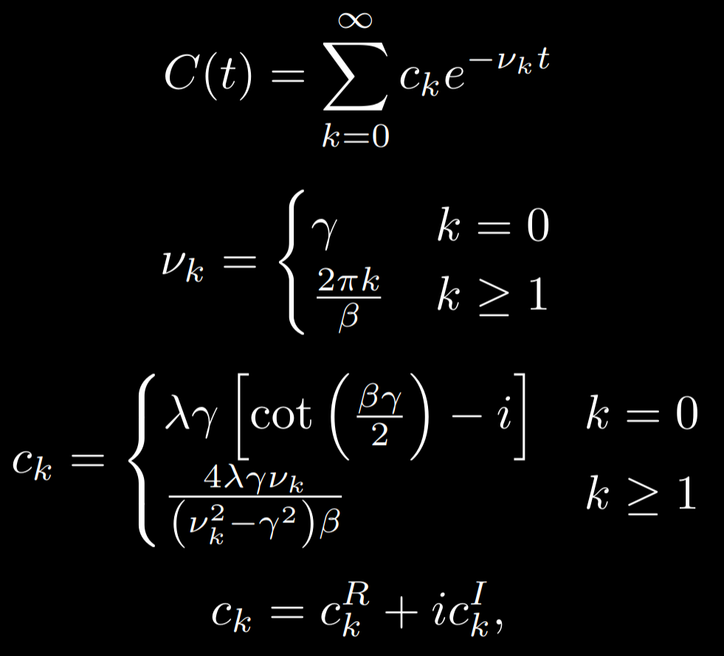
Matsubara
Solve integral with residuals

Slide 13
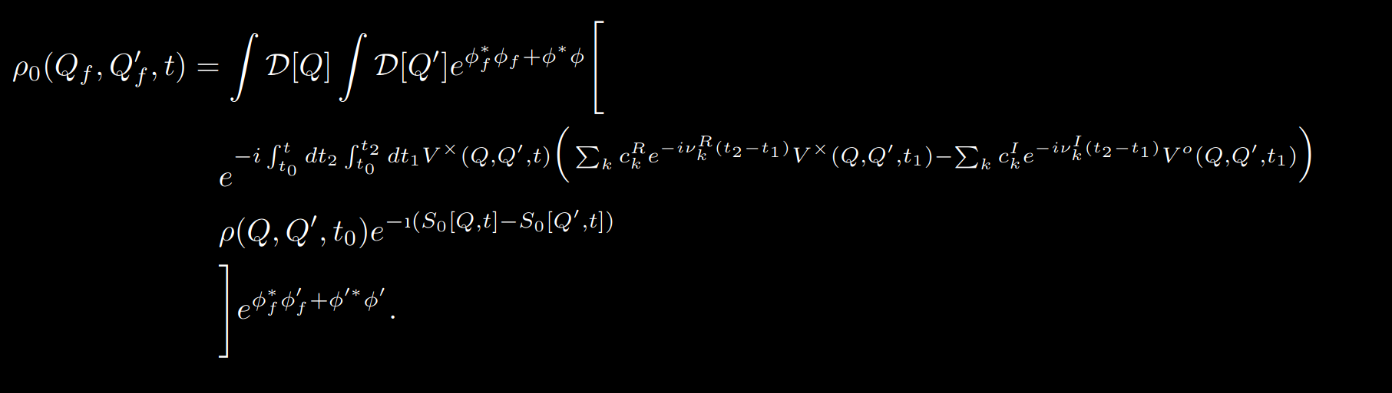
Density Matrix
Notes:
Notation change
Density matrix with exponential decomposition

Slide 14
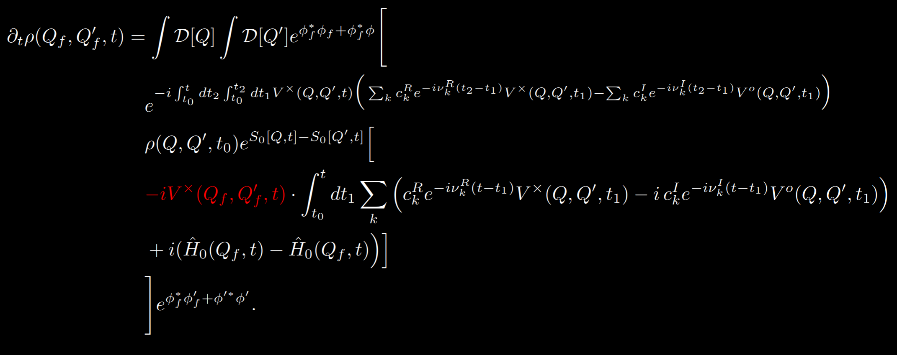
Derivative of the density Matrix

Slide 15
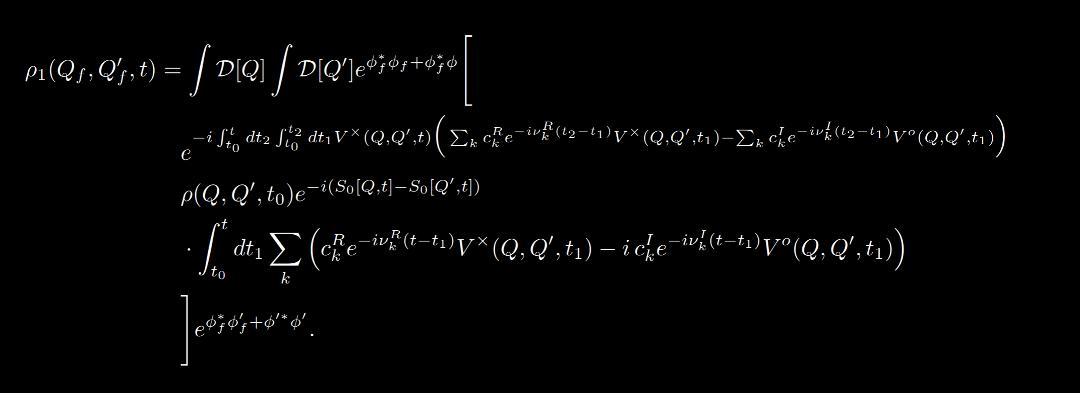
First auxilary

Slide 16
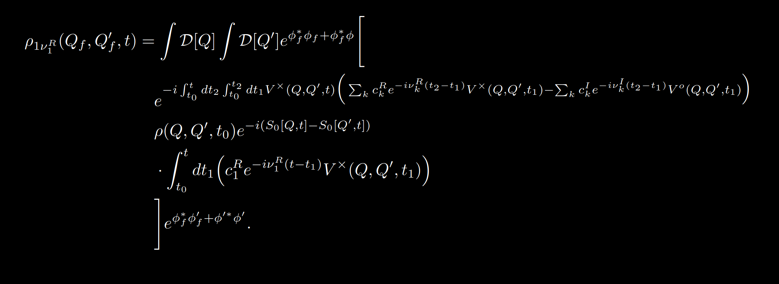
First auxilary for one matsubara

Slide 17
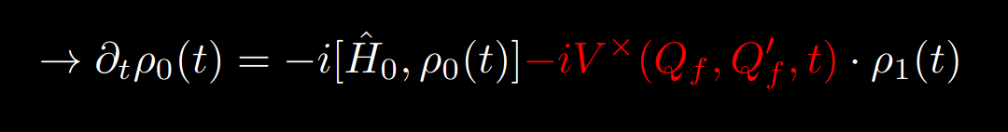
Therefore….
The auxiliary density matrix has no physical meaning.

Slide 18
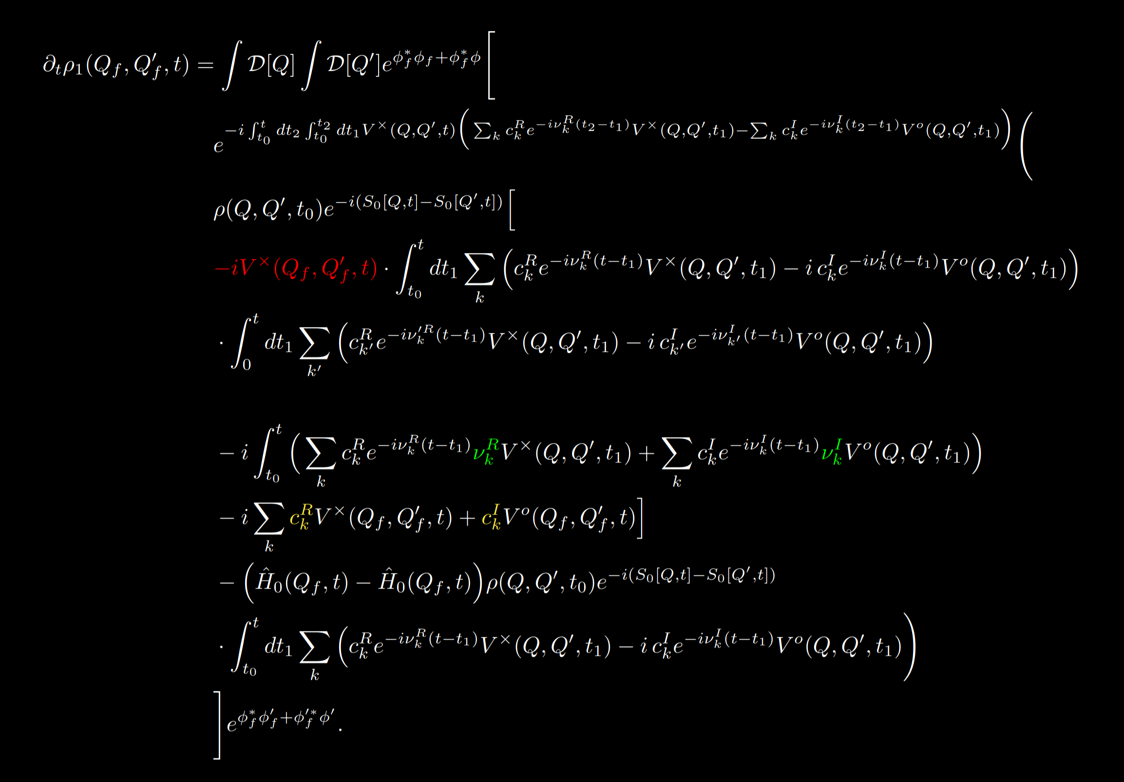
Derivatitive of the first auxilary matrix

Slide 19
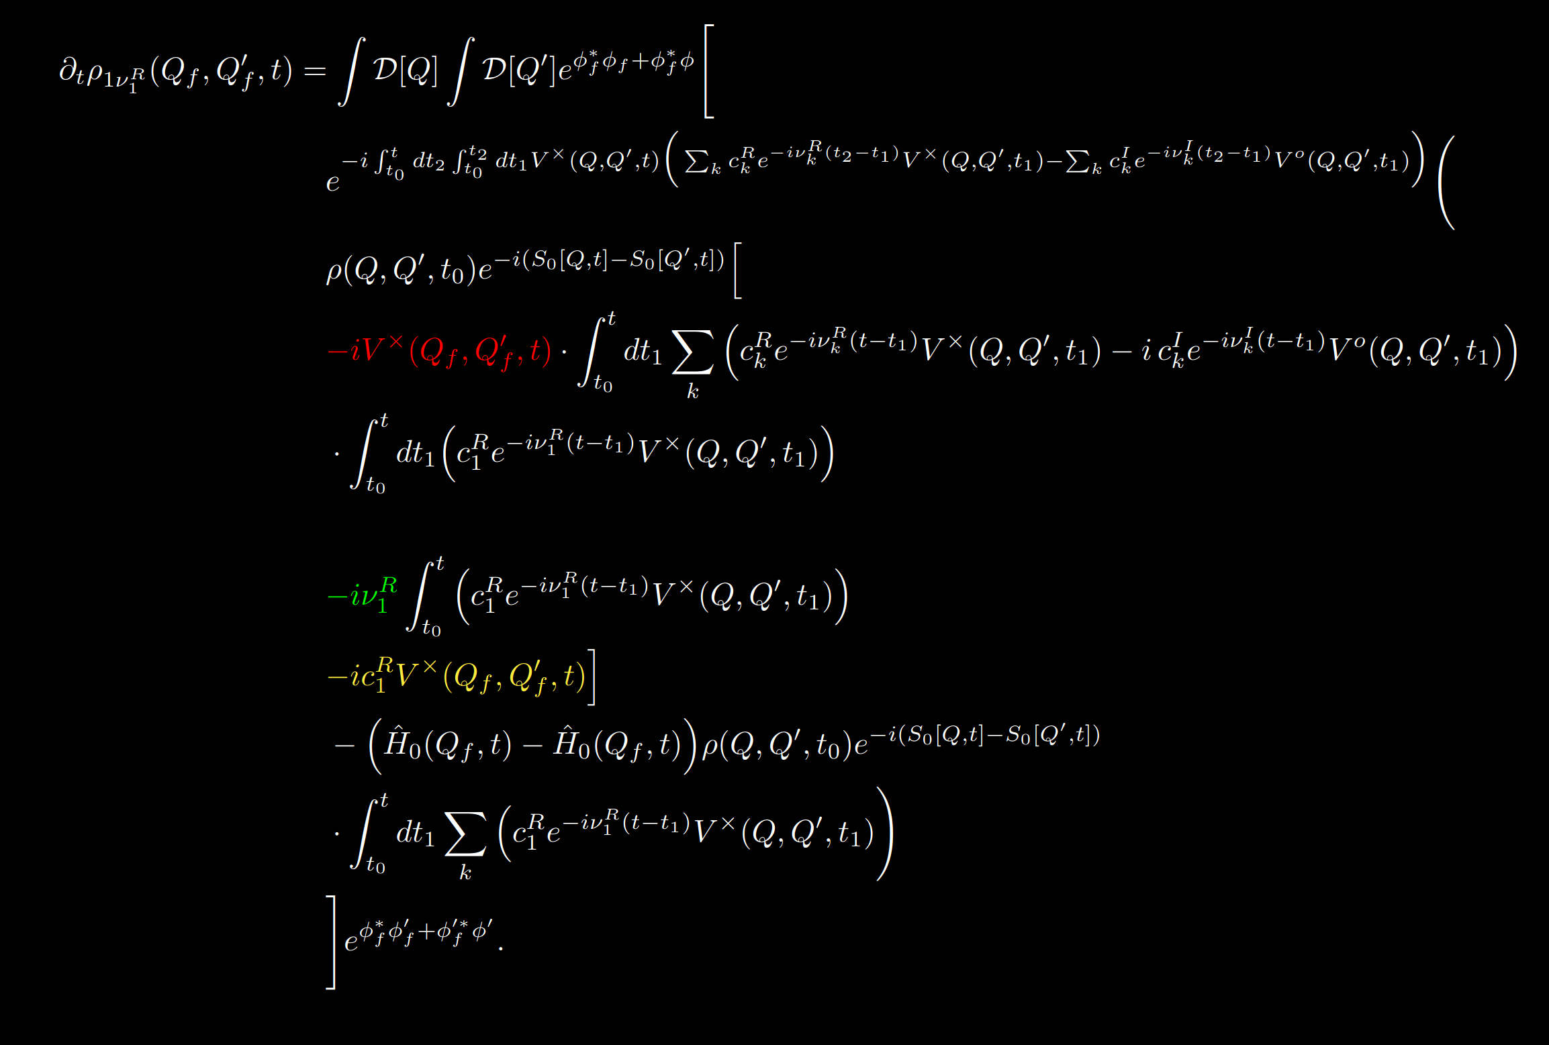
Derivatitive of the first auxilary matrix for one matsubara

Slide 20
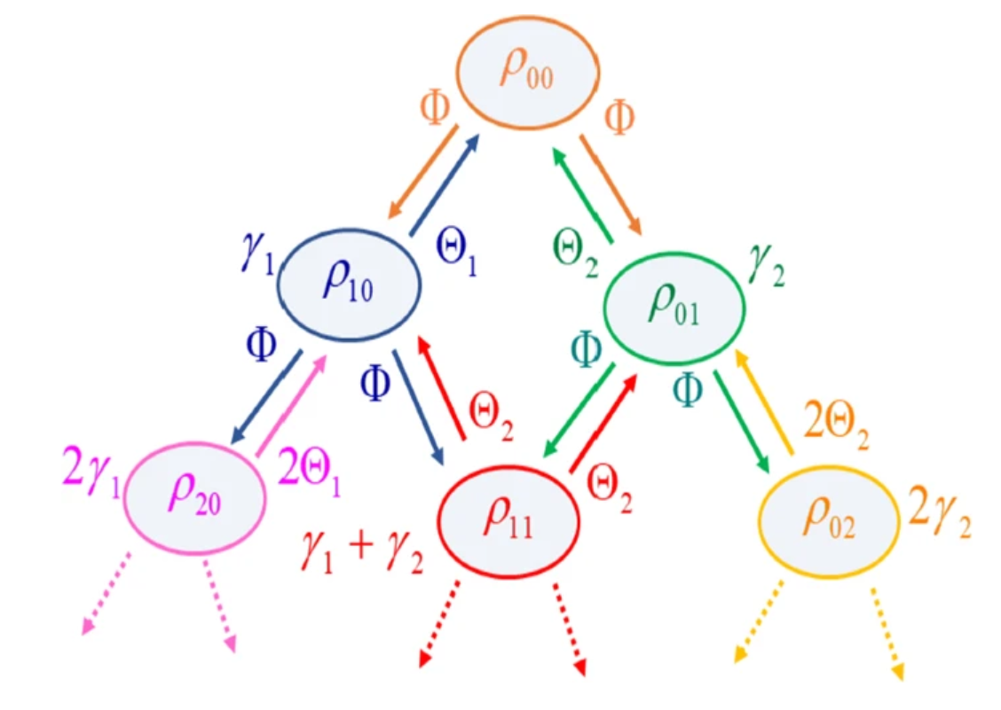
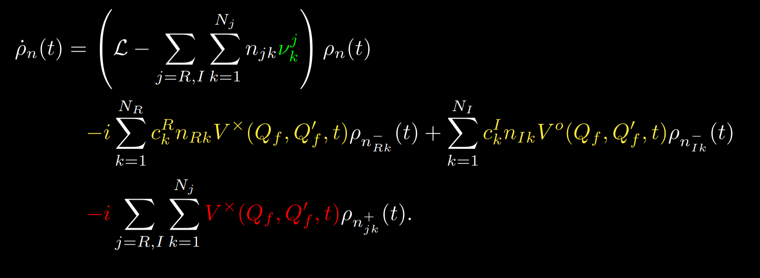
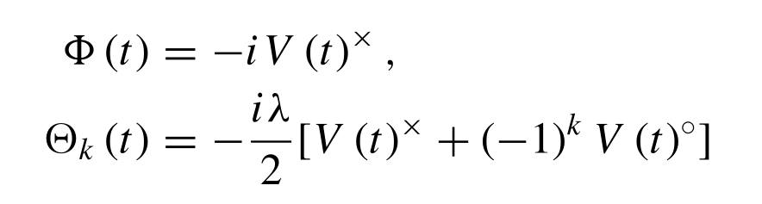
Structure of HEOM
arXiv:2010.10806v3
Notes:
Rekusiv formula

Slide 21
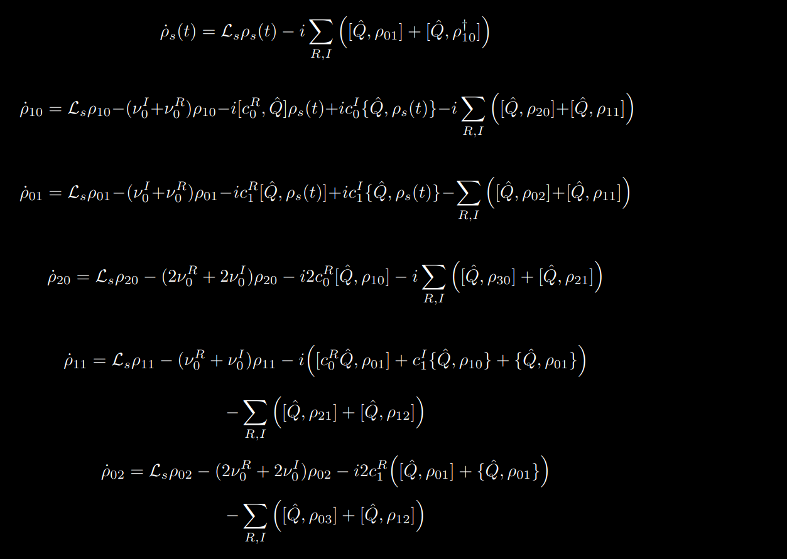
Apply HEOM

Slide 22
What are the requiremends
Linear coupling
Hammilton of the Systen
Coupling operator on System side
Bosonic/Fermionic bath
Spectral density
Cutoff frequencie

Slide 23
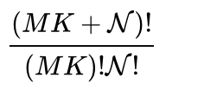
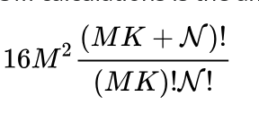
Truncation of the the Matsubara and deepnes
Stronger coupling→ higher N
#Matrix
#Bytes
Number of Matsubara
increase in the low temp regime
Notes:
Up two which level?
Answer easy
Until truncuation

Slide 24
Faster truncuation
Tensor-Train
GPU
Correctionterms
Terminators

Slide 25
Modify Heom
RWA (Rotating Wave Approximation)
Padé expansion
Non-linear coupling

Slide 26
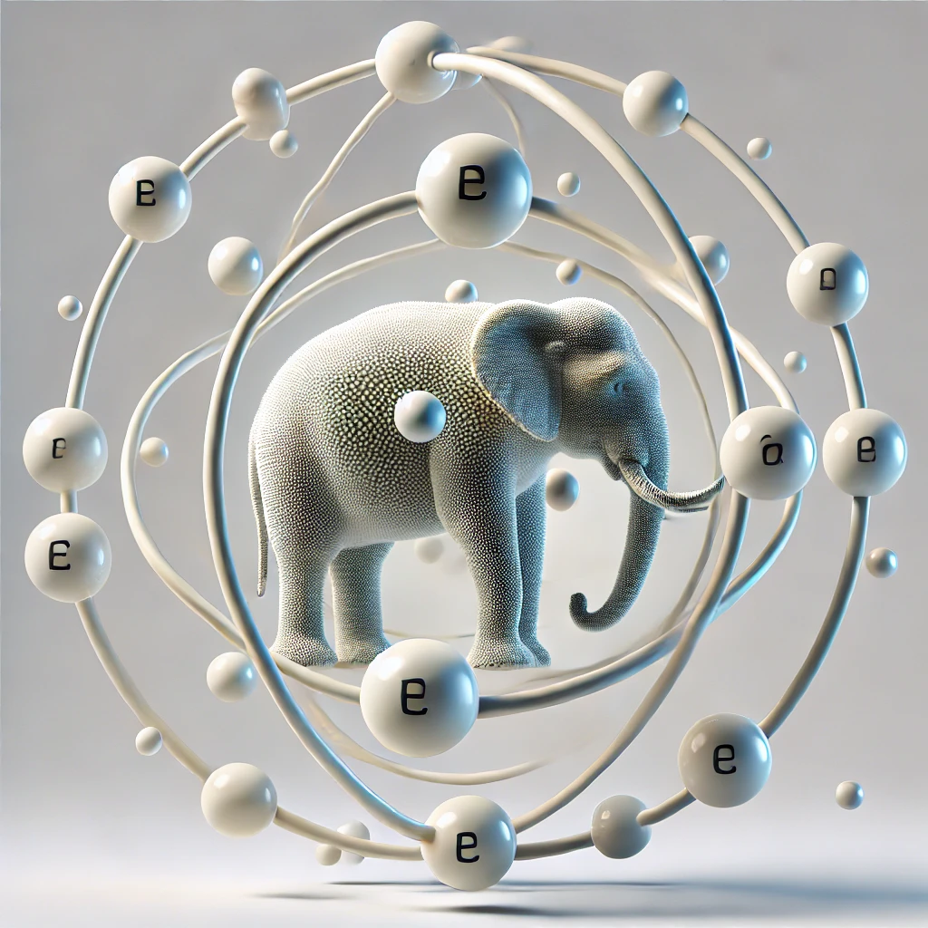
Outlook
Giant atom
Optovibronic mode

Slide 27
Questions?

