Slide 1
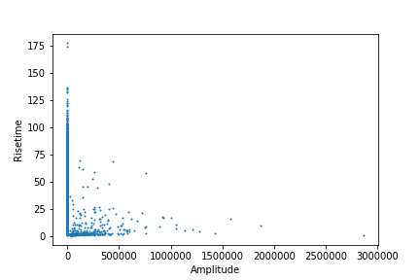
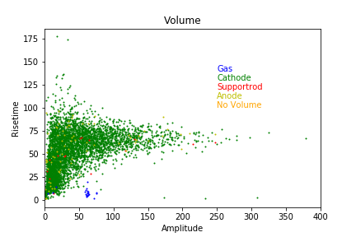
Sphere type | Number of Neutrons | Initial Position | Initial Direction
Steel | 120000 | 14.99 0 0 | 0 0 0
Total number of interacting events:

Slide 2
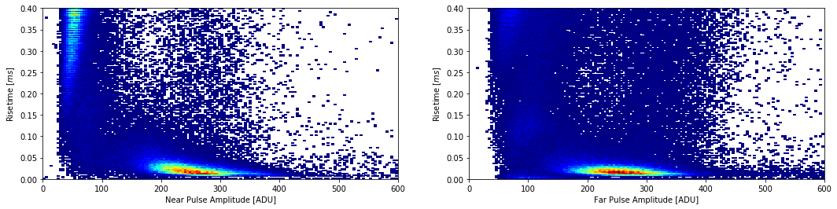

Slide 3
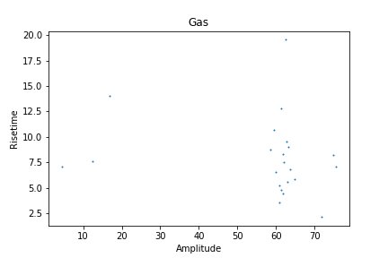
48781
66211
24532
Using volume to estimate efficiency:
Number events: 22
Efficiency: 1.83e-04

Slide 4
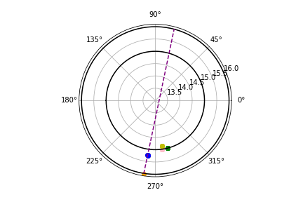
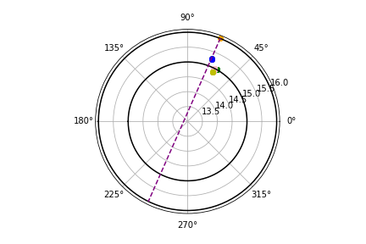
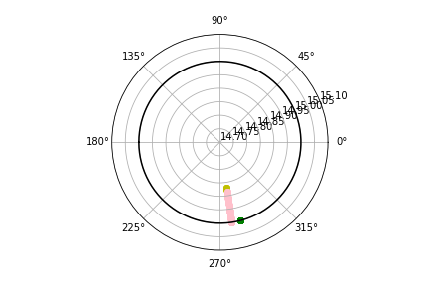
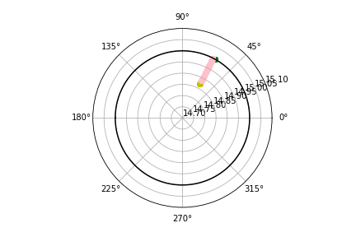
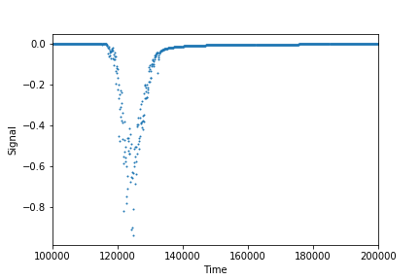
48781
Primary ,Cathode,hadElastic,2112.000000,15.862920,0.363288,-1.714954,0.000000,0.000000
Primary ,Cathode,hadElastic,2112.000000,15.239341,0.364067,-1.717205,0.000000,0.000000
Primary ,Cathode,hadElastic,2112.000000,15.273053,0.358847,-1.704594,0.000000,0.000000
Primary ,Cathode,hadElastic,2112.000000,15.241732,0.359520,-1.703626,0.000000,0.000000
Primary ,Gas,neutronInelastic,2112.000000,14.885306,0.455707,-1.425974,0.000000,0.000000
Secondary Gas,ionIoni,1000060140.000000,14.877850,0.455940,-1.425775,1.000000,0.015142
Secondary Gas,ionIoni,1000060140.000000,14.871897,0.456156,-1.425717,1.000000,0.009533
Secondary Gas,ionIoni,1000060140.000000,14.869012,0.456444,-1.425707,1.000000,0.012165
Secondary Gas,ionIoni,1000060140.000000,14.869255,0.456364,-1.425614,1.000000,0.005234
.
Secondary Gas,ionIoni,1000070140.000000,14.868922,0.456357,-1.425603,7.000000,0.000003
Secondary Gas,hIoni,2212.000000,14.885541,0.455701,-1.425975,1.000000,0.000037
Secondary Gas,hIoni,2212.000000,14.885647,0.455699,-1.425976,1.000000,0.000000
.
Secondary Gas,hIoni,2212.000000,14.997584,0.453129,-1.426871,1.000000,0.000299
Secondary Gas,Transportation,2212.000000,15.000000,0.453073,-1.426890,1.000000,0.000775
Secondary Cathode,hIoni,2212.000000,15.000001,0.453073,-1.426890,1.000000,0.000877
.
Secondary Cathode,hIoni,2212.000000,15.000231,0.453064,-1.426892,1.000000,0.068842
Secondary Cathode,phot,22.000000,15.000167,0.453071,-1.426892,1267.000000,0.000013
Phi
Theta

Slide 5
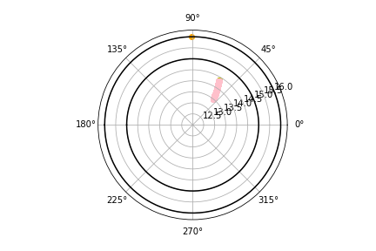
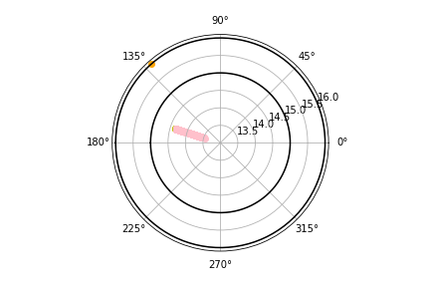
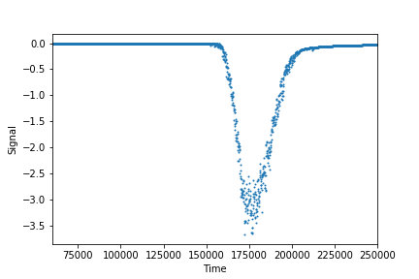
66211
Primary ,Gas,neutronInelastic,2112.000000,14.330469,-0.954750,1.034145,0.000000,0.000000
Secondary Gas,ionIoni,1000060140.000000,14.338768,-0.954743,1.034840,1.000000,0.018135
Secondary Gas,ionIoni,1000060140.000000,14.344885,-0.954705,1.035253,1.000000,0.015968
Secondary Gas,ionIoni,1000060140.000000,14.342634,-0.954736,1.034902,1.000000,0.007941
Secondary Gas,ionIoni,1000070140.000000,14.342287,-0.954738,1.034880,3.000000,0.000003
Secondary Gas,hIoni,2212.000000,14.329827,-0.954752,1.034050,1.000000,0.000118
Secondary Gas,hIoni,2212.000000,14.328946,-0.954755,1.033919,1.000000,0.000000
.
Secondary Gas,hIoni,2212.000000,13.497834,-0.957267,0.897108,1.000000,0.012050
Secondary Gas,hIoni,2212.000000,13.485523,-0.957302,0.894868,1.000000,0.010276
Secondary Gas,hIoni,2212.000000,13.474986,-0.957359,0.893012,1.000000,0.007344
Secondary Gas,hIoni,2212.000000,13.470064,-0.957446,0.891547,1.000000,0.000338
Secondary Gas,hIoni,2212.000000,13.471559,-0.957607,0.890585,1.000000,0.005251
Phi
Theta

Slide 6
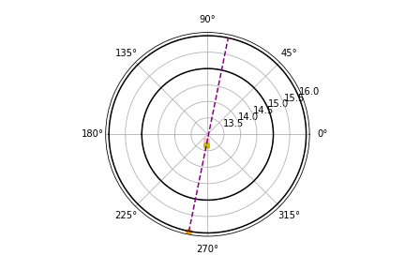
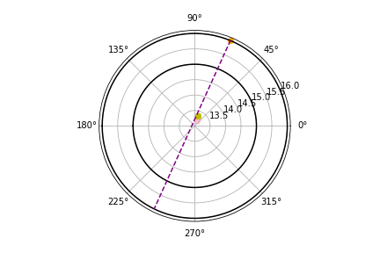
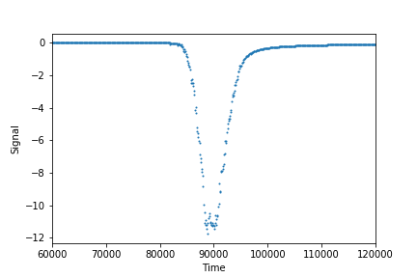
24532
Primary ,Gas,neutronInelastic,2112.000000,13.329809,0.274730,-1.691249,0.000000,0.000000
Secondary Gas,ionIoni,1000060140.000000,13.333085,0.274487,-1.690667,1.000000,0.019555
Secondary Gas,ionIoni,1000060140.000000,13.336142,0.274428,-1.690230,1.000000,0.009228
Secondary Gas,ionIoni,1000060140.000000,13.334914,0.274490,-1.689875,1.000000,0.007753
Secondary Gas,ionIoni,1000060140.000000,13.335574,0.274442,-1.690015,1.000000,0.005607
Secondary Gas,ionIoni,1000070140.000000,13.335257,0.274450,-1.689993,3.000000,0.000004
Secondary Gas,hIoni,2212.000000,13.329764,0.274737,-1.691271,1.000000,0.000000
Secondary Gas,hIoni,2212.000000,13.329553,0.274772,-1.691372,1.000000,0.000045
.
Secondary Gas,hIoni,2212.000000,13.204896,0.299269,-1.763271,1.000000,0.011594
Secondary Gas,hIoni,2212.000000,13.201942,0.299853,-1.764063,1.000000,0.008223
Secondary Gas,hIoni,2212.000000,13.199578,0.300359,-1.764380,1.000000,0.001163
Secondary Gas,hIoni,2212.000000,13.197898,0.300608,-1.764822,1.000000,0.001284
Secondary Gas,hIoni,2212.000000,13.194815,0.300703,-1.764946,1.000000,0.002718
Phi
Theta

Slide 8
Experimental Comparisons
Here the amplitude is much bigger than the simulation. This will have to be checked with the pre amp settings of the simulation

