Slide 1
Particle gun inside of detector

Slide 2
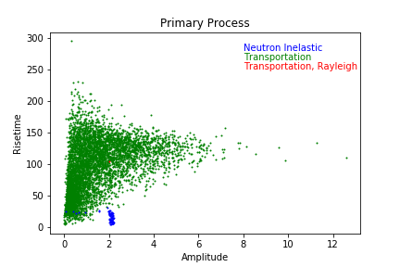
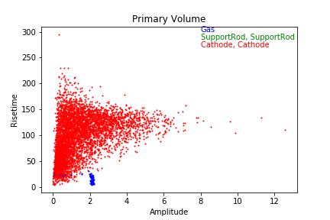
Sphere type | Number of Neutrons | Initial Position | Initial Direction
Steel | 100000 | 14.99 0 0 | 0 0.99 0
Expect smaller efficiency, due to initial conditions it is projecting the neutrons horizontally towards the center of the detector
Total number of interacting events: 5530
Using cuts to estimate efficiency: 1.8 < amp < 2.4 and 0 < rt <30
Number events: 124
Efficiency: 1.24e-3

Slide 3
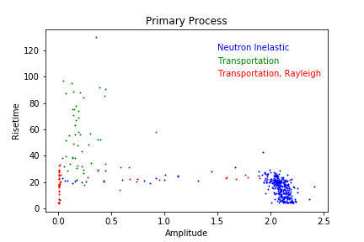
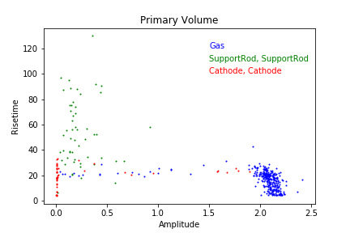
Sphere type | Number of Neutrons | Initial Position | Initial Direction
Galactic | 500000 | 14.99 0 0 | 0 0.99 0
Removing the wall of the sphere leaves mainly the region around amplitude 2
Total number of interacting events: 591
Using cuts to estimate efficiency: 1.8 < amp < 2.4 and 0 < rt <30
Number events: 284
Efficiency: 5.68e-4

Slide 4
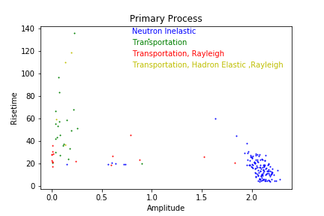
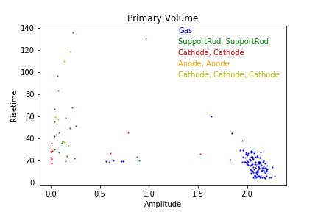
Sphere type | Number of Neutrons | Initial Position | Initial Direction
Galactic | 200000 | 0 0 0 | 0 0 0
Random initials, with the radius set at the size of the detector. The direction is bound by pi and negative pi on both the theta and phi dimensions. Min/max radius is set at 14.99
Total number of interacting events: 249
Using cuts to estimate efficiency: 1.8 < amp < 2.4 and 0 < rt <30
Number events: 124
Efficiency: 6.2e-4

Slide 5
N2 gas:15cm
Sphere wall: 1cm
Particle gun at 16.01cm
Andoe 0.15cm
3500V
To ensure that the gun is pointing towards the sphere the dot product is calculated. If positive the direction is accepted, if not a new direction is produced

Slide 6
Sphere type | Number of Neutrons | Initial Position | Initial Direction
Steel | 100000 | 14.99 0 0 | 0 0.99 0
Expect smaller efficiency, due to initial conditions it is projecting the neutrons horizontally towards the center of the detector
Total number of interacting events: 5530
Using cuts to estimate efficiency: 1.8 < amp < 2.4 and 0 < rt <30
Number events: 124
Efficiency: 1.24e-3

Slide 7
Sphere type | Number of Neutrons | Initial Position | Initial Direction
Galactic | 500000 | 14.99 0 0 | 0 0.99 0
Removing the wall of the sphere leaves mainly the region around amplitude 2
Total number of interacting events: 591
Using cuts to estimate efficiency: 1.8 < amp < 2.4 and 0 < rt <30
Number events: 284
Efficiency: 5.68e-4

