Slide 1
N2 gas:15cm
Sphere wall: 1cm
Particle gun at 16.01cm
Andoe 0.15cm
3500V
To ensure that the gun is pointing towards the sphere the dot product is calculated. If positive the direction is accepted, if not a new direction is produced

Slide 2
Useful notes
Particle Codes:
p 2212
n 2112
γ 22
Nuclear Codes- 10LZZZAAAI
1000060140 -Nitrogen
1000070140 - Carbon
1000260560 - Iron
G_4 Galactic: Density=1e-25 g/cm^3
G_4 Stainless_Steel: Density= 8 g/cm^3

Slide 3
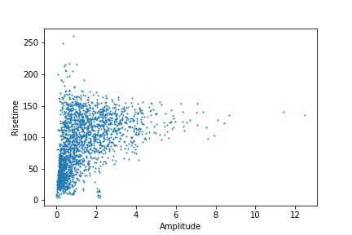
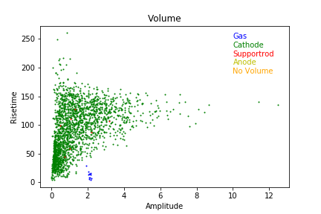
Sphere type | Number of Neutrons | Initial Position | Initial Direction
Steel | 50000 | 14.99 0 0 | 0 0 0
Total number of interacting events:

Slide 4
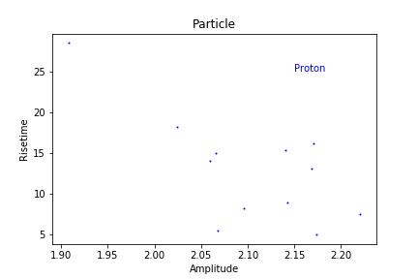
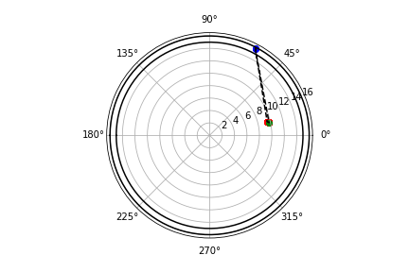
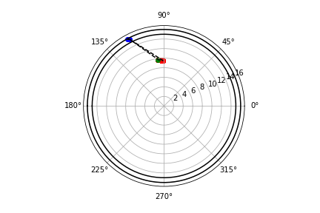
Focusing on the interactions within the gas that produce protons
Phi
Theta
ID 36589
ID 9485
ID 3201
ID 1828
Number events: 12
Efficiency: 3e-4
Key:
R- hIoni
B - hadElastic
G - NeutronInelastic
Y - IonIoni
G - Photoelectric

Slide 5
ID 36589, amp = 2.2205768, rt = 7.505226, ionisation track = 1.033 cm
Volume Process particle radius costheta phi ParentID Edep
Primary Cathode,hadElastic,2112.000000,15.910805,-0.480063,1.090262,0.000000,0.000000
Primary Cathode,hadElastic,2112.000000,15.644763,-0.456331,1.081948,0.000000,0.000000
Primary Gas,neutronInelastic,2112.000000,9.764614,-0.126397,0.210929,0.000000,0.000000
Secondary Gas,ionIoni,1000060140.000000,9.766259,-0.127275,0.210864,1.000000,0.014701
Secondary Gas,ionIoni,1000060140.000000,9.767459,-0.127981,0.210877,1.000000,0.009918
Secondary Gas,ionIoni,1000060140.000000,9.769386,-0.128514,0.210934,1.000000,0.010941
Secondary Gas,ionIoni,1000060140.000000,9.768289,-0.128671,0.210775,1.000000,0.006508
Secondary Gas,ionIoni,1000070140.000000,9.768457,-0.128687,0.210798,5.000000,0.000002
Secondary Gas,hIoni,2212.000000,9.764563,-0.126381,0.210933,1.000000,0.000017
.
Secondary Gas,hIoni,2212.000000,9.506510,-0.022910,0.235917,1.000000,0.000205
Secondary Gas,hIoni,2212.000000,9.506395,-0.022833,0.235871,1.000000,0.001331
Secondary Cathode,ionIoni,1000260560.000000,15.644763,-0.456331,1.081948,1.000000,0.000000
Secondary Cathode,ionIoni,1000280580.000000,15.910805,-0.480063,1.090262,1.000000,0.000000

Slide 6
ID 9485 amp = 1.9076828 rt = 28.564886
Volume Process particle radius
Primary Cathode, hadElastic, 2112, 15.8697,0,0
Primary Gas, neutronInelastic, 2112, 13.9616,0,0
Secondary Gas,ionIoni,1.00006e+09,13.9582,1,0.0193469
Secondary Gas,ionIoni,1.00006e+09,13.9553,1,0.010628
Secondary Gas,ionIoni,1.00006e+09,13.9522,1,0.00714696
Secondary Gas,ionIoni,1.00006e+09,13.9512,1,0.00489546
Secondary Gas,ionIoni,1.00007e+09,13.9514,4,2.83029e-06
Secondary Gas,hIoni,2212,13.9617,1,1.00877e-07
.
.
.
Secondary Gas,hIoni,2212,14.2484,1,0.00357187
Secondary Cathode,ionIoni,1.00026e+09,15.8697,1,6.03904e-10

Slide 7
ID 3201 amp = 2.1427293 rt = 8.880265
Volume Process particle radius
Primary Cathode,hadElastic,2112,15.0169,0,0
Primary Gas,neutronInelastic,2112,7.61845,0,0
Secondary Gas,ionIoni,1.00006e+09,7.61023,1,0.0126938
Secondary Gas,ionIoni,1.00006e+09,7.60347,1,0.0159068
Secondary Gas,ionIoni,1.00006e+09,7.59923,1,0.00621725
Secondary Gas,ionIoni,1.00006e+09,7.5968,1,0.00655729
Secondary Gas,ionIoni,1.00006e+09,7.59671,1,0.000717022
Secondary Gas,ionIoni,1.00007e+09,7.59687,4,3.25901e-06
Secondary Gas,hIoni,2212,7.61868,1,7.1459e-05
.
Secondary Gas,hIoni,2212,8.50897,1,0.00271888
Secondary Cathode,ionIoni,1.00026e+09,15.0169,1,1.38971e-09

Slide 8
ID 1828 amp = 2.0592895 rt = 14.076869
Volume Process particle radius
Primary Gas,neutronInelastic,2112,12.4171,0,0
Secondary Gas,ionIoni,1.00006e+09,12.4229,1,0.0220156
Secondary Gas,ionIoni,1.00006e+09,12.4259,1,0.0100386
Secondary Gas,ionIoni,1.00006e+09,12.4289,1,0.00476078
Secondary Gas,ionIoni,1.00006e+09,12.4277,1,0.00517939
Secondary Gas,ionIoni,1.00007e+09,12.4278,3,1.60823e-06
Secondary Gas,hIoni,2212,12.4171,1,1.59137e-06
.
.
.
Secondary Gas,hIoni,2212,11.784,1,0.000229246
Secondary Gas,hIoni,2212,11.784,1,0.000834101

Slide 9
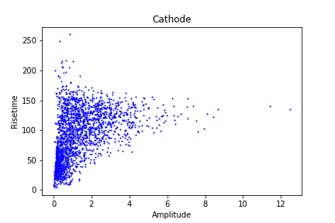
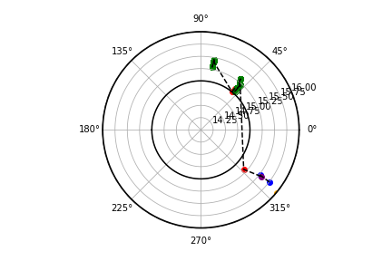
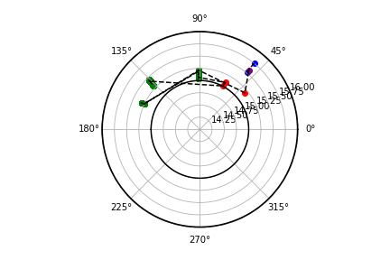
Focusing on the interactions within the cathode
ID: 40005
Number events: 2071
Efficiency:
Key:
R- compt
B - hadElastic
G - Photoelectric
Y - IonIoni
P - NCapture

Slide 10
ID 40005 amp = 0.80925155 rt = 83.52727
Volume Process particle radius
Primary Cathode,hadElastic,2112.000000,15.757149,0.633112,-0.652050,0.000000,0.000000
Primary Cathode,hadElastic,2112.000000,15.519220,0.635149,-0.652545,0.000000,0.000000
Primary Cathode,nCapture,2112.000000,15.560955,0.641091,-0.658065,0.000000,0.000000
Secondary Cathode,compt,22.000000,15.187529,0.776893,-0.745916,1.000000,0.000038
Secondary Cathode,phot,22.000000,15.213047,-0.023111,0.851358,8.000000,0.000026
.
.
.
Secondary Cathode,phot,22.000000,15.451020,0.836635,-0.889964,42371.000000,0.000013
Secondary Cathode,phot,22.000000,15.451023,0.836635,-0.889965,42374.000000,0.000013
Secondary Cathode,ionIoni,1000260570.000000,15.560955,0.641091,-0.658065,1.000000,0.000549
Secondary Cathode,ionIoni,1000260560.000000,15.519220,0.635149,-0.652545,1.000000,0.000000
Secondary Cathode,ionIoni,1000260560.000000,15.757149,0.633112,-0.652050,1.000000,0.000000

Slide 11
ID 2505 amp = 0.18 rt = 49.35¶
Volume Process particle radius
Primary Cathode,nCapture,2112,15.772,0,0
Secondary Cathode,ionIoni,1.00026e+09,15.772,1,0.00187488
Secondary Cathode,compt,22,15.4158,1,2.565e-05
Secondary Cathode,compt,22,15.1379,1,5.064e-05
Secondary Cathode,phot,22,15.1264,14,1.291e-05
.
.
.
Secondary Cathode,phot,22,15.4313,29030,0
Secondary Cathode,phot,22,15.4313,29697,2.565e-05

Slide 12
ID 7895 amp = 5.2817736 rt = 151.44699
Volume Process particle radius
Primary Cathode,hadElastic,2112,15.3812,0,0
Primary Cathode,nCapture,2112,15.0138,0,0
Secondary Cathode,ionIoni,1.00026e+09,15.0138,1,0.000398595
Secondary Cathode,compt,22,15.0507,1,9.01724e-06
Secondary Cathode,phot,22,15.2358,1,5.13e-05
.
.
.
Secondary Cathode,phot,22,15.021,65194,2.565e-05
Secondary Cathode,ionIoni,1.00026e+09,15.3812,1,9.5315e-10

Slide 13
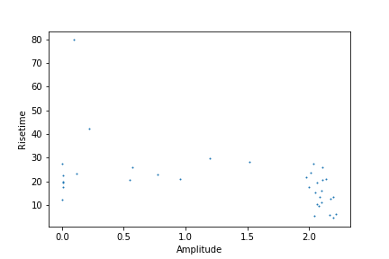
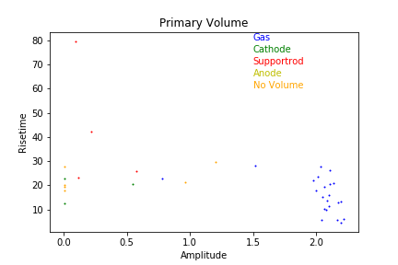
Sphere type | Number of Neutrons | Initial Position | Initial Direction
Galactic | 50000 | 14.99 0 0 | 0 0 0
Total number of interacting events:

Slide 14
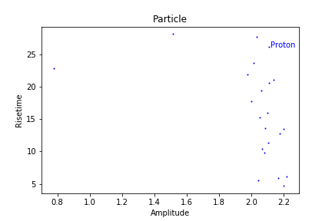
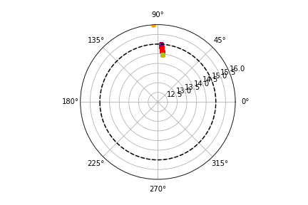
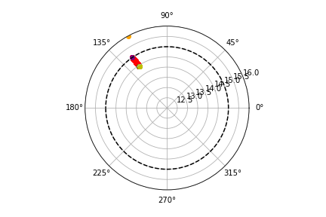
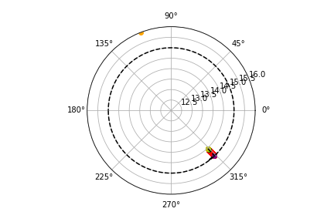
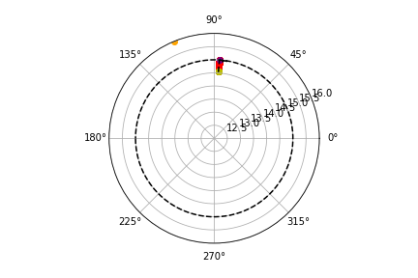
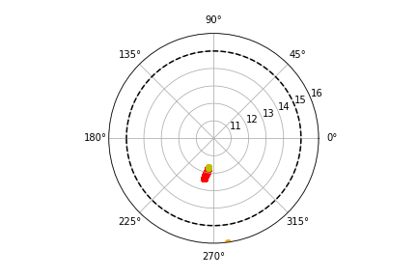
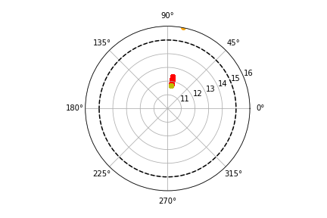
Focusing on the interactions within the gas that produce protons
Phi
Theta
id:14609
id:5768
Number events: 22
Efficiency: 4.4e-4
id:15580
Key:
R- hIoni
B - hadElastic
G - NeutronInelastic
Y - IonIoni
P - Transportaion

Slide 15
ID 5768 amp = 0.776204 rt = 22.85278, ionisation track = 0.435cm
Volume Process particle radius Phi costheta ParentId EnergyDeposit
Primary Gas,neutronInelastic,2112.000000,14.569867,0.061603,-0.807612,0.000000,0.000000
Secondary Gas,ionIoni,1000060140.000000,14.561318,0.061628,-0.807465,1.000000,0.013101
Secondary Gas,ionIoni,1000060140.000000,14.558872,0.061964,-0.807140,1.000000,0.006475
Secondary Gas,ionIoni,1000060140.000000,14.557111,0.062214,-0.806798,1.000000,0.009058
Secondary Gas,ionIoni,1000060140.000000,14.556726,0.062396,-0.806524,1.000000,0.013406
Secondary Gas,ionIoni,1000070140.000000,14.556827,0.062429,-0.806528,3.000000,0.000005
Secondary Gas,hIoni,2212.000000,14.570278,0.061607,-0.807614,1.000000,0.000261
.
.
.
Secondary Gas,hIoni,2212.000000,14.998966,0.066591,-0.810261,1.000000,0.000104
Secondary Gas,Transportation,2212.000000,15.000000,0.066605,-0.810268,1.000000,0.000260
Secondary Gas,phot,22.000000,14.986154,0.164321,-0.931537,1919.000000,0.000023
Secondary Gas,phot,22.000000,14.966074,0.111840,-0.863819,1912.000000,0.000023
Secondary Gas,phot,22.000000,14.929752,0.101980,-0.854337,1544.000000,0.000023

Slide 16
ID 14609 amp = 1.5170757 rt = 28.100945, Ionisation Track = 0.708cm
Volume Process particle radius Phi costheta ParentId EnergyDeposit
Primary Gas,neutronInelastic,2112.000000,14.462707,-0.552844,1.468701,0.000000,0.000000
Secondary Gas,ionIoni,1000060140.000000,14.459297,-0.552698,1.468059,1.000000,0.010050
Secondary Gas,ionIoni,1000060140.000000,14.460306,-0.552554,1.467471,1.000000,0.012879
Secondary Gas,ionIoni,1000060140.000000,14.462396,-0.552326,1.467150,1.000000,0.016099
Secondary Gas,ionIoni,1000060140.000000,14.462574,-0.552288,1.467114,1.000000,0.003054
Secondary Gas,ionIoni,1000070140.000000,14.462676,-0.552298,1.467140,3.000000,0.000003
Secondary Gas,hIoni,2212.000000,14.462897,-0.552849,1.468721,1.000000,0.000000
.
.
.
Secondary Gas,hIoni,2212.000000,14.999976,-0.566613,1.516207,1.000000,0.000005
Secondary Gas,Transportation,2212.000000,15.000000,-0.566613,1.516210,1.000000,0.000000
Secondary Gas,phot,22.000000,14.993468,-0.597212,1.621060,1593.000000,0.000023
Secondary Gas,phot,22.000000,14.976837,-0.564239,1.599220,1532.000000,0.000023

Slide 17
ID 15580 amp = 2.101192 rt = 16.015568, Ionisation track = 0.695cm
Volume Process particle radius Phi costheta ParentId EnergyDeposit
Primary Gas,neutronInelastic,2112.000000,11.710054,0.153790,-1.747241,0.000000,0.000000
Secondary Gas,ionIoni,1000060140.000000,11.703145,0.153637,-1.746794,1.000000,0.015682
Secondary Gas,ionIoni,1000060140.000000,11.698053,0.153522,-1.746406,1.000000,0.013941
Secondary Gas,ionIoni,1000060140.000000,11.694200,0.153648,-1.746245,1.000000,0.009114
Secondary Gas,ionIoni,1000060140.000000,11.693396,0.153656,-1.746277,1.000000,0.003230
Secondary Gas,ionIoni,1000070140.000000,11.693302,0.153654,-1.746272,3.000000,0.000000
Secondary Gas,hIoni,2212.000000,11.710256,0.153793,-1.747261,1.000000,0.000002
.
.
.
Secondary Gas,hIoni,2212.000000,12.388062,0.161657,-1.812574,1.000000,0.000193
Secondary Gas,hIoni,2212.000000,12.387984,0.161619,-1.812553,1.000000,0.001415

Slide 18
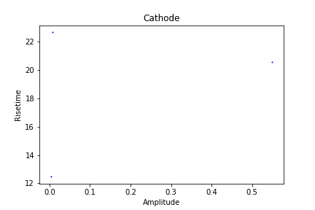
Focusing on the interactions within the cathode
ID : 42954
ID : 42954
Number events:
Efficiency:

Slide 19
ID 42954 amp = 0.54880875 rt = 20.564142
Primary Process is transportation in cathode
Volume Process particle radius
Secondary Gas,hIoni,2212.000000,14.999790,0.570026,0.817443,1.000000,0.000144
Secondary Gas,hIoni,2212.000000,14.999369,0.570005,0.817500,1.000000,0.000475
Secondary Gas,hIoni,2212.000000,14.999101,0.569991,0.817536,1.000000,0.000027
.
.
.
Secondary Gas,hIoni,2212.000000,14.878161,0.565462,0.833810,1.000000,0.000813
Secondary Gas,hIoni,2212.000000,14.873333,0.565544,0.833681,1.000000,0.001373
Secondary Gas,hIoni,2212.000000,14.872232,0.565683,0.833719,1.000000,0.002262
Secondary Gas,phot,22.000000,14.973601,0.595392,0.662342,1599.000000,0.000011
Secondary Gas,phot,22.000000,14.998441,0.560362,0.730049,1348.000000,0.000011
Secondary Gas,phot,22.000000,14.924835,0.659562,0.696075,1329.000000,0.000011
Secondary Gas,phot,22.000000,14.942685,0.663788,0.683689,1206.000000,0.000023
Secondary Gas,phot,22.000000,14.756405,0.641502,0.602603,1145.000000,0.000023

Slide 20
ID 20781 amp = 0.007814883 rt = 22.647875
Primary Process is transportation in cathode
Volume Process particle radius
Secondary Gas,phot,22.000000,14.897177,0.905351,2.166606,198.000000,0.000023
Secondary Gas,phot,22.000000,14.737684,0.881969,1.939795,2285.000000,0.000023

Slide 21
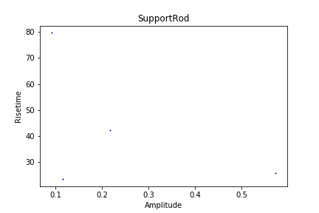
Focusing on the interactions within the Support Rod
ID :14009
ID : 10872
Number events: 4
Efficiency:

Slide 22
ID 10872 amp = 0.5727064 rt = 25.799135¶
Volume Process particle radius
Primary SupportRod,nCapture,2112.000000,4.170523,-0.999585,-1.809468,0.000000,0.000000
Secondary SupportRod,ionIoni,1000290640.000000,4.170523,-0.999585,-1.809460,1.000000,0.000531
Secondary SupportRod,eIoni,-11.000000,4.170493,-0.999586,-1.809435,9.000000,0.000020
Secondary SupportRod,eIoni,-11.000000,4.170408,-0.999586,-1.809333,9.000000,0.000591
.
.
.
Secondary SupportRod,phot,22.000000,4.100430,-0.997634,2.563365,21616.000000,0.000010
Secondary SupportRod,phot,22.000000,4.100335,-0.997634,2.563383,20299.000000,0.000010
Secondary SupportRod,phot,22.000000,4.100345,-0.997634,2.563453,21619.000000,0.000020

Slide 23
ID 14009 amp = 0.092168465 rt = 79.68108
Volume Process particle radius
Primary SupportRod,nCapture,2112.000000,13.729068,-0.999908,-0.158996,0.000000,0.000000
Secondary SupportRod,ionIoni,1000290640.000000,13.729068,-0.999908,-0.158996,1.000000,0.001369
Secondary SupportRod,ionIoni,1000280640.000000,13.729068,-0.999908,-0.158995,15.000000,0.000023
Secondary SupportRod,phot,22.000000,13.729002,-0.999908,-0.158455,22.000000,0.000030
.
.
.
Secondary SupportRod,phot,22.000000,14.227478,-0.999956,2.357028,3459.000000,0.000010
Secondary SupportRod,phot,22.000000,14.227474,-0.999956,2.356984,3453.000000,0.000010
Secondary SupportRod,phot,22.000000,14.227473,-0.999956,2.356995,3453.000000,0.000010

Slide 24
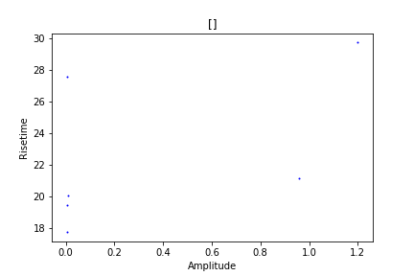
Focusing on the interactions with primary volume empty and primary process empty
ID : 40443
ID : 15479
Number events: 6
Efficiency:

Slide 25
ID 40443 amp = 1.1996145 rt = 29.73004
Volume Process particle radius
Secondary Gas,hIoni,2212.000000,14.998534,-0.768824,-1.631983,1.000000,0.000382
Secondary Gas,hIoni,2212.000000,14.998192,-0.768839,-1.631948,1.000000,0.000061
Secondary Gas,hIoni,2212.000000,14.998015,-0.768846,-1.631930,1.000000,0.000012
Secondary Gas,hIoni,2212.000000,14.997971,-0.768848,-1.631925,1.000000,0.000000
.
.
.
Secondary Gas,hIoni,2212.000000,14.648842,-0.783313,-1.594881,1.000000,0.000197
Secondary Gas,hIoni,2212.000000,14.649313,-0.783298,-1.594833,1.000000,0.000367
Secondary Gas,hIoni,2212.000000,14.649219,-0.783302,-1.594865,1.000000,0.000873

Slide 26
ID 15479 amp = 0.95840573 rt = 21.171947
Volume Process particle radius
Secondary Gas,hIoni,2212.000000,14.999992,0.040373,1.086342,1.000000,0.000000
Secondary Gas,hIoni,2212.000000,14.999672,0.040393,1.086308,1.000000,0.000396
Secondary Gas,hIoni,2212.000000,14.999114,0.040428,1.086248,1.000000,0.000223
.
.
.
Secondary Gas,hIoni,2212.000000,14.828912,0.052078,1.062778,1.000000,0.000371
Secondary Gas,hIoni,2212.000000,14.826378,0.052346,1.062790,1.000000,0.003098
Secondary Gas,phot,22.000000,14.515174,-0.029821,1.162457,582.000000,0.000023
Secondary Gas,phot,22.000000,14.961747,0.043856,1.400064,238.000000,0.000012
Secondary Gas,phot,22.000000,14.992342,-0.019302,1.267057,222.000000,0.000023
Secondary Gas,phot,22.000000,14.906126,-0.062646,1.104111,196.000000,0.000023
Secondary Gas,phot,22.000000,14.646008,-0.051176,1.319788,8.000000,0.000023

Slide 27
Next Objectives
Investigate the no volume, no primary process
Investigate the final interactions in the cathode

