Slide 1
Theatrical Genre Prediction using Social Network Metrics
Manisha Shukla, Susan Gauch,
and Lawrence Evalyn (2018)
Presented by April Walker

Slide 2
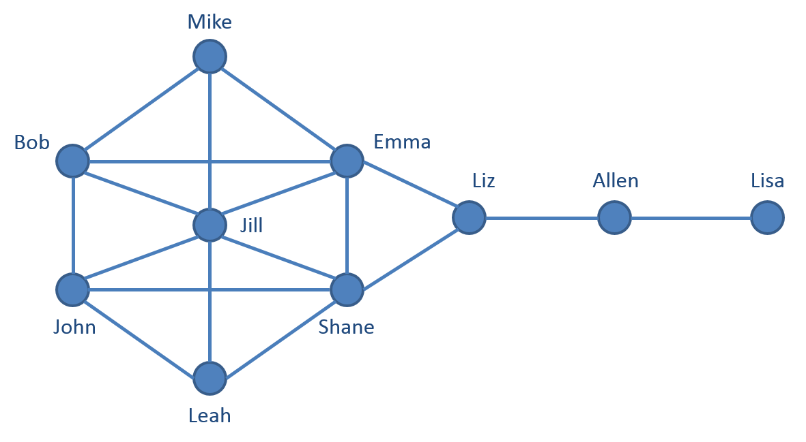
Social Network Analysis (SNA)
Social network graph: a structure of nodes (representing an individual or character) and edges (representing relations amongst nodes)
_
SNA assumes that valuable information can be derived from the relationships between nodes
_

Slide 3
Social Network Analysis (SNA)
Previous unique utilizations of SNA:
Detecting and disintegrating criminal social networks
Terrorist Activity (Anggraini et al., 2015)
Money Laundering (Dreżewski, et al., 2015)
Studying the impact interpersonal football team relationships on game performance (Trequattrini, et al., 2015)
This paper focuses on genre prediction using SNA. Because this method does not rely on the specific language of the play, it can be scaled extensively
_

Slide 4
Motivation:
“...explore correlations between the mathematical properties of the social networks of plays and the plays’ dramatic genre...”
Utilize social network theory as a method of feature extraction
Study the importance of these features by testing their predictive power

Slide 5
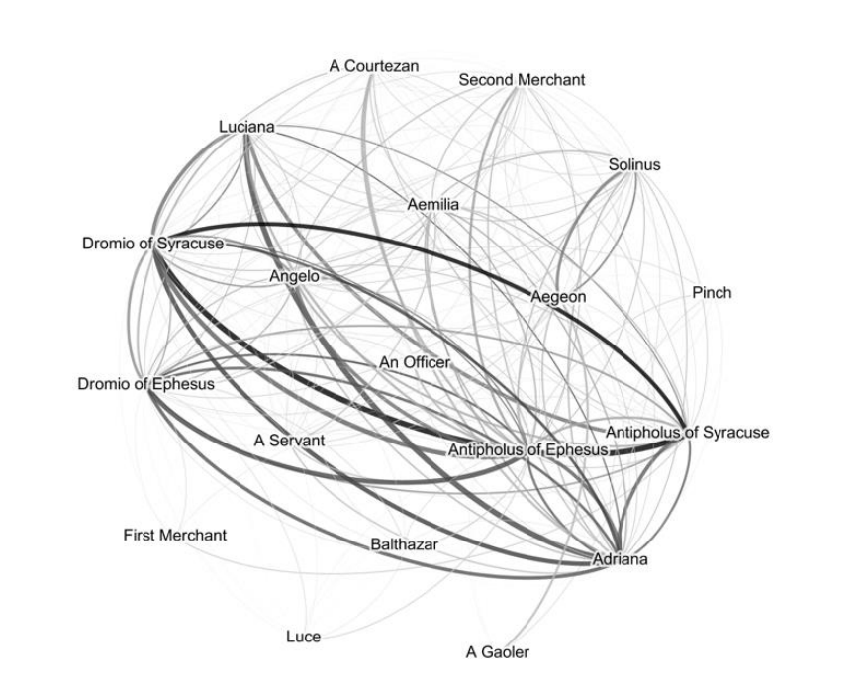
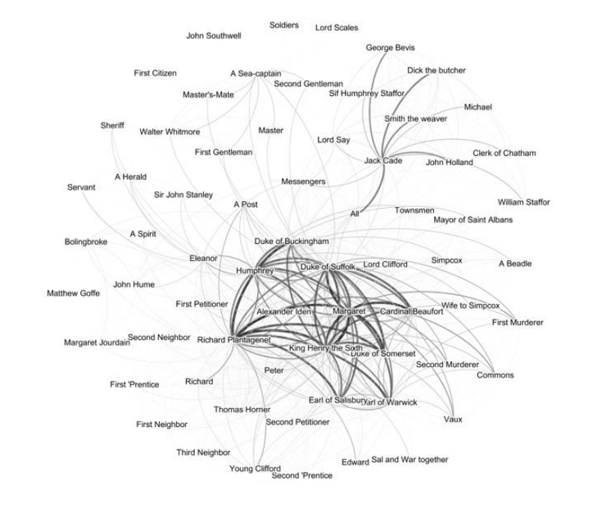
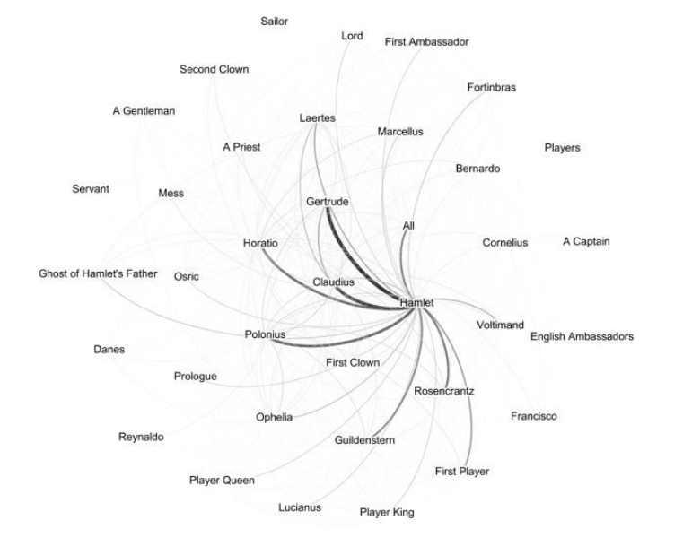
Social Network Graphs of Shakespearean Plays
Comedy of Errors
Hamlet
Henry V

Slide 6
Social Network Graphs of Shakespearean Plays
Comedy
Tragedy
History
Comedy of Errors
Hamlet
Henry V

Slide 7
Social Network Graphs of Shakespearean Plays
Comedy
Tragedy
History
Additionally, this study hoped to analyze Shakespeare’s disputed plays

Slide 8
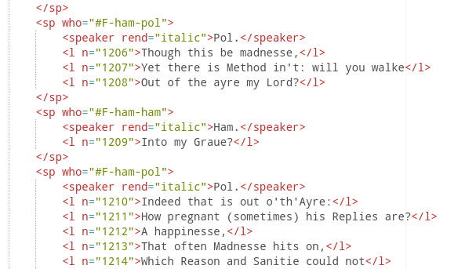
Preprocessing:
TEI-encoded XML formatted Shakespearean plays were downloaded from eXistdb Showcases
Extracted data to “Character” Java object:
Scenes acted
Number of lines spoken
Number of words spoken
Scene information to map other information

Slide 9
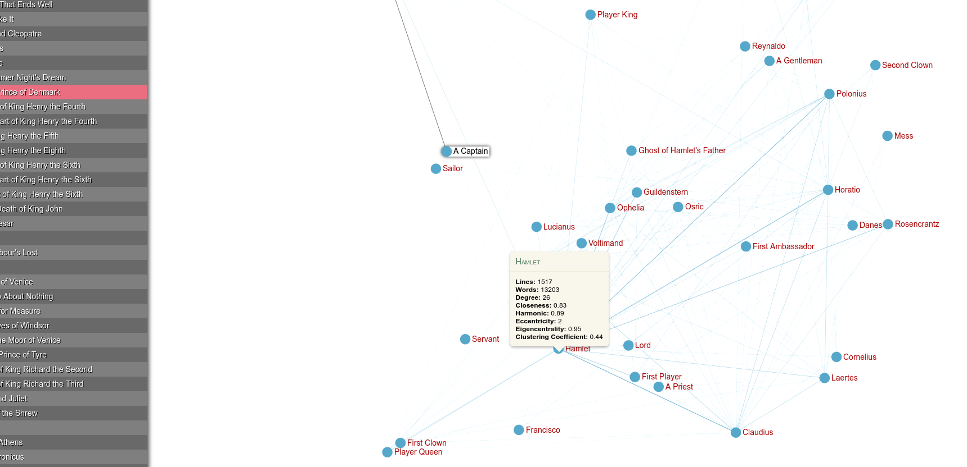
Resulting graphs:
Social network graphs in addition to many social network metrics were calculated using Gephi. All developed graphs are available on the UARK CSCE website here.

Slide 10
Overview of Social Network Metrics
Node/Character Features:
Degree: number of adjacently connected nodes
Centrality: measures character importance based nodes relationship to other nodes (Eigenvector, Closeness, Harmonic)
Eccentricity: max number of connections to another node
Graph Features:
Number of characters (nodes), connections (edges), words, lines
Path Length: average distance between nodes
Graph Density: contrasts total connections with total possible
Diameter: max distance between nodes

Slide 11
Overview of Social Network Metrics
Graph Features:
Number of characters (nodes), connections (edges), words, lines
Path Length: average distance between nodes
Graph Density: contrasts total connections with total possible
Diameter: max distance between nodes

Slide 12
Overview of Social Network Metrics
Each play was represented using 21 features, 4 features being extracted from the text, 8 node/character features, and 9 graph Features

Slide 13
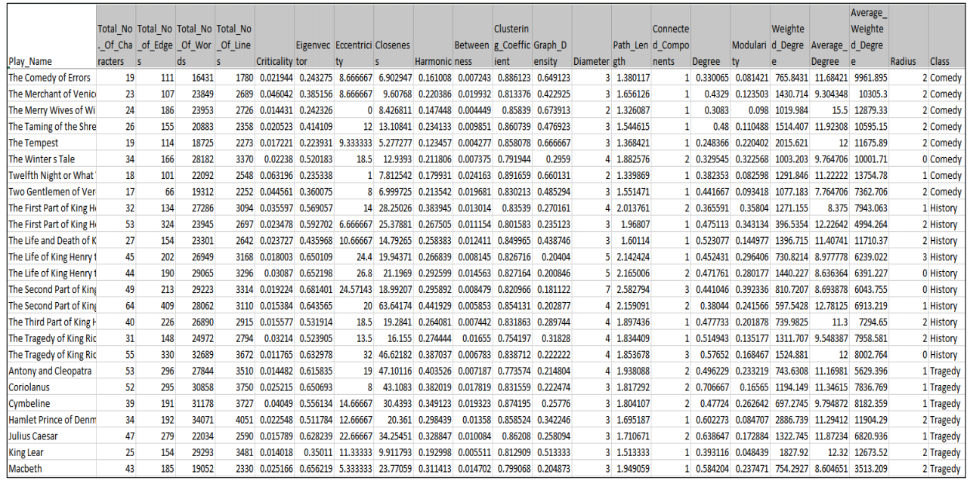
Example of Social Network Metric Output

Slide 14
Genre Predictor
The popular Support Vector Machine was utilized to develop the classifier. In order to accommodate more than two classes, it was combined with One vs One (OvO) classification.
OvO Classification:
Develop binary classification for each pair
Chose class with most “votes”

Slide 15
Results
Feature selection was of high importance, as an SVM trained on all features only gave an accuracy of 66.43%
The SVM was instead trained on individuals, pairs, and triads of features
The top triad of features lifted this accuracy to 83.57%

Slide 16
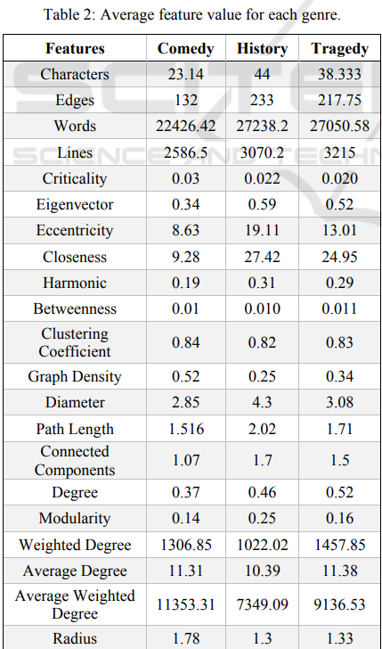
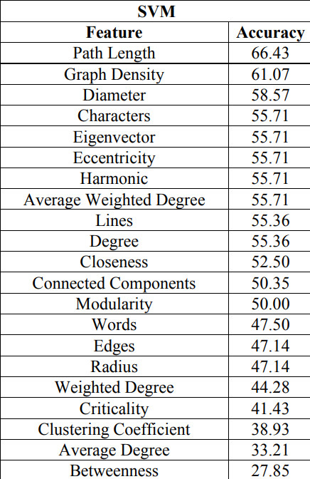
Results for single feature

Slide 17
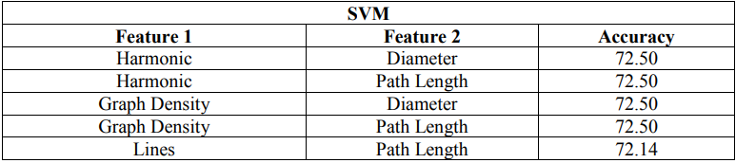
Results for single feature vs feature pairs
Pictured above are the feature pairs which provided at least 70% accuracy in genre prediction using a SVM
Recall Eigenvector, Closeness, and Harmonic are all methods of measuring centrality

Slide 18
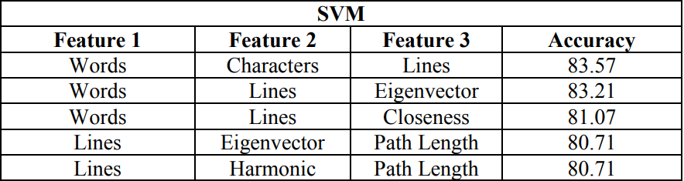
Results for single feature vs feature triads
Pictured above are the feature triads which provided at least 80% accuracy in genre prediction using a SVM
Recall Eigenvector, Closeness, and Harmonic are all methods of measuring centrality

Slide 19
Results for single feature vs feature triads
Additional numbers of feature combinations were not tested as computation time be wildin’

Slide 20
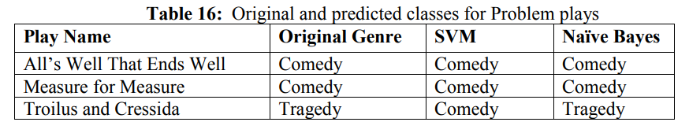
Results for problem plays

Slide 21
Conclusions
Shukla et al’s methodology successfully classified plays without relying on the vocabulary itself, implying scalability across languages.
Future work:
Reduce “false positives”
Make edges directional (capture relationship imbalance)
Incorporate NLP to distinguish targets of speech
Personal Questions:
Explore additional feature selection methods and classifiers
How scalable is this on a minimally processed corpus?

Slide 22
Questions?
Slides available at aprilwalker.io/NLP/presentation.pdf

Slide 23
Theatrical Genre Prediction using Social Network Metrics
Manisha Shukla, Susan Gauch,
and Lawrence Evalyn (2018)
Presented by April Walker

