Slide 1
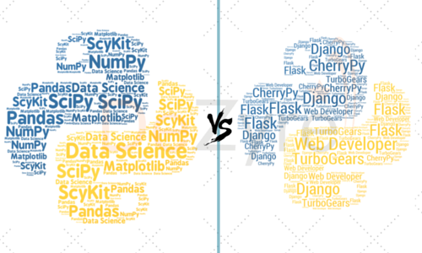
Twee wegen die naar Python leiden
Data Science
Backend Web Development
Notes:
but also easy way to access api’s etc.

Slide 2
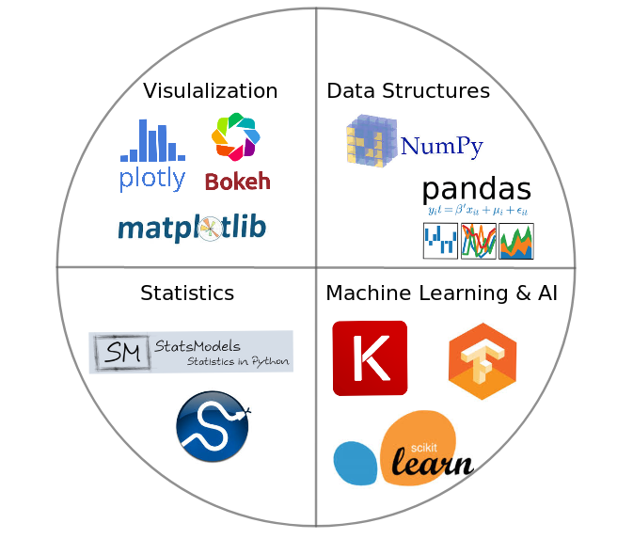
Python Data Science Libraries
Notes:
grote voordeel: 1 library die ergens heel erg goed in is

Slide 3
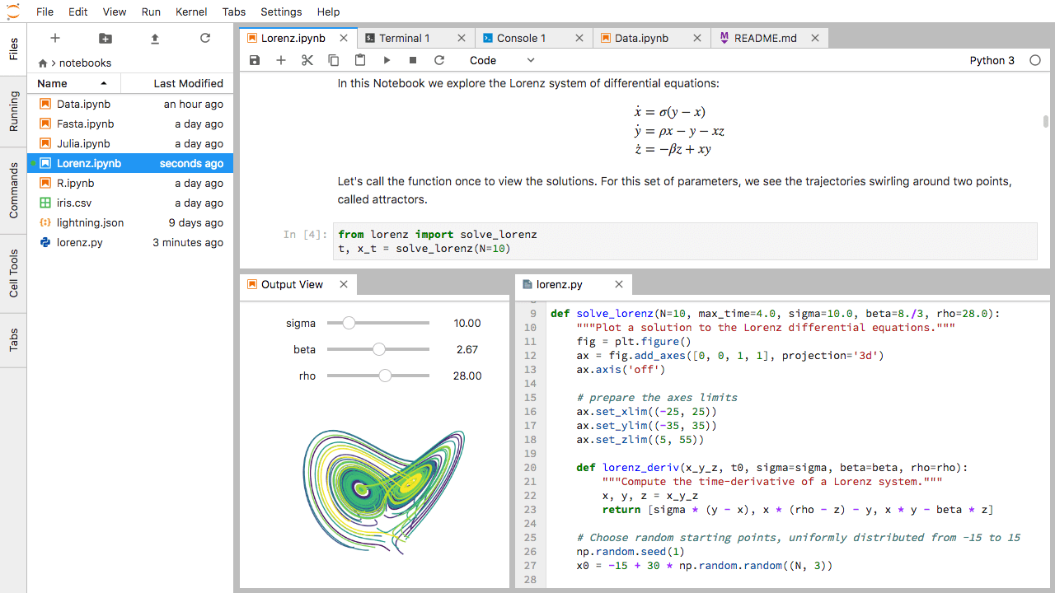
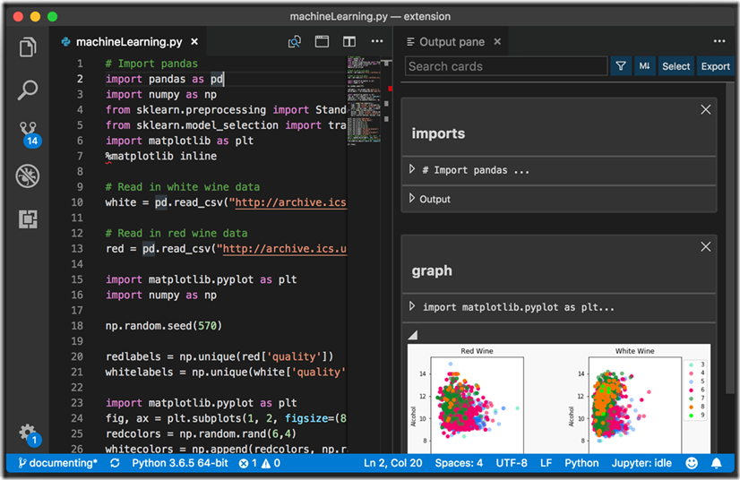
Jupyter Notebooks vs Visual Studio Code

Slide 4
Jupyter Notebooks tips and tricks
Shift + Enter to run code
Tab completion
Shift Tab to see arguments and information about methods, functions or classes
Magic commands, such as ls
? or ?? to get extra help and info

Slide 5
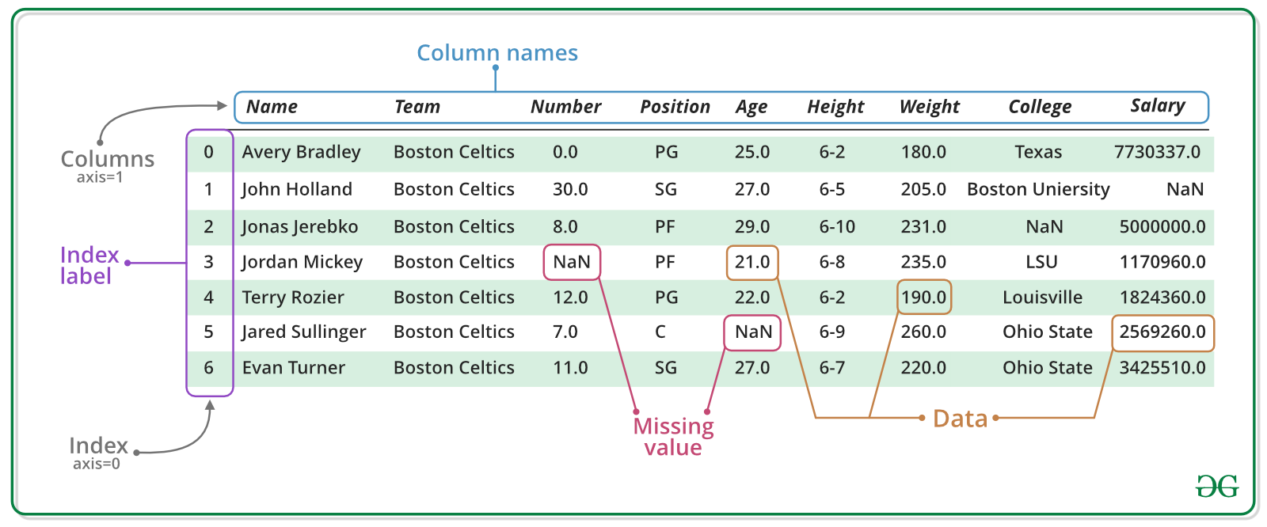
Most important concept is the DataFrame
Notes:
pandas series are just one column of your data, they are 1 dimensional

Slide 6
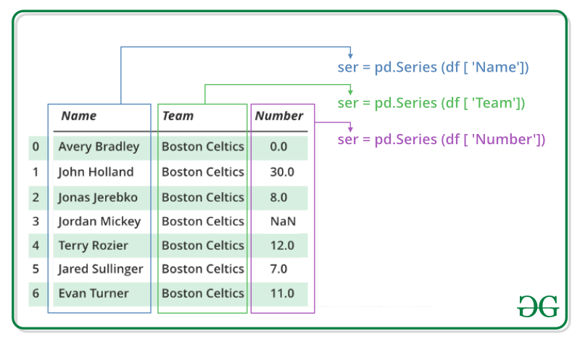
Example of a Pandas Series
Notes:
pandas series are just one column of your data, they are 1 dimensional

