Slide 1
Wat we gaan doen de komende 2 dagen
Introductie:
waar werk je nu,
met welke software,
gebruik je nu Python,
en: wat wil je vandaag leren
Highover uitleg Python, Pandas en belangrijkste Python data libraries
Intro Jupyter Notebook + Python refresher + opstarten VM
Data inlezen ---> pd.read_csv()
Data inspectie ---> df.info() df.head() df.describe()
Data selectie ---> df[df.column == ‘value’] df.loc[df.column == ‘value’, :]
Data wrangling ---> df[‘column’].fillna() of df.drop_duplicates()
Data joinen ---> df.merge(df2)
Data visualisatie ---> df.plot()
Eigen functies toepassen ---> df.apply(my_own_function)
Installeren Jupyter + Python + Pandas ---> pip install pandas
Notes:
ik heb geprobeerd de cursus terug te brengen tot de bare essentials

Slide 2
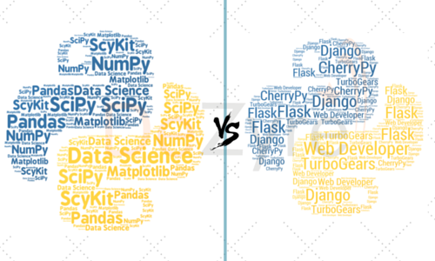
Twee wegen die naar Python leiden
Data Science / Data Engineering
Backend Web Development
Notes:
but also easy way to access api’s, scheduling using Airflow, webscraping with beautifulsoup, scrapy etc.

Slide 3

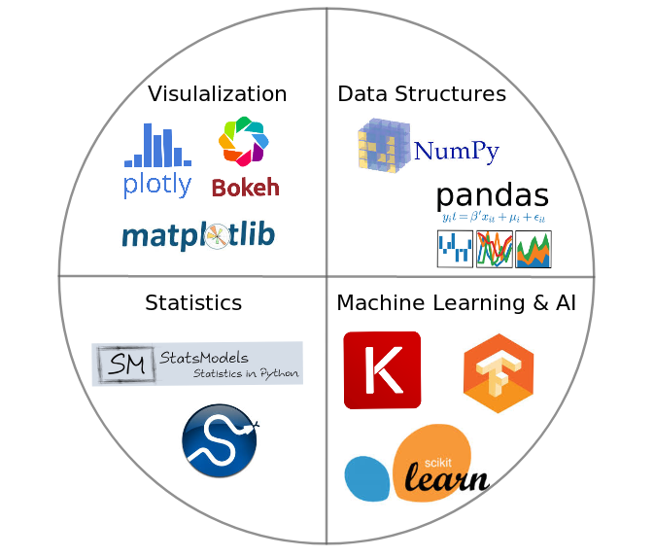



Python Data Science Libraries
Notes:
grote voordeel: 1 library die ergens heel erg goed in is

Slide 4
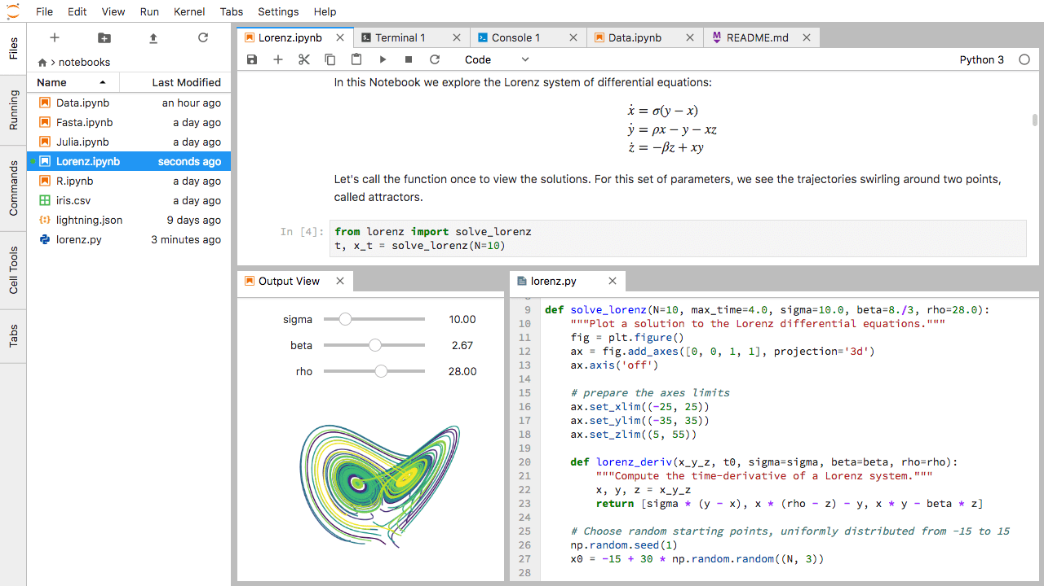
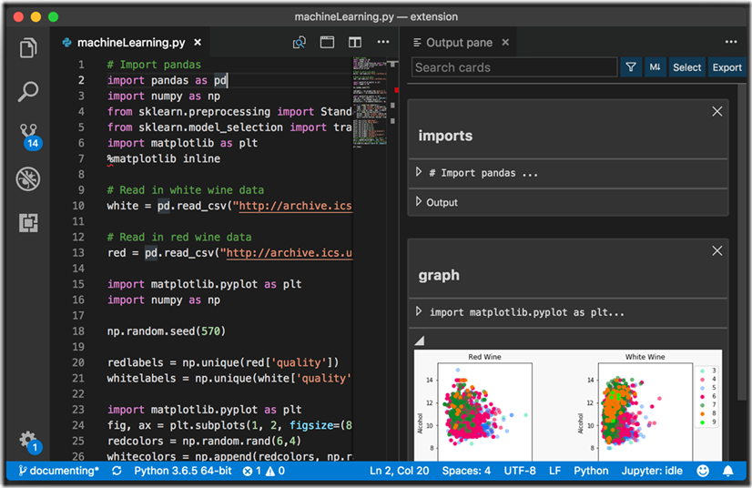
Jupyter Notebooks vs Visual Studio Code
Notes:
jupyter notebook for commenting and interactive data analysis, IDE is handier for writing production code, although Microsoft also makes it a lot easier to use Visual Studio as a notebook environment

Slide 5
Jupyter Notebooks tips and tricks
Shift + Enter to run code
Tab completion
Nieuwe cell: Escape gevolgd door a (above) of b (below) of dd (delete)
Shift Tab to see arguments and information about methods, functions or classes
Magic commands, such as ls
? or ?? to get extra help and info

Slide 6

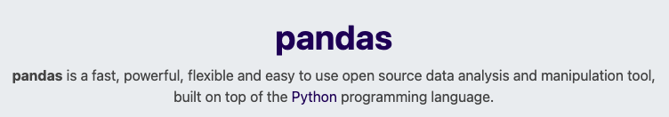
Wat is pandas?
Notes:
pandas mostly excels in data wrangling and analysis. Visualization could also be done in PowerBI or Tableau. I use SQL to get data and pandas to wrangle.

Slide 7
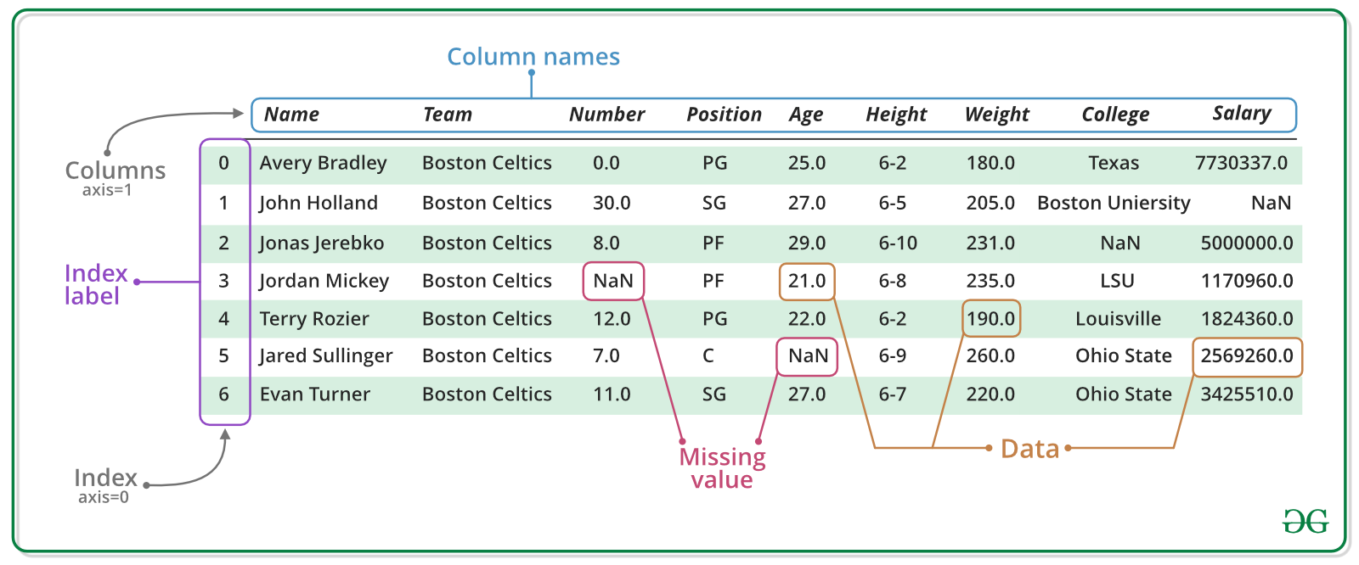
Most important concept is a DataFrame
Notes:
pandas series are just one column of your data, they are 1 dimensional
columns can contain mixed datatypes

Slide 8
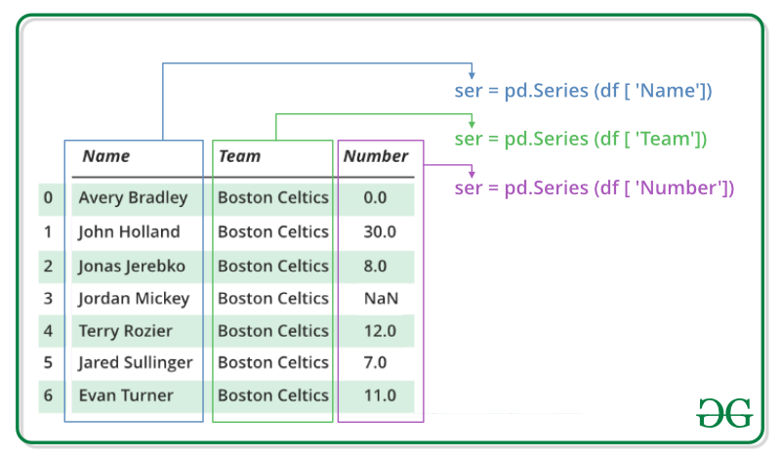
Example of a Pandas Series
Notes:
pandas series are just one column of your data, they are 1 dimensional

Slide 9
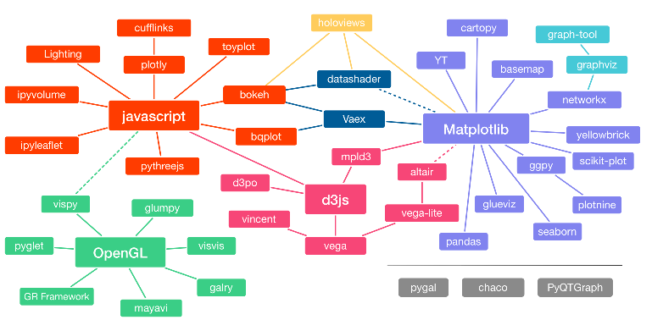
There are too many plotting packages

Slide 10


So my advice is: only focus on these
STATIC PLOTTING
INTERACTIVE PLOTTING
Matplotlib
Plotly
Bokeh
Seaborn
Pandas plotting
df.plot()
Plotly Express
hvPlot

Slide 11
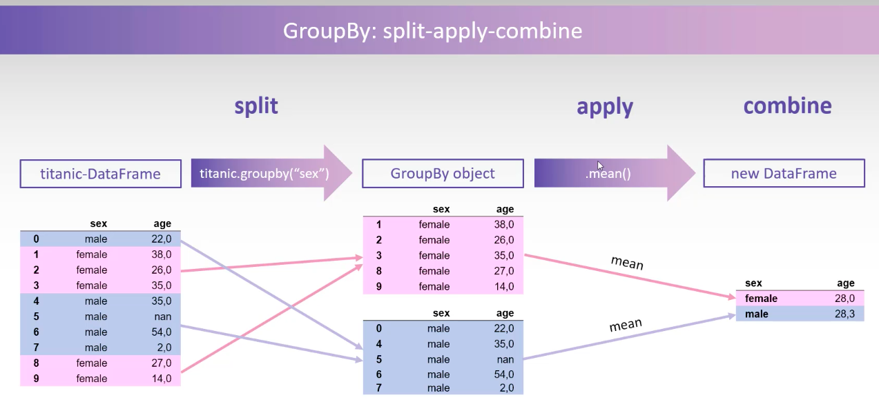
How groupby() works

Slide 12
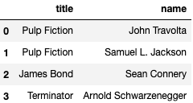
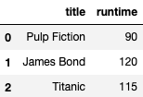
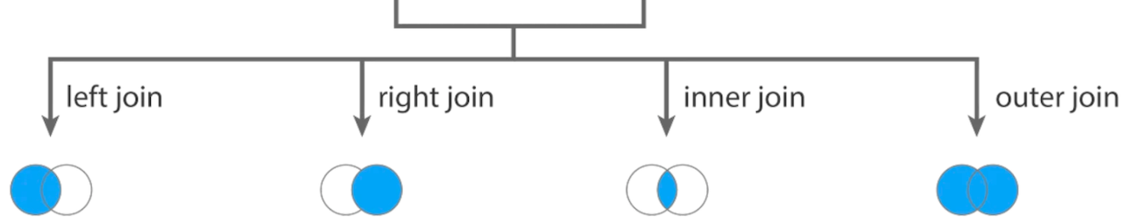
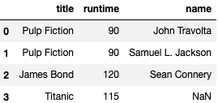
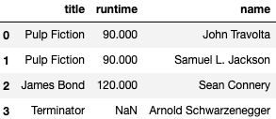
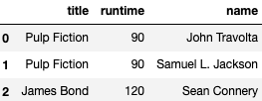
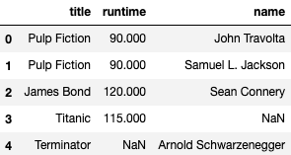
Joining tables with df.merge()

