Slide 1
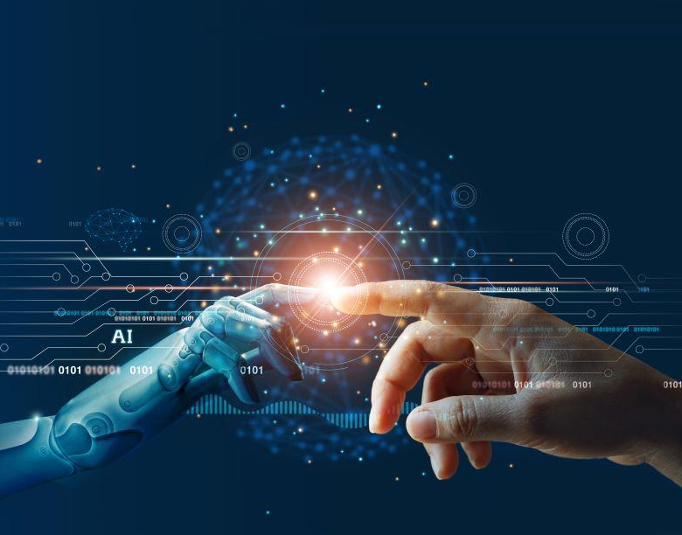
Applications of AI in the Real World
For RNATE 2K23
By Sandesh Gajendra Pol

Slide 2
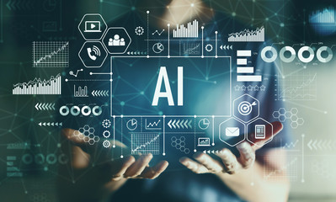

What is Artificial Intelligence
AI is the ability of the machines or computer program To carry out tasks that requires human beings to use their intelligence
Artificial intelligence is the ability of a computer program or a machine to think and learn.
The teams Machine Learning and Deep Learning is sub set of Artificial Intelligence

Slide 3
Hybrid system
base approach
Machine learning based approach
Major Artificial Intelligence approach
Neural Networks base approach
Rules and logic base approach
D
C
A hybrid system in AI refers to a combination of multiple artificial intelligence techniques or approaches that are used together to solve a particular problem.
Neural networks are a type of machine learning algorithm that are inspired by the structure of the human brain
Neural networks are particularly good at identifying patterns in complex data sets.
B
Machine learning is an AI approach that involves training algorithms to learn from data.
The system is fed large amounts of data and uses statistical methods to identify patterns and relationships.
The system can then use this knowledge to make predictions and decisions
In this approach, AI systems are programmed with a set of rules and conditions that dictate how they should behave in different situations.
These rules are based on human expertise and knowledge, and the system uses them to make decisions and perform tasks
A

Slide 4
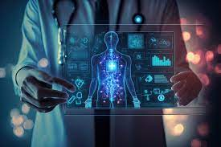
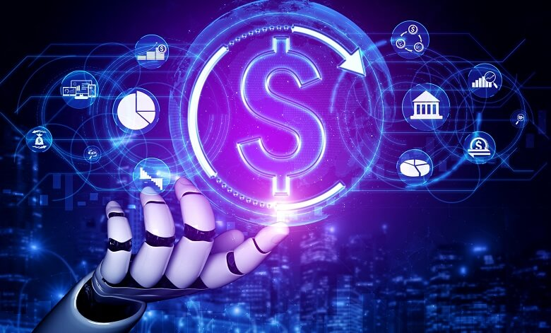
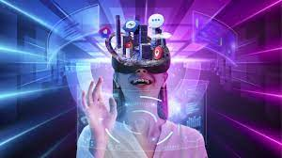
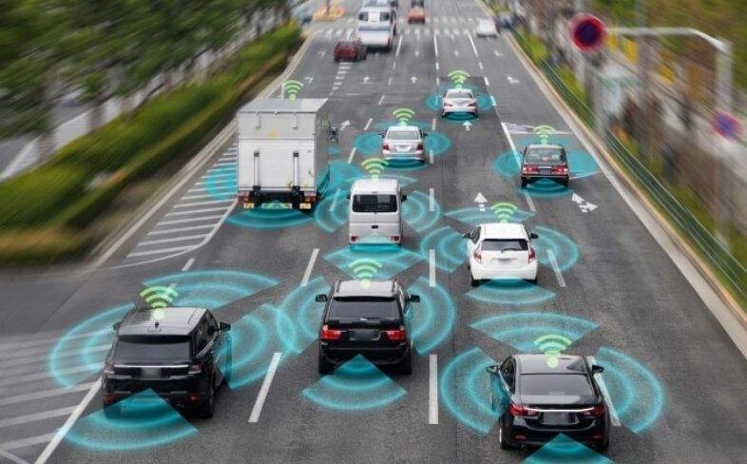
Application of AI
Applications of AI in Healthcare
Applications of AI in Finance
Virtual Health Assistants
Predictive Analytics
Personalized Treatment Plans
Early Disease Detection
Market Sentiment Analysis
Risk Assessment and Management
Algorithmic Trading
Enhanced Decision-Making
Applications of AI Entertainment
Applications of AI in Transportation
AI in Gaming
AI in Film and Animation
AI in Virtual Reality (VR) and Augmented Reality (AR):
Traffic Predictions and Congestion Mitigation
Autonomous Vehicles
Smart Traffic Management

Slide 5
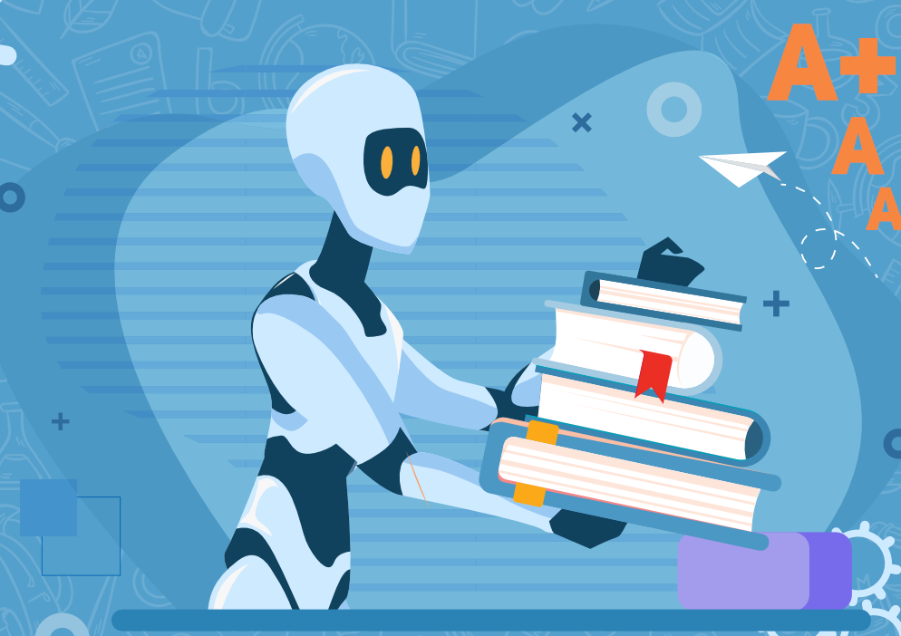
AI in Education
Personalized Learning
AI algorithms analyze students' learning patterns, strengths, and weaknesses to tailor educational content and pace
Virtual and Augmented Reality
Use AI tools to supplement, not replace, human teaching.
Homework and Assignment Help
Research Support

Slide 6
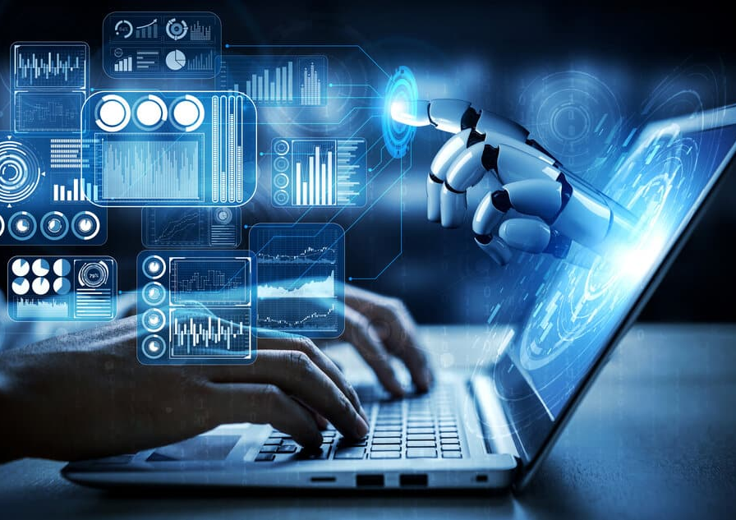
AI in Programing and Development
According to Stack Overflow’s March 2023 survey, 75% of Python coders have hopped on the ChatGPT train.
GitHub’s April 2023 survey shows a similar trend, with 60% of Python coders saying ‘yes’ to ChatGPT.
AI can help to a programmer to improve his productivity 10 times with more accurate and in less time

Slide 7
Famous AI tools in market
Docus
AI Health Mind
Tesla Autopilot
Copilot2trip
Effluence
covers AI
Formative AI
Chat gpt & Google Bard
BlackHedge
Potato
Blackbox AI Search
GitHub Copilot

Slide 8
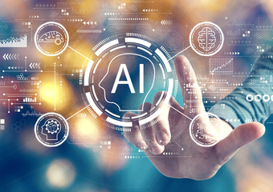
Conclusion
Artificial intelligence (AI) is rapidly transforming the real world, with applications in every industry and sector.
AI is a powerful tool that has the potential to make our lives better in many ways.
AI is already having a major impact on the real world, and its potential to revolutionize our lives is vast.

Slide 9
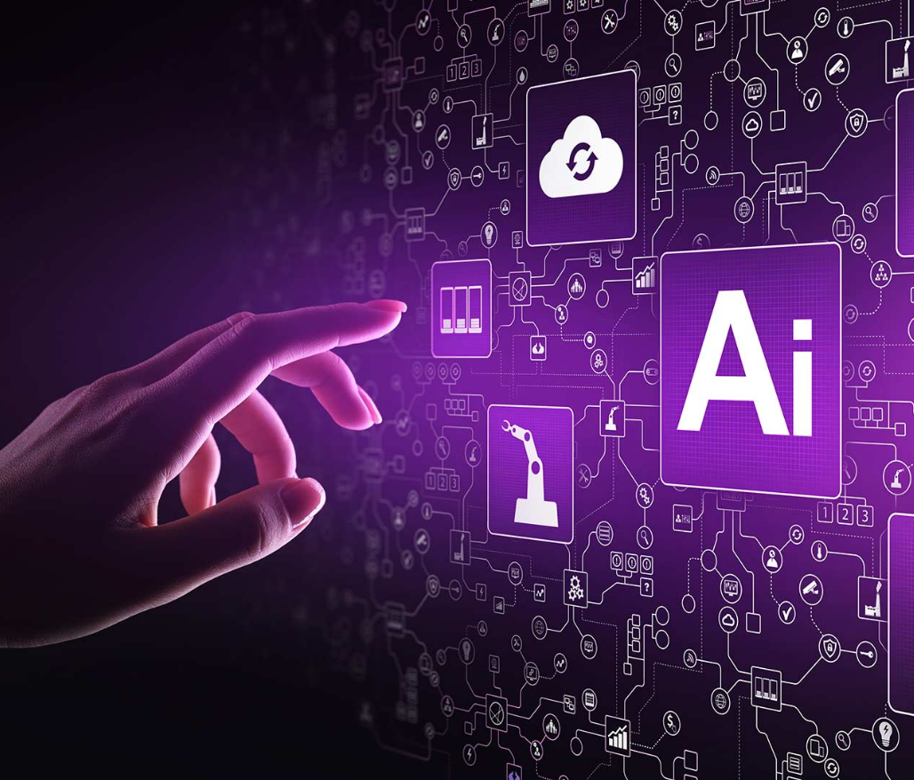
THANK YOU!
Sandesh Gajendra Pol
Phone:
9067248106
Email:
sandeshpol268@gmail.com

