Slide 1
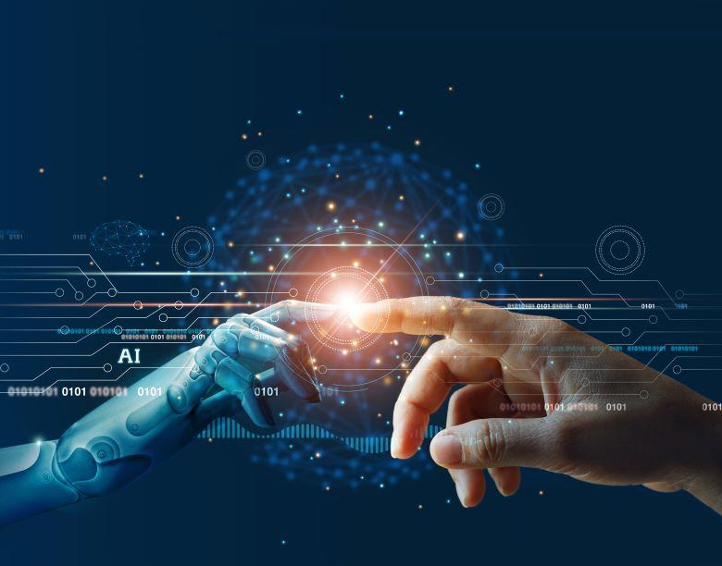
Artificial Intelligence
For ANUTTARA 20K23
By Sandesh Gajendra Pol

Slide 2
Point to be discussed
01 What is Artificial Intelligence
02 Major AI approach
03 Working of AI
04 Application & Case Study
05 Conclusion

Slide 3
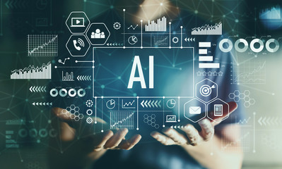
What is Artificial Intelligence
AI is the ability of the machines or computer program To carry out tasks that requires human beings to use their intelligence
Artificial intelligence is the ability of a computer program or a machine to think and learn.
The teams Machine Learning and Deep Learning is sub set of Artificial Intelligence

Slide 4
Relation between Artificial Intelligence & Machine learning
Artificial Intelligence
Ability of machine to imitate intelligent human behavior
Machine Learning
Application of AI that allows a system, to automatically learn and improve from experience
Deep learning
Application of Machine learning that uses complex algorithm and deep neural nets to train a module

Slide 5
Working of Artificial Intelligence
Problem Definition
Evolution and testing
Data collection and preparation
Deployment and maintains
Model building and training

Slide 6
Machine learning based approach
Major Artificial Intelligence approach
Hybrid system
base approach
Neural Networks base approach
Rules and logic base approach
D
C
A hybrid system in AI refers to a combination of multiple artificial intelligence techniques or approaches that are used together to solve a particular problem.
Ex – Atomic Car
Neural networks are a type of machine learning algorithm that are inspired by the structure of the human brain
Neural networks are particularly good at identifying patterns in complex data sets.
B
Machine learning is an AI approach that involves training algorithms to learn from data.
The system can then use this knowledge to make predictions and decisions
Ex – Image Classification (CNN algorithm)
In this approach, AI systems are programmed with a set of rules and conditions that dictate how they should behave in different situations.
Ex – Class , Spam mail detection
A

Slide 7
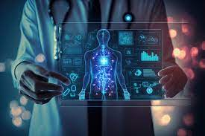
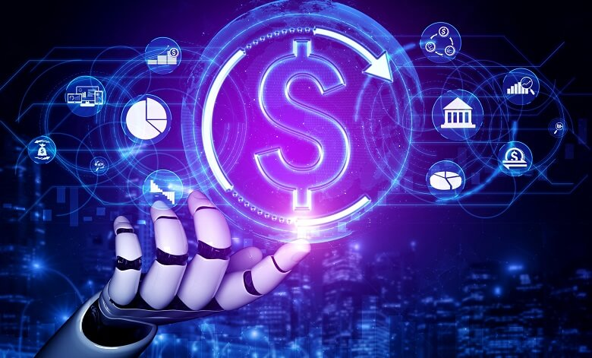
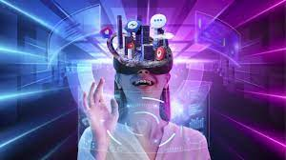
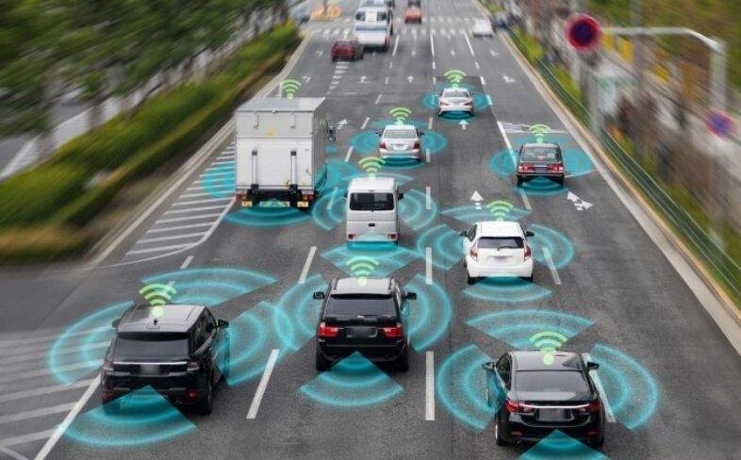
Application of AI
Applications of AI in Healthcare
Applications of AI in Finance
Virtual Health Assistants
Predictive Analytics
Early Disease Detection
Market Sentiment Analysis
Algorithmic Trading
Enhanced Decision-Making
Applications of AI Entertainment
Applications of AI in Transportation
Traffic Predictions and Congestion Mitigation
Autonomous Vehicles
AI in Gaming
AI in Film and Animation

Slide 8
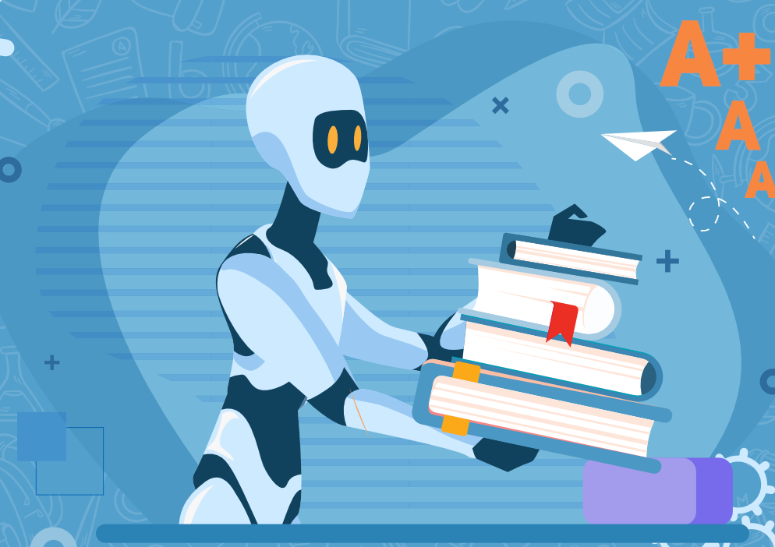
AI in Education
Personalized Learning
AI algorithms analyze students' learning patterns, strengths, and weaknesses to tailor educational content and pace
Use AI tools to supplement, replace, human teaching.
Homework and Assignment Help
Research Support

Slide 9
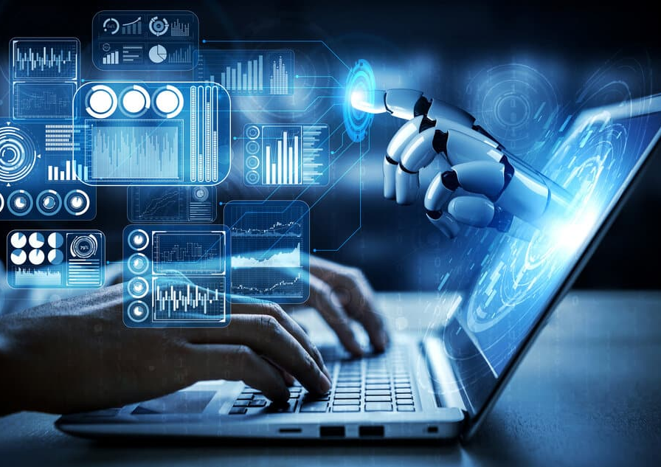
AI in Programing and Development
According to Stack Overflow’s March 2023 survey, 75% of Python coders have hopped on the ChatGPT train.
GitHub’s April 2023 survey shows a similar trend, with 60% of Python coders saying ‘yes’ to ChatGPT.
AI can help to a programmer to improve his productivity 10 times with more accurate and in less time

Slide 10
Famous AI tools in market
Docus
AI Health Mind
Tesla Autopilot
Copilot2trip
Effluence
covers AI
Formative AI
Chat gpt & Google Bard
Black Hedge
Potato
Blackbox AI Search
GitHub Copilot

Slide 11
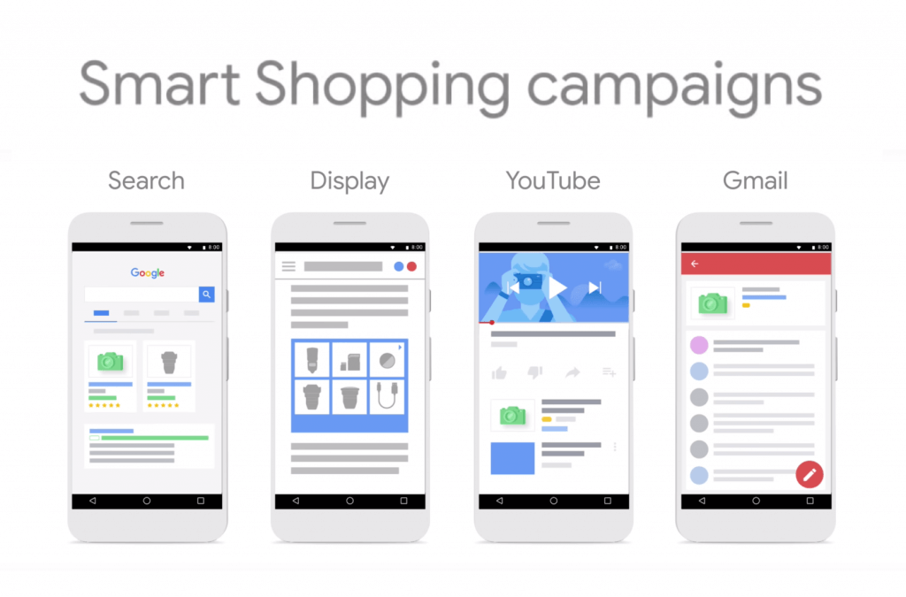
Case study on AI and Data science
Google search engines and shopping ads

Slide 12
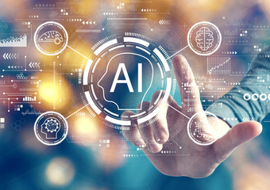
Conclusion
Artificial intelligence (AI) is rapidly transforming the real world, with applications in every industry and sector.
AI is a powerful tool that has the potential to make our lives better in many ways.
AI is already having a major impact on the real world, and its potential to revolutionize our lives is vast.

Slide 13
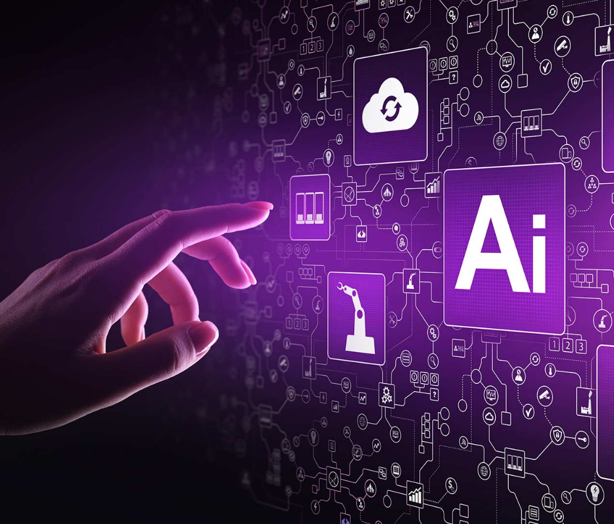
THANK YOU!
Sandesh Gajendra Pol
Phone:
9067248106
Email:
sandeshpol268@gmail.com

