Slide 1
FIFA WORLD CUP 2026
Assists Analysis
Do midfielders create more assists per 90 minutes than forwards?
GROUP PROJECT – OBJECTIVE 1 HIT140 – Foundation of Data Science
Aditya Banstola(S403120)

Slide 2
Assists Analysis
FIFA World Cup 2026 • Player assists
Do midfielders create more assists per 90 minutes than forwards?
WHY THIS QUESTION?
DATA
ANALYTIC APPROACH
An assist reflects how directly a player sets up a goal. Because players don't all log the same minutes, converting this to a per-90-minute rate puts midfielders and forwards on equal footing.
Player data sourced from FBref Comparing midfielders (MF) and forwards (FW) Only players with at least one full 90-minute equivalent qualified
Players under one full 90 were dropped A stratified sample of 40 MF and 40 FW was drawn Groups compared with a Welch two-sample t-test
Metric used: Assists ÷ 90-minute equivalents
1

Slide 3
Building a Balanced Sample from Eligible Players
→
→
→
MF + FW
40 / 40
80
1:1
eligible positions
midfielders / forwards
players in final sample
balanced position split
DATA PREPARATION
SAMPLING
Non-player rows were removed Midfielders (MF) and forwards (FW) were kept Players under one 90-minute equivalent were dropped Assists per 90 minutes were then calculated for each player
Sampling was stratified by position 40 midfielders and 40 forwards, 80 players in total Random seed set to 42 for reproducibility
2

Slide 4
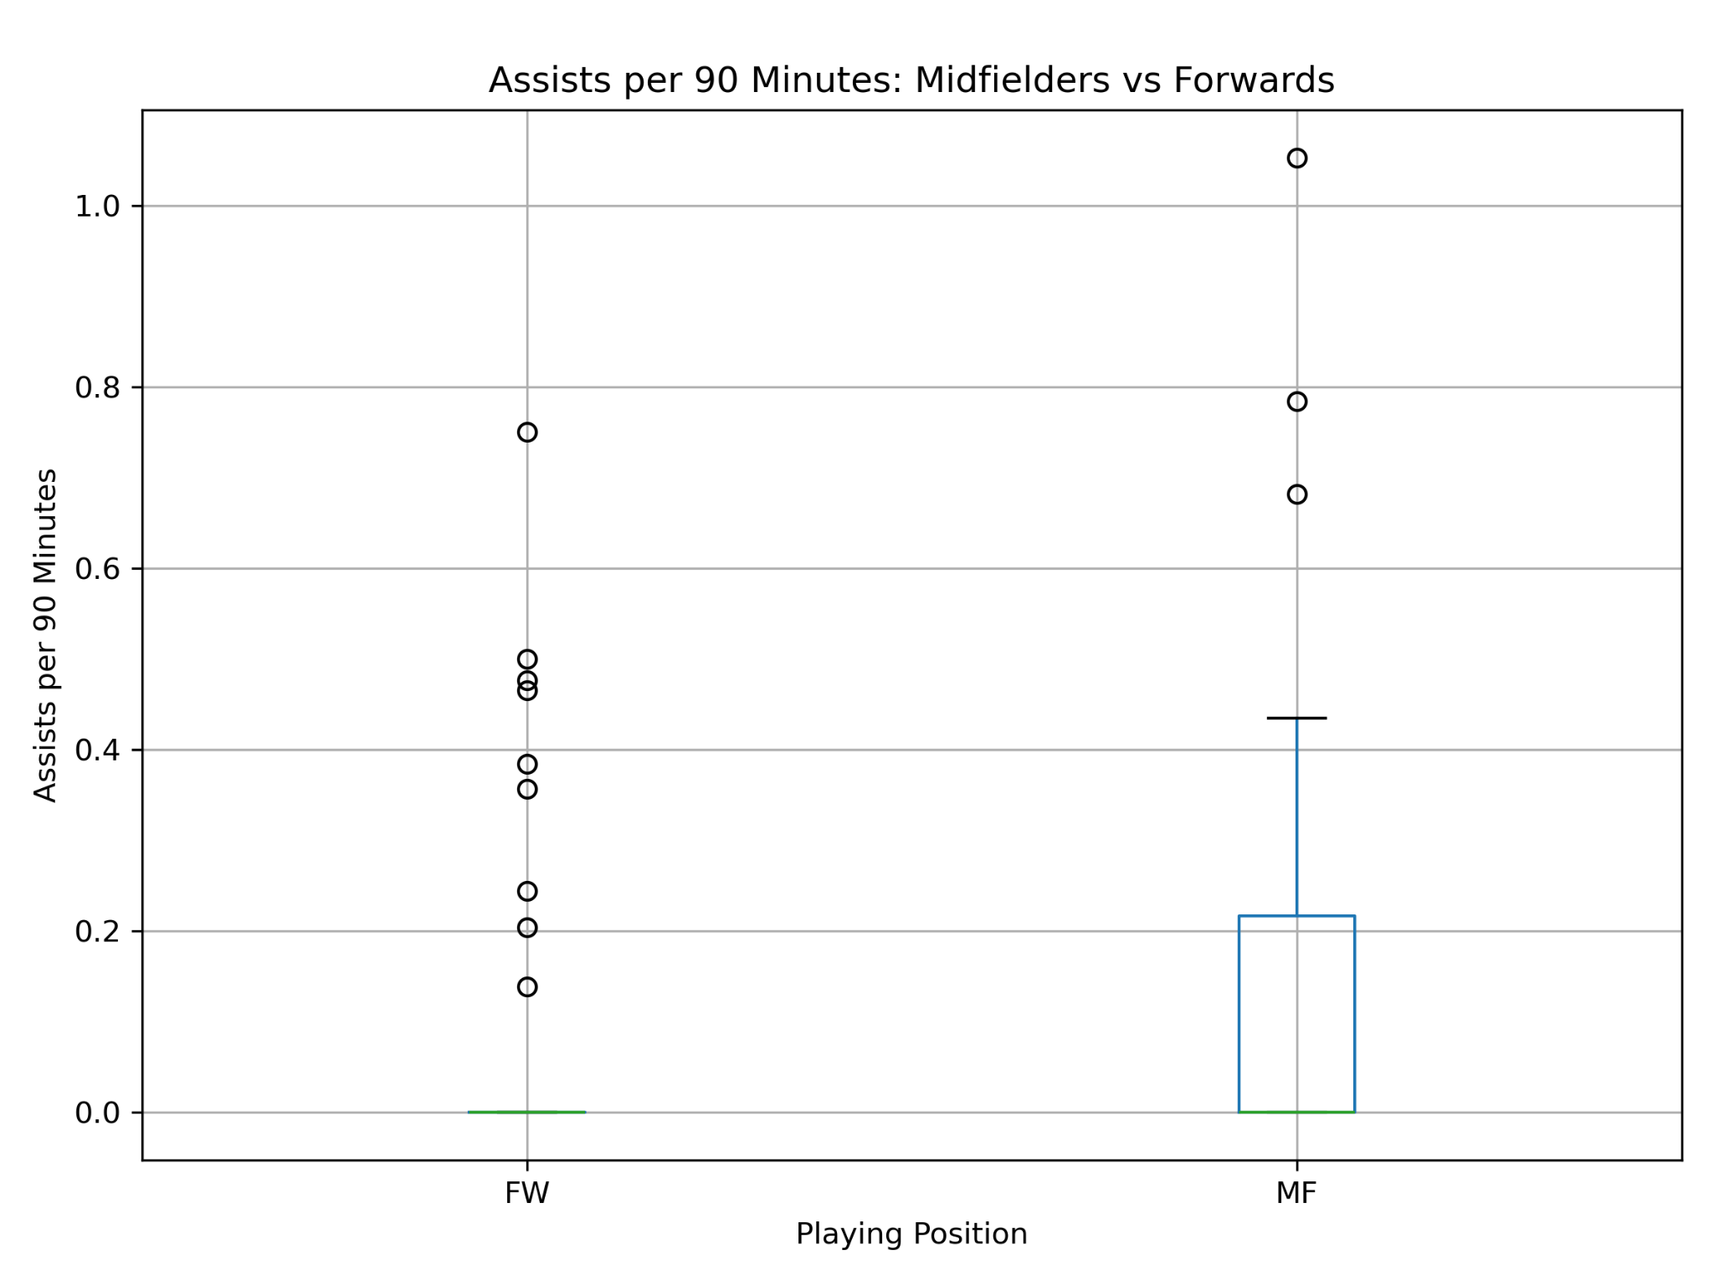
So, What Did the Data Show?
Assists per 90 minutes
MIDFIELDERS
0.133 Ast/90
95% CI: 0.055–0.212
FORWARDS
0.088 Ast/90
95% CI: 0.029–0.147
KEY RESULT
On average, midfielders came out ahead.
That said, both groups still had a median of 0 assists per 90.
3

Slide 5
Statistical Evidence & Conclusion
WELCH TWO-SAMPLE t-TEST
CONCLUSION
t = 0.925 p = 0.3581
Midfielders showed a higher average, but that gap wasn't statistically significant.
α = 0.05
p > 0.05 → fail to reject H₀
There isn't enough evidence here to say midfielders truly outperform forwards on assists per 90.
LIMITATIONS
A large share of zero-assist players skews the rate distribution. This analysis draws on a sample of 40 players per position, not the full eligible pool.
In short: a higher observed rate isn't the same as a statistically confirmed one.
4

