Slide 1
1. Introduction to Database
=

Slide 2
Data
Raw facts and Unprocessed information
building blocks of information
Raw, unprocessed facts or figures without context
Unorganized and unrefined
Often in raw formats like numbers, characters, or symbols.
Example: A list of numbers (e.g., 23, 45, 12).

Slide 3
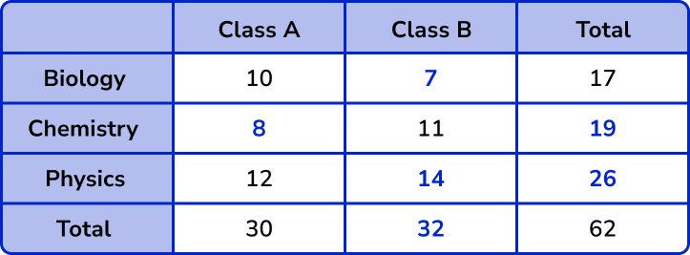
Data

Slide 4
Information
Processed, organized, or structured data with meaning or context
Organized and interpreted
Output after processing
Information depends on data to be created.
Used for decision-making, communication, or analysis.
Usually in a structured format like sentences, graphs, reports, or visualizations.
Example: The average temperature for the week was 26°C.

Slide 5
Why Information is important?
Accurate, relevant, and timely information is key to good decision making
Good decision making is the key to survival in a global environment

Slide 6
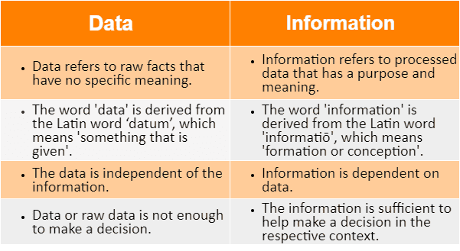
Data vs Information

Slide 7
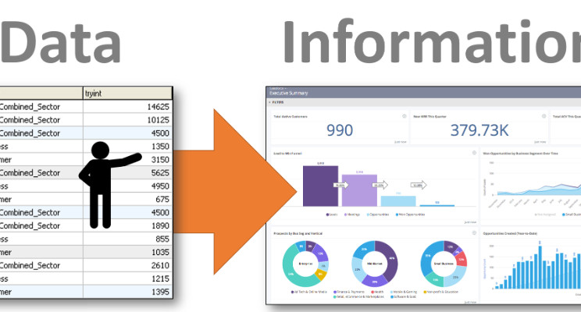
Data vs Information

Slide 8
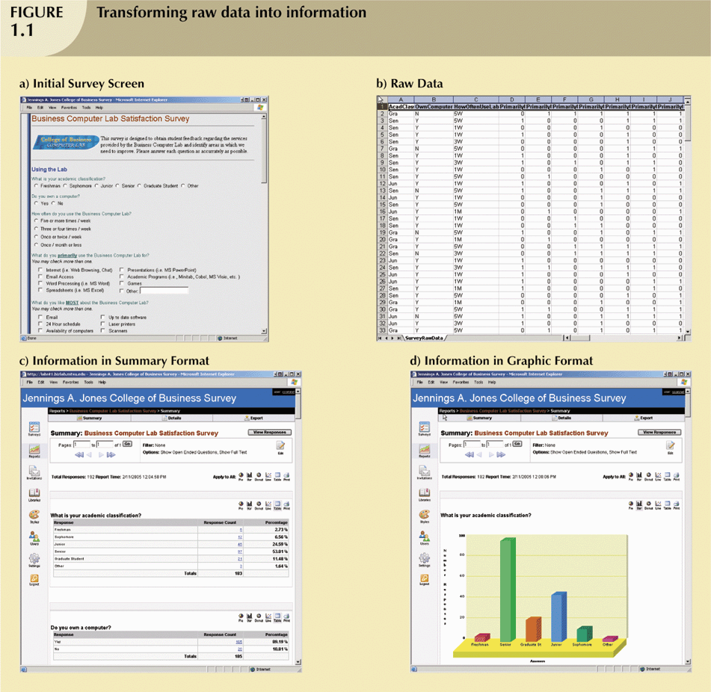
Data to Information

Slide 9
Data to Information

Slide 10
Data to Information

Slide 11
Database
A database is an organized collection of data that is stored, managed, and accessed electronically. It is designed to make data storage, retrieval, and management more efficient
It is shared, integrated computer structure that stores:
End user data (raw facts)
Metadata (data about data)

Slide 12
Database Management System
A Database Management System (DBMS) is software that allows users to interact with, manage, and control a database.
It provides a systematic and organized way to store, retrieve, update, and manage data, ensuring the data is secure, consistent, and easily accessible.
It is Collection of programs that manages database structure and controls access to data
It makes Possible to share data among multiple applications or users
It Makes data management more efficient and effective

Slide 13
Advantages of DBMS
End users have better access to more and better-managed data
Promotes integrated view of organization’s operations
Probability of data inconsistency is greatly reduced
Possible to produce quick answers to ad hoc queries

Slide 14
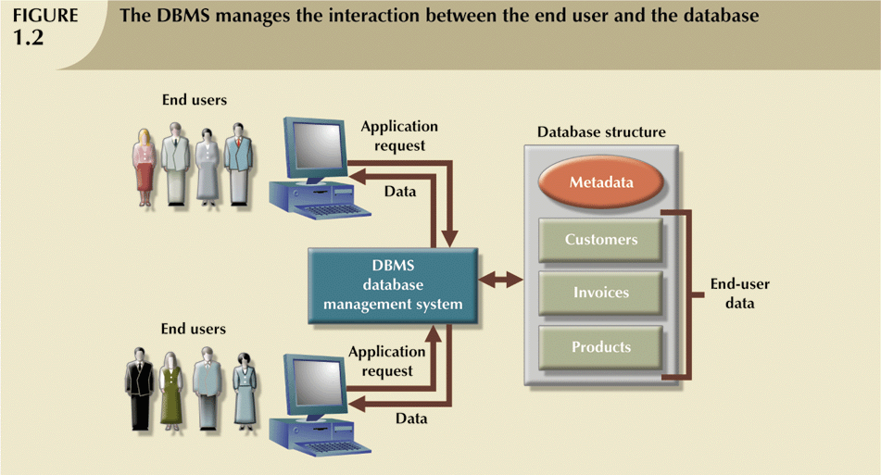
Database and DBMS

Slide 15
Types of Database(on the basis of user access)
Single-user:
Supports only one user at a time
Desktop:
Single-user database running on a personal computer
Multi-user:
Supports multiple users at the same time
Workgroup:
Multi-user database that supports a small group of users or a single department
Enterprise:
Multi-user database that supports a large group of users or an entire organization

Slide 16
Types of Database(on the basis of location)
Can be classified by location:
Centralized:
Supports data located at a single site
Distributed:
Supports data distributed across several sites

Slide 17
Types of Database(on the basis of use)
Transactional (or production):
Supports a company’s day-to-day operations
Data warehouse:
Stores data used to generate information required to make tactical or strategic decisions
Often used to store historical data
Structure is quite different

Slide 18
Types of Database(on the basis of structure)
Relational Database
Organizes data into tables (relations) consisting of rows and columns.
Hierarchical Database
Represents data in a tree-like hierarchy, where each "parent" node can have multiple "child" nodes, but each child has only one parent.
Network Database
Represents data as a graph or interconnected nodes. A record can have multiple parent and child records.
Object Oriented Database
Stores data in the form of objects, similar to object-oriented programming concepts.
Document Oriented Database(NoSQL)
Stores data in document formats like JSON, BSON, or XML.

