Slide 1
The Pursuit of Health Knowledge
Presenters:
Sanaa Mironov (Undergraduate, UMBC)
Sandesh Timilisina (Masters, UMBC)
Dataset: Health Information National Trends Survey (HINTS5, Cycle 3) [Level 4]

Slide 2
HINTS5 Dataset
BACKGROUND:
Research conducted by the U.S. National Cancer Institute (NCI)
Every few years to civilian, non- institutionalized adults in the U.S.
SUMMARY:
5247 completed questionnaires and 191 partially completed questionnaires.
5438 rows
730 features (columns)
To learn about U.S. adults’ cancer-related perceptions and knowledge, their health behaviors and their health-related information access, needs, seeking and use.

Slide 3
Approach
Step 1
Read the documentation
7 different documents explaining the methodology, webpilot results, and annotated Instrument details.
Step 2
Data Preprocessing
Removed 371 columns (NCI weighted scale) - not the focus of this work
Removed all values representing missing values (-9,-7,-5)
Removed non-numeric values (Eg: explanation for ‘if others’ field.)
Step 3
Analysis
Dimensionality Reduction
Reduced similar values to one group in multi-valued features. Eg: Age, Agree/Disagree scale, Daily/ Never scale, Always/Never scale.
Data Exploration techniques and Machine Learning Models
Used different classification and regression models.
Determine the correlation between the features.
Explored the dataset to extract interesting features using different stastistical methods.
Notes:
NCI weight scales they used for internal statistical analysis

Slide 4
Area of Interest
How we can use this dataset to extract information about health- related behaviour and how we can make it better.
Can we predict human health behaviour?
Can we improve health related information seeking behaviour - where and how?
Understand the Influence of social and economic factors on health-related behaviour
Use the understanding towards sustainability in Health sector
Why?
Healthy society is sustainable society.
Resources in health sector are under-utilized.

Slide 5
Pillars of Sustainability?
Social Aspect
Do they seek information?
Where they seek information?
Influence of electronic devices and social media?
Are they happy about it?
Economic Aspect
Does income influence the health behaviour?
Is there any other aspects of economics.
Environmental Aspect
Dataset did not have features to tell about this aspect
What could have been useful?
Carbon footprint of health institution/ locality.
Pollution level - water, air quality

Slide 6
People's’ Opinion about their health and its influence on health behaviour

Slide 7
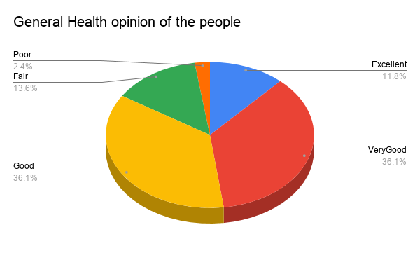
What people think about their health?
Observation:
Majority of the people think that they have Very Good or Good health.

Slide 8
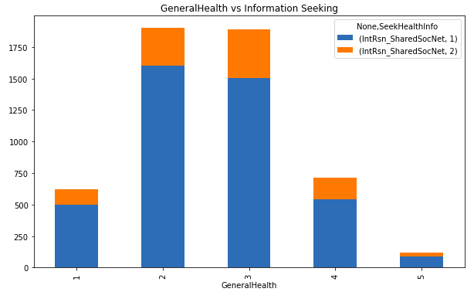
Do people seek health information?
Do not seek health info
Seek health info
Excellent 2. Very Good 3. Good 4. Fair 5. Poor
Observation:
Overall, about 22% of people do not seek health-related information no matter what they feel about their health.
28% of the people who feel that they have Poor health don’t seek health information. Reason? - Income?

Slide 9
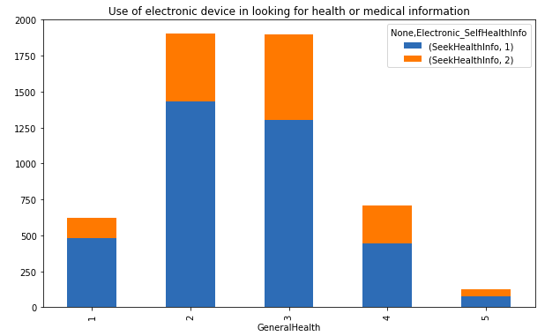
Do people use electronic means to look for health information? - [In past 12 months]
Did not use electronic means
Used electronic means
Excellent 2. Very Good 3. Good 4. Fair 5. Poor
Observation:
Most people have used electronic means to look for health or medical information for themselves.

Slide 10
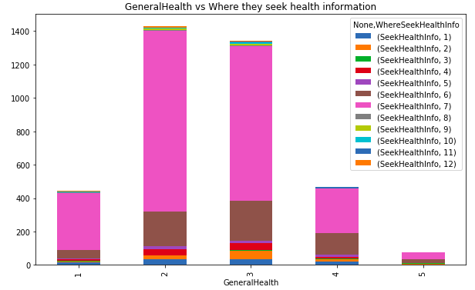
Where do they seek information - Generally?
Books
Brochures
Cancer orgs
Family
Friend/ Co-worker
Doctor
Internet
Library
Magazines
Newspapers
Telephone info
Alternative sources
Internet
Doctors
Excellent 2. Very Good 3. Good 4. Fair 5. Poor
Observation:
In general, people usually look into the Internet for health information more than they visit the Doctors and other health workers.
Mostly used devices: Mobile devices
Location of internet usage: Workplace (internet usage)

Slide 11
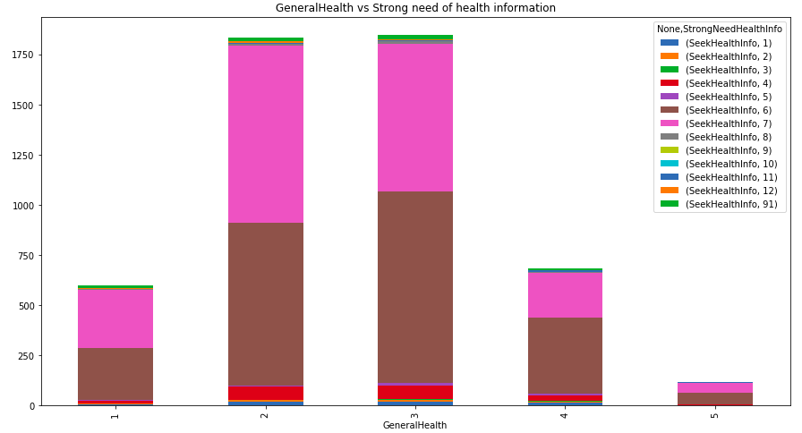
Where - when in strong need of health info?
Books
Brochures
Cancer orgs
Family
Friend / Co-worker
Doctor
Internet
Library
Magazines
Newspapers
Telephone info. no.
Alternative source
Internet
Doctors
Excellent 2. Very Good 3. Good 4. Fair 5. Poor
Observation:
But, when it comes to critical or strong need to get health information, they trust Doctors and other health workers more than Internet.

Slide 12
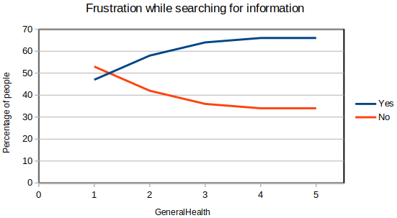
Do they feel frustrated when looking for health related information?
Observation:
Almost 47% of people who think they have excellent health(1) were frustrated.
The frustration gradually increases as the general health gradually decreases. The same goes for lots of effort.
Major source of frustration: Telephone information
Excellent 2. Very Good 3. Good 4. Fair 5. Poor

Slide 13
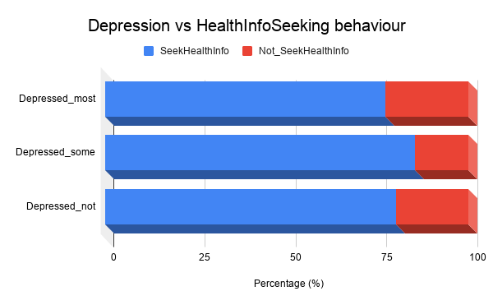
Does Depression/Hopelessness affect Information Seeking? - In past 2 weeks
Observation:
People who felt depressed/hopeless sometime within past 2 weeks sought more health-related information.
People who were depressed most of the time might have been overwhelmed with the amount of resources available. Not able to decide which one to trust.

Slide 14
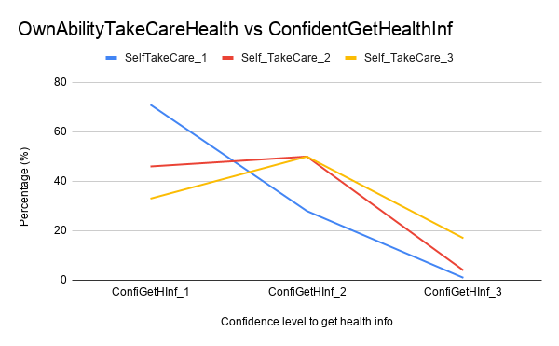
Does Own Ability to Take Care of their Health matters?
Observation: - Yes. It does!!!
Ability to take care goes down -> confidence to get health information goes down.
How do we increase self-efficacy?
Find better ways to point out reliable source. [Reliability index]
Encouraging peer-groups and discussion groups.

Slide 15
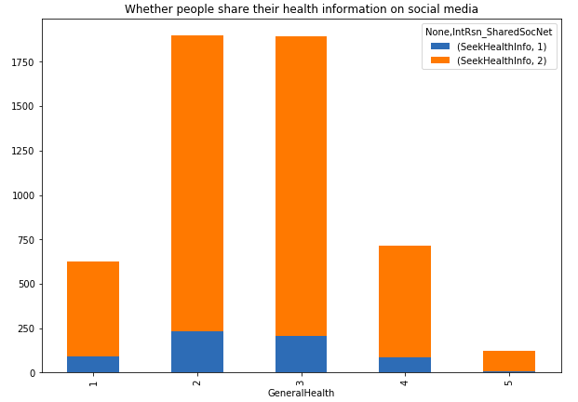
Do they like sharing health related information on Social Media?
Not Share on Social Media
Share on Social Media
Excellent 2. Very Good 3. Good 4. Fair 5. Poor
Observation:
Very few people like to share their health related information on social media, no matter what they feel about their health.

Slide 16
Analysis based on Observation:
Most of the people believe that they have good health in general. This mean that they don’t have any diseases that they know of.
People still trust doctors and other health care workers no matter how advanced the internet or technology has become.
Looking for health related information in workplace means that people,in general, don’t like to share their health issues even with their family members. Majority of the day is spent at work.
People try to get health related information on their own. But the information available makes it difficult to filter out the relevant and reliable sources.
Self efficacy matters when it comes to health related information seeking.
People love using social media platform for different purposes but sharing personal health information is not among them.
Notes:
Need for monitoring the information that is available to public
Point out reliable electronic sources
Too much availability of resources makes it difficult for people to filter out the relevant and reliable source.

Slide 17
Economic Aspects of Health Seeking Behavior

Slide 18
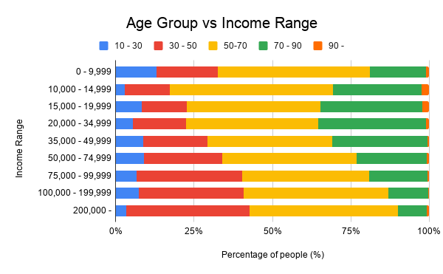
Does Age affects Income?
Observation: - Yes. It does!!!
Working age groups 30-50 and 50-70 had higher income compared to other age groups
Reasons
Work more -> earn more

Slide 19
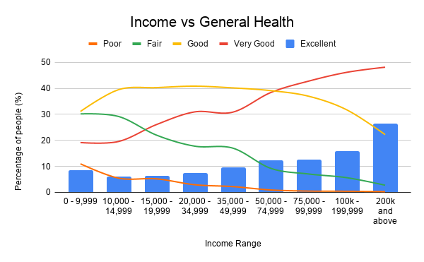
Does Income affects General Health opinion?
Observation: - Yes. It does!!!
The percentage of people who reported Excellent and Very Good health increased with the increase in income.
Reasons
Higher self confidences and better access to health care and treatment.

Slide 20
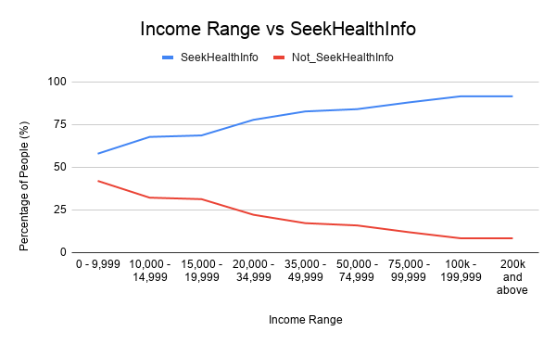
Does Income affects Health Information seeking?
Observation: - Yes. It does!!!
Higher the income -> Higher their desire to seek health related information.
Reasons
Higher income people believe that they can afford the treatment if there is something wrong.

Slide 21
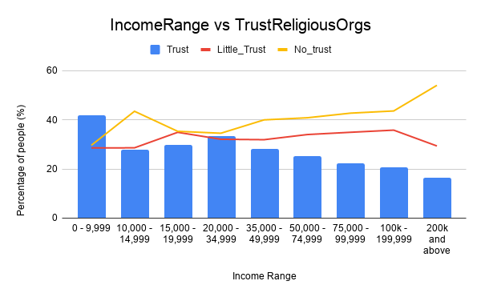
Does Income affects People’s Trust in Religious Orgs for Health related Information?
Observation: - Yes. It does!!!
Higher the income -> Lower the trust over Religious organization for health information.
Income Range 10,000 - 14,999 is an anomaly.

Slide 22
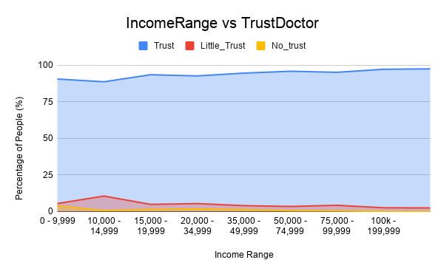
Does Income affects People’s Trust in Doctor for Health related Information?
Observation: - Yes. It does!!!
Trust in doctor increases slightly as the income range increases.
Income Range 10,000 - 14,999 is an anomaly.

Slide 23
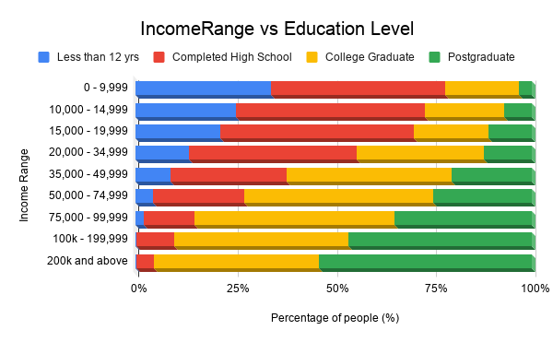
Reason? - Education Level
Observation:
As income range increases, people value education more and more.
This likely makes people aware that Health Workers/Doctors are well equipped and knowledgeable than Religious orgs in terms of health related information.

Slide 24
Analysis based on Observation:
Person’s income influences their health related behaviour and information seeking.
People with higher income believe that they have better health. This might be because people with higher income can spend more on health care and do regular health check-ups.
People with higher income tend to seek more health related information. The likely reason is the higher self-esteem and belief that they can achieve a positive outcome by an informed action.
Lower Income families and individuals trust Religious Orgs more for health related information as they are less educated and have less money for insurance, medical care and treatment.
Higher income family/individuals spend more money on health care and hence seek health treatments from qualified health workers.
Income and Education level are correlated. As one increases so does the other.
Notes:
Need for monitoring the information that is available to public
Point out reliable electronic sources
Too much availability of resources makes it difficult for people to filter out the relevant and reliable source.

Slide 25
Analysis of Cancer

Slide 26
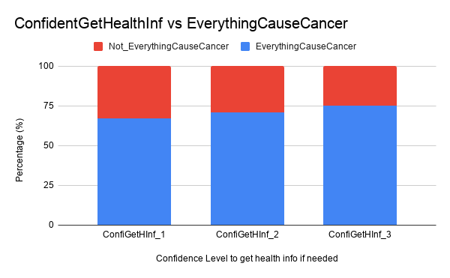
Does Everything CauseCancer?
Highly Confident Somewhat confident Not confident at all
Observation:
People who are less confident about whether they can get health related information in need are more likely to believe that everything causes cancer.
Once you start figuring out information, people realize not everything causes cancer.

Slide 27
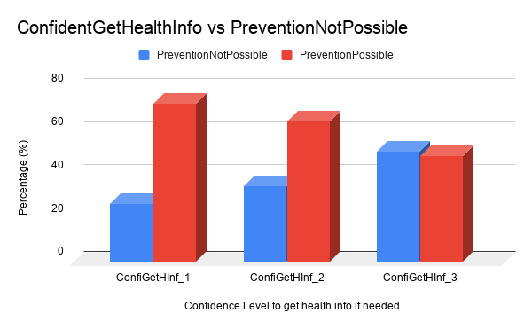
Is Cancer Prevention Not Possible?
Highly Confident Somewhat confident Not confident at all
Observation:
High confidence to get needed health information -> believe Prevention is possible.

Slide 28
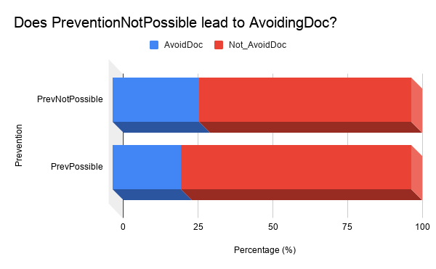
Does PreventionNotPossible lead to AvoidingDoc?
Observation:
People who believed Prevention is not possible avoided doctors more.
People who believed that Cancer prevention is possible also avoided Doctors. This might be because of financial issue.

Slide 29
Analysis based on Observation:
Self-confidence is considered one of the most influential motivators and regulators of behavior in people's everyday lives.
Self-confidence increases with education and income.
Self-confidence translates into relying on healthcare professionals rather than religious organizations for health knowledge.
As people's self-confidence decreases, their outlook on life and disease prevention decrease.
Motivation to seek health knowledge decreases with the decrease in perceived self efficacy, i.e. with the perceived inability to use the information to improve health prospects.
Everyone turns to the Internet for health knowledge first, except individuals with an immediate and apparent health problem.
The absolute majority of the surveyed individuals avoid doctors, regardless of all other factors.
Notes:
Need for monitoring the information that is available to public
Point out reliable electronic sources
Too much availability of resources makes it difficult for people to filter out the relevant and reliable source.
self-efficacy (self-confidence) is a major determinant of behavior only when people have sufficient incentives to act on their self-perception of confidence and when they possess the requisite skills.

Slide 30
Summary
Most people use the Internet as the primary source of health-related information.
People who are more likely to seek health-related information are well-off, well educated, confident, and slightly depressed.
Self-confidence, the belief that a person can achieve better health by self-directed action, is the leading factor motivating people to seek health-related knowledge.
Offering reliable educational online resources for motivated individuals would be the most effective and sustainable way of improving the individual health-related behavior.
We can influence the health related information seeking of the people by monitoring the current health behaviour and motivating people to seek for reliable health information.

Slide 31
Thank You

