Slide 1
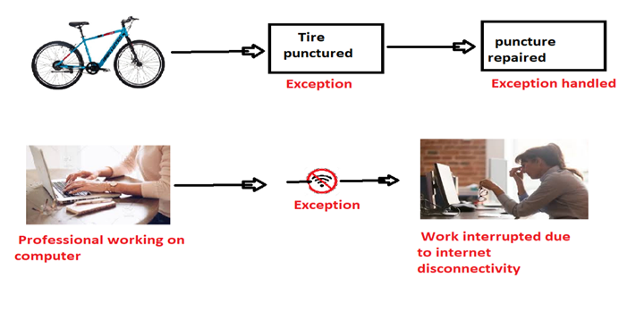
Exception Handling

Slide 2
What is Exception?
Exception is an unwanted or unexpected event, which occurs during the execution of a program, i.e. at run time, that disrupts the normal flow of the program’s instructions.
Exceptions can be caught and handled by the program. When an exception occurs within a method, it creates an object.
This object is called the exception object. It contains information about the exception, such as the name and description of the exception and the state of the program when the exception occurred.
The Exception Handling in Java is one of the powerful mechanism to handle the runtime errors such as ClassNotFoundException, IOException, SQLException, RemoteException, etc. So that the normal flow of the application can be maintained.

Slide 3
Blocks & Keywords used for exception handling
1. try:
The try block contains a set of statements where an exception can occur.
try {
// statement(s) that might cause exception
}
2. catch:
The catch block is used to handle the uncertain condition/ of a try block.
A try block is always followed by a catch block, which handles the exception that occurs in the associated try block.

Slide 4
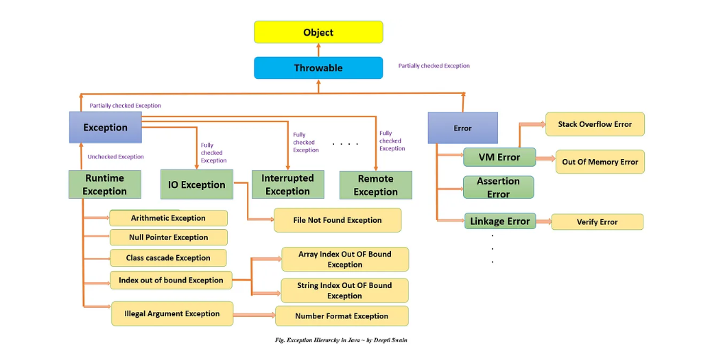
Exception Hierarchy

Slide 5
1. Throwable class: As shown in the above figure, Throwable class which is derived from Object class, is a top of exception hierarchy from which all exception classes are derived directly or indirectly. It is the root of all exception classes. It is present in java.lang package.
Throwable class is the superclass of all exceptions in java.
This class has two subclasses:
Error and Exception.
Errors or exceptions occurring in java programs are objects of these classes. Using Throwable class, you can also create your own custom exceptions.
2. Error: Error class is the subclass of Throwable class and a superclass of all the runtime error classes.
It terminates the program if there is problem-related to a system or resources (JVM).
An error generally represents an unusual problem or situation from which it is difficult to recover.
It does not occur by programmer mistakes. It generally occurs if the system is not working properly or resource is not allocated properly.
3. Exception: It is represented by an Exception class that represents errors caused by the program and by external factors.
Exception class is a subclass of Throwable class and a superclass of all the exception classes.
All the exception classes are derived directly or indirectly from the Exception class. They originate from within the application.

Slide 6
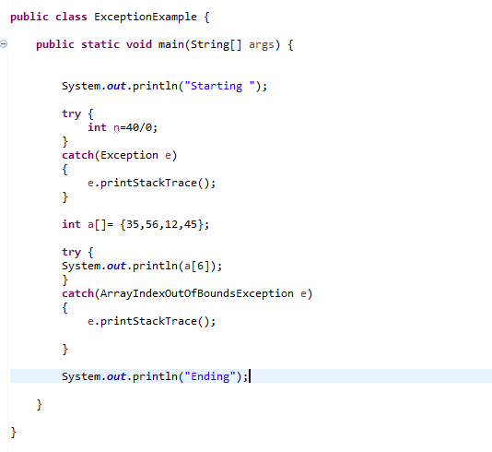
Example

Slide 7
Types Of Exceptions In Java
Exception
Checked
Exception
Unchecked Exception

Slide 8
Checked Exception
These are the exceptions that are checked by the compiler at compile time.
If a method throws a checked exception, then the caller of the method must either handle the exception or declare it in the throws clause.
Unchecked Exception
The RuntimeException class is the superclass of all unchecked exceptions.
The table below represents some of the commonly used unchecked exception classes in Java with their description.

Slide 9
List of common checked exceptions in Java
IOException:
This exception is raised when an input/output operation fails.
SQLException:
This exception is raised when a database operation fails.
ClassNotFoundException: This exception is raised when a class cannot be found.
InstantiationException:
This exception is raised when an object cannot be instantiated.
NoSuchMethodException:
This exception is raised when a method cannot be found.

Slide 10
List of common unchecked exceptions in Java
RuntimeException: This is the superclass of all unchecked exceptions.
NullPointerException: This exception is raised when a null value is used where an object is required.
ArithmeticException: This exception is raised when an arithmetic operation fails.
ArrayIndexOutOfBoundsException: This exception is raised when an array index is out of bounds.

Slide 11
throw
The throw keyword in Java is used to explicitly throw an exception from a method or any block of code.
We can throw either checked or unchecked exception.
The throw keyword is mainly used to throw custom exceptions.
throws
throws is a keyword in Java which is used in the signature of method to indicate that this method might throw one of the exceptions.
The caller to these methods has to handle the exception using a try-catch block.

Slide 12
finally Block
A finally keyword is used to create a block of code that follows a try block. A finally block of code is always executed whether an exception has occurred or not.
Using a finally block, it lets you run any cleanup type statements that you want to execute, no matter what happens in the protected code.
A finally block appears at the end of catch block. finally blocks are used to nullify the object references and closing the I/O streams.
The finally block always executes when the try block exits. This ensures that the finally block is executed even if an unexpected exception occurs.
But finally is useful for more than just exception handling — it allows the programmer to avoid having cleanup code accidentally bypassed by a return, continue, or break.
Putting cleanup code in a finally block is always a good practice, even when no exceptions are anticipated.

Slide 13
Custom Exception
User-defined/custom exceptions in Java are those exceptions that are created by a programmer (or user) to meet the specific requirements of the application. That’s why it is also known as user-defined exception.
It is useful when we want to properly handle the cases that are highly specific and unique to different applications.
For example:
1. A banking application, a customer whose age is lower than 18 years, the program throws a custom exception indicating “needs to open a joint account”.
2. Voting age in India: If a person’s age entered is less than 18 years, the program throws “invalid age” as a custom exception.

Slide 14
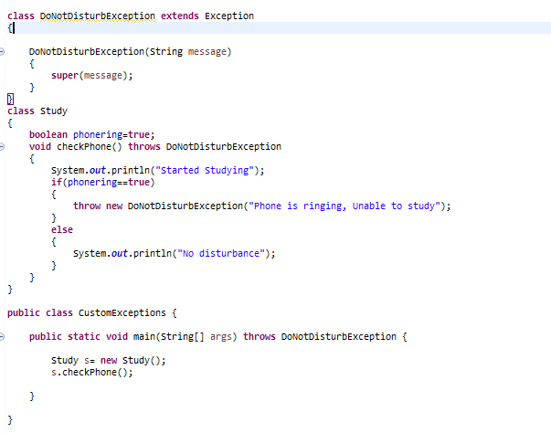
Example For Custom Exception Handling

Slide 15
Methods used in Exception Handling
Using printStackTrace() method − It print the name of the exception, description and complete stack trace including the line where exception occurred.
eg: catch(Exception e)
{
e.printStackTrace();
}
Using toString() method − It prints the name and description of the exception.
Eg:
catch(Exception e)
{
System.out.println(e.toString());
}
Using getMessage() method − Mostly used. It prints the description of the exception.
Eg:
catch(Exception e)
{
System.out.println(e.getMessage());
}

Slide 16
Exception Handling with Method Overriding in Java
Scenrario 1:
If the superclass method does not declare an exception
If the superclass method does not declare an exception, subclass overridden method cannot declare the checked exception but it can declare unchecked exception.
Scenario 2:
If the superclass method declares an exception
If the superclass method declares an exception, subclass overridden method can declare same, subclass exception or no exception but cannot declare parent exception.

