Slide 1
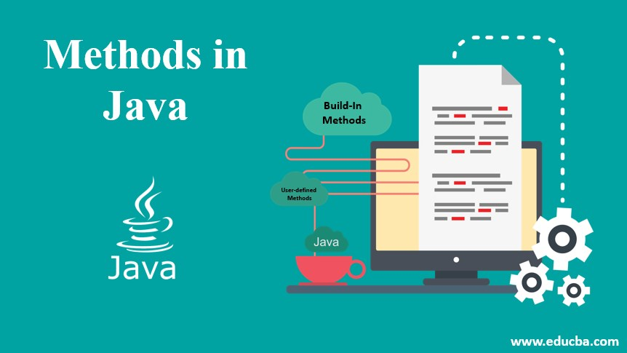

Slide 2
What is Method?
A method is a block of code or collection of statements or a set of code grouped together to perform a certain task or operation.
It is used to achieve the reusability of code.
We write a method once and use it many times.
We do not require to write code again and again.
It also provides the easy modification and readability of code, just by adding or removing a chunk of code.
The method is executed only when we call or invoke it.
Syntax:
<access_modifier> <return_type> <method_name>( list_of_parameters)
{
//body
}

Slide 3
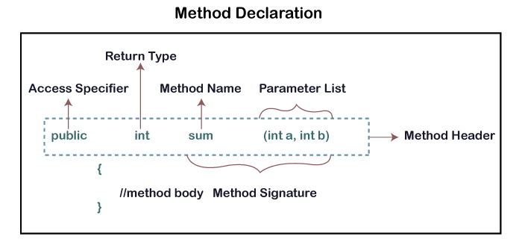
Method Declaration

Slide 4
Return Type: Return type is a data type that the method returns. It may have a primitive data type, object, collection, void, etc. If the method does not return anything, we use void keyword.
Method Name: It is a unique name that is used to define the name of a method.
Parameter List: It is the list of parameters separated by a comma and enclosed in the pair of parentheses. It contains the data type and variable name. If the method has no parameter, left the parentheses blank.
Method Body: It is a part of the method declaration. It contains all the actions to be performed. It is enclosed within the pair of curly braces.

Slide 5
Naming a Method
While defining a method, remember that the method name must be a verb and start with a lowercase letter.
If the method name has more than two words, the first name must be a verb followed by adjective or noun.
In the multi-word method name, the first letter of each word must be in uppercase except the first word. For example:
Single-word method name: sum(), area()
Multi-word method name: areaOfCircle(), stringComparision()
It is also possible that a method has the same name as another method name in the same class, it is known as method overloading.

Slide 6
Java Method Return Type
A Java method may or may not return a value to the function call. We use the return statement to return any value.
int sum()
{
return 10+20;
}

Slide 7
Recursion
The process in which a function/method calls itself directly or indirectly is called recursion and the corresponding function is called as recursive function.
It is especially good for working on things that have many possible branches and are too complex for an iterative approach.
When a recursive call is made, new storage locations for variables are allocated on the stack. As, each recursive call returns, the old variables and parameters are removed from the stack. Hence, recursion generally uses more memory and is generally slow.
On the other hand, a recursive solution is much simpler and takes less time to write, debug and maintain.

Slide 8
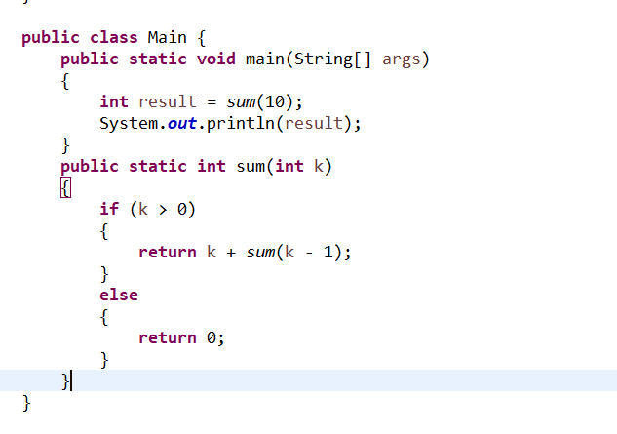
Example:

