Slide 1

Arrays In Java

Slide 2
Arrays in Java
Arrays in Java are fundamental data structures used to store and manipulate collections of elements of the same type.
An array is a collection of similar type of elements which has contiguous memory location.
Java array is an object which contains elements of a similar data type.
It is a data structure where we store similar elements. We can store only a fixed set of elements in a Java array.
Array in Java is index-based, the first element of the array is stored at the 0’th index, 2nd element is stored on 1st index and so on.

Slide 3
Creating an Array in Java
Unlike declaration of the primitive data type variable, the declaration of an array variable does not create any space in memory for the array.
It creates only a memory space for the reference to an array.
If an array variable does not have a reference to an array, the value of the variable is null. We cannot assign values or data to an array unless it has already been created.
In Java, an array is an object. Every object in java belongs to a class, so we can create an array object by using a new keyword and assign its reference to the variable.
The general syntax for the creation of array object is as follows:
dataType arr_name[]=new dataType[size];
In this syntax, arraySize specifies the number of elements in the array that we want to store in it. arrayname is an array variable that is linked to an array.

Slide 4
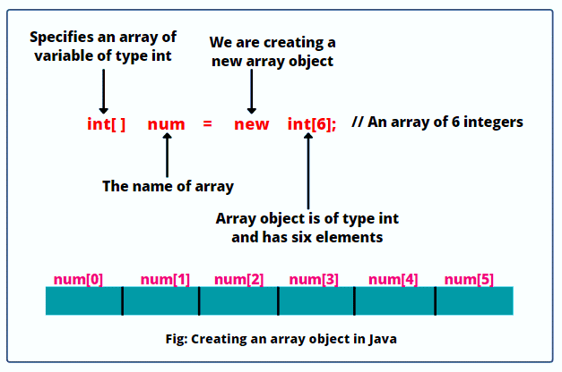
Example

Slide 5
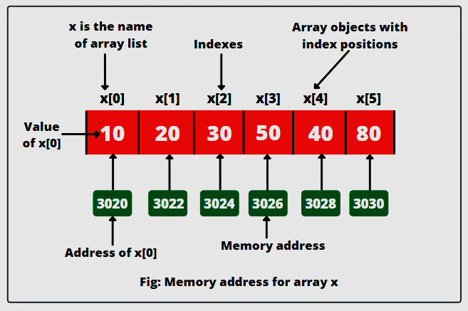
Int x[]={10,20,30,40,80};

Slide 6
Single Dimension Array
Types of Array
Multi Dimension Array

Slide 7
Types of Array in java
There are two types of array.
Single Dimensional Array
The general form of a one-dimensional array declaration is
dataType var-name[];
or
dataType [] var-name;
Multidimensional Array
In such case, data is stored in row and column based index (also known as matrix form).
Syntax:
dataType[ ][ ] var-name; (or)
dataType [ ][ ] var-name; (or)
dataType var-name[ ][]; (or)
dataType [] var-name[];

Slide 8
Example of Java Array
class Testarray{
public static void main(String args[]){
int a[]=new int[5];//declaration and instantiation
a[0]=10;//initialization
a[1]=20;
a[2]=70;
a[3]=40;
a[4]=50;
//traversing array
for(int i=0;i<a.length;i++)//length is the property of array
System.out.println(a[i]);
}
}

Slide 9
Multidimensional array
Multidimensional Arrays can be defined in simple words as array of arrays.
Data in multidimensional arrays are stored in tabular form (in row major order).
It can be both 2D (2 Dimension) Or 3D(3 Dimension)
Syntax:
data_type[1st dimension][2nddimension][]..[Nthdimension] array_name = new data_type[size1][size2]….[sizeN];

Slide 10
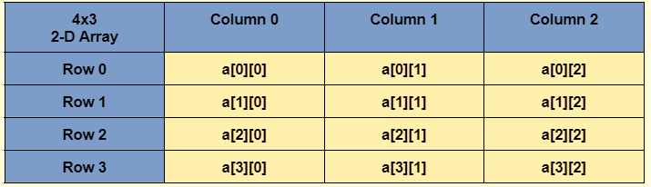
Ex: int [][] x = new int[4][3];

