Slide 2

Core Java & Advanced Java
Java Full Stack Development

Slide 3

Major Companies Who Use Java

Slide 4
Agenda:
Introduction to Java
Features of Java
Types of Applications in Java
Java Editions
JDK,JRE and JVM
Data types in Java
Variables, Identifiers, Constants, Literals
Control Statements
Methods in Java
Recursion
Java Array
Modifiers in Java

Slide 5
OOPs Concepts:
Class, Object, and Types of classes
Constructors
Inheritance
Polymorphism
Abstraction
Encapsulation

Slide 6
Collection Frameworks
Java Collection Framework
Collections class in Java
Collection Interface in Java
How to learn Java collections
List Interface in Java
Queue Interface in Java
Map Interface in Java
Set in Java
Iterator in Java
Comparator in Java
Difference between Comparator and Comparable in Java

Slide 7
Exception Handling in Java
Multithreading in Java
File Handling in Java
Java I/O

Slide 8
Introduction to Java
What is a Programming Language?
A programming language is a computer language that is used by programmers (developers) to communicate with computers. It is a set of instructions written in any specific language ( C, C++, Java, Python) to perform a specific task.

Slide 9
Types of Programming Language
There are 2 types
Low-level programming language
It is a category of computer programming language in which the computer codes are written in the binary language or machine codes.
Because of this, low-level language is sometimes also known as machine language.
The low-level language is less friendly for human (programmer), but more friendly for machine because the computer processor can directly process the codes written in the low-level language.

Slide 10
High-Level Language
Its is a computer programming language that uses English like statements to write the computer instructions.
High-level languages are most widely programming languages because they are easy to understand to human being.

Slide 11
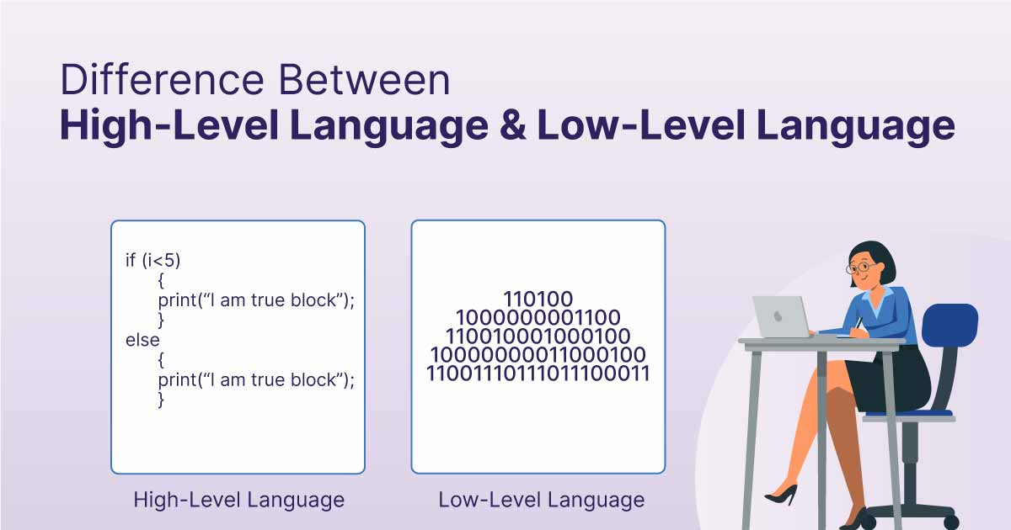

Slide 12
What is Java?
Java is a programming language and a platform. Java is a high level, robust, class based object-oriented and secure programming language. Its used to develop a application.
Java was developed by Sun Microsystems(James Gosling) (which is now the subsidiary of Oracle) in the year 1995.
Object-oriented programming (OOP) is a programming paradigm based on the concept of "objects", which can contain data and code.
The data is in the form of fields (often known as attributes or properties), and the code is in the form of procedures (often known as methods).

Slide 13
Features of Java
Simple:
Java is very easy to learn, and its syntax is simple, clean and easy to understand.
Java has removed many complicated and rarely-used features.
For example, explicit pointers, operator overloading, etc.
There is no need to remove unreferenced objects because there is an Automatic Garbage Collection in Java.

Slide 14
Object-Oriented
Java is an Object Oriented Programming Language, which means in Java everything is written in terms of classes and objects.
Object is nothing but a real world entity that can represent any person, place, or thing and can be distinguished from others.

Slide 15
Platform Independent
Java is platform independent because it is different from other languages like C, C++, etc.
Which are compiled into platform specific machines while Java is a write once, run anywhere language(WORA).
A platform is the hardware or software environment in which a program runs.

Slide 16
Architectural Neutral
Java will never communicate with platform Directly.
Changes and Upgrades in operating systems, processors and system resources will not make any changes in Java Program.
so it avoids rebuilding problem.

Slide 17
Portable
We can carry the java byte code any platform without making any changes.
We can migrate from one operating system to another operating system without changing the code.

Slide 18
Robust
Java is a robust language that can handle run-time errors as it checks the code during the compile and runtime.
Which means it is capable of handling unexpected termination of a program.
Java has a most important and helpful feature called Exception Handling.
Another reason why Java is strong lies in its memory management features.
Unlike other low level languages, Java provides a runtime Garbage collector offered by JVM, which collects all the unused variables.

Slide 19
Secured
Java never communicate directly with machine
First it will be converted into byte code and then that byte code will be converted into machine code by JVM
If the byte-code has some problem or not properly formatted, then JVM won’t allow the code to run and will raise error.
Byte-code verifier checks the code fragments for illegal code that can violate access right to object.

Slide 20
Multi-Threaded
Multithreading is a Java feature that allows concurrent execution of two or more parts of a program for maximum utilization of CPU. Each part of such program is called a Thread.
In Java, you can create threads in two ways, either by implementing the Runnable interface or by extending the Thread class.

Slide 21
Compiled & Interpreted
In programming languages, you have learned that they use either the compiler or interpreter, but Java programming language uses both a compiler and interpreter.
Java programs are compiled to generate bytecode files then JVM interprets the bytecode file during execution.

Slide 22
Distributed
Java lets us create distributed applications that can run on multiple computers simultaneously.
This feature of Java makes us able to access files by calling the methods from any machine on the internet.

Slide 23
Dynamic
In case of Java Programs, all .class file won’t be loaded at the beginning, At run time if JVM required any classes only the corresponding .class file will be loaded(Dynamic Loading).
The main advantage is program will always get latest version of .class file and memory utilization will be improved.

Slide 24
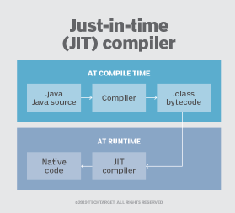
High-performance
Java uses Just-In-Time compiler thus giving us a high performance.
Just-in-time compilation(JIT) is a way of executing computer code that involves compilation during execution of a program rather than before execution.

Slide 25
Types of Java Applications (There are 4 Types)
1) Standalone Application
2) Web Application
3) Enterprise Application
4) Mobile Application

Slide 26
1) Standalone Application
Standalone applications are also known as desktop applications or window-based applications.
These are traditional software that we need to install on every machine. Examples of standalone application are Media player, antivirus, etc.
AWT(Abstract Window Toolkit) and Swing are used in Java for creating standalone applications.

Slide 27
2) Web Application
Java Web Application is used to create dynamic websites. Java provides support for web application through Servlets and JSPs. We can create a website with static HTML pages but when we want information to be dynamic, we need web application. Currently, Servlet, JSP, Struts, Spring, Hibernate, etc. technologies are used for creating web applications in Java.

Slide 28
3) Enterprise Application
An application that is distributed in nature, such as banking applications, etc. is called an enterprise application.
It has advantages like high-level security, load balancing, and clustering.
In Java, EJB(Enterprise Java Bean) is used for creating enterprise applications.

Slide 29
4) Mobile Application
An application which is created for mobile devices is called a mobile application.
Currently, Android and Java ME are used for creating mobile applications.

Slide 30
Java Editions/ Platforms
Java Standard Edition (Java SE)
Java SE's API provides the core functionality of the Java programming language.
Java Enterprise Edition (Java EE)
The Java EE platform provides an API and runtime environment for developing and running large-scale, multi-tiered, scalable, reliable, and secure network applications.
Java Micro Edition (Java ME)
The Java ME platform provides an API and a small-footprint virtual machine for running Java programming language applications on small devices, like mobile phones.
JavaFX
JavaFX is a platform for creating rich internet applications using a lightweight user-interface API.

Slide 31
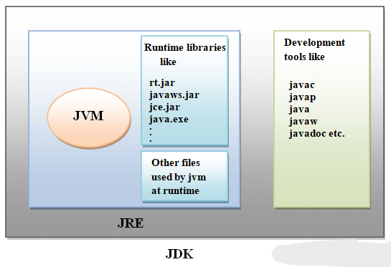
JDK, JRE and JVM

Slide 32
Java Development Kit (JDK)
JDK is a software development environment used for developing Java applications.
It provides an environment to develop and execute(run) the Java program
It includes the Java Runtime Environment (JRE), an interpreter/loader (JVM)(Java), a compiler (javac), an archiver (jar), a documentation generator (Javadoc), and other tools needed in Java development.

Slide 33
JRE (Java Runtime Environment)
Java Run-time Environment (JRE) is the part of the Java Development Kit (JDK).
JRE (Java Runtime Environment) is an installation package that provides an environment to only run(not develop) the java program(or application)onto your machine.
JRE is only used by those who only want to run Java programs that are end-users of your system. The source Java code gets compiled and converted to Java byte code.
If you wish to run this bytecode on any platform, you require JRE. The JRE loads classes, verify access to memory, and retrieves the system resources.

Slide 34
JVM(Java Virtual Machine
JVM is a very important part of both JDK and JRE because it is contained or inbuilt in both.
Whatever Java program you run using JRE or JDK goes into JVM and JVM is responsible for executing the java program line by line, hence it is also known as an interpreter.
JVM (Java Virtual Machine) acts as a run-time engine to run Java applications. JVM is the one that actually calls the main method present in a java code.

Slide 35
Syntax:
Example
HelloWorld.Java
class HelloWorld {
public static void main(String[] args)
{
System.out.println("Hello, World!");
}
}
AccessModifier class class-name{
/*…………..lines of code……………..*/
public static void main(String[] args) {
/*
code
*/
}
}

Slide 36
Variable
Variable in Java is a data container that stores the data values during Java program execution.
A variable is assigned with a data type.
Variable is a memory location name of the data.
It is a combination of "vary + able" which means its value can be changed.
Syntax:
datatype variableName = value;

Slide 37
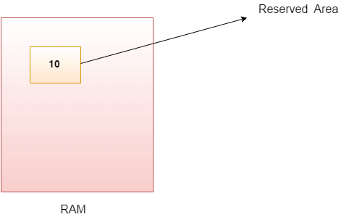
Ex:
int num=10;//Here num is variable

Slide 38
Rules for declaring Variables
A variable name can consist of Capital letters A-Z, lowercase letters a-z digits 0-9, and two special characters such as _ underscore and $ dollar sign.
The first character must not be a digit.
Blank spaces cannot be used in variable names.
Java keywords cannot be used as variable names.
Variable names are case-sensitive.
There is no limit on the length of a variable name but by convention, it should be between 4 to 15 chars.
Variable names always should exist on the left-hand side of assignment operators.

Slide 39
Types of Variables
Local Variables
Instance Variables
Static Variables

Slide 40
Local Variables
A variable declared inside the body of the method is called local variable.
You can use this variable only within that method and the other methods in the class aren't even aware that the variable exists.
A local variable cannot be defined with "static" keyword

Slide 41
Instance Variable
Instance variables are defined without the STATIC keyword .
They are defined Outside a method declaration.
They are Object specific and are known as instance variables.
We need to create an object reference to invoke the variable.

Slide 42
Static Variables
Static variables are initialized only once, at the start of the program execution.
These variables should be initialized first, before the initialization of any instance variables.
When a variable is declared as static, then a single copy of the variable is created and shared among all objects at the class level.
We can call the static variable with the class name directly.

Slide 43
Example:
class Demo{
static int a = 1; //static variable
int data = 99; //instance variable
void method()
{
int b = 90; //local variable
}
}

Slide 44
Identifiers in Java
Identifiers in Java are symbolic names used for identification.
They can be a class name, variable name, method name, package name, constant name, and more.
Ex:
public class Test {
public static void main(String[] args)
{
int a = 20;
}
}

Slide 45
Rules for defining Java Identifiers
If the identifiers are not properly declared, we may get a compile-time error.
Following are some rules and conventions for declaring identifiers:
A valid identifier must have characters [A-Z] or [a-z] or numbers [0-9], and underscore(_) or a dollar sign ($).
There should not be any space in an identifier.
An identifier should not contain a number at the starting.
An identifier should be of length 4-15 letters only. However, there is no limit on its length. But, it is good to follow the standard conventions.
We can't use the Java reserved keywords as an identifier such as int, float, double, char, etc.
An identifier should not be any query language keywords such as SELECT, FROM, COUNT, DELETE, etc.
Names are case sensitive ("myVar" and "myvar" are different variables)

Slide 46
Constant
Constant in Java is an entity that cannot be changed once assigned.
Constant in Java makes the primitive data types immutable.
Java does not directly support the constants. There is an alternative way to define the constants in Java by using the non-access modifiers static and final.
Syntax:
final datatype identifier_name = value;

Slide 47
Data Types in Java
A data type in Java is a term that specifies memory size and type of values that can be stored into the memory location.
In other words, data types define different values that a variable can take.There are two types of data types in Java:
Primitive data types: Primitive types are predefined (already defined) in Java
Non-primitive data types: Non-Primitive data types refer to objects and hence they are called reference types.(Object,String, ArrayList etc)

Slide 48
Data Types
Primitive
Non Primitive
Arrays
Integer
Floating Point
Character
Boolean
Strings
byte
float
char
boolean
short
double
Classes
int
Interfaces
long
Etc.

Slide 49
Primitive Datatypes
boolean
char
byte
short
int
long
float
double

Slide 50
Data Type | Size | Description | Default Value
byte | 1 byte | Stores whole numbers from -128 to 127 | 0
short | 2 bytes | Stores whole numbers from -32,768 to 32,767 | 0
int | 4 bytes | Stores whole numbers from -2,147,483,648 to 2,147,483,647(2^31 to 2^32-1 | 0
long | 8 bytes | Stores whole numbers from -9,223,372,036,854,775,808 to 9,223,372,036,854,775,807(-2^63 to 2^64-1) | 0L
float | 4 bytes | Stores fractional numbers. Sufficient for storing 6 to 7 decimal digits | 0f
double | 8 bytes | Stores fractional numbers. Sufficient for storing 15 decimal digits | 0d
boolean | 1 bit | Stores true or false values | false
char | 2 bytes | Stores a single character/letter or ASCII values | '\u0000'

Slide 51
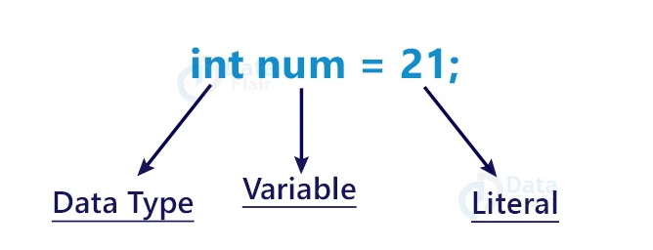
Literals
Literals in Java are a synthetic representation of boolean , character, numeric, or string data.
They are a means of expressing particular values within a program.

Slide 52
Types of Literals in Java
Integral Literals:
Floating-Point Literals
Char Literals
String Literals
Boolean Literals
Null Literals

Slide 53
Non-primitive data types
The non-primitive data types include:
Classes
Interfaces
Arrays
Strings
Enum , Etc.

Slide 54
Operator
Operator in Java is a symbol that is used to perform operations.
For example: +, -, *, / etc.
Java provides many types of operators which can be used according to the need.
They are classified based on the functionality they provide. Some of the types are:

Slide 55
Arithmetic Operators
They are used to perform simple arithmetic operations.
Addition (+)
Subtraction (-)
Multiplication (*)
Division (/)
Modulus(%)

Slide 56
Unary Operators
Java unary operators are the types that need only one operand to perform any operation like increment, decrement, negation, etc.
It consists of various arithmetic, logical and other operators that operate on a single operand.

Slide 57
Operator 1: Unary minus(-)s
This operator can be used to convert a positive value to a negative one.
Syntax:
-(operand)
Illustration:
a = -10

Slide 58
Operator 3: Increment(++)
It is used to increment the value of an integer. It can be used in two separate ways:
Post-increment operator:
When placed after the variable name, the value of the operand is incremented but the previous value is retained temporarily until the execution of this statement and it gets updated before the execution of the next statement.
Syntax:
num++
llustration:
num = 5 num++ = 6

Slide 59
Pre-increment operator:
When placed before the variable name, the operand’s value is incremented instantly.
Syntax:
++num
Illustration:
num = 5 ++ num = 6

Slide 60
Operator 4: Decrement(-–)
It is used to decrement the value of an integer. It can be used in two separate ways:
Post-decrement operator
When placed after the variable name, the value of the operand is decremented but the previous values is retained temporarily until the execution of this statement and it gets updated before the execution of the next statement.
Syntax:
num—
Illustration:
num = 5 num-- = 5 // Value will be decremented before execution od next statement.

Slide 61
Pre-decrement operator
When placed before the variable name, the operand’s value is decremented instantly.
Syntax:
--num
Illustration:
num = 5 --num = 5 //output is 5, value is decremented before execution of next statement

Slide 62
Relational Operators
Java Relational Operators are a bunch of binary operators used to check for relations between two operands, including equality, greater than, less than, etc.
They return a boolean result after the comparison and are extensively used in looping statements as well as conditional if-else statements and so on.
Syntax:
variable1 relational_operator variable2

Slide 63
‘Equal to’ operator (==):
This operator is used to check whether the two given operands are equal or not.
The operator returns true if the operand at the left-hand side is equal to the right-hand side, else false.
‘Not equal to’ Operator(!=):
This operator is used to check whether the two given operands are equal or not.
It functions opposite to that of the equal-to-operator. It returns true if the operand at the left-hand side is not equal to the right-hand side, else false.

Slide 64
‘Greater than’ operator(>):
This checks whether the first operand is greater than the second operand or not.
The operator returns true when the operand at the left-hand side is greater than the right-hand side.
‘Less than’ Operator(<):
This checks whether the first operand is less than the second operand or not.
The operator returns true when the operand at the left-hand side is less than the right-hand side. It functions opposite to that of the greater-than operator.

Slide 65
Greater than or equal to (>=)
This checks whether the first operand is greater than or equal to the second operand or not.
The operator returns true when the operand at the left-hand side is greater than or equal to the right-hand side.
Syntax:
var1 >= var2;

Slide 66
Example for Relational Operators
class Main {
public static void main(String[] args)
{
// create variables
int a = 7, b = 11;
// value of a and b
System.out.println("a is " + a + " and b is " + b);
// == operator
System.out.println(a == b); // false
// != operator
System.out.println(a != b); // true
// > operator
System.out.println(a > b); // false
// < operator
System.out.println(a < b); // true
// >= operator
System.out.println(a >= b); // false
// <= operator
System.out.println(a <= b); // true
}
}

Slide 67
Logical Operator
Logical operators are used to performing logical “AND”, “OR” and “NOT” operations.
They are used to combine two or more conditions/constraints or to complement the evaluation of the original condition under particular consideration.

Slide 68
1. Logical ‘AND’ Operator (&&)
This operator returns true when both the conditions under consideration are satisfied or are true.
If even one of the two yields false, the operator results false.
In Simple terms, cond1 && cond2 returns true when both cond1 and cond2 are true (i.e. non-zero).
Syntax:
condition1 && condition2

Slide 69
2. Logical ‘OR’ Operator (||)
This operator returns true when one of the two conditions under consideration is satisfied or is true.
If even one of the two yields true, the operator results true. To make the result false, both the constraints need to return false.
Syntax:
condition1 || condition2

Slide 70
3. Logical ‘NOT’ Operator (!)
Unlike the previous two, this is a unary operator and returns true when the condition under consideration is not satisfied or is a false condition.
Basically, if the condition is false, the operation returns true and when the condition is true, the operation returns false.
Syntax:
!(condition)

Slide 71
Examples For Logical Operators
class Main {
public static void main(String[] args) {
// && operator
System.out.println((5 > 3) && (8 > 5)); // true
System.out.println((5 > 3) && (8 < 5)); // false
// || operator
System.out.println((5 < 3) || (8 > 5)); // true
System.out.println((5 > 3) || (8 < 5)); // true
System.out.println((5 < 3) || (8 < 5)); // false
// ! operator
System.out.println(!(5 == 3)); // true
System.out.println(!(5 > 3)); // false
}
}

Slide 72
Ternary Operator
Java ternary operator is the only conditional operator that takes three operands.
We can use the ternary operator in place of if-else conditions or even switch conditions using nested ternary operators.
Although it follows the same algorithm as of if-else statement, the conditional operator takes less space and helps to write the if-else statements in the shortest way possible.
Syntax:
variable = Expression ? Expression1: Expression2
Here's how it works.
If the Expression is true, expression1 is assigned to the variable.
If the Expression is false, expression2 is assigned to the variable.

Slide 73
Bitwise Operators
Bitwise operators are used to performing the manipulation of individual bits of a number.
They can be used with any integral type (char, short, int, etc.).
Types:
Bitwise AND(&)
Bitwise inclusive OR |
Bitwise exclusive XOR(^)
Bitwise Complement (~)
Left Shift (<<)
Right Shift(>>)

Slide 74
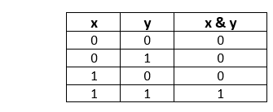
Bitwise Operators
Bitwise AND (&)
The bitwise AND & operator returns 1 if and only if both the operands are 1. Otherwise, it returns 0.

Slide 75
Bitwise OR Operator (|)
The bitwise OR(|) operator returns 1 if any one of the operands is 1. Otherwise, it returns 0 when both operands returns 0.
X | Y | X|Y
0 | 0 | 0
1 | 0 | 1
0 | 1 | 1
1 | 1 | 1

Slide 76
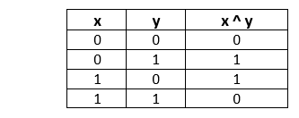
Bitwise XOR Operator(^)
The bitwise XOR ^ operator returns 1 if and only if one of the operands is 1. However, if both the operands are 0 or if both are 1, then the result is 0

Slide 77
Bitwise Complement Operator(~)
The bitwise complement operator is a unary operator (works with only one operand).
It is denoted by ~.
It changes binary digits 1 to 0 and 0 to 1.
Note:
Here the bitwise compliment of any integer N is equal to –(N+1)

Slide 78
Shift Operators
Left Shift Operator(<<)
The left shift operator shifts all bits towards the left by a certain number of specified bits.
It is denoted by <<.

Slide 79
Right Shift Operator
The right shift operator shifts all bits towards the right by a certain number of specified bits. It is denoted by >>

Slide 80
Control Statements
Control statements in Java are instructions that manage the flow of execution of a program based on certain conditions.
They are used to make decisions, to loop through blocks of code multiple times, and to jump to a different part of the code based on certain conditions.
Control statements are fundamental to any programming language, including Java, as they enable the creation of dynamic and responsive programs.
Java provides three types of control flow statements.
- Decision Making statements
- Loop statements
- Jump statements

Slide 81
Decision-Making statements
Decision making statements contain conditions that are evaluated by the program.
If the condition is true, then a set of statements are executed and if the condition is false then another set of statements is executed.
Types:
if
if-else
nested-if
if-else-if
switch-case

Slide 82
If condition
It is used to decide whether a certain statement or block of statements will be executed or not
I.e if a certain condition is true then a block of statements is executed otherwise not.
Syntax:
if(condition) {
// Statements to execute if condition is true
}

Slide 83
if-else Statement
We can use the else statement with the if statement to execute a block of code when the condition is false.
Syntax:
if (condition) {
// Executes this block if condition is true
}
else
{
// Executes this block if condition is false
}

Slide 84
Nested-if
Nested if statements mean an if statement inside an if statement.
Yes, java allows us to nest if statements within if statements.
i.e, we can place an if statement inside another if statement.
Syntax:
if (condition1) {
// Executes when condition1 is true
if (condition2)
{
// Executes when condition2 is true
}
}

Slide 85
if-else-if ladder:
The if statements are executed from the top down.
As soon as one of the conditions controlling the if is true, the statement associated with that ‘if’ is executed, and the rest of the ladder is bypassed.
If none of the conditions is true, then the final else statement will be executed.
There can be as many as ‘else if’ blocks associated with one ‘if’ block but only one ‘else’ block is allowed with one ‘if’ block.
Syntax:
if (condition) statement;
else
if (condition) statement;
. .
else statement;

Slide 86
Switch statement
The Java switch statement executes one statement from multiple conditions.
It is like if-else-if ladder statement.
The switch statement works with byte, short, int, long, enum types, String and some primitive data types like Byte, Short, Int, and Long.
Since Java 7, you can use strings in the switch statement.

Slide 87
Syntax:
switch(expression){
case value1:
//code to be executed;
break; //optional
case value2:
//code to be executed;
break; //optional
......
default:
code to be executed if all cases are not matched;
}

Slide 88
int day = 4;
switch (day)
{
case 1:
System.out.println("Monday");
break;
case 2:
System.out.println("Tuesday");
break;
case 3: System.out.println("Wednesday");
break;
case 4: System.out.println("Thursday");
break;
case 5: System.out.println("Friday");
break;
case 6: System.out.println("Saturday");
break;
case 7: System.out.println("Sunday");
break;
} // Outputs "Thursday" (day 4)

Slide 89
Jump Statements
Break: In Java, a break is majorly used for Terminate a sequence in a switch statement (discussed above).
To exit a loop.
Continue: The continue statement is used in loop control structure when you need to jump to the next iteration of the loop immediately.
It can be used with for loop or while loop.

Slide 90
Looping Statements
Looping in programming languages is a feature which facilitates the execution of a set of instructions/functions repeatedly while some condition evaluates to true.
There are 3 Ways:
For Loop
While Loop
Do While Loop

Slide 91
For Loop:
It enables us to initialize the loop variable, check the condition, and increment/decrement in a single line of code.
We use the for loop only when we exactly know the number of times, we want to execute the block of code.
Syntax:
for(initialization; condition; increment/decrement){
//statement or code to be executed
}

Slide 92
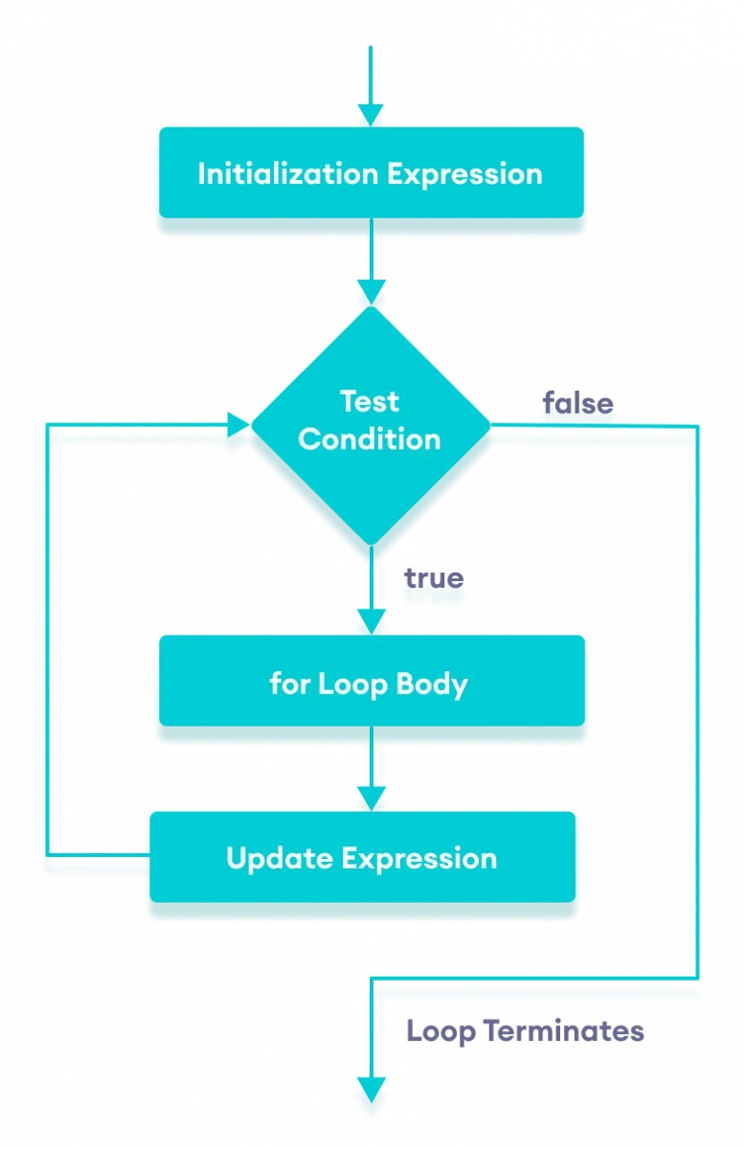
Flow Chart:

Slide 93
How does a For loop execute?
Control falls into the for loop. Initialization is done
The flow jumps to Condition
Condition is tested.
If Condition yields true, the flow goes into the Body
If Condition yields false, the flow goes outside the loop
The statements inside the body of the loop get executed.
The flow goes to the Updation(Increment/Decrement)
Updation takes place and the flow goes to Step 3 again
The for loop has ended and the flow has gone outside.

Slide 94
Nested For Loops
Nested For loop means a loop statement inside another loop statement. That is why nested loops are also called as “loop inside loop“.
Syntax for Nested For loop:
for ( initialization; condition; increment )
{
for ( initialization; condition; increment )
{
// statement of inside loop
}
// statement of outer loop
}

Slide 95
class Main {
public static void main(String[] args)
{
int weeks = 3;
int days = 7;
// outer loop prints weeks
for (int i = 1; i <= weeks; ++i)
{
System.out.println("Week: " + i);
// inner loop prints days
for (int j = 1; j <= days; ++j)
{
System.out.println(" Day: " + j);
}
}
}
}

Slide 96
While loop
Java while loop allows code to be executed repeatedly based on a given Boolean condition.
The while loop can be thought of as a repeating if statement.
While loop in Java comes into use when we need to repeatedly execute a block of statements.
The while loop is considered as a repeating if statement.
If the number of iterations is not fixed, it is recommended to use the while loop.

Slide 97
Do While Loop
Java do-while loop is an Exit control loop. Therefore, unlike for or while loop, a do-while check for the condition after executing the statements of the loop body.
Syntax:
do {
// Loop Body Update_expression
}
// Condition check
while (test_expression);

