Slide 1
Fundamentals Of OOPS
Classes & Objects
Constructors

Slide 2

Objects

Slide 3
Object
An object is a basic unit of an object-oriented programming language. It is any real-world thing that has properties and actions.
In other words, an entity that has state and behavior is known as object in Java. Here, the state represents properties, and behavior represents actions or functionality.
For example, book, pen, pencil, TV, fridge, washing machine, mobile phone, etc. Objects consist of states or attributes (called data members) and behaviors (called methods) in Java.
An object is an instance of a class. Each instance of an object holds its own relevant data.
We create an object using new keyword
Syntax :
Class_Name ref_variable_name=new Class_Name();

Slide 4
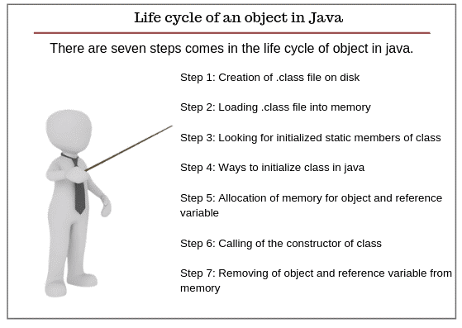
Life Cycle Of An Object
We should know how objects are born, live their life, and then die at the end.

Slide 5
Step 1: Creation of .class file on disk
As you know that Java programs run on the Java virtual machine (JVM). When we compile the Java class, it is transformed into byte code which is platform and machine-independent. The compiled classes are stored as a .class file on a disk.
Step 2: Loading .class file into memory
After that, the Java runtime finds out that class on the disk that is in the form of a .class file. Java classloader loads that class into memory and then Java runtime reads it into the memory.
Step 3: Looking for initialized static members of class
Now Java looks for all initialized static members of the class such as static method, static field, and static block.
You always remember that all the static members of the class do not belong to any particular instance of the class. It belongs to the class itself and is shared by all the objects created from the class.
Step 4: Ways to initialize class in java
A class can be initialized in two ways in Java. First, when you access a static field or static method of the class.
For example, when you run the main method in a class, the class is initialized because the main method is static and the second way is when object or instance of the class is created using the new keyword, the class is initialized.

Slide 6
Step 5: Allocation of memory for object and reference variable
In stage 5, Java allocates the memory on the heap for the object and memory on the stack for object reference variable.
Step 6: Calling of the constructor of class
After allocating the memory, JVM calls the constructor of the class which is like a method but it is called only once when the object is created.
Step 7: Removing of object and reference variable from memory
When the accessing of field and methods are completed, the object and its reference are removed from the memory by the JVM. At this time the object has died.
You don’t have to destroy objects yourself. Actually, when the object is no longer in use, Java runtime calls the garbage collector to destroy all the objects. Thus, objects are born, live, a

Slide 7
Characteristics Of An Object
An object in Java has three characteristics:
1. State: State represents properties or attributes of an object. It is represented by instance variable. The properties of an object are important because the outcome of functions depends on the properties.
2. Behavior: Behavior represents functionality or actions. It is represented by methods in Java.
3. Identity: Identity represents the unique name of an object. It differentiates one object from the other. The unique name of an object is used to identify the object.

Slide 8
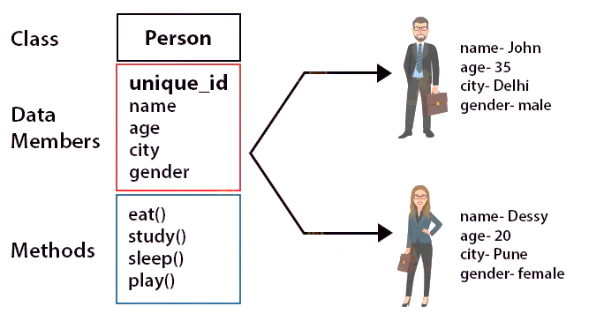
Object representation

Slide 9
Ways to create an Object
We can create object in 5 ways
Java new Operator
Java Class.newInstance() method
Java newInstance() method of constructor
Java Object.clone() method
Java Object Serialization and Deserialization

Slide 10
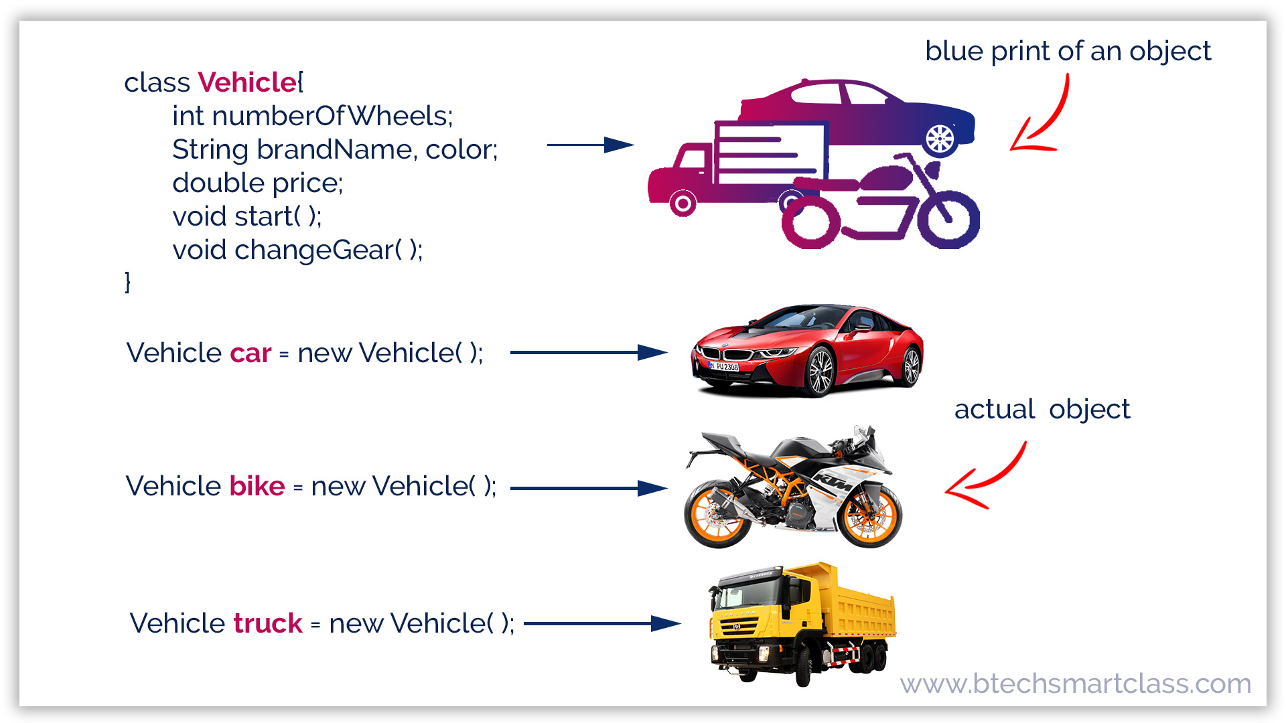
Class

Slide 11
What is Class?
Class is a blue print of an object.
A class in Java is a fundamental building block of object-oriented programming (OOP) language. In other words, a class is the basic unit of OOP.
According to OOPs concept in Java, a class is the blueprint/template of an object. It contains the similar types of objects having the same states (properties) and behavior.
In other words, a class can also be defined as “a class is a group of objects which are common to all objects of one type”.
Syntax to Declare Class in Java
access_modifier Class_Name
{
// class body
}

Slide 12
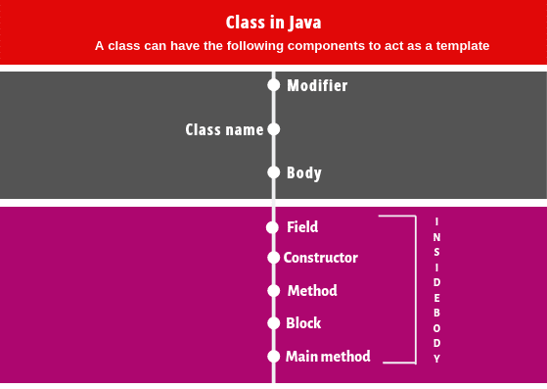
Components Of Class

Slide 13
1. Modifiers: A class can be either a public or default access modifier. But the members of class can be public, private, default, and protected. All these are the access modifiers.
2. Class name: By convention, a class name should begin with a capital letter and subsequent characters lowercased (for example Student). If a name consists of multiple words, the first letter of each word should be uppercased ( for example CollegerStudent).
3. Body: Every class’s body is enclosed in a pair of left and right braces.
Note:
A class name can also start with an underscore ”_”. The following class name can be valid such as _, _Student. Keywords cannot be a valid class name. For example, class, true, null, etc are not accepted as a class name.

Slide 14
Inner Class In Java
Java inner class or nested class is a class that is declared inside the class or interface.
We use inner classes to logically group classes and interfaces in one place to be more readable and maintainable.
Additionally, it can access all the members of the outer class, including private data members and methods.
Syntax:
class Java_Outer_class{
//code
class Java_Inner_class{
//code
}
}
Need of Java Inner class
Sometimes users need to program a class in such a way so that no other class can access it. Therefore, it would be better if you include it within other classes.

