Slide 1
Constructor in Java

Slide 2
What is constructor?
A constructor in Java is a block of code, syntactically similar to a method that is used to initialize the state of an object in a class.
In other words, a constructor is a special member function of a class used to initialize instance variables of a class. The sole purpose of a constructor is to perform the initialization of data fields of an object in the class.
Java constructor can perform any action, but specially designed to perform initializing actions, such as initializing the instance variables with legal initial values.
A constructor within a class allows constructing the object of the class at runtime. It is automatically invoked when an instance of a class is created using the new operator.
Constructors can also accept arguments like methods and can be overloaded. If we try to create an object of the class without specifying any constructor in the class, the compiler automatically creates a default constructor for us.

Slide 3
Syntax:
Access modifiers_name class_name(parameter_list) // constructor header.
{
// Constructor body which is a block of statements.
// Here, we can initialize the values of instance variables.
}
Note:
If you apply a private access modifier with a Java constructor, you cannot create an object of that class in other classes. If somebody asks that I want to create a class but nobody should instantiate it, you can say “make the constructor private”.

Slide 4
Characteristics Of a Constructor
Constructor’s name must be exactly the same as the class name in which it is defined. It must end with a pair of simple braces.
The constructor should not have any return type even void also because if there is a return type, then JVM would consider as a method, not a constructor.
Compiler and JVM differentiate constructor and method definitions on the basis of the return type.
Suppose you define the method and constructor with the same name as that of the class name, then JVM would differentiate between them by using return type.

Slide 5
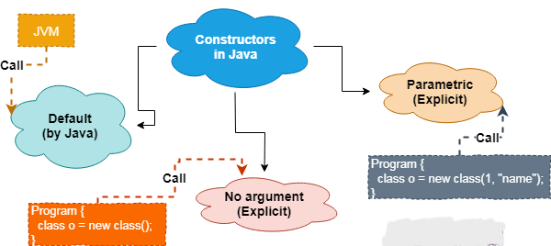
Types of Constructors in Java
Basically, there are three types of constructors in Java programming. They are as:
Default Constructor
Non-parameterized constructor
Parameterized Constructor

Slide 6
Default Constructor
A constructor that has no parameter is known as default constructor in Java. When a class does not declare a constructor, Java compiler automatically adds a constructor for that class.
In other words, the compiler adds a default constructor only when we do not define any constructor explicitly. The constructor added by compiler is called default constructor.
Non-parameterized Constructor in Java
A constructor which has no parameters in the parentheses but contains statements inside its body is called a non-parametrized constructor. We also call it as a non-argument constructor in Java.
A non-parameterized constructor has the same signature as that of default constructor, except for only one difference between them. Using non-parameterized constructor, we can initialize any values for the instance variables.
Parameterized Constructor
A constructor that takes one or more parameters and contains statements inside its body is called parameterized constructor in Java. In the parameterized constructor, instance variables automatically initialize at runtime when we pass values to parameters during object creation.
The parameterized constructor is used to provide different values to distinct objects. It allows us to initialize instance variables with unlike values. In the case of the default constructor, values remain the identical for all objects.

Slide 7
Difference between Constructor and Method in Java
SN | Constructor | Method
1. | Constructor is a special type of method that is used to initialize the state of an object. | Method is used to expose the behaviour of an object.
2. | It has no return type even void also. | It has both void and return type.
3. | If we don’t provide any constructor in the class, Java Compiler provides a default constructor for that class. | Method is not provided by the compiler in any case.
4. | Constructor’s name must be the same as the name of the class. | Method name may or may not be the same name as the class name.
5. | The purpose of a constructor is to create an object of a class. | The purpose of a method is to execute the functionality of the application.
6. | They are not inherited by subclasses. | They are inherited by subclasses.

Slide 8
Constructor Chaining
Constructor chaining in Java is a technique of calling one constructor from within another constructor by using this and super keywords.
The keyword “this” is used to call a constructor from within another constructor in the same class.
The keyword “super” is used to call the parent (super) class constructor from within child (subclass) class constructor. It occurs through inheritance.
We cannot call the constructor directly by name because it is illegal in Java. When we implement constructor chaining technique in Java programming, it is important to understand the order in which constructors will execute.

Slide 9
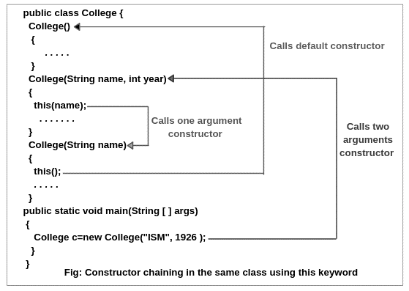
Order of Execution of Constructor

Slide 10
Constructor Overloading
In Java, constructor overloading means to define multiple constructors but with different signatures.
Constructor overloading is a technique of having more than one constructor in the same class with different parameter lists.
In other words, defining two or more constructors with the same name in a class but with different signatures is called constructor overloading.
We arrange them in a such a way that each constructor performs a different task.
Java compiler differentiates these constructors based on the number of the parameter lists and their types. Therefore, the signature of each constructor must be different.
The signature of a constructor consists of its name and sequence of parameter types. If two constructors of a class have the same signature, it represents ambiguity. In this case, Java compiler will generate an error message because the compiler will be unable to differentiate which form to execute.

Slide 11
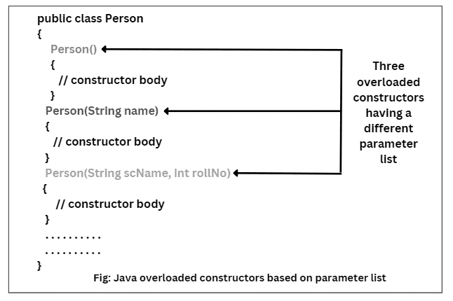
Example

Slide 12
Copy Constructor
By default, Java compiler does not create any copy constructor in a class like C++. Like a constructor, a copy constructor also does not have a return type.
A constructor which is used to copy the data of one object to another object of the same class type is called copy constructor in Java.
In other words, a constructor that creates a copy of an existing object is called copy constructor. It provides an easy and attractive mechanism to create an exact copy of an object from an object sent as an argument to the constructor.
A copy constructor is called when it takes a reference to an object of the same class as an argument and returns a new copy with the same values as the argument.

Slide 13
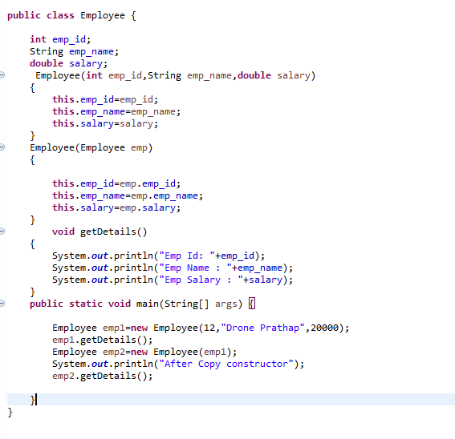
Example of Copy Constructor

