Slide 1
Fundamentals Of OOPS
Classes & Objects
Constructors

Slide 2

Objects

Slide 3
Object
An object is a basic unit of an object-oriented programming language. It is any real-world thing that has properties and actions.
In other words, an entity that has state and behavior is known as object in Java. Here, the state represents properties, and behavior represents actions or functionality.
For example, book, pen, pencil, TV, fridge, washing machine, mobile phone, etc. Objects consist of states or attributes (called data members) and behaviors (called methods) in Java.
An object is an instance of a class. Each instance of an object holds its own relevant data.
We create an object using new keyword
Syntax :
Class_Name ref_variable_name=new Class_Name();

Slide 4
Characteristics Of An Object
An object in Java has three characteristics:
1. State: State represents properties or attributes of an object. It is represented by instance variable. The properties of an object are important because the outcome of functions depends on the properties.
2. Behavior: Behavior represents functionality or actions. It is represented by methods in Java.
3. Identity: Identity represents the unique name of an object. It differentiates one object from the other. The unique name of an object is used to identify the object.

Slide 5
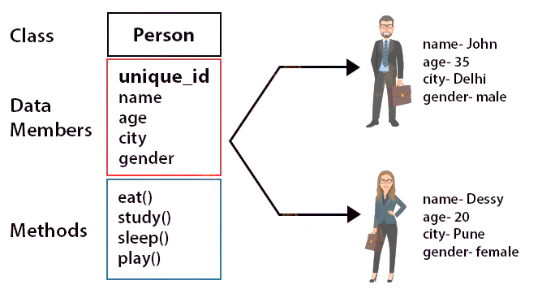

Slide 6
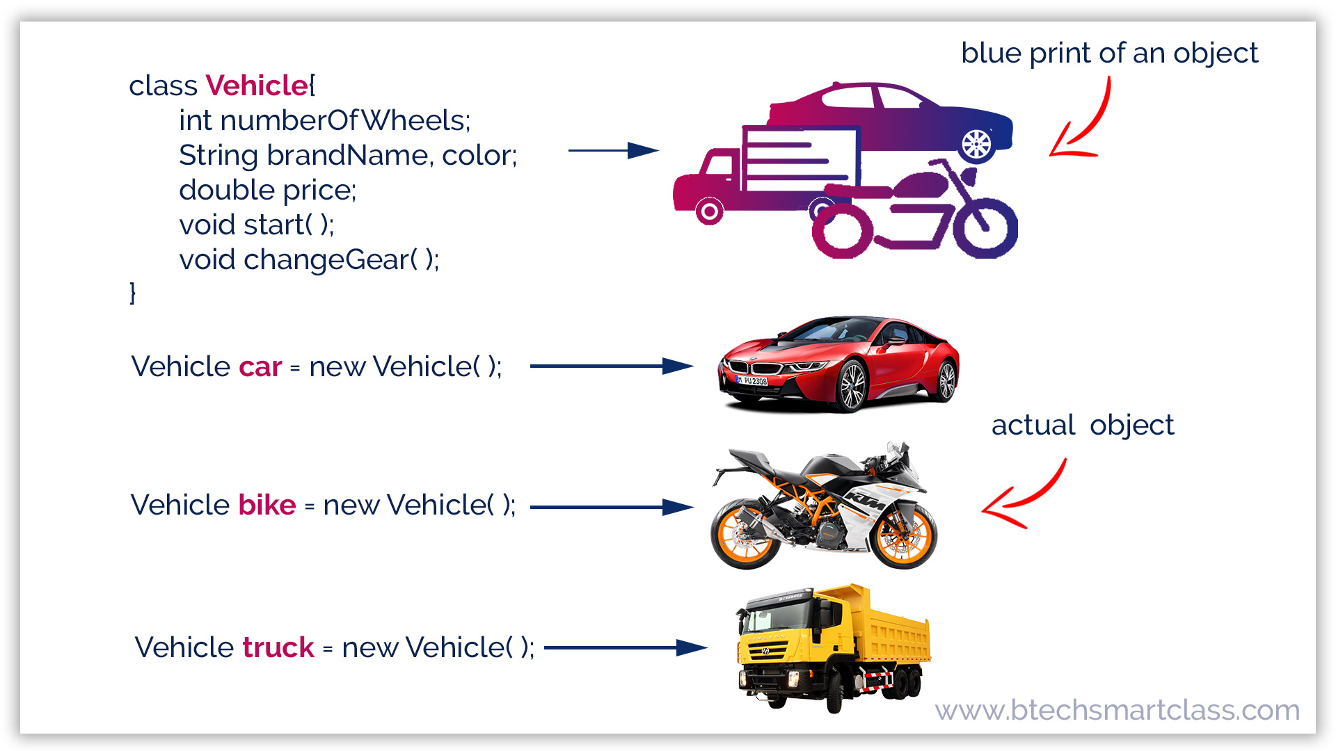
Class

Slide 7
What is Class?
Class is a blue print of an object.
A class in Java is a fundamental building block of object-oriented programming (OOP) language. In other words, a class is the basic unit of OOP.
According to OOPs concept in Java, a class is the blueprint/template of an object. It contains the similar types of objects having the same states (properties) and behavior.
In other words, a class can also be defined as “a class is a group of objects which are common to all objects of one type”.
Syntax to Declare Class in Java
access_modifier Class_Name
{
// class body
}

Slide 8
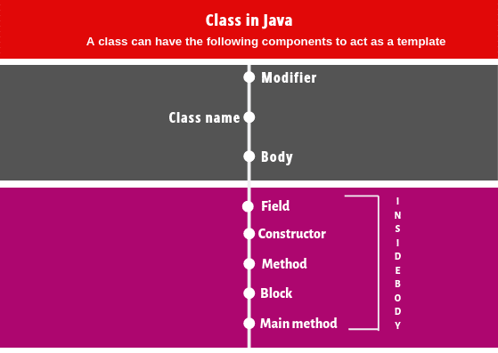
Components Of Class

Slide 9
1. Modifiers: A class can be either a public or default access modifier. But the members of class can be public, private, default, and protected. All these are the access modifiers.
2. Class name: By convention, a class name should begin with a capital letter and subsequent characters lowercased (for example Student). If a name consists of multiple words, the first letter of each word should be uppercased ( for example CollegerStudent).
3. Body: Every class’s body is enclosed in a pair of left and right braces.
Note:
A class name can also start with an underscore ”_”. The following class name can be valid such as _, _Student. Keywords cannot be a valid class name. For example, class, true, null, etc are not accepted as a class name.

Slide 10
Inner Class In Java
Java inner class or nested class is a class that is declared inside the class or interface.
We use inner classes to logically group classes and interfaces in one place to be more readable and maintainable.
Additionally, it can access all the members of the outer class, including private data members and methods.
Syntax:
class Java_Outer_class{
//code
class Java_Inner_class{
//code
}
}
Need of Java Inner class
Sometimes users need to program a class in such a way so that no other class can access it. Therefore, it would be better if you include it within other classes.

