Slide 1

Abstraction

Slide 2
Abstraction
Abstraction is another OOPs principle that provides a powerful way to manage complexity. The process of hiding complex internal implementation details from users and providing only necessary functionality is called abstraction.
In other words, abstraction is a technique in Java by which we can hide the data that is not required to a user. It hides all unwanted data so that users can work only with the required data.
It removes all non-essential things and shows only important things to users. That is, every user will get the required data and will not get confused with unnecessary data.
The main purpose of abstraction is to represent the essential features without including the background details.

Slide 3
Ways to achieve Abstraction
There are two ways to achieve abstraction in java
Abstract class (0 to 100%)
Interface (100%)
Java allows us to implement multiple levels of abstraction for a Java project. Abstract class and interface are the most common ways to achieve abstraction in Java.

Slide 4
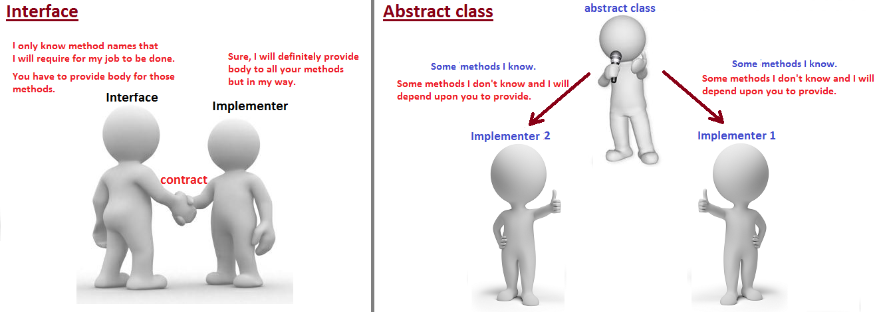
Abstract class in Java

Slide 5
What is Abstraction?
An abstract class in Java is a class, which is declared with an abstract keyword. It is just like a normal class but has two differences.
1. We cannot create an object of this class. Only objects of its non-abstract (or concrete) sub-classes can be created.
2. It can have zero or more abstract methods which are not allowed in a non-abstract class (concrete class). Classloader class is a good example of an abstract class that does not have any abstract methods.
The abstract keyword is a non-access modifier, used for classes and methods.
Abstract class: is a restricted class that cannot be used to create objects (to access it, it must be inherited from another class).
Abstract method: can only be used in an abstract class, and it does not have a body.

Slide 6
Rules for creating abstract class
An abstract class must be declared with an abstract keyword.
Object for abstract can’t be created but we can create reference variables.
It can have abstract and non-abstract methods.
It cannot be instantiated.
It can have constructors and static methods also.
It can have final methods which will force the subclass not to change the body of the method.

Slide 7
Important rules for abstract methods
Any class that contains one or more abstract methods must also be declared abstract
The following are various illegal combinations of other modifiers for methods with respect to abstract modifier:
final
abstract native
abstract synchronized
abstract static
abstract private

Slide 8
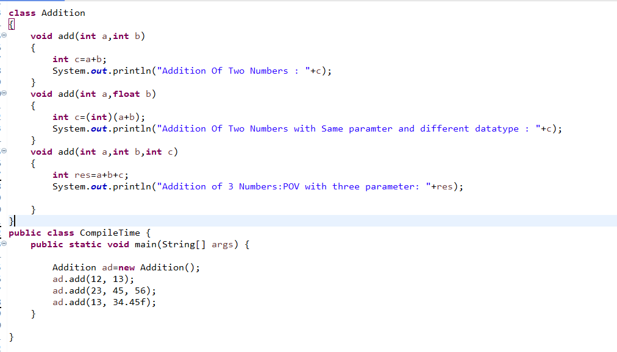
Example

Slide 9
Interface

Slide 10
What is Interface?
The interface in Java is a mechanism to achieve abstraction.
There can be only abstract methods and constant variables in the Java interface, not the method body.
It is used to achieve abstraction and multiple inheritance in Java.
a class extends another class, an interface extends another interface, but a class implements an interface.
When a class implements an interface, it must provide an implementation for all the methods defined in the interface.
Java Interface also represents the IS-A relationship.
Syntax:
interface interfaceName2 extends interfaceName1
{
// body of interfaceName2.
}

Slide 11
Why do we use an Interface?
It is used to achieve total abstraction.
Since java does not support multiple inheritances in the case of class, by using an interface it can achieve multiple inheritances.
Any class can extend only 1 class but can any class implement infinite number of interface.
Abstract classes may contain non-final variables, whereas variables in the interface are final, public and static.
Every interface in Java is abstract by default. So, it is not compulsory to write abstract keyword with an interface.
Once an interface is defined, we can create any number of separate classes and can provide their own implementation for all the abstract methods defined by an interface.
Note:
Since Java 8, we can have method body in interface. But we need to make it default method. Let's see an example:

Slide 12
Why do We Use Interface?
There are mainly five reasons or purposes of using an interface in Java. They are as follows:
1. In industry, architect-level people create interfaces, and then they are given to developers for writing classes by implementing interfaces provided.
2. Using interfaces is the best way to expose our project’s API to some other projects. In other words, we can provide interface methods to the third-party vendors for their implementation. For example, HDFC bank can expose methods or interfaces to various shopping carts.
3. Programmers use interface to customize features of software differently for different objects.
4. It is used to achieve full abstraction in java.
5. By using interfaces, we can achieve the functionality of multiple inheritance.

Slide 13
Note:
a) Earlier to Java 8, an interface could not define any implementation whatsoever. An interface can only declare abstract methods.
b) Java 8 changed this rule. From Java 8 onwards, it is also possible to add a default implementation to an interface method.
c) To support lambda functions, Java 8 has added a new feature to interface. We can also declare default methods and static methods inside interfaces.
d) From Java 9 onwards, an interface can also declare private methods.

Slide 14
Features of Interface
1. Interface provides pure abstraction in Java. It also represents the Is-A relationship.
2. An interface can contain three types of methods: abstract, default, and static methods.
3. All the (non-default) methods declared in Java interface are by default abstract and public. So, there is no need to write abstract or public modifiers before them.
4. The fields (data members) declared in an interface are by default public, static, and final. Therefore, they are just public constants. So, we cannot change their value by implementing class once they are initialized.
5. Java Interface cannot have constructors.
6. The interface is the only mechanism that allows achieving multiple inheritance in Java.
7. A Java class can implement any number of interfaces by using keyword implements.
8. Interface can extend an interface and can also extend multiple interfaces.

Slide 15
Rules for Interface
1. An interface cannot be instantiated directly. But we can create a reference to an interface that can point to an object of any of its derived types implementing it.
2. An interface may not be declared with final keyword.
3. It cannot have instance variables. If we declare a variable in an interface, it must be initialized at the time of declaration.
4. A class that implements an interface, must provide its own implementations of all the methods defined in the interface.
5. We cannot reduce the visibility of an interface method while overriding. That is, when we implement an interface method, it must be declared as public.
6. It can also be declared with an empty body (i.e. without any members). For example, java.util package defines EventListener interface without a body.
7. An interface can be declared within another interface or class. Such interfaces are called nested interfaces in Java.
8. A top-level interface can be public or default with the abstract modifier in its definition. Therefore, an interface declared with private, protected, or final will generate a compile-time error.
9. All non-default methods defined in an interface are abstract and public by default. Therefore, a method defined with private, protected, or final in an interface will generate compile-time error.

Slide 16
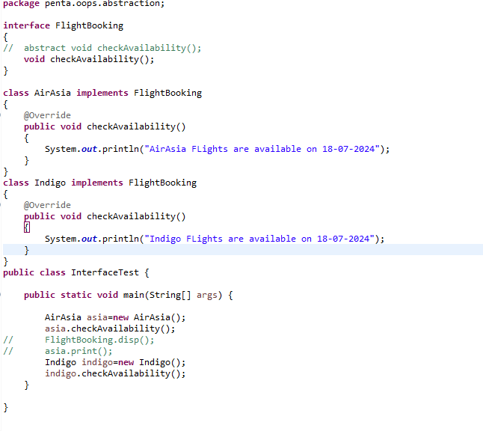
Example

Slide 17
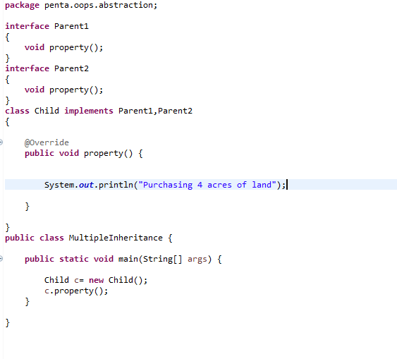
Multiple Inheritance by Interface

