Slide 1
Encapsulation in Java

Slide 2
What is Encapsulation?
The process of binding data and corresponding methods (behavior) together into a single unit is called encapsulation in Java.
In other words, encapsulation is a programming technique that binds the class members (variables and methods) together and prevents them from being accessed by other classes.
Thereby, we can keep variables and methods safes from outside interference and misuse.
Encapsulation can be achieved by declaring all the variables in the class as private and writing public methods in the class to set and get the values of variables.
It is more defined with the setter and getter method.
The Java Bean class is the example of a fully encapsulated class

Slide 3
Realtime Example :
Suppose you have an account in the bank. If your balance variable is declared as a public variable in the bank software, your account balance will be known as public, In this case, anyone can know your account balance. So, would you like it? Obviously No.
So, they declare balance variable as private for making your account safe, so that anyone cannot see your account balance.
The person who has to see his account balance, will have to access only private members through methods defined inside that class and this method will ask your account holder name or user Id, and password for authentication.

Slide 4
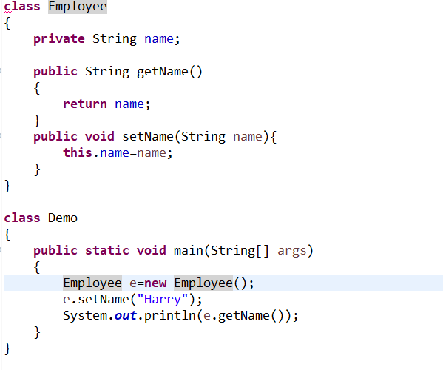
Example For Encapsulation

Slide 5
Pros Of Encapsulation
1. The encapsulated code is more flexible and easy to change with new requirements.
2. It prevents the other classes from accessing the private fields.
3. Encapsulation allows modifying the implemented code without breaking other code that has implemented the code.
4. It keeps the data and codes safe from external inheritance. Thus, encapsulation helps to achieve security.
5. It improves the maintainability of the application.
6. If you don’t define the setter method in the class, then the fields can be made read-only.
7. If you don’t define the getter method in the class, then the fields can be made write-only.
8. If you define both getter and setter methods in the class, then the fields can be made both read-write.

Slide 6
Cons Of Encapsulation
The major disadvantage of encapsulation in Java is it increases the length of the code and slows shutdown execution.

