Slide 1
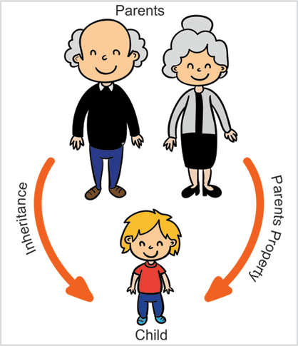
Inheritance

Slide 2
Inheritance in Java
Inheritance in Java is a mechanism in which one object acquires all the properties and behaviors of a parent object.
It is an important part of OOPs (Object Oriented programming system).
In Java, inheritance means creating new classes based on existing ones.
A class that inherits from another class can reuse the methods and fields of that class.
In addition, you can add new fields and methods to your current class as well.

Slide 3
Why do we need it?
Code Reusability: The code written in the Superclass is common to all subclasses.
Child classes can directly use the parent class code.
Method Overriding: Method Overriding is achievable only through Inheritance.
It is one of the ways by which java achieves Run Time Polymorphism.
Abstraction: The concept of abstract where we do not have to provide all details is achieved through inheritance.
Abstraction only shows the functionality to the user.

Slide 4
Terminologies used in Inheritance
Class: A class is a group of objects which have common properties.
It is a template or blueprint from which objects are created.
Sub Class/Child Class: Subclass is a class which inherits the other class.
It is also called a derived class, extended class, or child class.
Super Class/Parent Class: Superclass is the class from where a subclass inherits the features. It is also called a base class or a parent class.
Reusability: As the name specifies, reusability is a mechanism which facilitates you to reuse the fields and methods of the existing class when you create a new class.
You can use the same fields and methods already defined in the previous class.

Slide 5
The syntax of Java Inheritance
class Subclass-name/derived-class-name extends Superclass-name /Base class-name
{
//methods and fields
}
subclass (child) - the class that inherits from another class
superclass (parent) - the class being inherited from

Slide 6
Example
class Employee{
float salary=40000;
}
class Programmer extends Employee
{
int bonus=10000;
public static void main(String args[])
{
Programmer p=new Programmer();
System.out.println("Programmer salary is:"+p.salary);
System.out.println("Bonus of Programmer is:"+p.bonus);
}
}

Slide 7
Types of inheritance in java
1. Single Inheritance
2. Multilevel Inheritance
3. Hierarchical Inheritance
4. Multiple Inheritance (Through Interfaces)
5. Hybrid Inheritance(Through Interfaces)

Slide 8
1. Single Inheritance
Single inheritance is when a class inherits from only one superclass. In Java, this is the most commonly used type of inheritance.
Class A
Class B

Slide 9
2. Multilevel Inheritance
When there is a chain of inheritance, it is known as multilevel inheritance.
In Multilevel Inheritance, a derived class will be inheriting a base class, and as well as the derived class also acts as the base class for other classes.
In the below image, class A serves as a base class for the derived class B, which in turn serves as a base class for the derived class C.
In Java, a class cannot directly access the grandparent’s members.
Grand Parent
Parent
Child

Slide 10
3. Hierarchical Inheritance
When two or more classes inherits a single class, it is known as hierarchical inheritance.
one class serves as a superclass (base class) for more than one subclass.
In the below image, class A serves as a base class for the derived classes B, C, and D.
Parent
Child 1
Child 2

Slide 11
4. Multiple Inheritance
Multiple inheritance in Java refers to a scenario where a class can inherit properties and methods from more than one superclass.
However, Java does not support multiple inheritance directly through classes due to the complexity and ambiguity it can cause.
One example of this complexity is the 'Diamond Problem,' where a class inherits from two classes that have a common ancestor, leading to ambiguity regarding which inherited method should be called.
Parent 1
Parent 2
Child

Slide 12
Hybrid Inheritance
Hybrid Inheritance in Java is a combination of all inheritances.
Single and hierarchical inheritances or multiple inheritance.
For example, if we have a class Son and a class Daughter that extends the class Mother, and then there is another class Grandmother that extends the class, Mother, then this type of Inheritance is known as Hybrid Inheritance.
In short, A hybrid inheritance combines more than two inheritance types, such as multiple and single.
Grand Parent
Parent 2
Parent 1
Child

Slide 13
Pros of Inheritance in Java:
Code Reuse: Subclasses can inherit fields and methods from their superclass, reducing redundant code and promoting modular design.
Method Overriding: Subclasses can provide their own implementation of methods defined in the superclass, allowing for customization of behavior.
Polymorphism: In Java, inheritance enables polymorphic behavior, where a variable of the superclass type can refer to an object of any subclass.
Easy Maintenance: Changes made to a superclass are automatically propagated to subclasses, ensuring consistency and reducing maintenance effort.

Slide 14
Cons of Inheritance in Java
Coupling: Subclasses are tightly coupled to their superclass, which can lead to dependencies that make the code harder to maintain.
Inheritance Hierarchy: Over time, inheritance hierarchies can become complex and difficult to manage, especially when multiple levels of inheritance are involved.
Inflexibility: Subclasses inherit all aspects of their superclass, including methods and fields that may not be relevant or appropriate for the subclass. This can lead to a bloated subclass.
Fragility: Changes to the superclass can potentially impact all subclasses, leading to unintended consequences if not carefully managed.

