Slide 1
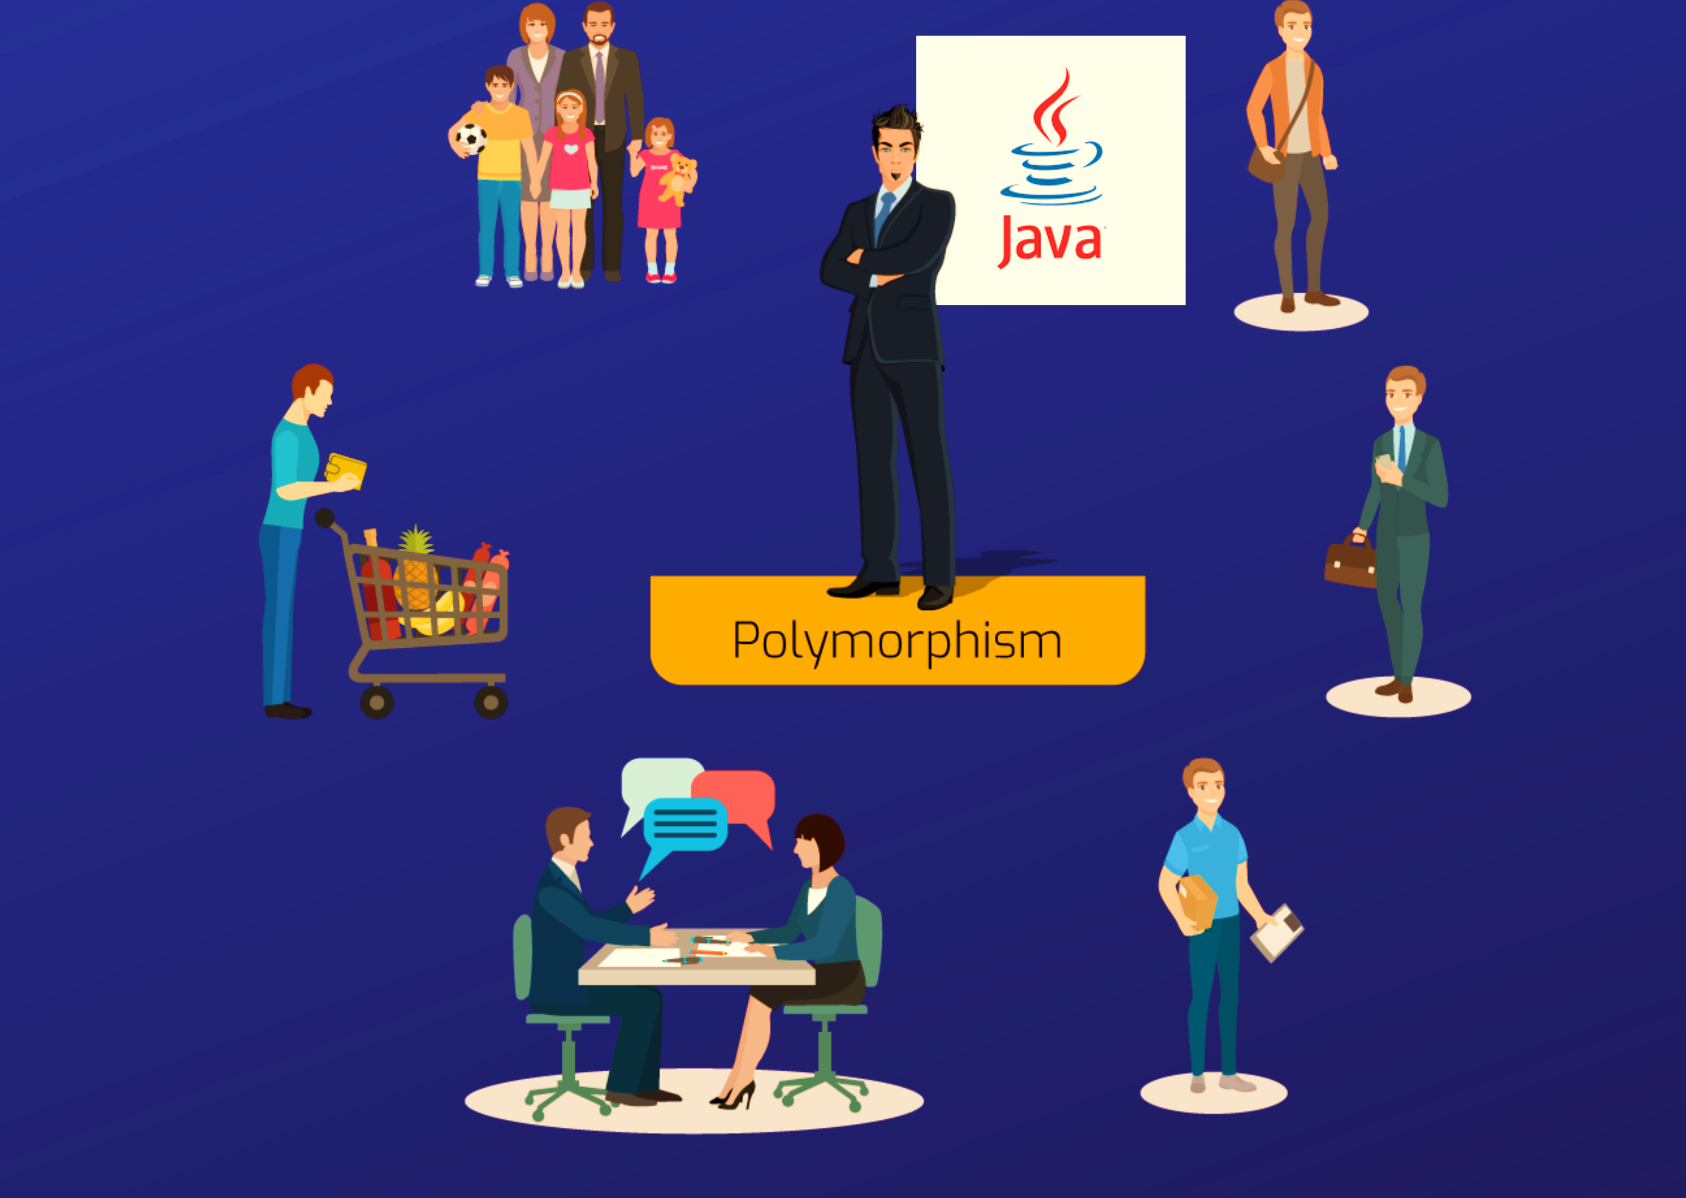

Slide 2
Polymorphism
The word polymorphism means having many forms.
In simple words, we can define polymorphism as the ability of a message to be displayed in more than one form.
The word "poly" means many and "morphs" means forms. So polymorphism means many forms.
There are two types of polymorphism in Java:
compile-time polymorphism and runtime polymorphism.
We can perform polymorphism in java by method overloading and method overriding.

Slide 3
Compile Time Polymorphism
Compile time polymorphism is a type of polymorphism which can be achieved at Java compile time. It is also known as Static Polymorphism or Early binding.
In order to achieve compile time polymorphism we use concept of Method overloading.
Method overloading :
•Method overloading in Java is a feature that allows a class to have multiple methods with the same name but different parameters with in the same class . These methods can have different number of parameters or different types of parameters or different order of parameters. Java determines which methods to call based on the arguments provided.

Slide 4
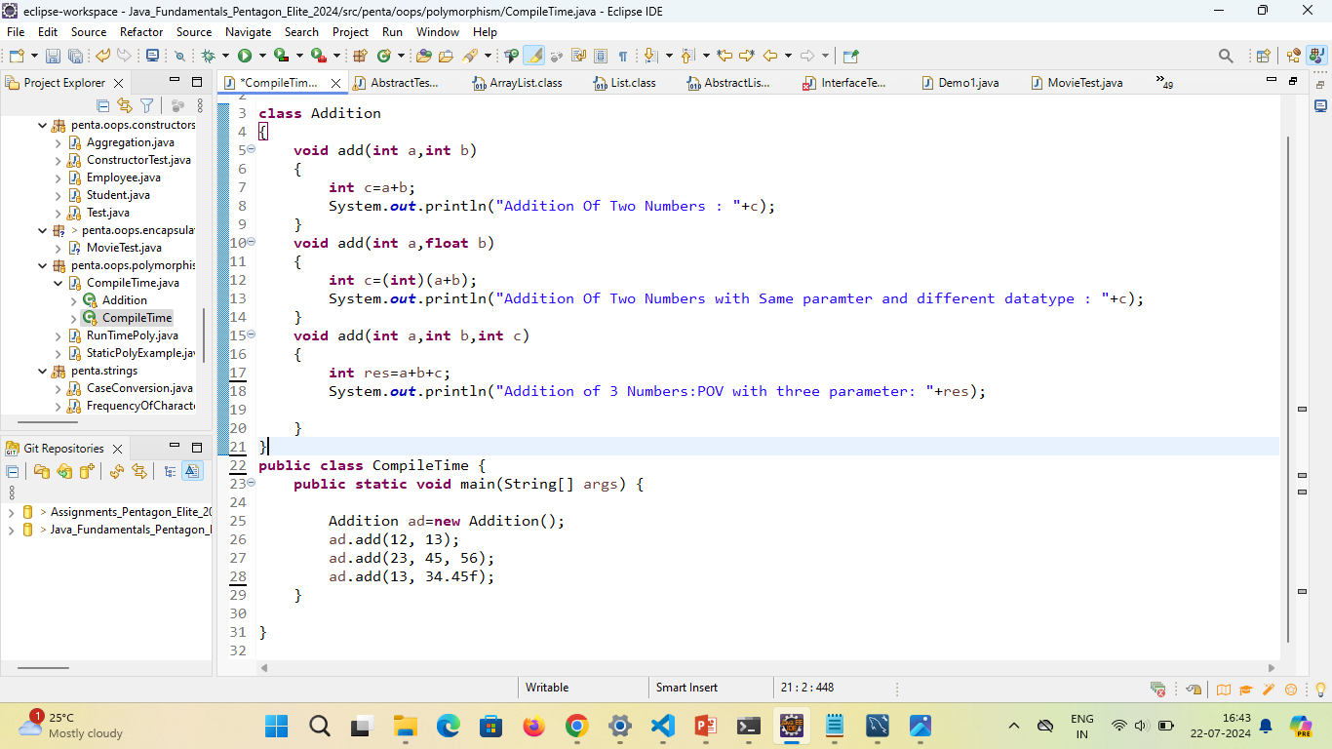
Example

Slide 5
Runtime Polymorphism
Run-Time polymorphism is a type of polymorphism which can be achieved at run time or execution time based on object reference. It is also known as Dynamic polymorphism or Dynamic method dispatch.
•Run-Time polymorphism in Java is achieved by the concept of Method Overriding.
Method overriding :
Method overriding in Java is a feature that allows a subclass to provide a specific implementation of a method that is already defined in its superclass.
It enables a subclass to provide its own implementation of a method extended from its superclass, thereby giving our own implementation customizing or extending the behavior of the superclass method

Slide 6
Example

Slide 7
Pros of Polymorphism :
Code Reusability
Flexibility in code implementation
Maintainability of code
Polymorphism enables us to write code that can be flexible, extensible and can adapt to changing requirements and behaviours.

Slide 8
Cons of Polymorphism
Complexity: While polymorphism simplifies code in many scenarios, it can introduce complexity in understanding the flow of control, especially in large codebases with deep inheritance hierarchies. Developers need to carefully manage class relationships and method overrides to ensure correct behavior.
Performance Overhead: Dynamic method resolution (runtime polymorphism) involves some performance overhead because the correct method implementation has to be determined at runtime using vtable or dispatch table mechanisms. This overhead is usually minimal but can become noticeable in performance-critical applications.
Potential for Mistakes: Improper use of polymorphism, such as overriding methods incorrectly or using inappropriate casts, can lead to runtime errors that are harder to debug. It requires a good understanding of inheritance and method overriding rules to avoid such pitfalls.
Dependency on Inheritance: Polymorphism heavily relies on inheritance relationships between classes. If not used carefully, deep inheritance hierarchies can lead to tight coupling and make the codebase harder to understand, maintain, and extend. Changes in superclass implementations can affect subclasses in unexpected ways.
Design Considerations: Proper design patterns (like interfaces, abstract classes, and method signatures) are crucial for effective use of polymorphism. Poorly designed class hierarchies or misuse of polymorphic behavior can lead to confusion and inefficiencies in the codebase.

