Slide 1
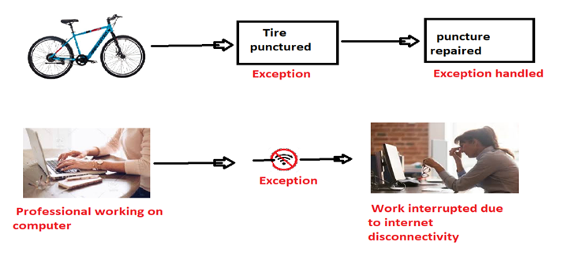
Exception Handling

Slide 2
What is Exception?
Exception in java is an unwanted and unexpected behavior/event that interrupts the normal execution flow of the program is called exception in Java. It is thrown from a method. The caller of the method can catch and handle the exception.
An exception can be identified only at runtime, not at compile time.
Therefore, it is also called runtime errors that are thrown as exceptions in Java. They occur while a program is running.

