Slide 1

CloneSpy
Duplicate Download Detection System
Team No. |  | B2
Sl. No. | Name |  | SRN.
1 | Sandesh Arun Chavan |  | 02FE22BCS102
2 | Sanika Uttarkar |  | 02FE22BCS105
3 | Shreyas Patil |  | 02FE22BCS130
4 | Abhay Patil |  | 02FE22BCS002
Under the guidance of Dr. Manisha Tapale
Department of Computer Science and Engineering,
KLE Technological University’s Dr. M. S. Sheshgiri College of Engineering and Technology, Belagavi

Slide 2
1. Motivation
Frequent Downloads: People are downloading more files than ever, causing their storage to get cluttered.
User Problems: Many users have trouble managing duplicate files, which wastes space and data.
Need for Smart Solutions: There’s a strong need for easy-to-use systems that can prevent duplicate downloads and save resources.
Department of Computer Science and Engineering,
KLE Technological University’s Dr. M. S. Sheshgiri College of Engineering and Technology, Belagavi

Slide 3
2. Problem Statement
To design and implement a system that detects duplicate files during the downloading process, preventing unnecessary downloads of identical files and optimizing both storage and bandwidth usage.
Department of Computer Science and Engineering,
KLE Technological University’s Dr. M. S. Sheshgiri College of Engineering and Technology, Belagavi

Slide 4
3. Target Audience
Students: Remove duplicate files like notes and assignments for clutter-free storage
Professors: Organize teaching materials and identify duplicate submissions easily
Researchers: Avoid downloading the same research papers multiple times during literature surveys
Department of Computer Science and Engineering,
KLE Technological University’s Dr. M. S. Sheshgiri College of Engineering and Technology, Belagavi

Slide 5
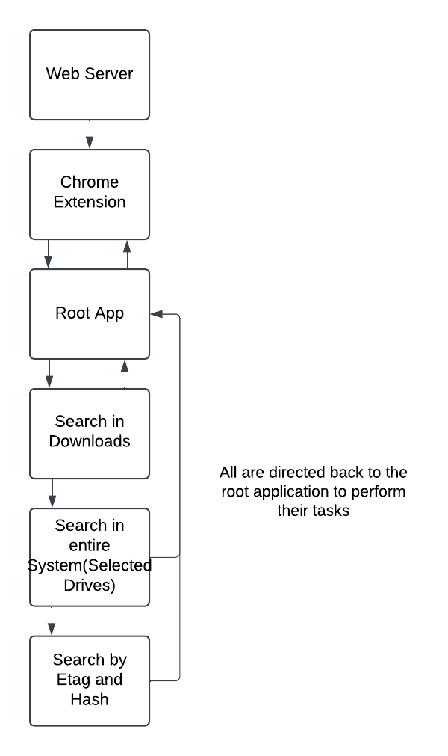
4. Data Flow
Department of Computer Science and Engineering,
KLE Technological University’s Dr. M. S. Sheshgiri College of Engineering and Technology, Belagavi

Slide 6
5. Frontend and Backend Details
Frontend:
Built with Tkinter for GUI interactions
Functions: * Drive selection * Duplicate file deletion * Search logs display
Backend:
Flask API endpoints:
* /check-duplicate: Handles duplicate checks * /save-file-path: Stores file paths and Etags
Python Functions:
* File hash generation (SHA256) * Drive detection * Duplicate search using binary search and
hash matching
Department of Computer Science and Engineering,
KLE Technological University’s Dr. M. S. Sheshgiri College of Engineering and Technology, Belagavi

Slide 7
5. Frontend and Backend Details (Algorithm)
1. Check for Duplicate (API)
The client sends a POST request with the filename and ETag.
The backend cleans the filename and checks if a file with the same name exists in the Downloads folder.
If a duplicate is found, return the duplicate path. If not, prompt the user to search the entire system.
2. Search Entire System (GUI + Binary Search)
If the user agrees to search:
Retrieve available drives and prompt the user to select which ones to search.
Perform a recursive search using os.walk and binary search to find matching files across selected drives.
If files are found display a GUI for the user to select files to delete.
If files are selected, delete them and log the deletion process in the GUI.
Department of Computer Science and Engineering,
KLE Technological University’s Dr. M. S. Sheshgiri College of Engineering and Technology, Belagavi

Slide 8
5. Frontend and Backend Details (Algorithm)
3. Storing File Paths and Etags
When a file is downloaded, store the file path and ETag in a local “Etags” file for future reference.
4. File Hashing and Etags for Duplicate detection
When a new file is downloaded, retrieve the ETag from the file's header.
Compare the ETag with the one in the existing “Etags” file.
If the ETag is found, retrieve the file path from the “Etags” file.
Generate the hash of every file in the specified path and compare it with the hash of the newly downloaded file.
If the hashes match, display the GUI for file deletion.
Department of Computer Science and Engineering,
KLE Technological University’s Dr. M. S. Sheshgiri College of Engineering and Technology, Belagavi

Slide 9
6. Test Cases
Functional Test Cases:
Detect duplicate files in Downloads folder
Search files across selected drives effectively
Identify renamed duplicates with identical content
Non-Functional Test Cases:
Measure time to scan large drives for duplicates
Comparison between linear and binary search
Prompt confirmation for file deletions securely
Department of Computer Science and Engineering,
KLE Technological University’s Dr. M. S. Sheshgiri College of Engineering and Technology, Belagavi

Slide 10
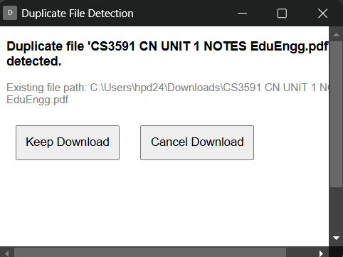
7. Execution Results
Fig.1: Duplicate check in Downloads
Department of Computer Science and Engineering,
KLE Technological University’s Dr. M. S. Sheshgiri College of Engineering and Technology, Belagavi

Slide 11
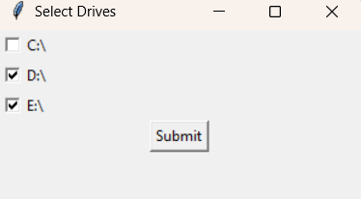
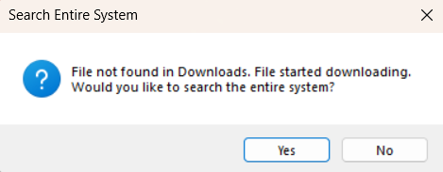
7. Execution Results
Fig.2: Prompt User to search entire System
Fig.3: Selection of Drives
Department of Computer Science and Engineering,
KLE Technological University’s Dr. M. S. Sheshgiri College of Engineering and Technology, Belagavi

Slide 12
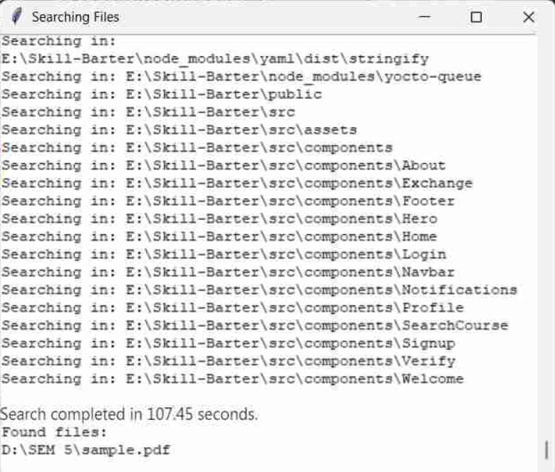
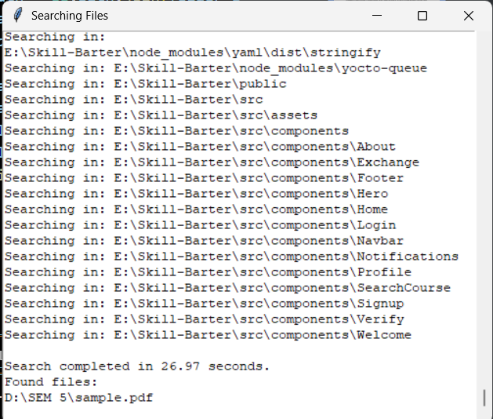
7. Execution Results
Fig.4: Searching with linear search
Fig.5: Searching with Binary search
Department of Computer Science and Engineering,
KLE Technological University’s Dr. M. S. Sheshgiri College of Engineering and Technology, Belagavi

Slide 13
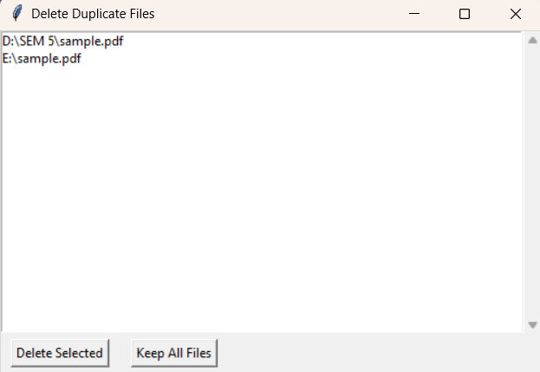
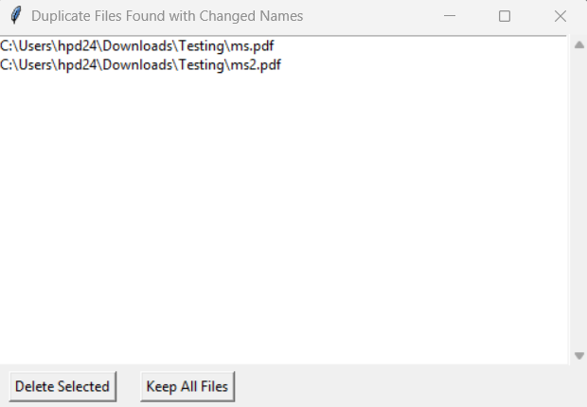
7. Execution Results
Fig.6: Deleting duplicates of same name
Fig.7: Deleting renamed duplicates
Department of Computer Science and Engineering,
KLE Technological University’s Dr. M. S. Sheshgiri College of Engineering and Technology, Belagavi

