Slide 1
Semi-Supervised Classification with Graph Convolutional Network
Paper Summary

Slide 2
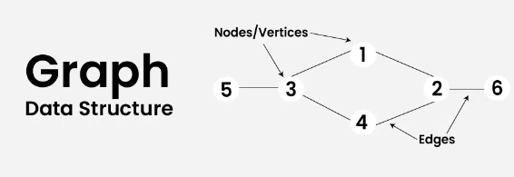
Terminology
Semi-Supervised Classification: This approach involves training a model on a small labeled dataset along with a unlabeled dataset. The key idea is to use the connectivity of nodes to learn representations that can generalize from the labeled nodes to the unlabeled ones.
GCN
Citation Networks: Citation networks are graphs where nodes represent academic papers, and directed edges indicate citations from one paper to another, illustrating the flow of knowledge.
Link: Graph DSA

Slide 3
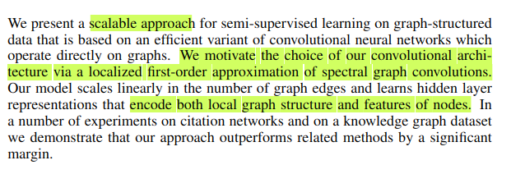
Abstract
Scalable approach: Efficiently handle increasing amounts of work or data, maintaining performance and effectiveness as the scale grows.
Spectral theory: Spectral theory refers to the study of the properties of linear operators, especially those pertaining to eigenvalues and eigenvectors. In the context of graph theory, spectral theory focuses on examining the properties of the adjacency and Laplacian matrices associated with a graph.
Spectral graph convolutions: These are the method for applying convolutional operations to graph-structured data, leveraging the graph's spectral properties (eigenvalues and eigenvectors of the graph Laplacian). This approach allows for filtering signals on the graph in the frequency domain.

Slide 4
Abstract
First-order approximation: It simplifies the spectral graph convolutions by focusing only on the immediate neighbors of each node, rather than considering the entire graph structure. This makes the computations more tractable and efficient.
1
Link: Spectral Graph Convolutions
5
3
4

Slide 5
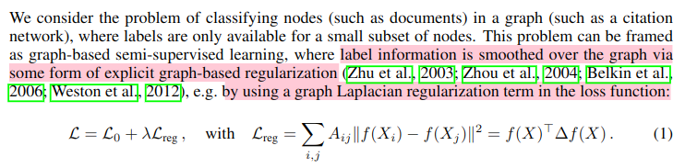
Introduction
Previous Research:
Label Smoothing Over the Graph: This means that the labels of the nodes (which might be known for a subset of nodes) are spread or diffused across the graph to influence the labels of the unlabeled nodes. The goal is to make the labels of neighboring nodes similar, leveraging the graph structure to improve classification accuracy.
Graph-Based Regularization: Explicitly refers to methods that incorporate the graph's structure directly into the learning process. One common method is to include a graph Laplacian term in the model's loss function. The graph Laplacian is a matrix that represents the structure of the graph, capturing information about node connections. This regularization term encourages the model to assign similar labels to nodes that are close to each other in the graph, effectively smoothing the label distribution over the graph.

Slide 6
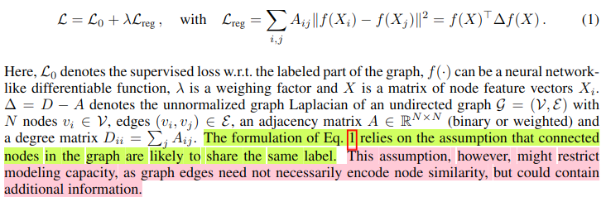
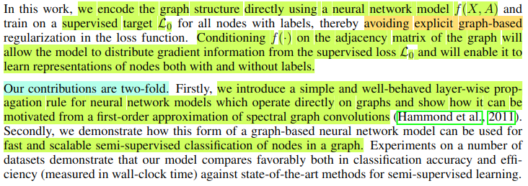
Introduction
Previous Research:
GCN Research:

Slide 7
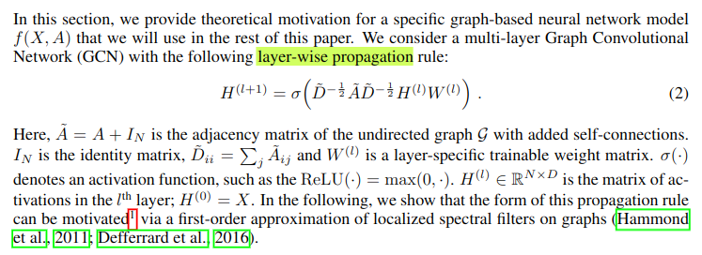
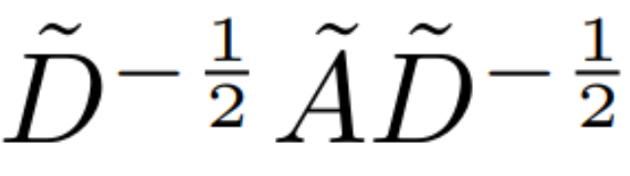

Fast Approximate Convolutions On Graph
This term in equation 2 is for the normalization so that there won’t be vanishing and exploding gradients.

Slide 8
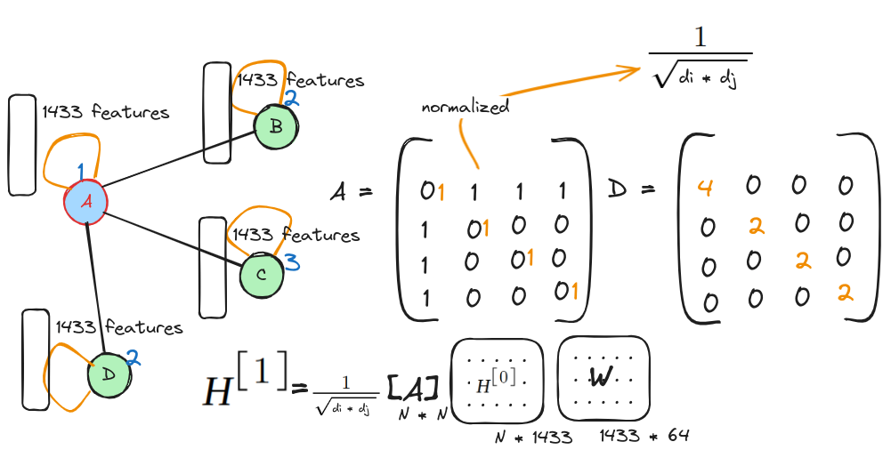

Slide 9
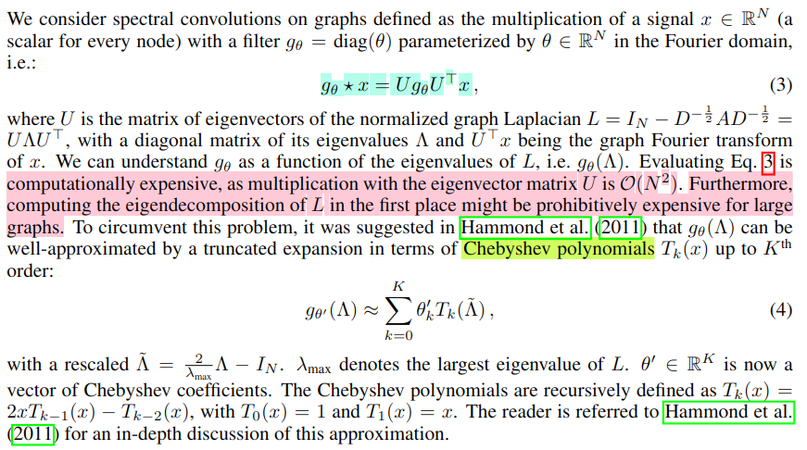
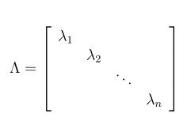
Spectral Graph Convolutions
To balance the influence of highly connected nodes, and ensuring that nodes with lower degrees are not overshadowed. This is achieved by dividing each entry by the sum of the degrees of the corresponding node.
L = D - A

Slide 10
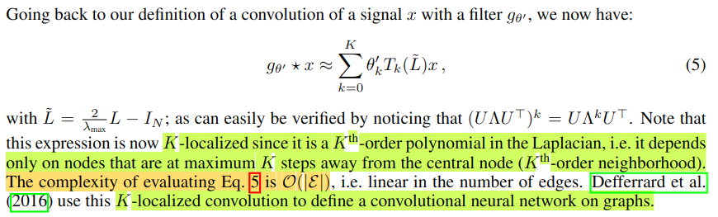
Spectral Graph Convolutions

Slide 11

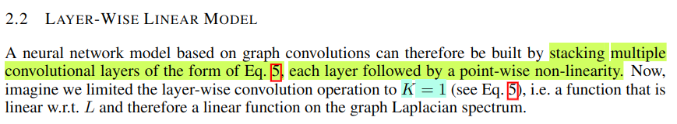

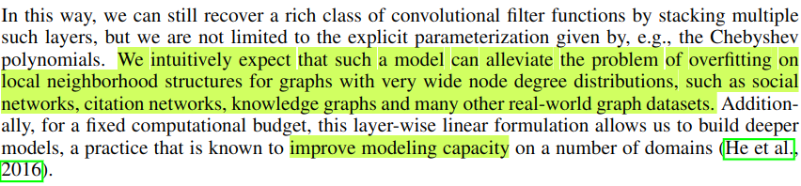
Layer-Wise Linear Model
Eq: 5 ⇒

Slide 12
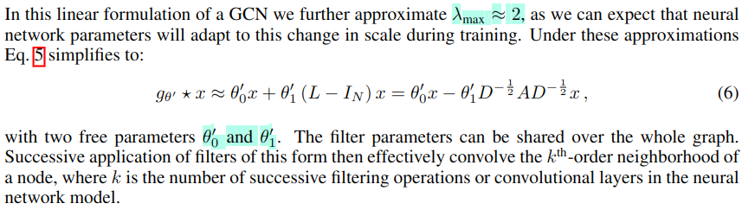
Layer-Wise Linear Model

Slide 13
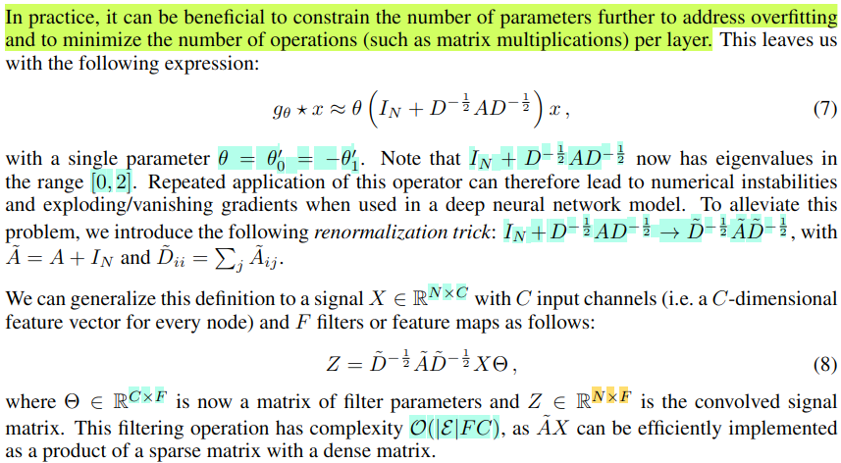
Layer-Wise Linear Model

Slide 14
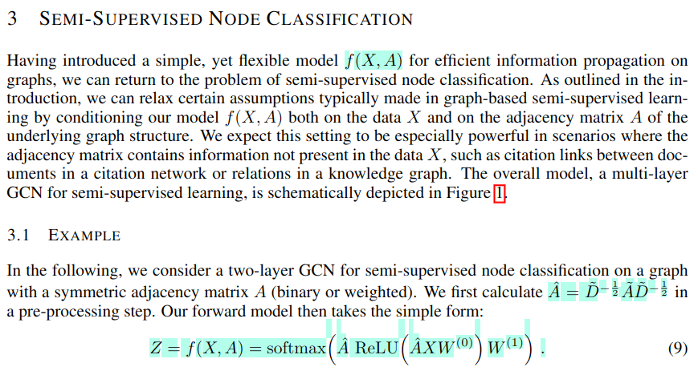

Slide 15
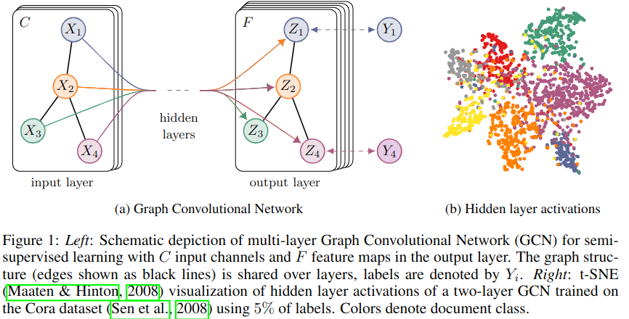
Semi-Supervised Node Classification

Slide 16
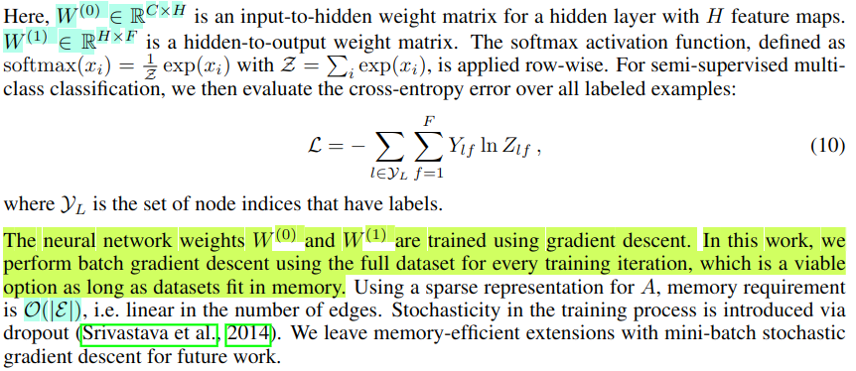
Semi-Supervised Node Classification

Slide 17
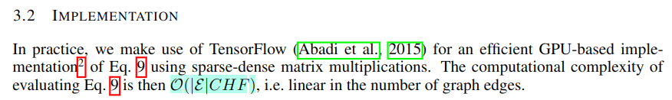
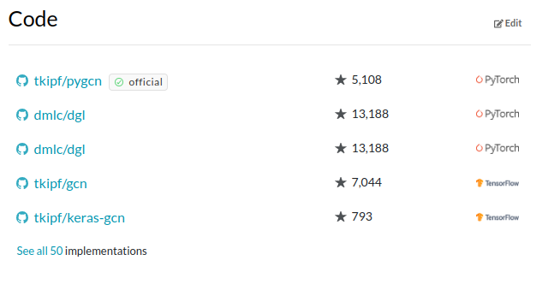
Implementation
https://github.com/tkipf/gcn
GCN Code link

Slide 18
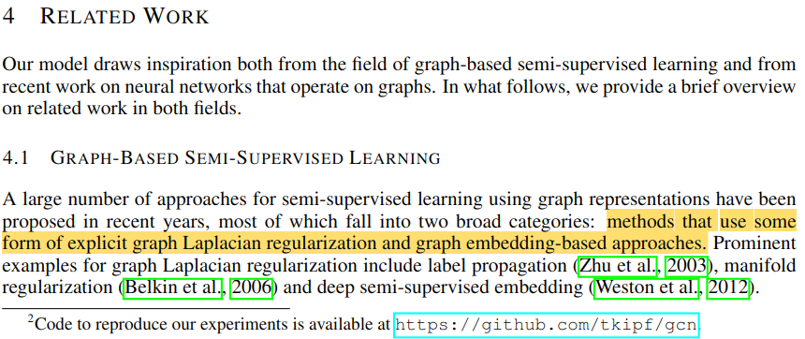
Related Work

Slide 19
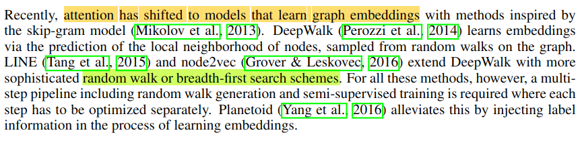
Related Work

Slide 20
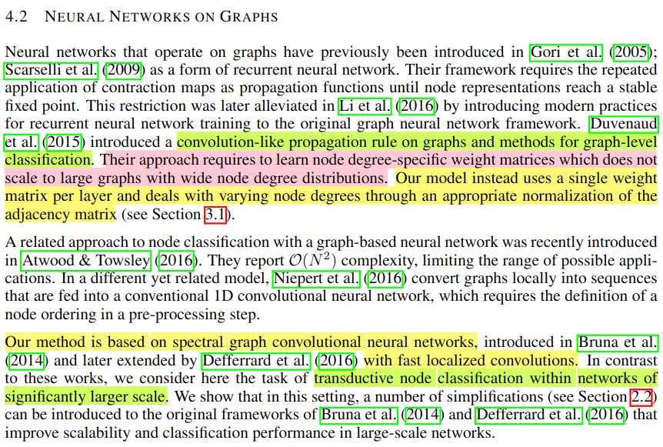

Slide 21
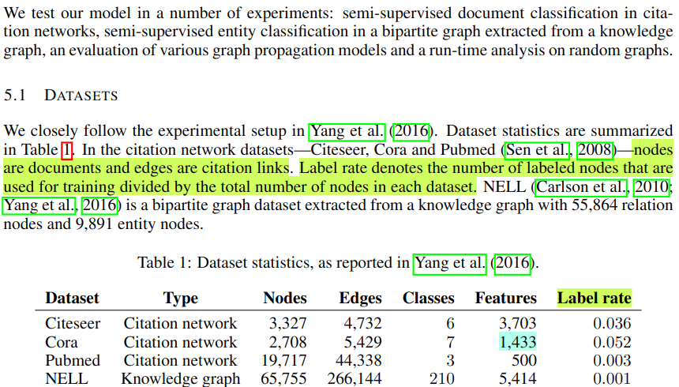
Experiments

Slide 22
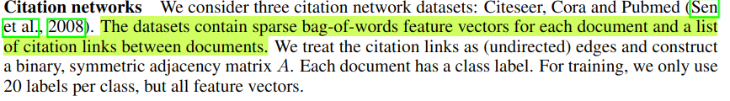
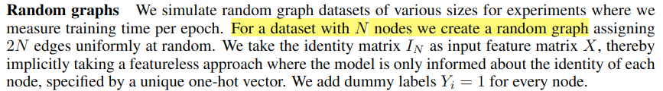
Datasets

Slide 23
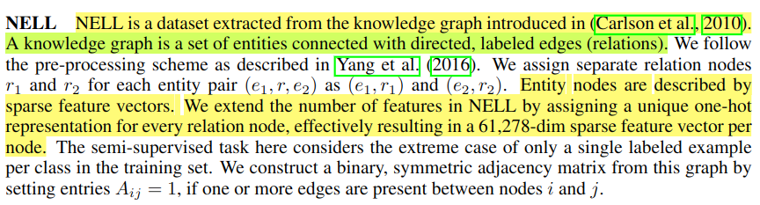
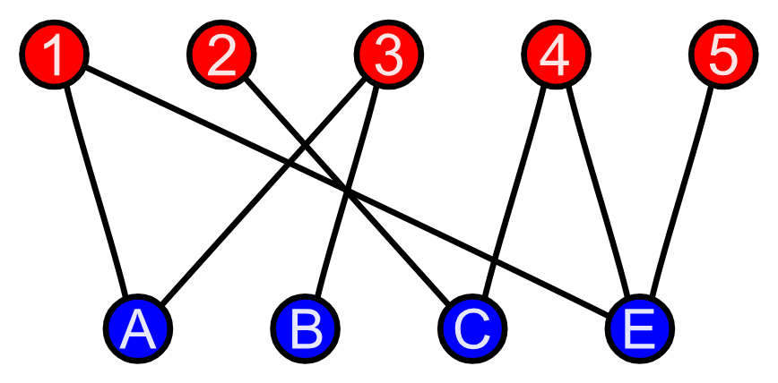
Datasets
A bipartite graph (or bigraph) is a graph whose vertices (or nodes) can be divided into two disjoint sets X and Y such that every edge connects a vertex in X to one in Y.

Slide 24
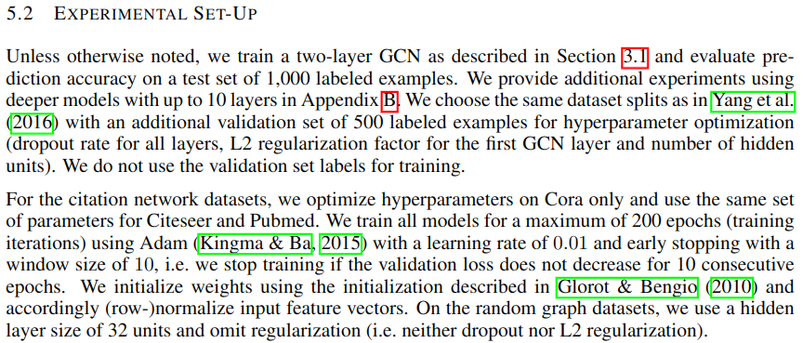
Experimental Setup

Slide 25
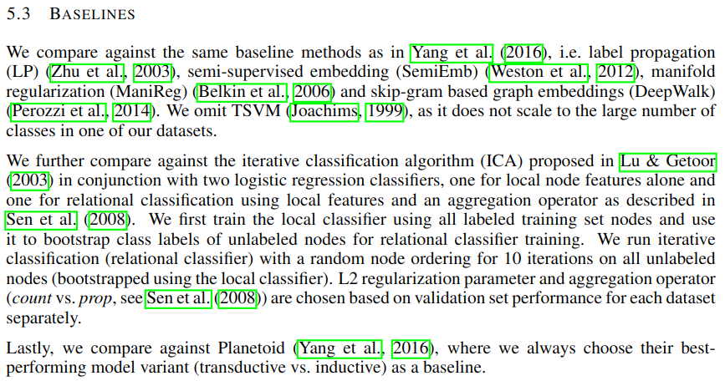
Baselines

Slide 26
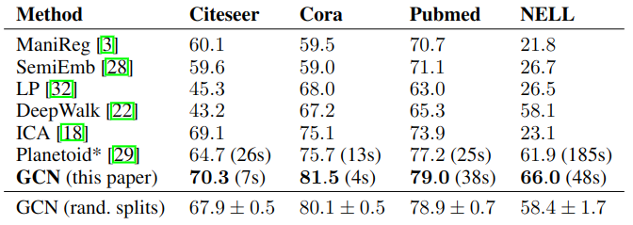
Results
wall-clock training time in seconds until convergence
same hardware (with GPU)

Slide 27
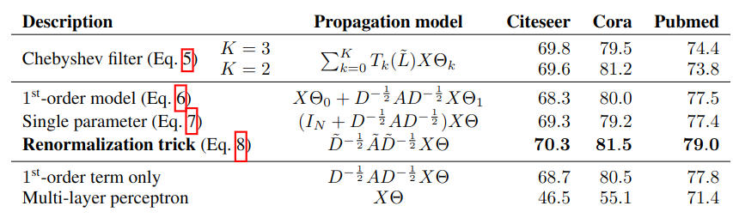
Evaluation of Propagation Model
Reported numbers denote mean classification accuracy for 100 repeated runs with random weight matrix initializations. In case of multiple variables Θ per layer, we impose L2 regularization on all weight matrices of the first layer.

Slide 28
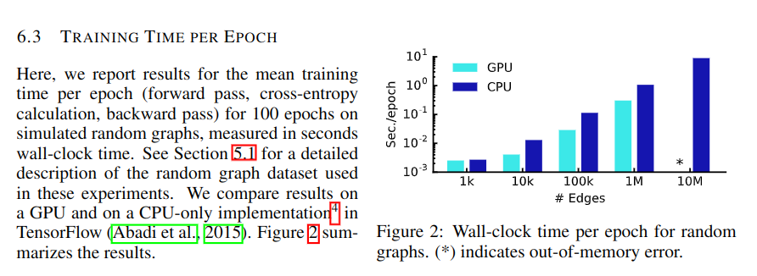
Training Time Per Epoch

Slide 29
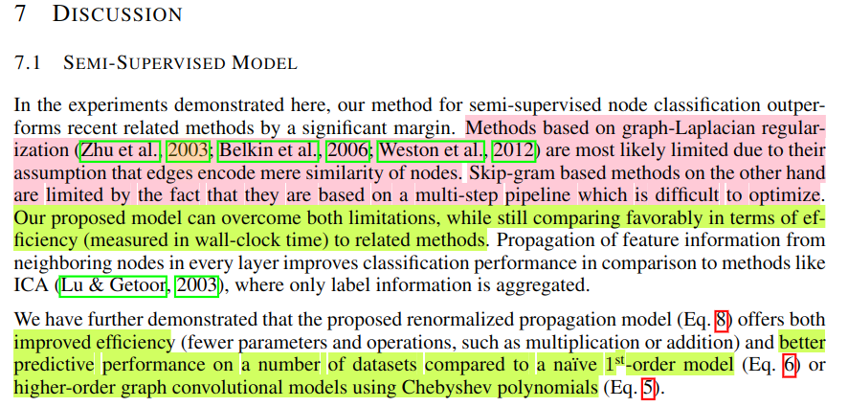
Discussion

Slide 30
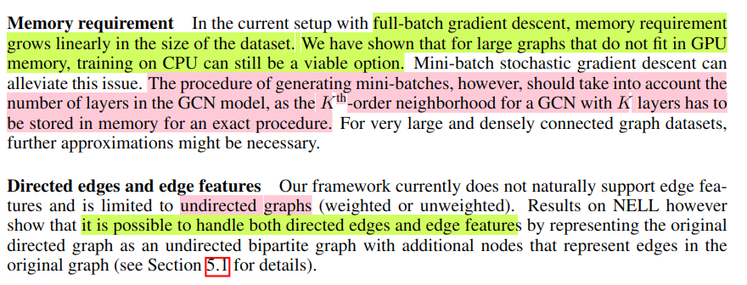
Limitations and Future Work

Slide 31
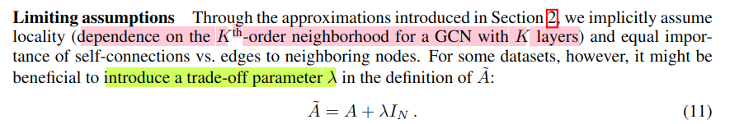
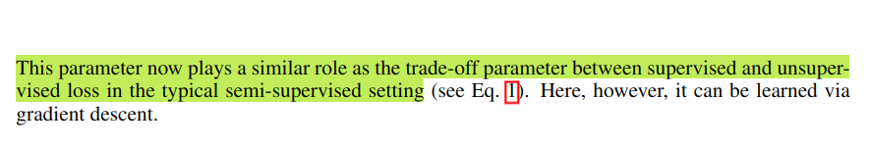
Limitations and Future Work

Slide 32
Limitations and Future Work

Slide 33
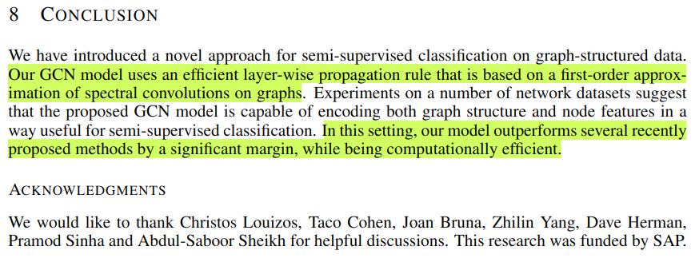
Conclusion

