Slide 1
Automated DevSecOps Pipeline
for Container Security
Implementation and comparative evaluation
Simran Bahrani 23K-2036
Sandesh Gehani 23K-2004
Nomeer Ahsan 23K-2040
12 November 2026
Container security project
Notes:
Introduce the group and the aim. The project integrates automated container checks, release policy and measured comparison. Source proposal supplied by the group. Repository https://github.com/SandeshGehani/cloudsec-container-security

Slide 2
Project scope
One Flask task tracker, built as an insecure baseline and a hardened image.
Five security tools across Dockerfile, image and infrastructure checks. Syft supplies the SBOM.
GitHub Actions collects evidence and publishes the approved hardened image to GHCR.
Container security project
Notes:
Explain that the sample app supplies a consistent workload. The security pipeline is the project deliverable. Kubernetes and Terraform use kind through the Kubernetes provider. The hosted runner supplies Linux containers. Runtime protection, signing, admission control and app penetration testing were excluded by the proposal.

Slide 3
Pipeline and evidence
Before the image build
Hadolint
Checkov for YAML and Terraform
Custom infrastructure checks
After the image build
Trivy image and secret scan
Syft SBOM, Grype matching, Dockle audit
One final gate evaluates every required report before publication.
Container security project
Notes:
Describe the sequence and the fail-closed final evaluation. Independent scanners continue collecting after policy findings. Build failure makes dependent reports unavailable and blocks publication. Sources scripts/run_pipeline.py, scripts/evaluate.py, .github/workflows/scan.yml. https://github.com/SandeshGehani/cloudsec-container-security/tree/4d3888b443da19ed8b583ad38f2efbe0c3c59852

Slide 4
Release policy
0
fixable HIGH or CRITICAL findings allowed
Secrets, root execution, fatal image findings and required infrastructure failures block release.
Missing reports, scanner crashes and invalid database metadata also block release.
Unfixed findings remain visible for review under the agreed policy.
Container security project
Notes:
The team authorised us to resolve the proposal ambiguity. Both vulnerability scanners block any fixable HIGH or CRITICAL finding, giving a numeric high threshold of zero. Required Checkov IDs are explicit. The central exceptions list is empty. Missing or failed evidence always blocks release. Source policy/gates.json. The baseline collector job can be green while its security gate is FAIL.

Slide 5
Baseline and hardened results
BASELINE
4,981 blockers
Gate FAIL in every measured trial
HARDENED
0 blockers
Gate PASS in every measured trial
Container security project
Notes:
These counts are from the first cold trial of each variant in evaluation run 43103995123 at source commit 4d3888b. All six baseline gates failed consistently with 4981 blockers. All six hardened gates passed with zero blockers. All measured runs had zero collection errors. The remaining unfixed severity findings appear in the report. https://github.com/SandeshGehani/cloudsec-container-security/actions/runs/43103995123

Slide 6
Image size after remediation
86.3% smaller hardened image
Container security project
Notes:
Docker image metadata reports uncompressed image size, expressed in decimal MB. Baseline 928.46 MB, hardened 127.16 MB. The 86.3 percent reduction combines slim base selection, multi-stage dependency installation and removal of runtime packaging tools. It does not isolate the effect of an individual change. Sources first cold image-inspect.json for both variants. https://github.com/SandeshGehani/cloudsec-container-security/actions/runs/43103995123

Slide 7
Repeated collection timings
Fresh build and database caches define the cold condition.
Container security project
Notes:
Three cold trials, excluded warm-up, then three warm trials per variant. Cold disables Docker build-cache use and uses fresh vulnerability DB directories. Base-image downloads can remain cached. Warm cache presence is checked. Separate variant runners, fixed condition order and network variation limit generalisation. Durations exclude job setup and artifact publication. Baseline raw cold 123.429,91.241,92.07 and warm 33.631,33.439,34.122. Hardened cold 90.829,79.325,79.263 and warm 19.129,14.151,14.206. https://github.com/SandeshGehani/cloudsec-container-security/actions/runs/43103995123

Slide 8
Scanner overlap
Advisory IDs | Trivy only | Shared | Grype only
Baseline | 11730 | 1396 | 28
Hardened | 5 | 120 | 3
Explicit advisory aliases increased baseline shared IDs from 1,370 to 1,396.
An unmatched scanner record still requires contextual review.
Container security project
Notes:
Compare advisory IDs after joining only explicit related-advisory links found in Grype reports. Advisory counts differ from package-vulnerability counts in the severity table. Baseline exact shared IDs 1370, alias shared 1396. Hardened shared 120 under either comparison. Uniqueness can reflect database, cataloguing or alias differences. It does not establish detection accuracy. Source docs/overlap.json and scripts/analyze_overlap.py. https://github.com/SandeshGehani/cloudsec-container-security/actions/runs/43103995123

Slide 9
Triage of selected findings
Werkzeug path finding
The advisory requires Windows with Python below 3.11. Our baseline scan target is Linux.
Debian zlib finding
Debian states that this Bookworm source version does not build the vulnerable MiniZip code into its binaries.
Ten reviewed records. Purposive selection limits statistical inference.
Container security project
Notes:
The documented purposive sample has ten records. No population false-positive rate can be estimated. Affected package and app exploitability are reviewed separately. Source docs/triage.json. CVE-2024-49766 platform qualification https://github.com/pallets/werkzeug/security/advisories/GHSA-f9vj-2wh5-fj8j . CVE-2023-45853 Debian binary qualification https://security-tracker.debian.org/tracker/CVE-2023-45853 . Package fixes remain applied, raw reports remain available, and the central exception list stays empty.

Slide 10
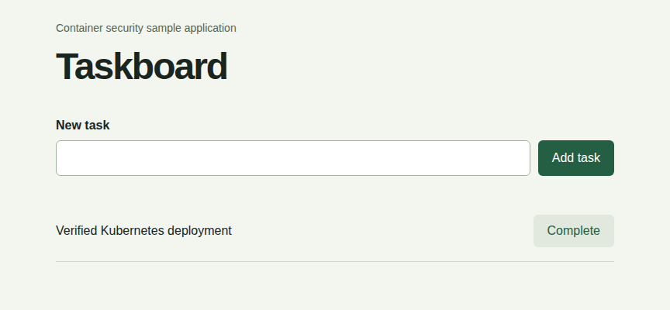
Kubernetes and Terraform verification
Both deployment definitions passed
Ready replica
UID 10001
Health and task creation
Root write rejected
Hosted kind cluster
NetworkPolicy resource verified
Container security project
Notes:
The actual screenshot comes from the GitHub-hosted kind YAML deployment after the task-creation request. Both YAML and Terraform deployments passed readiness, health, task creation, UID 10001 and filesystem-write checks. Both disallow privileges and drop ALL capabilities. Terraform created four resources in its own namespace. Resource creation of NetworkPolicy passed. Default kind CNI does not establish traffic enforcement. The script deletes its disposable cluster after evidence collection. https://github.com/SandeshGehani/cloudsec-container-security/actions/runs/43103995123

Slide 11
Demonstration sequence
Show the baseline FAIL gate and its retained findings.
Show the hardened PASS gate and published image.
Compare image size, scanner overlap and cache timings.
Show the working app and verified deployment evidence.
Local Docker and WSL setup remains for an on-laptop cluster demo.
Container security project
Notes:
Use docs/DEMO.md during the presentation. Open the release run and show both gate summaries. Green baseline evidence collection means reports were collected, and its gate.json explicitly says FAIL. Then show hardened zero-blocker report and published image commit tag. Open repeated evaluation and explain the sample and caches. Open local Kubernetes verification JSON and screenshot. Run the Flask app locally for interaction while Docker and WSL setup remains pending. Retained evidence supports the completed hosted deployment. https://github.com/SandeshGehani/cloudsec-container-security/actions/runs/43103995163 https://github.com/SandeshGehani/cloudsec-container-security/actions/runs/43103995123

