Slide 1
Assignment-3
Dual Fuel Engine Technologies using Biofuels
Name- Sandesh Narayan
Roll No.-180667
Department of Mechanical Engineering
Indian Institute of Technology Kanpur, Kanpur

Slide 2
Table of Contents
What is Dual fuel engine
Dual fuel engine using biofuels
Modifications needed to convert conventional diesel engine to Dual fuel Engine
Combustion process in dua fuel engine using biofuels
Biofuels
Fuel injection in dual fuel engine
Aftertreatment in Dual fuel engine using biofuels
Advantages of Dual fuel engines using biofuels
Diesel like performance
Knocking in dual fuel engine using biofuels
Experimental study
Conclusion

Slide 3
What is Dual Fuel Engine
Duel Fuel Engines are internal combustion engines designed to run on two different fuels at once.
Primary fuel is usually natural gas and secondary fuel (Pilot fuel) is usually diesel.
Combustion process is initiated by pilot fuel and main fuel is used to enhance combustion efficiency, reduce emissions, and other benefits.
Pilot fuel is injected in form of spray similar to conventional diesel engine, and it undergoes compression and ignition.
Main fuel can be injected separately or can be mixed with intake air to help combustion initiated by primary fuel.
It can also operate using diesel fuels only if main fuel is unavailable.
Duel Fuel Engine using Biofuels
Biofuels are used as main fuel.
Biodiesel can be used as pilot fuel.
Both liquid and gaseous fuels can be used, using proper modifications.

Slide 4
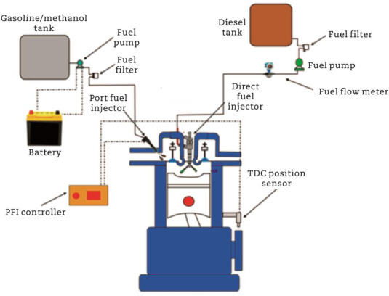
Modifications needed to convert conventional diesel engine to Dual fuel Engine
Injection system needs to be modified to inject biofuel, they may need to be recalibrated to optimize fuel atomization.
Fuel Storage and Delivery needs to be modified to Store secondary fuel and channel it to engine.
ECU needs reprogramming to control fuel injection timing and quantity.
Exhaust gas treatment may be needed based on the emission, SCR and DPF can be installed.
https://ars.els-cdn.com/content/image/1-s2.0-S2095756421000866-gr3.jpg

Slide 5
Combustion process in dua fuel engine using biofuels
During Intake phase air enters the combustion chamber which is mixed with main fuel and a small amount of pilot fuel.
Combustion begins at top dead center when pilot fuel reaches its auto ignition temperature. Which leads to combustion of biofuel which has higher auto ignition temperature.
Biofuels ​
Liquid Biofuels
They are easier to store compared to gaseous ones.​
They can be directly injected in combustion chamber.​
Incomplete atomization or mixing with air can cause unburned hydrocarbon and particulate matter in exhaust.​
Gaseous biofuels
They have better air mixing and faster flame propagation, which results in better efficiency and reduced emission.​
Can achieve higher substitution rates (proportion in fuel mixture) compared to liquid biofuels.​
Additional modifications may be needed such as gas injector, carburetion system.​

Slide 6
Fuel injection in dual fuel engine
Pilot fuel is injected into the combustion chamber using a high-pressure fuel injection system.
The fuel injector nozzle atomizes the liquid fuel into a fine spray, which mixes with the compressed air in the combustion chamber.
The timing and duration of pilot fuel injection are controlled by the ECU based on engine speed, load, and operating conditions.
Main fuel is introduced separately.
For some designs the main fuel is injected alongside intake air using a separate fuel injection system or carburetion system.
In others main fuel is premixed with the intake air before entering the combustion chamber.
The injection pressure of both primary and secondary fuels are very high to ensure proper atomization and distribution of fuel within the combustion chamber.
The fuel injection timing and pressure are controlled dynamically by ECU based on real-time sensor feedback, including crankshaft position, engine speed, manifold pressure, and exhaust gas composition.

Slide 7
Aftertreatment in Dual fuel engine using biofuels
Incomplete combustion may lead to emission of HC, CO, PM.
Under high load condition, NOx emission can be significant.
Combustion of diesel may led to PM formation.
SCR and EGR can be used to reduce NOx emission.
Diesel oxidation catalysts (DOC), Diesel particulate filter (DPF) can be used to reduce HC, CO, PM emissions.
SCR systems use a catalyst and a reducing agent, typically aqueous urea solution (DEF or AdBlue), to convert nitrogen oxides (NOx) into nitrogen (N2) and water (H2O).

Slide 8
Advantages of Dual fuel engines using biofuels
Substituting the diesel fuel with biofuels- Diesel fuels undergoes a longer journey such as, oil production, oil transportation, diesel production at refinery, transportation, which can be avoided by using biofuels which can be produces locally.
Diesel like performance- Diesel engines have higher power density than natural-gas only engines. The diesel engines upfitted for dual fuel combined with the electronic controls within the engine allows a dual fuel engine to feature diesel-like power density while operating in dual fuel model.
Transient Response- 100% biofuel engines have trouble responding to varying load. Meanwhile, dual fuel engine provides compaarable transient response to their diesel only alternatives.
Optimized operating range- Engines often run at a standard duty cycle per the application they are used in, but by varying substitution rate maximus fuel saving and improved performance can be achieved.
Financial benefits- The dual fuel kit costs less than buying a new engine and requires minimal changes to the existing engine, resulting in reduced equipment integration efforts.
Reduced Emission- Using biofuels helps reduce emissions.
Reduced wear and maintenance- Using biofuels leads to reduced engine wear, longer service interval, extended engine lifespan, providing long term financial benefits.

Slide 9
Diesel like performance
Dual fuel engines have higher compression ratio, similar to that of conventional diesel engines, it maximizes the thermal efficiency by increasing temperature and pressure of air fuel mixture before combustion.
It uses diesel pilot injection, which ensures alternative fuel combusts efficiently,
ECU optimizes injection timing, injection duration, injection pressure and substitution ratio which helps in achieving optimal combustion.
Knocking in dual fuel engine using biofuels
Biofuels with lower octane ratings are prone to premature ignition, which leads to knocking in high compression engines.
If ignition timing is too advanced then it can lead to knocking.
High load condition or incomplete combustion may also lead to knocking.
Knocking can be controlled by excess supply of air, EGR, cooling of piston, knock sensors.

Slide 10
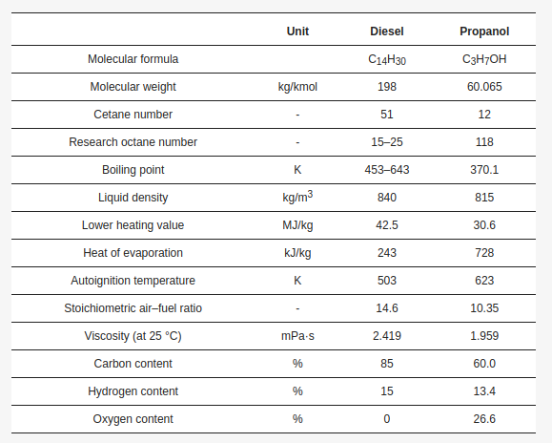
Experimental study- Effects of Propanol on the Performance and Emissions of a Dual-Fuel Industrial Diesel Engine.

Slide 11
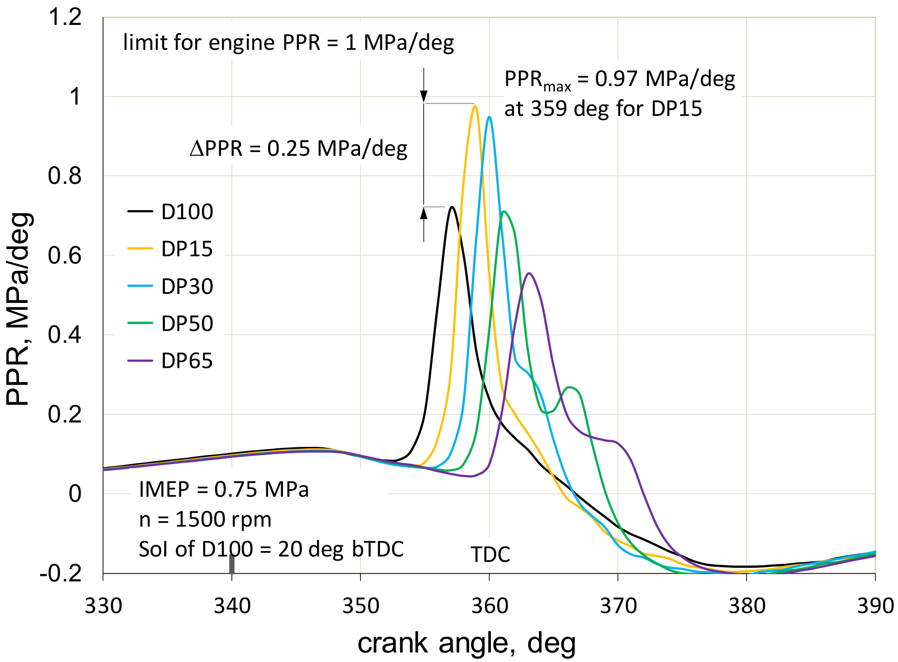
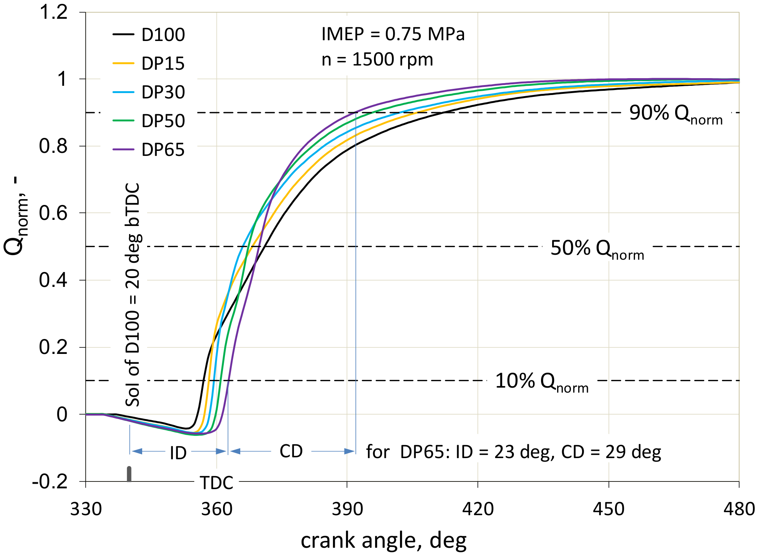

Slide 12
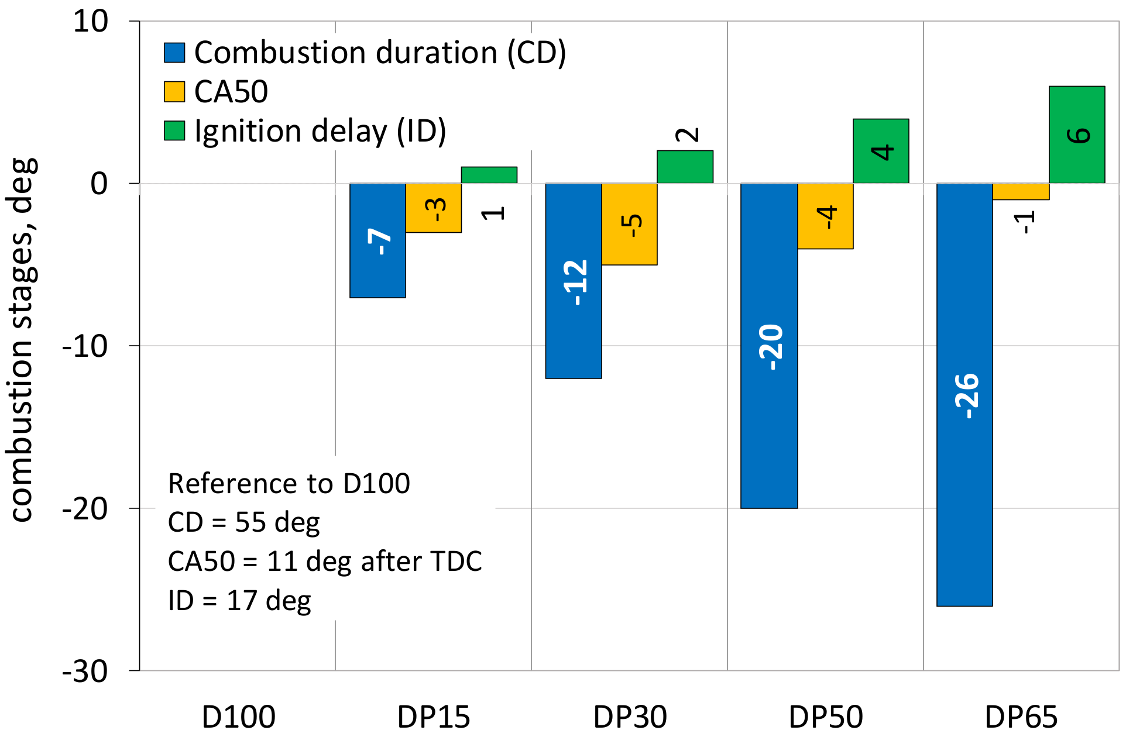
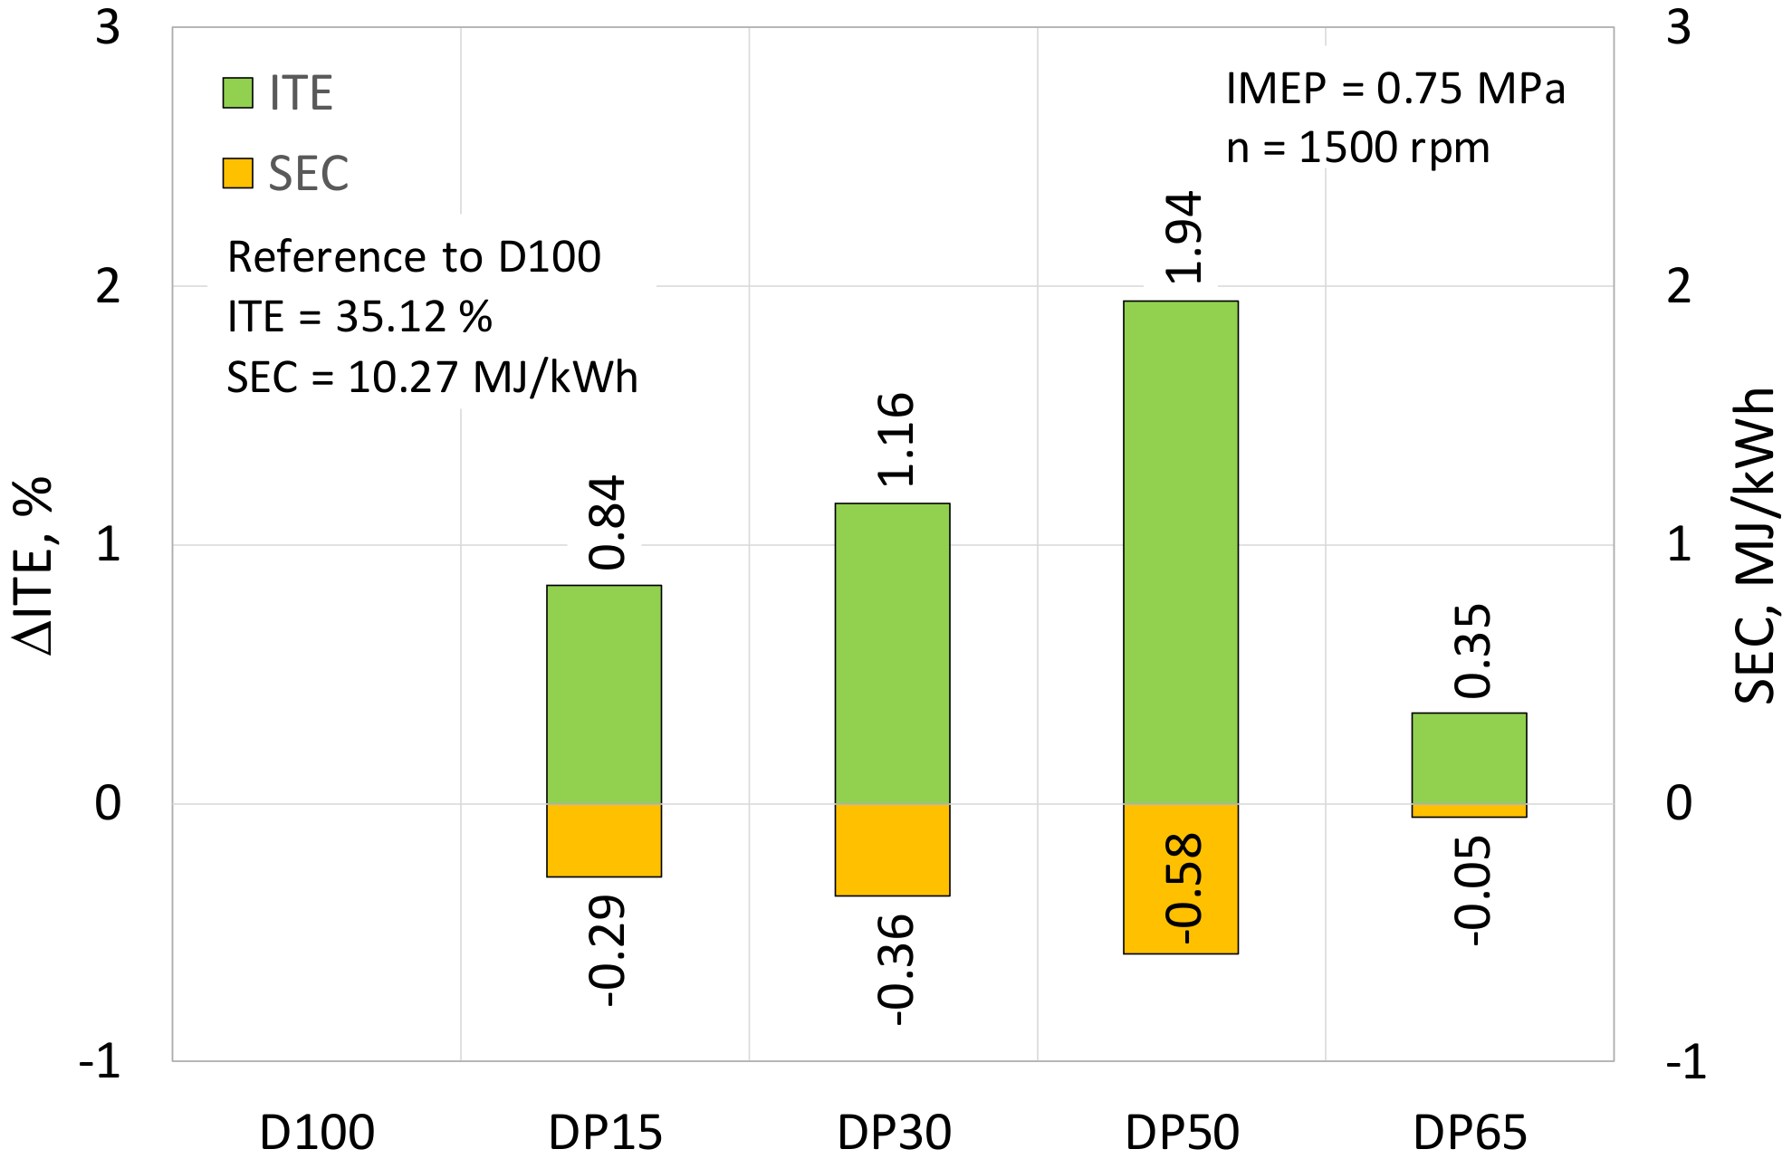
Performance

Slide 13
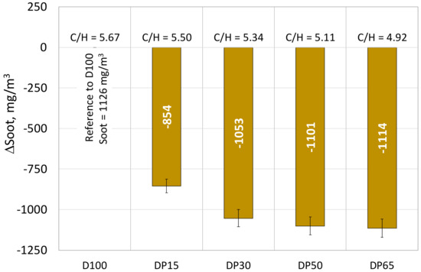
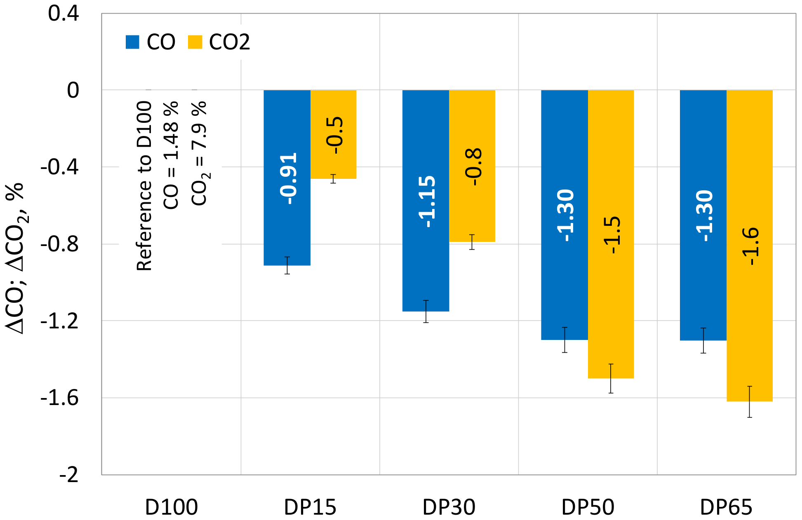
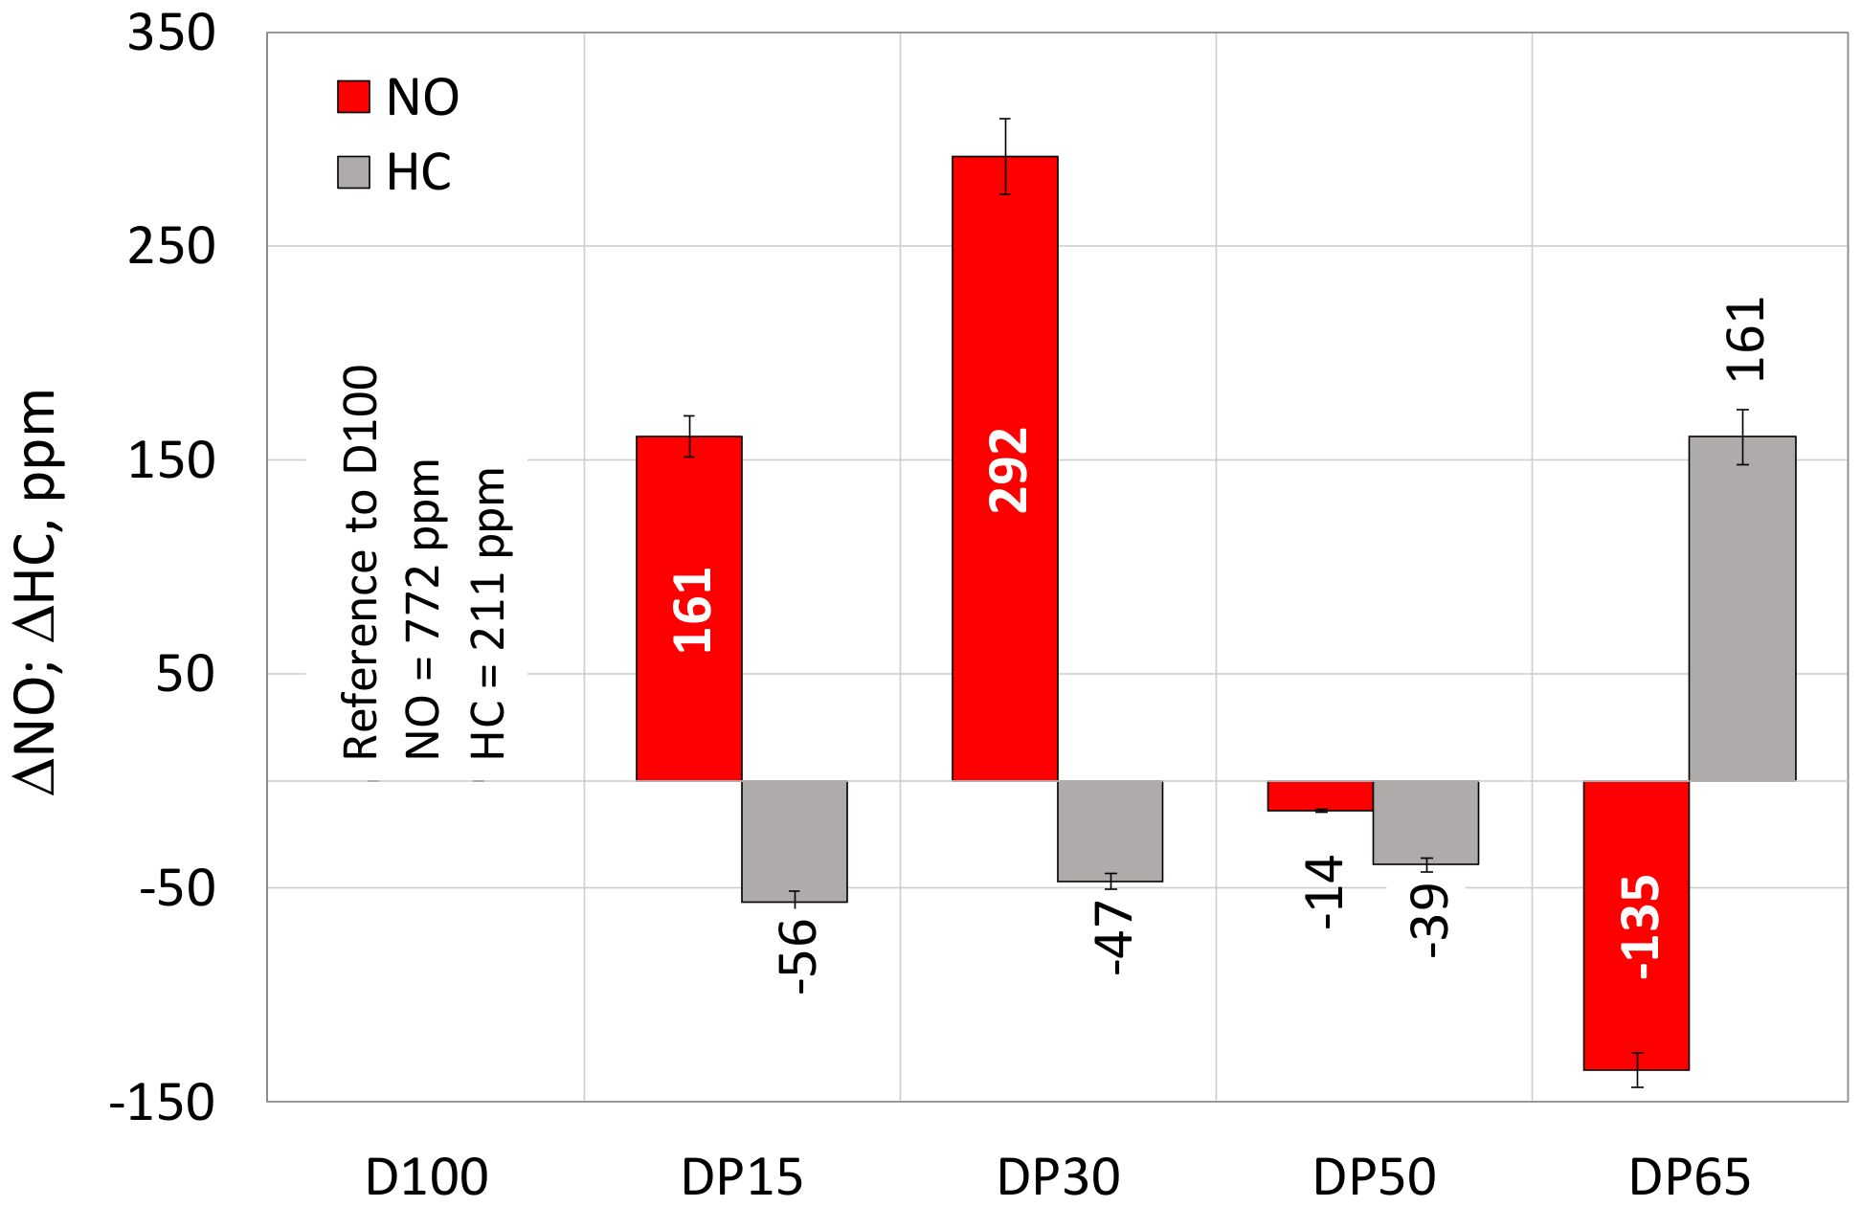
Emissions

Slide 14
Conclusion
Increasing propanol proportion increases peak pressure.
Increasing propanol proportion increases ignition delay, and significantly decreases combustion duration.
Emissions are decreasing with addition of propanol compared to conventional diesel engine but can be optimized for specific substitution ratio.
Refrences
MDPI and ACS Style
Jamrozik, A.; Tutak, W.; Grab-Rogaliński, K. Effects of Propanol on the Performance and Emissions of a Dual-Fuel Industrial Diesel Engine. Appl. Sci. 2022, 12, 5674. https://doi.org/10.3390/app12115674
AMA Style
Jamrozik A, Tutak W, Grab-Rogaliński K. Effects of Propanol on the Performance and Emissions of a Dual-Fuel Industrial Diesel Engine. Applied Sciences. 2022; 12(11):5674. https://doi.org/10.3390/app12115674
Chicago/Turabian Style
Jamrozik, Arkadiusz, Wojciech Tutak, and Karol Grab-Rogaliński. 2022. "Effects of Propanol on the Performance and Emissions of a Dual-Fuel Industrial Diesel Engine" Applied Sciences 12, no. 11: 5674. https://doi.org/10.3390/app12115674
Thank you

