Slide 1

CSE 5539: Natural Language Processing and Information Extraction for the Social Web
Instructor: Alan Ritter

Slide 2
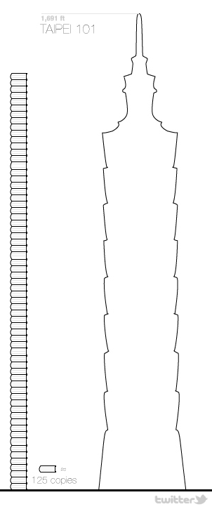


Why Study NLP in Social Media?
Data Analytics / Big Data
Companies have lots of data lying around
Computing cycles are cheap
Using data to get insights:
Business, Healthcare, Science, Government, Politics
Challenge: Most data is Unstructured
Text
Speech
Images
Structured Data
Bigger Unstructured Data

Slide 3

Extracting Knowledge from Text
The Web
News
Text Extractors
Structured Data

Slide 4
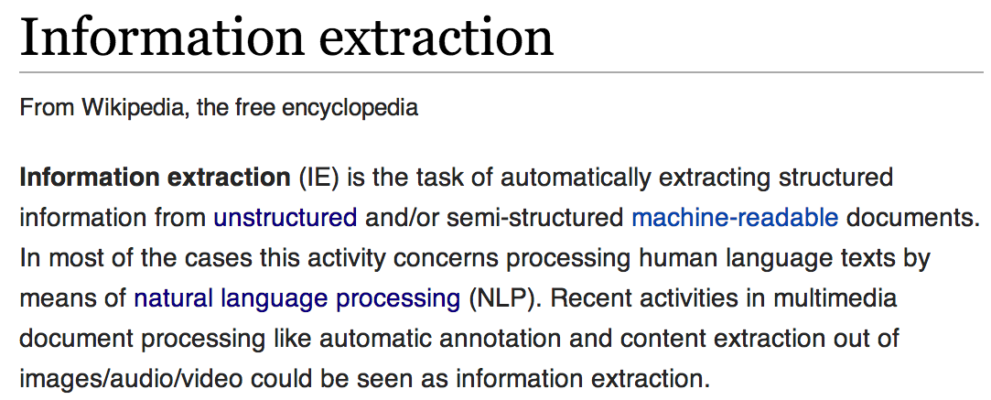

Slide 5
Example: Information Extraction from Twitter
“Yess! Yess! Its ofﬁcial Nintendo announced today that they Will release the Nintendo 3DS in north America march 27 for $250”
Notes:
OK, so just to make this a bit more concrete, let’s look at an idealized version of information extraction on Twitter.

Slide 6
Example: Information Extraction from Twitter
“Yess! Yess! Its ofﬁcial Nintendo announced today that they Will release the Nintendo 3DS in north America march 27 for $250”
Notes:
Typically the first step in an IE pipeline, is Named Entity recognition.
Here you can see that I’ve just highlighted all the “entities” in this post, for example Nintendo, 3DS, the date, and price.
Doing this kind of thing automatically is the standard NLP task of “Named Entity Recognition”

Slide 7
Example: Information Extraction from Twitter
“Yess! Yess! Its ofﬁcial Nintendo announced today that they Will release the Nintendo 3DS in north America march 27 for $250”
COMPANY | PRODUCT | DATE | PRICE | REGION
PRODUCT RELEASE
Notes:
Next we might classify this post as a PRODUCT RELEASE event.
We might also have a pre-defined idea that product release events involve a company, a product, a date on which the product is released, the price and the geographical region where it is being released.

Slide 8
Example: Information Extraction from Twitter
“Yess! Yess! Its ofﬁcial Nintendo announced today that they Will release the Nintendo 3DS in north America march 27 for $250”
COMPANY | PRODUCT | DATE | PRICE | REGION
Nintendo | 3DS | March 27 | $250 | North America
PRODUCT RELEASE
Notes:
And so the information extraction task is to fill in the fields for the event.
So you could imagine many events mentioned on Twitter which fit this general schema.
If we can automatically convert tweets into database rows like this, then we can do SQL-like queries and higher-level data mining and analysis on top of this that wasn’t possible by just directly looking at the text.

Slide 9
Example: Information Extraction from Twitter
Samsung Galaxy S5 Coming to All Major U.S. Carriers Beginning April 11th
COMPANY | PRODUCT | DATE | PRICE | REGION
Samsung | Galaxy S5 | April 11 | ? | U.S.
Nintendo | 3DS | March 27 | $250 | North America
PRODUCT RELEASE
Notes:
And so the information extraction task is to fill in the fields for the event.
So you could imagine many events mentioned on Twitter which fit this general schema.
If we can automatically convert tweets into database rows like this, then we can do SQL-like queries and higher-level data mining and analysis on top of this that wasn’t possible by just directly looking at the text.

Slide 10
Example: Information Extraction from Twitter
News
COMPANY | PRODUCT | DATE | PRICE | REGION
Samsung | Galaxy S5 | April 11 | ? | U.S.
Nintendo | 3DS | March 27 | $250 | North America
… | … | … | … | …
PRODUCT RELEASE
Notes:
And so the information extraction task is to fill in the fields for the event.
So you could imagine many events mentioned on Twitter which fit this general schema.
If we can automatically convert tweets into database rows like this, then we can do SQL-like queries and higher-level data mining and analysis on top of this that wasn’t possible by just directly looking at the text.

Slide 11
Example Applications of Information Extraction
Question Answering / Structured Queries
Which companies are releasing new smartphones new products in Europe this Spring?
Alert me anytime a new smartphone is announced in the U.S.
Data Mining
Analyze trends in product releases across different industries
Is there a correlation between price and date of release?

Slide 12
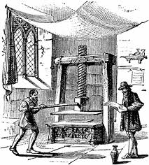

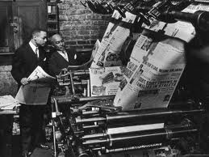
Background: Event Extraction from Newswire
Historically, the most important source of info on current events
Since spread of printing press
Lots of previous work on Newswire
MUC & ACE competitions
Timebank
Notes:
Of course there has been a ton of previous work on IE and NLP in newspaper articles.
This makes a lot of sense because historically news has been the best source of info on current events.
*******************************************************
A large portion of previous work on IE and NLP has focused on processing newspaper articles, so I think it’s worth stepping back for a second to ask why that is.
Historically newswire has been the best source of information on current events
Current events are a great application area for NLP
If our goal is to extract historical or encyclopedic information, then it’s very difficult to compete with manually curated structured data sources such as WP or FB.
But newswire is somewhat challenging for NLP applications as well, partly because it’s already quite well organized and edited.
It’s easy to keep up to date on current events by reading the newspaper every day.
***********************************************
A large portion of previous work on IE and NLP has focused on processing newspaper articles, so I think it’s worth taking a moment to reflect on why that is.
-Historically news articles have been the best source of information on current events (really since the spread of the printing press…)
Current events are a really good application area for NLP and IE
-If our goal is to extract encyclopedic knowledge, then it’s really difficult to compete with manually compiled structured data sources such as Wikipedia or Freebase, but if we’re extracting fresh information from news, then we have an opportunity to open up new data-analysis applications.
-One challenge for NLP applications on newswire text, however is that news is already very well organized. It’s fairly easy for a person to keep up to date on important events of the day by reading the newspaper.
********************************************************************************
If we just focus on extracting encyclopedic knowledge (information which is not new) from text, then it’s difficult to compete with manually compiled sources of structured data such as Freebase or Wikipedia.
People are more likely to mention new information using natural language than to fill out structured data forms, so by extracting up-to-date information about current events, we should be able to enable new data-analysis applications
*****************************************************************
Like I mentioned, most previous work on IE / NLP is focused on processing news articles. Since the NLP community is spending so much time working with this data, I think it’s worth stepping back a bit and evaluating why we’ve decided to do this, and whether it makes sense to shift our focus.
Newswire is a natural choice for NLP applications
-Historically newspapers have contained the best source of info on up to date info and current events.
-Clearly NLP can have a big impact by extracting machine processable information on current events
--if we just extract “old” information (that was already known), it’s difficult to compete with manually constructed structured data resources such as Freebase
-
-----------------------------------------------------------------------------------------
Why are we spending so much time working on NLP and IE from newswire? Certainly is a useful domain, but might be time to consider looking at others as well…
Think it’s worth keeping in mind why we’ve chosen this text genre to work on originally, and to evaluate whether it’s necessary to think about other types of text as well…
----------------------------------------------------------------------------------
Of course there has been tons of previous work on extracting events from newswire text.
This makes sense because historically news has been the best source of information on current events.
Examples include the Timebank corpus and the MUC and ACE competitions

Slide 13


Background: Event Extraction from Newswire
Current Events: good application area for IE
Historical Information -> Difficult to compete
Challenge for NLP Applictions:
News is already well organized…
Notes:
Current events are a really good application area for information extraction.
If our goal is to extract historical or encyclopedic information, then it’s really difficult to compete with manually compiled structured data sources like WP or FB.
But news is also a challenging area for NLP applications. In part because news is already well organized.
It’s easy to keep up to date with the important news stories each day by reading the paper.
*****************************************
A large portion of previous work on IE and NLP has focused on processing newspaper articles, so I think it’s worth stepping back for a second to ask why that is.
Historically newswire has been the best source of information on current events
Current events are a great application area for NLP
If our goal is to extract historical or encyclopedic information, then it’s very difficult to compete with manually curated structured data sources such as WP or FB.
But newswire is somewhat challenging for NLP applications as well, partly because it’s already quite well organized and edited.
It’s easy to keep up to date on current events by reading the newspaper every day.
***********************************************
A large portion of previous work on IE and NLP has focused on processing newspaper articles, so I think it’s worth taking a moment to reflect on why that is.
-Historically news articles have been the best source of information on current events (really since the spread of the printing press…)
Current events are a really good application area for NLP and IE
-If our goal is to extract encyclopedic knowledge, then it’s really difficult to compete with manually compiled structured data sources such as Wikipedia or Freebase, but if we’re extracting fresh information from news, then we have an opportunity to open up new data-analysis applications.
-One challenge for NLP applications on newswire text, however is that news is already very well organized. It’s fairly easy for a person to keep up to date on important events of the day by reading the newspaper.
********************************************************************************
If we just focus on extracting encyclopedic knowledge (information which is not new) from text, then it’s difficult to compete with manually compiled sources of structured data such as Freebase or Wikipedia.
People are more likely to mention new information using natural language than to fill out structured data forms, so by extracting up-to-date information about current events, we should be able to enable new data-analysis applications
*****************************************************************
Like I mentioned, most previous work on IE / NLP is focused on processing news articles. Since the NLP community is spending so much time working with this data, I think it’s worth stepping back a bit and evaluating why we’ve decided to do this, and whether it makes sense to shift our focus.
Newswire is a natural choice for NLP applications
-Historically newspapers have contained the best source of info on up to date info and current events.
-Clearly NLP can have a big impact by extracting machine processable information on current events
--if we just extract “old” information (that was already known), it’s difficult to compete with manually constructed structured data resources such as Freebase
-
-----------------------------------------------------------------------------------------
Why are we spending so much time working on NLP and IE from newswire? Certainly is a useful domain, but might be time to consider looking at others as well…
Think it’s worth keeping in mind why we’ve chosen this text genre to work on originally, and to evaluate whether it’s necessary to think about other types of text as well…
----------------------------------------------------------------------------------
Of course there has been tons of previous work on extracting events from newswire text.
This makes sense because historically news has been the best source of information on current events.
Examples include the Timebank corpus and the MUC and ACE competitions

Slide 14


Social Media
Competing source of info on current events
Status Messages
Short
Easy to write (even on mobile devices)
Instantly and widely disseminated
Double Edged Sword
Many irrelevant messages
Many redundant messages
Information Overload
Notes:
In the meantime social media has emerged as an important competing source of information on current events.
The status messages written by users of these social networking websites have very different characteristics from news articles.
They are short, easy for anyone to write and are instantly and widely distributed.
For these reasons, social media often contains more up to date information on a wider variety of topics than news.
But this lowering of the barier to publication is a double-edged sword.
Because these messages are so easy to write, we end up with a lot of irrelevant and redundant information, leading to a situation of information overload.
Again this motivates the need for automatic text processing techniques to aggregate and categorize this disorganized stream of information.
***************************************************
Recently social media has emerged as an important competing source of information on current events. The status messages found on these social networing sites have several unique characteristics as compared with news: they are short, easy for anyone to write even on mobile devices, and are also instantly and widely disseminated. For these reasons Twitter often contains the most up-to-date info on current events.
Lowering the barrier to publication is kind of a double edged sword, however because this also leads to many irrelevant and redundant messages. No person can sit down and read all of the millions of Tweets written every day leading to a situation of information overload and motivating the need for automatic text processing techniques to extract and aggregate the most important information from Twitter.

Slide 15
Noisy Text: Challenges
Lexical Variation (misspellings, abbreviations)
`2m', `2ma', `2mar', `2mara', `2maro', `2marrow', `2mor', `2mora', `2moro', `2morow', `2morr', `2morro', `2morrow', `2moz', `2mr', `2mro', `2mrrw', `2mrw', `2mw', `tmmrw', `tmo', `tmoro', `tmorrow', `tmoz', `tmr', `tmro', `tmrow', `tmrrow', `tmrrw', `tmrw', `tmrww', `tmw', `tomaro', `tomarow', `tomarro', `tomarrow', `tomm', `tommarow', `tommarrow', `tommoro', `tommorow', `tommorrow', `tommorw', `tommrow', `tomo', `tomolo', `tomoro', `tomorow', `tomorro', `tomorrw', `tomoz', `tomrw', `tomz‘
Unreliable Capitalization
“The Hobbit has FINALLY started filming! I cannot wait!”
Unique Grammar
“watchng american dad.”
Notes:
OK, so the noisy, informal text we find on Twitter presents a number of challenges for NLP systems.
First there is a lot of lexical variation; Twitter users are very creative with their use of spelling and abbreviations.
As an example, I ran a distributional word clustering algorithm on a large corpus of tweets, then picked out and cleaned up one of the clusters.
Here you can see there are over 50 different ways people can refer to the word “tomorrow” on twitter. Clearly we aren’t going to see this same kind of lexical variation in news.
Tweets also contain unreliable capitalization. For instance people will often capitalize words simply for emphasis, or leave the whole message lowercased; this is particularly challenging for NE segmentation which relies heavily on capitalization.
Finally tweets have a unique grammar, for instance, users will often drop personal pronouns assuming the subject of the sentence refers to the speaker.
*****************************************************
On the other hand, shallow-syntactic annotation tasks are generally more difficult in Twitter because of their noisy and informal style.
First of all, people are really creative with their use of spelling and abbreviation; as an example, I ran a distributional word clustering algorithm on a large corpus of tweets, then picked out and cleaned up one of the clusters and you can see there are over 50 different ways to refer to the word “tomorrow”. Clearly you wouldn’t see this same kind of lexical variation in grammatical texts such as news articles.
Another problem is unreliable capitalization – People often capitalize words simply for emphasis or don’t capitalize proper nouns. This is a big problem for named entity segmentation which traditionally relies heavily on capitaliation.
Finally tweets have a unique grammar, for example we often see tweets which begin with verbs which isn’t common in news sentences.

Slide 16
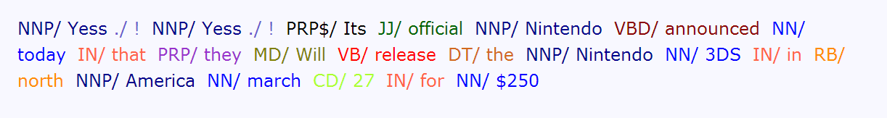
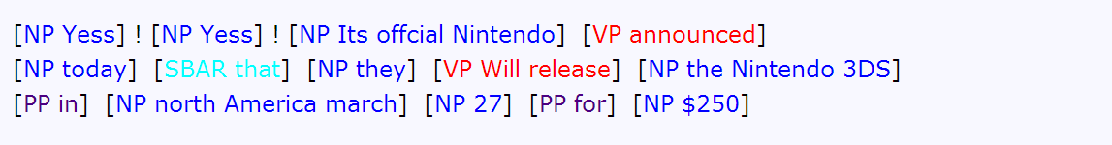
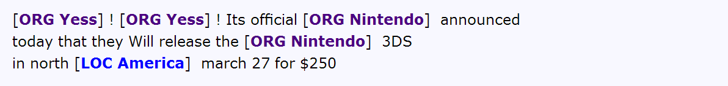
Let’s try NLP on Twitter…
Oops!
“Yess! Yess! Its ofﬁcial Nintendo announced today that they Will release the Nintendo 3DS in north America march 27 for $250”
POS:
Twitter Has Noisy & Unique Style
Chunk:
NER:
Notes:
OK, so you might be wondering how off-the-shelf NLP systems perform on Twitter.
And the answer is “quite poorly”.
For example the POS tagger here mis-categorizes “Yess” as a proper noun (because of the funny spelling).
The chunker mis-segments “Its official Nintendo” as an NP which is clearly a problem.
Also the NER mis-segments “America” as a location whereas if you look carefully, you will notice it should be north america“north America”.
OK, so I’m not pointing out all of the errors that are being made here, but the point is that Twitter has a noisy and unique style which systems tuned for grammatical texts weren’t meant to handle.
***********************************************************
OK, so hopefully I’ve convinced you we should be spending more effort on NLP and information extraction on informal text.
So the first question you might be asking is: how well to existing NLP tools work on Twitter?
And the answer is quite poorly.
For example you can see that Yess is mis-tagged as a proper noun (it’s a funny spelling).
“Its official Nintendo” is tagged as an NP which is clearly wrong.
And “America” is mis-segmented as a location (should be north america).
What’s going on here is that Twitter has a noisy and unique style which NLP tools designed for edited texts such as newspaper articles weren’t meant to handle.
************************************************************
TODO: fix the POS example (of-fi-cial)
Show example tweet and run off-the shelf tools on it.

Slide 17

Re-Building the NLP Pipeline for Twitter
Syntax
Annotate corpus of tweets (~2000)
Train in-domain sequence models
Word Clusters / Semi-supervised learning
Lexical Semantics
Supervised
POS
Shallow Parse
Entity
Event
Unsupervised
Named Entity
Classification
Event
Classification
Relation Extraction
Notes:
-To address these challenges I’ve re-built an NLP pipeline which is tuned to work specifically on noisy Twitter data.
-To do this, we have annotated a corpus of tweets with part of speech tags, shallow parse tags, named entities and events.
-Also I just want to highlight here that Sam Clark, a masters student working with our group annotated tweets and built this part of the pipeline which includes shallow parsing and chunking.
-These annotations are then used to train sequence models which can automatically annotate millions of Tweets streaming in realtime.
-We’re taking a mostly supervised approach to these syntactic annotation tasks.
-There is a lot of really interesting research on unsupervised learning for syntax. So far supervised methods perform better, and we’re trying to take a practical approach here.
-Informal text is highly diverse, however; therefore we need unsupervised learning methods which can leverage large quantities of unlabeled training data.
-I am going to talk about some unsupervised methods for information extraction, including named entity classification, event classification and relation extraction.
-I believe that unsupervised learning is a bit more practical for these more semantic tasks.
NEEDS PRACTICE
***************************************************************
-> Could think about using this as an outline for the talk (e.g. mention event categorization, named entity recognition and relation extraction on this slide…
TODO: Need to explain supervised / unsupervised distinction on this slide (this will tie together the later parts of the talk and make everything sound more coherent….)
-> coherent story = New domain, re-build some parts, unsupervised for other parts where appropriate, now I want to do this for more domains.
We are doing semi-supervised learning… Word clusters
Unsupervised methods for tasks like parsing and POS tagging generally don’t work very well as compared with a relatively small amount of labeled data
We’re interested in building something that works
Later in the talk I’ll talk about unsupervised and weakly supervised methods for information extraction which are well motivated in the context of noisy real-time text and I believe will generalize well to other domains.
TODO: somehow incorporate idea of unsupervised information extraction into this.
TODO: Explain Unsupervised vs. Supervised…
In addition we’re applying a number of unsupervised techniques for information extraction which I’ll get to later in the talk.
-For these syntactic annotation tasks, the strictly unsupervised techniques have been shown to have very poor performance compared with just a small amount of labeled data
-We’re really trying to take a practical approach here and actually get information extraction working on Twitter data, to ask what are the important questions which come up when we scale up to large datasets…
To address this, we’ve re-built an NLP pipeline which is tuned specifically for Twitter.
This includes POS tagging, Shallow parsing (or chunking), Named Entity Recognition, and Event tagging.
To do this, I annotated a corpus of tweets with each of these phenomenon, and trained in-domain sequence labeling models.
In addition we applied some unsupervised and weakly supervised methods which I’ll get to later in the talk.
**************************************************
To address this we’ve rebuilt an NLP pipeline for Twitter including POS tagging, shallow parsing, named entity recognition and event tagging.
I’m skipping over a bunch of details here, but by using a relatively small amount
in general our approach is to annotate a corpus of Tweets and train in-domain models.
We have also used some unsupervised and weakly supervised techniques here, some of which will come up later in the talk.

Slide 18
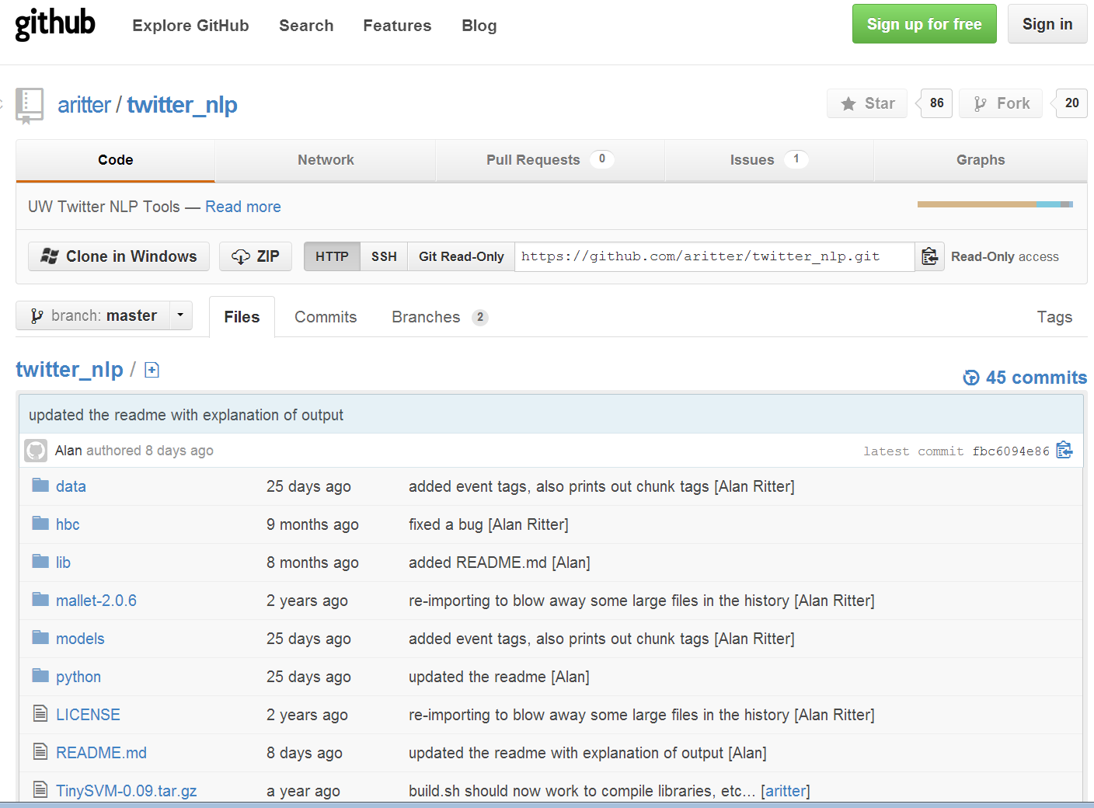
Improved NLP on Twitter
[Ritter et. al. EMNLP 2011]
Notes:
Here I’m showing our performance at each of these tasks, in comparison to out-of-domain models trained on news articles.
As you can see in each case we’re doing significantly better than the news-trained systems.
In addition we’ve made our NLP tools tuned for Twitter available on github, you’re welcome to download and try them out, and it appears that a bunch of people have been finding them useful.
********************************************
Here I’m showing performance at these various NLP tasks, comparing our system against off-the-shelf NLP tools tuned for newswire, and you can see that we’re doing much better.
And our tools are available on Github, a bunch of people seem to find them useful.
******************************************************
These are not the kind of accuracies and F1 scores you would expect to see for the same tasks in edited texts (e.g. news articles)
These tasks are more difficult in noisy text
***But my claim is that this is actually good enough in this domain, because we have other factors working in our favor***

Slide 19
Computational Social Science
Predicting User Attributes from Language
Age
Gender
Income
Ethnicity
Evaluate Sociolinguistic Hypotheses using Real-World Data

Slide 25

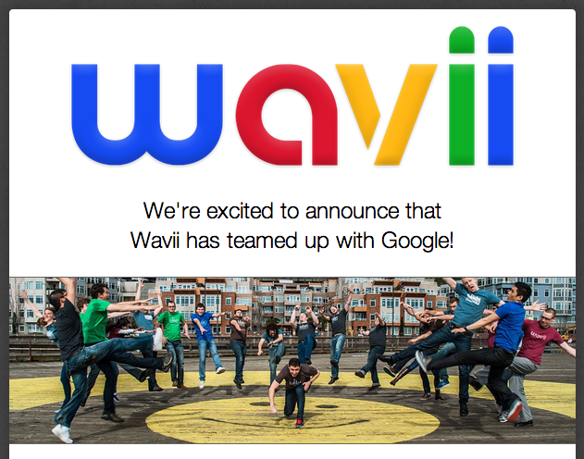



More Applications: News Recommendation

Slide 26
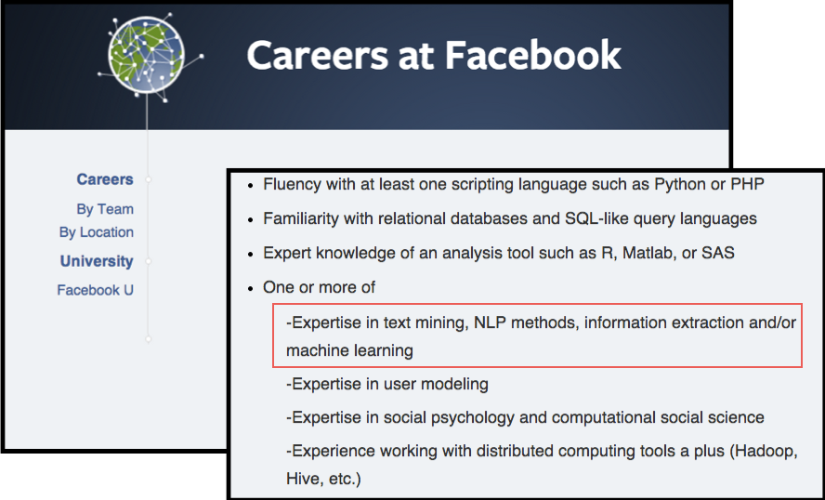
Why Study NLP in Social Media?

Slide 27
Administrative Details
Course Webpage
http://aritter.github.io/courses/5539.html

