Slide 1
Probability
CSE 5522
Instructor: Alan Ritter

Slide 2
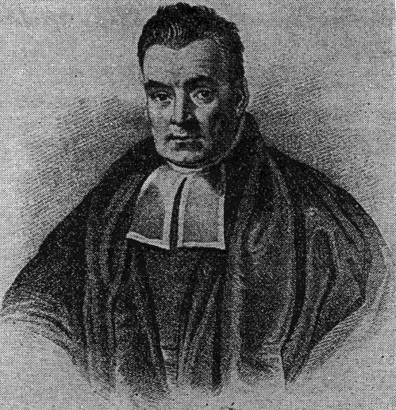
What is Probability?
“The probability the coin will land heads is 0.5”
Q: what does this mean?
2 Interpretations:
Frequentist (Repeated trials)
If we flip the coin many times…
Bayesian
We believe there is equal chance of heads/tails
Advantage: events that do not have long term frequencies
Q: What is the probability the polar ice caps will melt by 2050?

