Slide 1


A Latent Dirichlet Allocation Method For Selectional Preferences
Alan Ritter
Mausam
Oren Etzioni

Slide 2
Selectional Preferences
Encode admissible arguments for a relation
E.g. “eat X”
Plausible | Implausible
chicken | Windows XP
eggs | physics
cookies | the document
… | …
FOOD
Notes:
Metaphor
Less categorical?

Slide 3




Motivating Examples
“…the Lions defeated the Giants….”
X defeated Y => X played Y
Lions defeated the Giants
Britian defeated Nazi Germany
Notes:
Buys/acquire?
More examples srl, coref, etc..

Slide 4
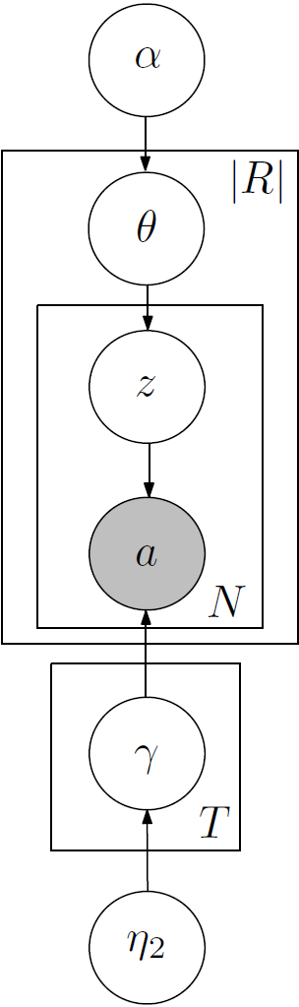
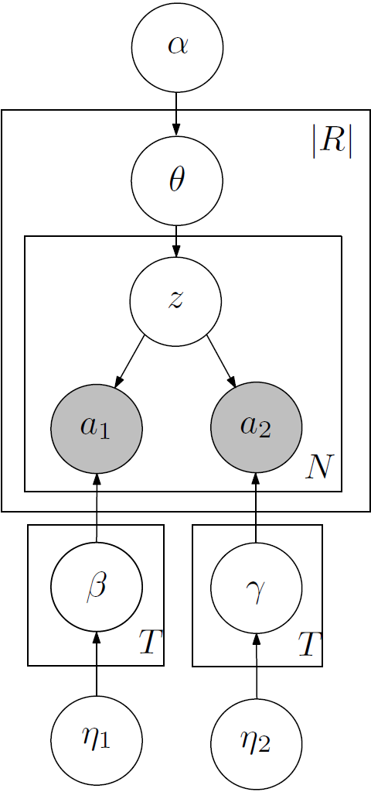
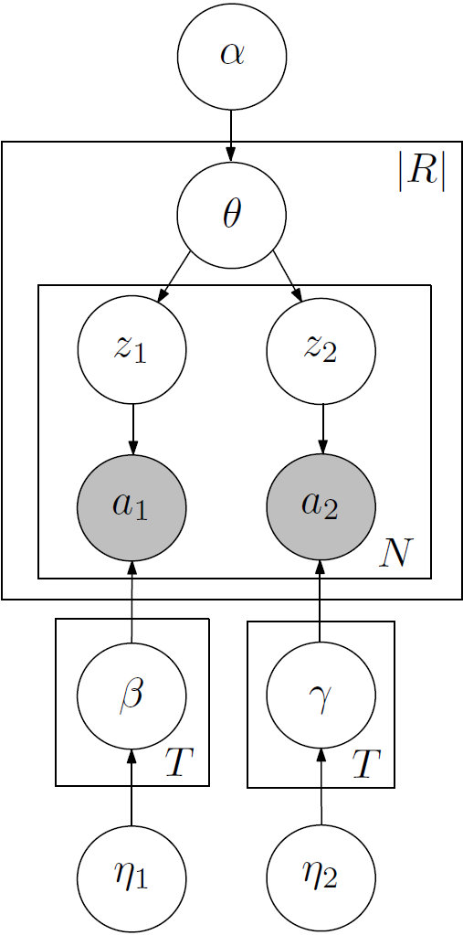
Our Contributions
Apply Topic Models to Selectional Preferences
Also see [Ó Séaghdha 2010] (the next talk)
Propose 3 models which vary in degree of independence:
IndependentLDA
JointLDA
LinkLDA
Show improvements on Textual Inference Filtering Task
Database of preferences for 50,000 relations available at:
http://www.cs.washington.edu/research/ldasp/
Notes:
Crisp – input/output

Slide 5

Previous Work
Class-based SP
[Resnik’96, Li & Abe’98,…, Pantel et al’07]
maps args to existing ontology, e.g., Wordnet
human-interpretable output
poor lexical coverage
word-sense ambiguity
Similarity based SP
[Dagan’99, Erk’07]
based on distributional similarity;
data driven
no generalization: plausibility of each arg independently
not human-interpretable
Notes:
More detail on previous work….
Previous work before evaluation?
Table?
One slide which contrasts with previous work
One slide which highlights contributions/differences…
Outline!
More detail on similarity based (this is what we compare to).
Remind people what similarity-based methods are for evaluation.

Slide 6
Previous Work (contd)
Generative Probabilistic Models for SP
[Rooth et al’99], [Ó Séaghdha 2010], our work
simultaneously learn classes and SP
good lexical coverage
handles Ambiguity
easily integrated as part of larger system (probabilities)
output human interpretable with small manual effort
Discriminative Models for SP
[Bergsma et al’08]
recent
Similar in spirit to similarity-based methods

Slide 7

Topic Modeling For Selectional Preferences
Start with (subject, verb, object) triples
Extracted by TextRunner (Banko & Etzioni 2008)
Learn preferences for TextRunner relations:
E.g. Person born_in Location

Slide 8
Topic Modeling For Selectional Preferences
born_in(Sergey Brin, Moscow)
headquartered_in(Microsoft, Redmond)
born_in(Bill Gates, Seattle)
born_in(Einstein, March)
founded_in(Google, 1998)
headquartered_in(Google, Mountain View)
born_in(Sergey Brin, 1973)
founded_in(Microsoft, Albuquerque)
born_in(Einstein, Ulm)
founded_in(Microsoft, 1973)

Slide 9

Relations as “Documents”

Slide 10
Args can have multiple Types

Slide 11
LDA Generative “Story”
For each relation, randomly pick a distribution over types
born_in X
P(Location|born_in)= 0.5
P(Date|born_in)= 0.3
…
For each extraction, first pick a type
born_in Location
born_in Date
Then pick an argument based on type
born_in New York
born_in 1988
For each type, pick a random distribution over words
Type 1: Location
P(New York|T1)= 0.02
P(Moscow|T1)= 0.001
…
Type 2: Date
P(June|T2)=0.05
P(1988|T2)=0.002
…
Notes:
Type names are invented by me
Throughout this talk I’m putting labels on these things

Slide 12
Inference
Collapsed Gibbs Sampling [Griffiths & Steyvers 2004]
Sample each hidden variable in turn, integrating out parameters
Easy to implement
Integrating out parameters:
More robust than Maximum Likelihood estimate
Allows use of sparse priors
Other options: Variational EM, Expectation Propagation

Slide 13
Dependencies between arguments
Problem: LDA treats each argument independently
Some types are more likely to co-occur
(Politician, Political Issue)
(Politician, Software)
How best to handle binary relations?
Jointly Model Both Arguments?

Slide 14
JointLDA
Notes:
TODO: add example (e.g. politician – political issue)

Slide 15
JointLDA
X born_in Y
P(Person,Location|born_in)=0.5
P(Person,Date|born_in)= 0.3
…
Both arguments share a hidden variable
Person born_in Location
Note: two different distributions are needed to represent the type “Person”
Alice born_in New York
Arg 1 Topic 1: Person
P(Alice|T1)= 0.02
P(Bob|T1)= 0.001
…
Arg 2 Topic 1: Date
P(June|T1)=0.05
P(1988|T1)=0.002
…
Two separate sets of type distributions
Arg 1 Topic 2: Person
P(Alice|T2)= 0.03
P(Bob|T2)= 0.002
…
Arg 2 Topic 2: Location
P(Moscow|T2)= 0.00 P(New York|T2)= 0.021
…
Pick a topic for arg2
Notes:
TODO: add example (e.g. politician – political issue)
Moscow – high prob
T1 T2 flipped

Slide 16
LinkLDA [Erosheva et. al. 2004]
Both arguments share a distribution over topics
Likely that z1 = z2
(Both drawn from same distribution)
Pick a topic for arg2
LinkLDA is more flexible than JointLDA
Relaxes the hard constraint that z1 = z2
z1 and z2 are more likely to be the same
Drawn from the same distribution

Slide 17
LinkLDA vs JointLDA
Initially Unclear which model is better
JointLDA is more tightly coupled
Pro: one argument can help disambiguate the other
Con: needs multiple distributions to represent the same underlying type
Person Location
Person Date
LinkLDA is more flexible
LinkLDA: T² possible pairs of types
JointLDA: T possible pairs of types

Slide 18
Experiment: Pseudodisambiguation
Generate pseudo-negative tuples
randomly pick an NP
Goal: predict whether a given argument was
observed vs. randomly generated
Example
(President Bush, has arrived in, San Francisco)
(60[deg. ] C., has arrived in, the data)

Slide 19
Data
3,000 TextRunner relations
2,000-5,000 most frequent
2 Million tuples
300 Topics
about as many as we can afford to do efficiently

Slide 20
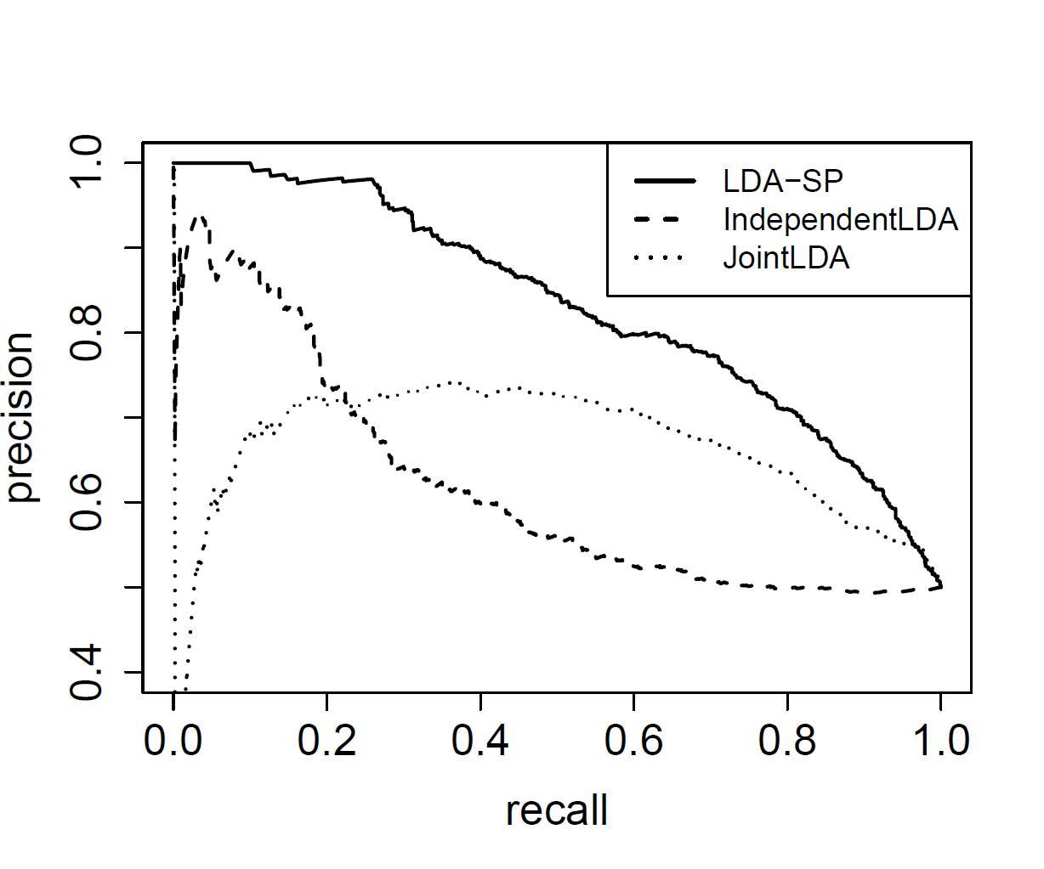
Model Comparison - Pseudodismabiguation
LinkLDA
LDA
JointLDA
Notes:
TODO: rename LDA-SP -> LinkLDA

Slide 21
Why is LinkLDA Better than JointLDA?
Many relations share a common type in one argument while the other varies:
Person appealed to Court
Company appealed to Court
Committee appealed to Court
Not so many cases where distinct pairs of Types are needed:
Substance poured into Container
People poured into Building

Slide 22
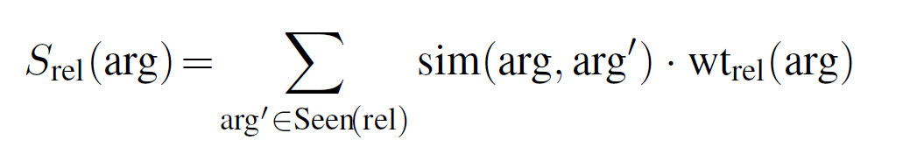
How does LDA-SP compare to state-of-the-art Methods?
Compare to Similarity-Based approaches [Erk 2007] [Pado et al. 2007]
Distributional Similarity
eat X
chicken
eggs
cookies
…
?
tacos

Slide 23
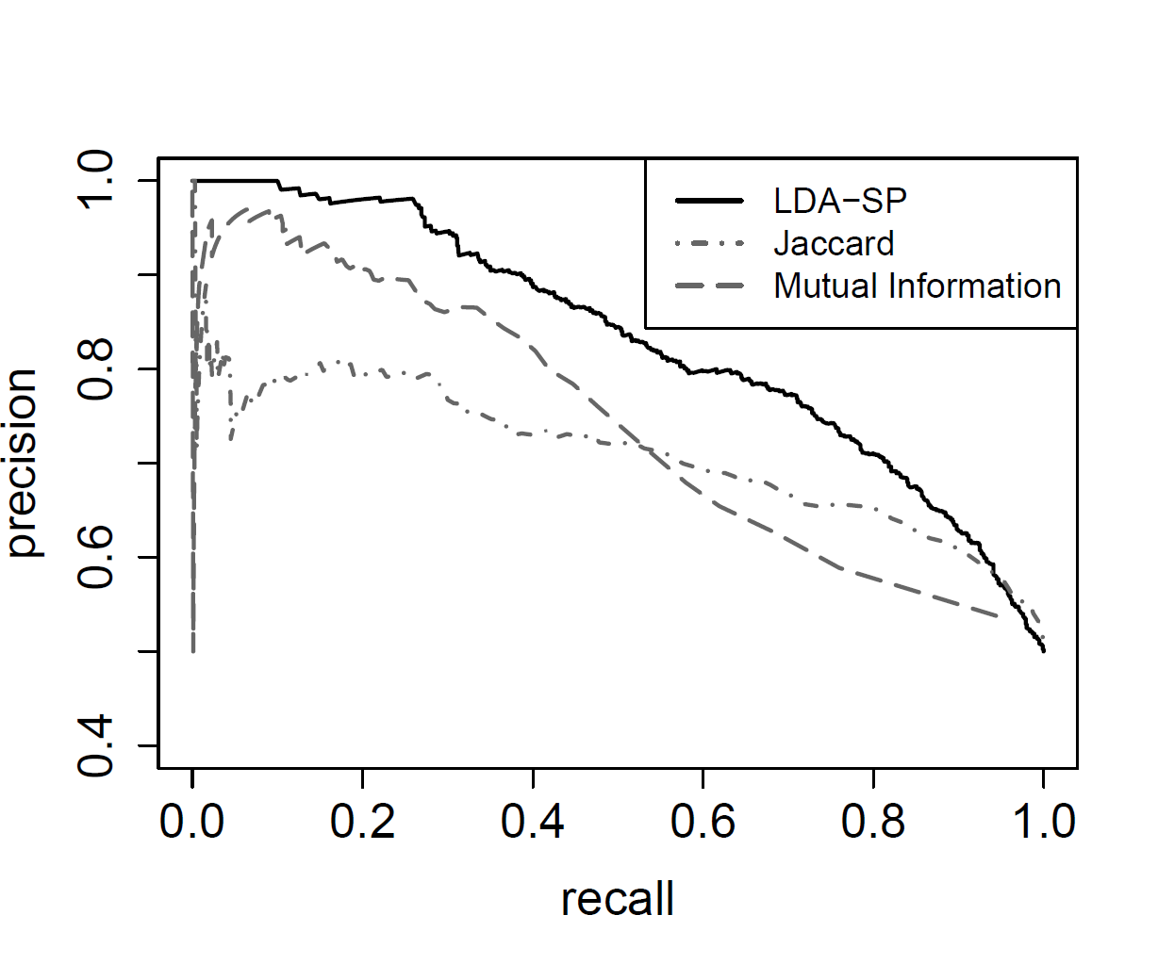
How does LDA-SP compare to state-of-the-art Similarity Based Methods?
15% increase in AUC

Slide 24
Example Topic Pair (arg1-arg2)
Topic 211: politician
President Bush
Bush
The President
Clinton
the President
President Clinton
Mr. Bush
The Governor
the Governor
Romney
McCain
The White House
President
Schwarzenegger
Obama
US President George W. Bush
Today
the White House
Topic 211: political issue
the bill
a bill
the decision
the war
the idea
the plan
the move
the legislation
legislation
the measure
the proposal
the deal
this bill
a measure
the program
the law
the resolution
efforts
John Edwards
Gov. Arnold Schwarzenegger
The Bush administration
WASHINGTON
Bill Clinton
Washington
Kerry
Reagan
Johnson
George Bush
Mr Blair
The Mayor
Governor Schwarzenegger
Mr. Clinton
the agreement
gay marriage
the report
abortion
the project
the title
progress
the Bill
President Bush
a proposal
the practice
bill
this legislation
the attack
the amendment
plans 49

Slide 25
What relations assign higest probability to Topic 211?
hailed
“President Bush hailed the agreement, saying…”
vetoed
“The Governor vetoed this bill on June 7, 1999.”
favors
“Obama did say he favors the program…”
defended
“Mr Blair defended the deal by saying…”

Slide 26
End-Task Evaluation: Textual Inference [Pantel et al’07] [Szpektor et al ‘08]
DIRT [Lin & Pantel 2001]:
Filter out false inferences based on SPs
X defeated Y => X played Y
Lions defeated the Giants
Britian defeated Nazi Germany
Filter based on:
Probability that arguments have the same type in antecedent and consequent.
Team defeated Team
Team played Team
Lions defeated Saints
Lions played Saints
Country defeated Country
Team played Team
Britian defeated Nazi Germany
Britian played Nazi Germany

Slide 27
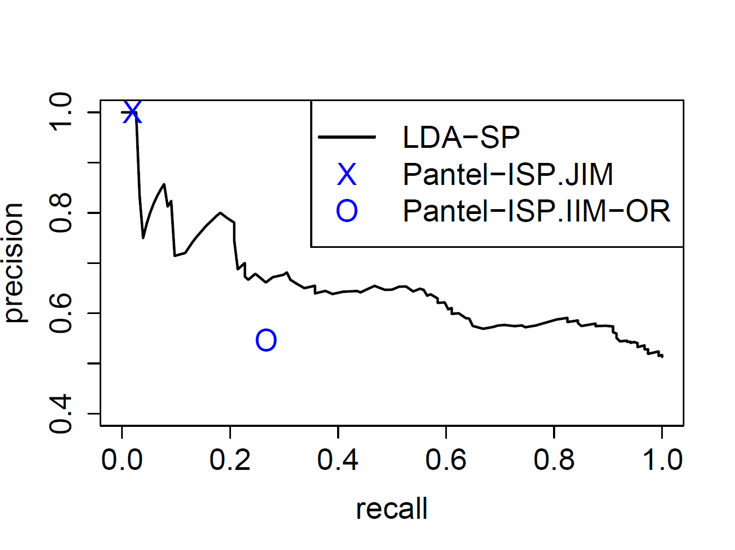
Textual Inference Results

Slide 28
Database of Selectional Preferences
Associated 1200 LinkLDA topics to Wordnet
Several hours of manual labor.
Compile a repository of SPs for 50,000 relation strings
15 Million tuples
Quick Evaluation
precision 0.88
Demo + Dataset:
http://www.cs.washington.edu/research/ldasp/
Notes:
Now scaled up to data

Slide 29
Conclusions
LDA works well for Selectional Preferences
LinkLDA works best
Outperforms state of the art
pseudo-disambiguation
textual inference
Database of preferences for 50,000 relations available at:
http://www.cs.washington.edu/research/ldasp/
Thank YOU!

Slide 30
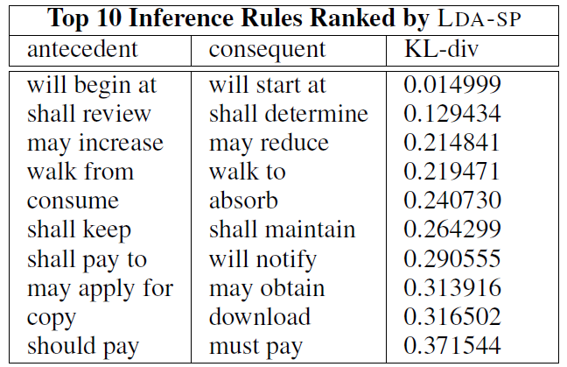
Notes:
More cool, qualitative evaluation.

Slide 31
