Slide 1

Extracting a Calendar from Twitter
Alan Ritter
Sam Clark, Oren Etzioni, Mausam

Slide 2
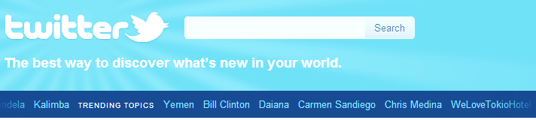
Why Information Extraction from Twitter?
Short messages are quick/easy to create
Often the most up-to date source of information
Many Users talking about the same events [Popescu et. al. 2011]
Multiple Perspectives
Natural measure of importance/interestingness
But, causes Information Overload
Many irrelevant or redundant messages [Zanzotto et. al. 2011]
Need automatic text processing techniques
Notes:
So why would we want to do information extraction and build NLP tools for Twitter? So I don’t think Twiitter is going to be a useful source of information for things like answering Jeopardy questions or discovering new protien interactions, but I think it does provide useful information about events that are taking place in the world.
What is interesting and unique about Twitter as compared with other text genres such as news articles is that Tweets are very short and easy to create (even on mobile devices); and they are also widely distributed. For these reasons, they often contain the most up-to-date source of information on events taking place. Because there are so many users talking about the same events, we also get a good measure of which events are the most interesting or important.
But this ease of creation and distribution is a double edged sword. Many tweets are redundant or irrelevant leading to information overload. In general a person can’t read all of the hundreds of millions of tweets produced every day in order to figure out what are the most interesting and important events, so I think there is strong motivation for extracting and aggregating this information automatically.
Of course people are already doing this to some extent, for example if you go on Twitter’s website, they provide a list of trending topics which are short phrases which are relatively frequent in the current stream of tweets.
What our goal is in this work is to move beyond the trends and extract a more structured representation of events people are talking about on Twitter to allow more interesting queries and visualizations of this information.

Slide 3
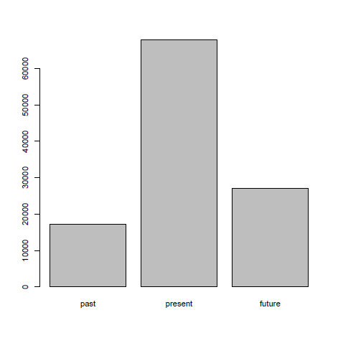
References to the Future
Not only talking about events happening now
Also talk about events happening in the future
E.g. “next Friday”
Higher proportion references to future dates
8% of time refs. in news refer to future dates
25% refer to future in Twitter
Past
Present
Future
Notes:
In addition to discussing events as they take place, Twitter users also often mention events which will happen in the Future. For example, if we see a phrase like “next Friday”, we can figure out which calendar day the user is referring to since we have the timestamp when the Tweet was created.
What’s interesting about temporal references in Twitter is that a larger proportion of them appear to refer to events which will occur in the future. From examining a sample of temporal expressions in news articles we found that only 8% of temporal expressions refer to the future whereas 25% do so on Twitter.

Slide 4
Calendar Demo
Extract Entities from millions of Tweets
Continuously
Using NER trained on Labeled Tweets
[Ritter et. al. EMNLP 2011]
Extract and Resolve Temporal Expressions
For example “Next Friday” = 09-09-11
Count Entity/Day co-occurrences
G² Log Likelihood Ratio
Plot Top K Entities for Each Day
_{http://statuscalendar.com}
Notes:
In order to help motivate why doing information extraction and NLP on Twitter is worth our effort, I’d like to start out by showing a demo, where we automatically extract a calendar of popular events which are occurring in the near future.
What we’re doing here is actually quite simple. We first extract named entities from Tweets using a NER system which we’ve trained on some in-domain annotated Twitter data (and which I’ll have more to say about shortly). We also extract and resolve temporal expressions. Then we simply count the number of times each entity co-occurs with a reference to each calendar day, and plot the top k entities for each day on a calendar.

Slide 5
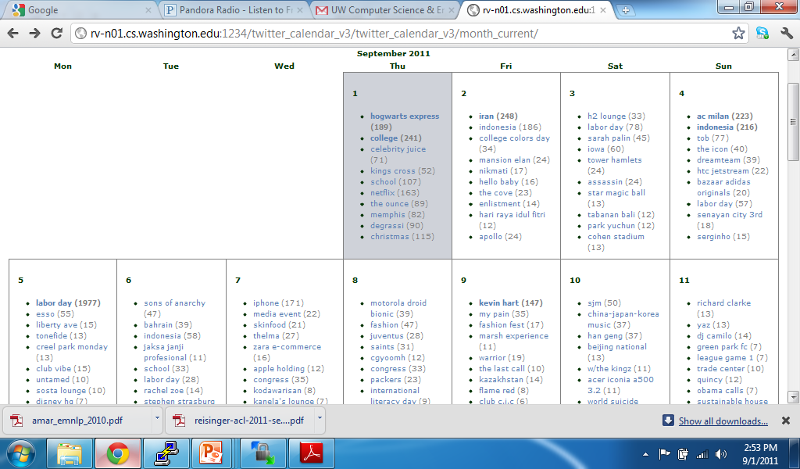

Slide 6
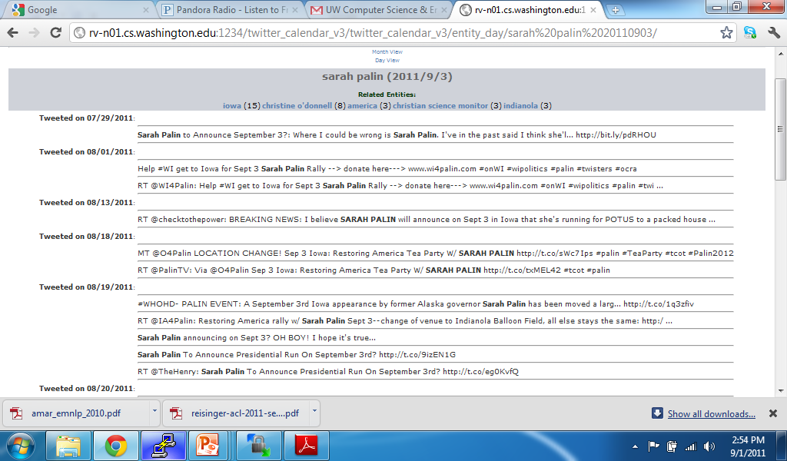

Slide 8
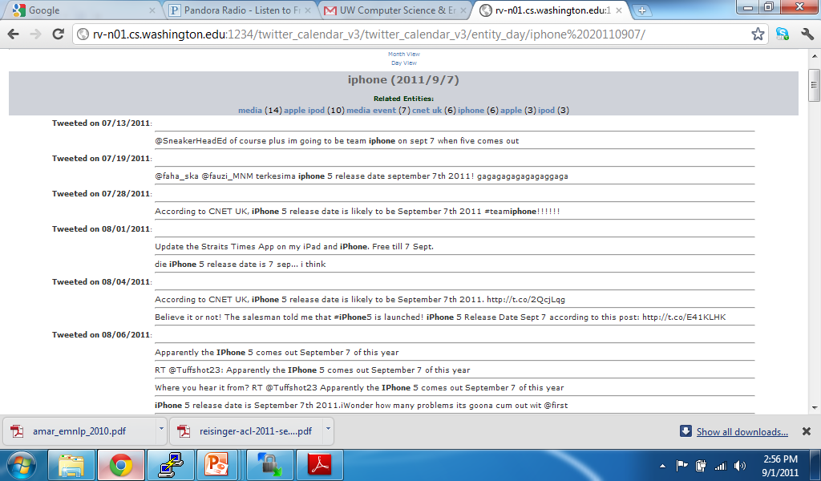

Slide 9
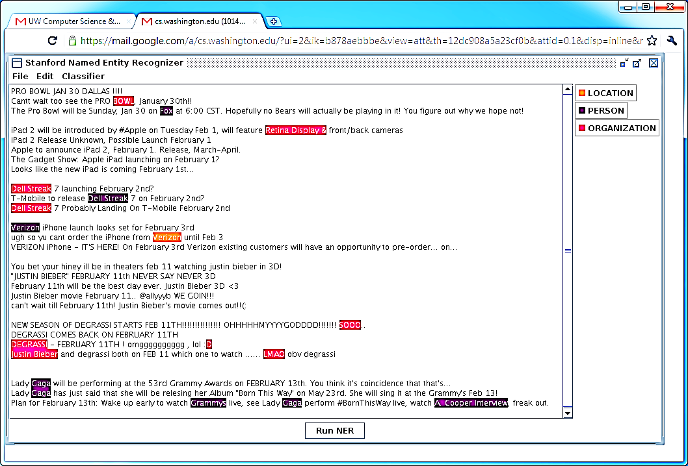
Off The Shelf NLP Tools Fail
Notes:
So hopefully now I’ve convinced you that doing IE and NLP on Tweets is worthwhile, now I’d like to show how off-the-shelf tools trained on out of domain data perform very poorly on this task. For example, here I’ve just pasted a bunch of tweets into the stanford NE tagger, and as you can see the results are pretty bad. For example it ….

Slide 10
Off The Shelf NLP Tools Fail
Twitter Has Noisy & Unique Style

Slide 11
Noisy Text: Challenges
Lexical Variation (misspellings, abbreviations)
`2m', `2ma', `2mar', `2mara', `2maro', `2marrow', `2mor', `2mora', `2moro', `2morow', `2morr', `2morro', `2morrow', `2moz', `2mr', `2mro', `2mrrw', `2mrw', `2mw', `tmmrw', `tmo', `tmoro', `tmorrow', `tmoz', `tmr', `tmro', `tmrow', `tmrrow', `tmrrw', `tmrw', `tmrww', `tmw', `tomaro', `tomarow', `tomarro', `tomarrow', `tomm', `tommarow', `tommarrow', `tommoro', `tommorow', `tommorrow', `tommorw', `tommrow', `tomo', `tomolo', `tomoro', `tomorow', `tomorro', `tomorrw', `tomoz', `tomrw', `tomz‘
Unreliable Capitalization
“The Hobbit has FINALLY started filming! I cannot wait!”
Unique Grammar
“watchng american dad.”
Notes:
So I think there are 3 main challenges for NLP tools on Tweets:
First of all, people are really creative with how they spell things in tweets, as an example, we did some distributional clustering over words appearing in a large # of tweets, and I picked out a cluster and cleaned it up to show how many different ways people can refer to the word “tomorrow”.
Another problem is unreliable capitalization – People often capitalize words just for emphasis or don’t capitalize entities. This is a big problem for recognizing named entities
Finally twitter has a different style of grammar than is found for example in news articles.

Slide 12
Part of speech tagging
Notes:
I’m going to start by talking about adapting part of speech taggers to twitter. POS tagging is useful for a number of different IE tasks, including generating useful features for Named Entity recognition.

Slide 13
Part Of Speech Tagging: Accuracy Drops on Tweets
Most Common Tag : 76% (90% on brown corpus)
Stanford POS : 80% (97% on news)
Notes:
So a strong baseline for POS tagging is to simply predict the most common tag associated with each word. This baseline gets about 90% accuracy on the brown corpus, but when we apply a similar baseline on Twitter, the accuracy is only about 76%. The Stanford POS tagger does a bit better, getting 80% accuracy, but this is much lower than the 97% it’s able to get on news text.
********************************************************
-A strong baseline for POS tagging is predicting the most frequent tag for each word
This baseline performs much worse on Twitter
-The Stanford POS tagger gets about 80% accuracy on Tweets
Much less than 97% on news
-Common errors include:
confusing nouns and proper nouns (important for NER) (unreliable capitalization)
Mis-tagging verbs and interjections as nouns

Slide 14
Part Of Speech Tagging: Accuracy Drops on Tweets
Most Common Tag : 76% (90% on brown corpus)
Stanford POS : 80% (97% on news)
Most Common Errors:
Confusing Common/Proper nouns
Misclassifying interjections as nouns
Misclassifying verbs as nouns
Notes:
Common errors we see the Stanford tagger include misclassifying common and proper nouns (this is due to the unreliable capitalization I mentioned earlier), also many interjections and verbs are misclassified as nouns because they are out of vocabulary.

Slide 15
POS Tagging
Labeled 800 tweets w/ POS tags
About 16,000 tokens
Also used labeled news + IRC chat data (Forsyth and Martell 07)
CRF + Standard set of features
Contextual
Dictionary
Orthographic
Notes:
To address this, and get better performance POS tagging tweets, we’ve annotated some in domain Twitter data with POS tags. We labeled 800 tweets, which works out to about 16K tokens. We also found it helpful to use an existing corpus of IRC chat data which has been annotated with parts of speech, as IRC and Twitter are somewhat similar in style.
For learning and inference, we are using conditional random fields with a fairly standard set of features including contextual features of the text, dictionaries of Parts of Speech, and orthagraphic features of the words.
***********************************************************
-Sam has been working on building a POS tagger for tweets
-He labeled 800 tweets w/ POS
-Also used existing annotated out of domain news and IRC chat data (somewhat similar in style to tweets)
-For learning he used standard linear chain conditional random fields
-Features are fairly straightforward (contextual, dictionary, orthographic – prefixes/suffixes)

Slide 16
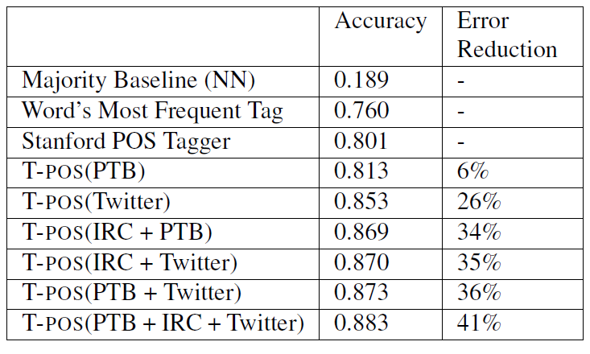
Results
Notes:
Here are some performance numbers on POS tagging tweets. Like I mentioned the stanford tagger gets about 80% accuracy, so just training on in-domain data we’re able to get up to about 85%. By including some out of domain IRC and PTB data we’re able to get performance almost up to 90%.
In general, I think POS tagging tweets is a more difficult task than edited texts such as news articles, so performance will likely always be lower.
**************************************************************************
Here are some numbers on POS tagging.
Like I mentioned before, the stanford tagger gets about 80% accuracy.
When trained on out of domain data, our tagger which uses a few twitter-specific features gets slightly better performance
By adding in-domain data, in addition to annotated IRC chat data, and some labeled newswire data from the penn treebank, we’re able to reduce error by about 41%, getting almost 90% precision.
Note that this is lower than POS tagging results in grammatical texts, but POS tagging twitter is a more challenging task. This is good enough to be useful – in fact we show that features generated based on this tagger are helpful in segmenting named entities.

Slide 17
XX/YY = XX is misclassified as YY
Notes:
In order to give an idea of where we are making improvements; I’m showing the most common errors made by the Stanford tagger, and how our POS tagger does on them.
You can see that we’re making a big improvement on the problem of misclassifying verbs and interjections as nouns, but there is still a problem misclassifying common and proper nouns due to Twitter’s unreliable capitalization.
***************************************************
Looking at where we’re getting improvements, here I’m showing the most common errors made by the stanford tagger, in addition to how much we’ve reduced them.
You can see we’ve fixed a lot of the interjections and verbs which are misclassified as nouns, but confusing common and proper nouns is still problematic.

Slide 18
Named Entity Segmentation
Off the shelf taggers perform poorly
Stanford NER: F1=0.44
not including classification
Notes:
Moving on now t Named entity segmentation, like I showed before, off-the shelf Named Entity taggers perform very poorly on tweets. In fact the Stanford tagger gets only 0.44 F1 score at segmenting entities in tweets
*****************************************************************
Off the shelf named entity taggers perform very poorly on twitter
Stanford NER gets an F1 score of 0.44 (not including entity classification)
To give an idea of what these errors look like, here’s a tweet annotated by the Stanford NER
-Mis-segments “Yess” as a named entity (out of vocabulary + capitalized)
-”Nintendo” is misclassified as a location
-Second occurrence of “Nintendo” should really be “Nintendo 3DS” (product)
-”America” should be segmented as “north America”

Slide 19
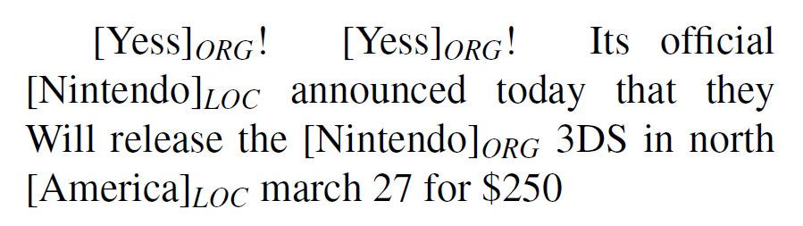
Named Entity Segmentation
Off the shelf taggers perform poorly
Stanford NER: F1=0.44
not including classification
Notes:
Here is another example of the kinds of errors made by the stanford tagger. You can see that Yess has ben mis-tagged as a named entity, because it’s capitalized, and likely out of vocabulary (you wouldn’t see this kind of spelling in edited text. The first mention of “Nintendo” is segmented correctly, but it’s misclassified as a location, whereas the second mention should really be “Nintendo 3DS” (the product). Finally it’s missing “North America” since only “America” is capitalized.
***************************************************
Off the shelf named entity taggers perform very poorly on twitter
Stanford NER gets an F1 score of 0.44 (not including entity classification)
To give an idea of what these errors look like, here’s a tweet annotated by the Stanford NER
-Mis-segments “Yess” as a named entity (out of vocabulary + capitalized)
-”Nintendo” is misclassified as a location
-Second occurrence of “Nintendo” should really be “Nintendo 3DS” (product)
-”America” should be segmented as “north America”

Slide 20
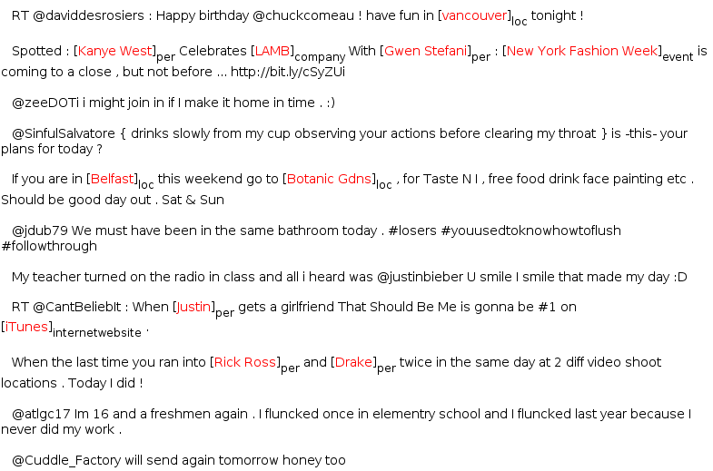
Annotating Named Entities
Annotated 2400 tweets (about 34K tokens)
Train on in-domain data
Notes:
To address this we manually annotated 2,400 tweets with named entities as in-domain training data. Also, it’s probably worth mentioning, that I tried to include some out-of domain training data from the MUC competitions, but found that it actually lowered performance. I think what’s going on here is that the way people refer to Named Entities in Twitter is just very different.

Slide 21
Learning
Sequence Labeling Task
IOB encoding
Conditional Random Fields
Features:
Orthographic
Dictionaries
Contextual
Word | Label
T-Mobile | B-ENTITY
to | O
release | O
Dell | B-ENTITY
Streak | I-ENTITY
7 | I-ENTITY
on | O
Feb | O
2nd | O
Notes:
For learning and inference, again we’re using CRFs. We treat this task as a sequence labeling problem using the standard IOB encoding. For features, we use orthographic features of the words, large dictionaries of named Entities, in addition to contextual features.
******************************************************************
Treat this in a fairly standard way:
-Sequence labeling task (decide if each word begins, is included in, or is outside of an entity
-Again use CRFs for classification
-Standard set of features (orthographic, dictionaries, contextual)

Slide 22
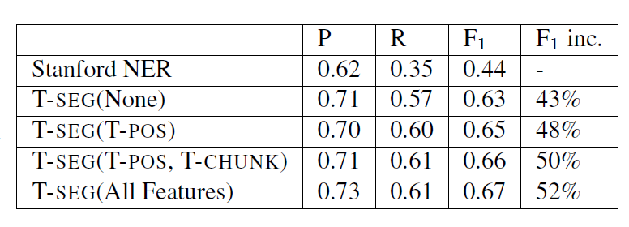
Performance (Segmentation Only)
Notes:
Here I’m showing performance at segmenting named entities. Like I mentioned, the stanford Named entity tagger gets an F1 score of about 0.44. Just by training on in-domain data we’re able to get it up to about 0.63. And by adding additional features (including POS features) we’re able to get up almost to about 0.7 F1.
Of course this is lower than the performance we might expect on edited texts, but I think performance at these kinds of tasks will always be lower on Twitter due to it’s noisy and unique style.
*************************************************************
Looking at performance we see the Stanford NE tagger gets an F1 score of about 0.5.
By training on 30k tokens of in-domain data we’re able to get about a 40% increase in F1
Adding in features based on the POS tags, gives us another nice boost in performance

Slide 23
Named Entity Classification
Notes:
Now I’m going to move on and talk about classifying named entities, which I think is an even more difficult task on Twitter

Slide 24
Challenges
Plethora of distinctive, infrequent types
Bands, Movies, Products, etc…
Very Little training data for these
Can’t simply rely on supervised classification
Very terse (often contain insufficient context)
Notes:
There are two things which I think make classifying named entities in Tweets difficult.
The first is that there are many unique and infrequent types. On Twitter people are talking about bands, movies, products, sports teams and so on, so I don’t think that the standard types PLO will be sufficient.
Many of these types are relatively infrequent, so in any randomly sampled set of Tweets there will be very few training examples for each type. For this reason I don’t think we can simply rely on supervised learning for classifying named entities.
The second thing which makes named entity classification in tweets difficult is that they are often very terse, lacking enough context to determine the type of entities they refer to.

Slide 25
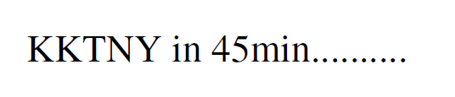
Challenges
Plethora of distinctive, infrequent types
Bands, Movies, Products, etc…
Very Little training data for these
Can’t simply rely on supervised classification
Very terse (often contain insufficient context)
Notes:
For example if we see a tweet like this one, it’s very difficult to determine which type of entity KKTNY is referring to without some kind of background knowledge.

Slide 26
Weakly Supervised NE Classification (Collins and Singer 99) (Etzioni et. al. 05) (Kozareva 06)
Freebase lists provide a source of supervision
But entities often appear in many different lists, for example “China” could be:
A country
A band
A person (member of the band “metal boys”)
A film (released in 1943)
Notes:
To deal with both these issues, we are proposing a weakly supervised approach to named entity classification. Our idea is to make use of large dictionaries of entities and their types as a source of distant supervision for training a Named Entity tagger.
Of course we can’t simply look up named entities to find their types, because they are often highly ambiguous. For example if we look up the phrase “China” in Freebase, we see that it could refer to a country, a band, a person or a film.

Slide 27
Weakly Supervised NE Classification (Collins and Singer 99) (Etzioni et. al. 05) (Kozareva 06)
Freebase lists provide a source of supervision
But entities often appear in many different lists, for example “China” could be:
A country
A band
A person (member of the band “metal boys”)
A film (released in 1943)
We need Some way to disambiguate
Notes:
We need some way to disambiguate between these possibilities.

Slide 28
Distant Supervision With Topic Models
Treat each entity as a “document”
Words in document are those which co-occur with entity
LabeledLDA (Ramage et. al. 2009)
Constrained Topic Model
Each entity is associated with a distribution over topics
Constrained based on FB dictionaries
Each topic is associated with a type (in Freebase)
Notes:
To do this, we are proposing an approach to distant supervision using topic models.
The idea is to treat each entity as a mixture of types.
To make use of the freebase dictionaries as a source of supervision, we constrain each entity’s distribution over types based on the Freebase dictionaries it appears in.
So each topic in our model is going to correspond to one Freebase dictionary.

Slide 29
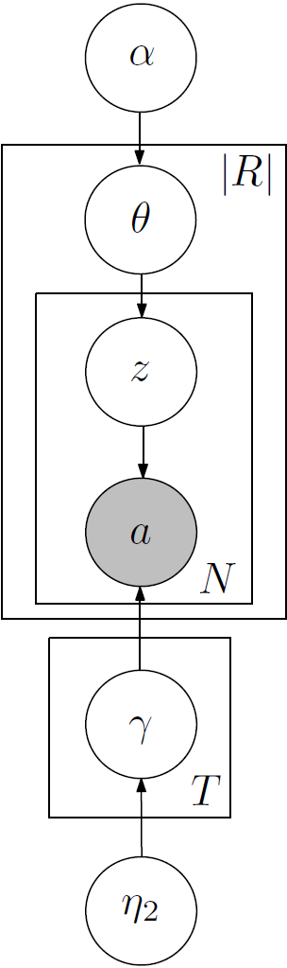
Generative Story
Notes:
In order to make this clear, I think it’s helpful to walk through the generative story for LDA in the context of our data.

Slide 30
Generative Story
For each type, pick a random distribution over words
Notes:
First of all we have a set of types, where each type corresponds to one of the Freebase dictionaries.
For each type we pick a random distribution over words which co-occur with it’s mentions.

Slide 31
Generative Story
For each type, pick a random distribution over words
Type 1: TEAM
P(victory|T1)= 0.02
P(played|T1)= 0.01
…
Type 2: LOCATION
P(visiting|T2)=0.05
P(airport|T2)=0.02
…
Notes:
For example we might have a type TEAM, which commonly co-occurs with words like “victory” and “played”, and a type LOCATION which co-occurs with words like “visiting” and “airport”.

Slide 32
Generative Story
For each entity, pick a distribution over types (constrained by Freebase)
For each type, pick a random distribution over words
Type 1: TEAM
P(victory|T1)= 0.02
P(played|T1)= 0.01
…
Type 2: LOCATION
P(visiting|T2)=0.05
P(airport|T2)=0.02
…
Notes:
Now for each entity in our data, we pick a random distribution over types, constrained using the FB dictionaries.

Slide 33
Generative Story
For each entity, pick a distribution over types (constrained by Freebase)
Seattle
P(TEAM|Seattle)= 0.6
P(LOCATION|Seattle)= 0.4
For each type, pick a random distribution over words
Type 1: TEAM
P(victory|T1)= 0.02
P(played|T1)= 0.01
…
Type 2: LOCATION
P(visiting|T2)=0.05
P(airport|T2)=0.02
…
Notes:
For example, if we look up “Seattle” in FB, we may see that it could be either a TEAM or a LOCATION, and we pick a random probability distribution over these two possibilities.

Slide 34
Generative Story
For each entity, pick a distribution over types (constrained by Freebase)
Seattle
P(TEAM|Seattle)= 0.6
P(LOCATION|Seattle)= 0.4
For each position, first pick a type
For each type, pick a random distribution over words
Type 1: TEAM
P(victory|T1)= 0.02
P(played|T1)= 0.01
…
Type 2: LOCATION
P(visiting|T2)=0.05
P(airport|T2)=0.02
…
Notes:
Now for each context word position, we first draw a type from this distribution

Slide 35
Generative Story
For each entity, pick a distribution over types (constrained by Freebase)
Seattle
P(TEAM|Seattle)= 0.6
P(LOCATION|Seattle)= 0.4
For each position, first pick a type
Is a TEAM
For each type, pick a random distribution over words
Type 1: TEAM
P(victory|T1)= 0.02
P(played|T1)= 0.01
…
Type 2: LOCATION
P(visiting|T2)=0.05
P(airport|T2)=0.02
…

Slide 36
Generative Story
For each entity, pick a distribution over types (constrained by Freebase)
Seattle
P(TEAM|Seattle)= 0.6
P(LOCATION|Seattle)= 0.4
For each position, first pick a type
Is a TEAM
Then pick an word based on type
For each type, pick a random distribution over words
Type 1: TEAM
P(victory|T1)= 0.02
P(played|T1)= 0.01
…
Type 2: LOCATION
P(visiting|T2)=0.05
P(airport|T2)=0.02
…

Slide 37
Generative Story
For each entity, pick a distribution over types (constrained by Freebase)
Seattle
P(TEAM|Seattle)= 0.6
P(LOCATION|Seattle)= 0.4
For each position, first pick a type
Is a TEAM
Then pick an word based on type
victory
For each type, pick a random distribution over words
Type 1: TEAM
P(victory|T1)= 0.02
P(played|T1)= 0.01
…
Type 2: LOCATION
P(visiting|T2)=0.05
P(airport|T2)=0.02
…
Notes:
And then pick a word from the associated type distribution

Slide 38
Generative Story
For each entity, pick a distribution over types (constrained by Freebase)
Seattle
P(TEAM|Seattle)= 0.6
P(LOCATION|Seattle)= 0.4
For each position, first pick a type
Is a TEAM
Is a LOCATION
Then pick an word based on type
victory
For each type, pick a random distribution over words
Type 1: TEAM
P(victory|T1)= 0.02
P(played|T1)= 0.01
…
Type 2: LOCATION
P(visiting|T2)=0.05
P(airport|T2)=0.02
…

Slide 39
Generative Story
For each entity, pick a distribution over types (constrained by Freebase)
Seattle
P(TEAM|Seattle)= 0.6
P(LOCATION|Seattle)= 0.4
For each position, first pick a type
Is a TEAM
Is a LOCATION
Then pick an word based on type
victory
airport
For each type, pick a random distribution over words
Type 1: TEAM
P(victory|T1)= 0.02
P(played|T1)= 0.01
…
Type 2: LOCATION
P(visiting|T2)=0.05
P(airport|T2)=0.02
…
Notes:
And we repeat this process for each word in the corpus.

Slide 40
Data/Inference
Gather entities and words which co-occur
Extract Entities from about 60M status messages
Used a set of 10 types from Freebase
Commonly occur in Tweets
Good coverage in Freebase
Inference: Collapsed Gibbs sampling:
Constrain types using Freebase
For entities not in Freebase, don’t constrain
Notes:
So we gathered named entities and context vectors from about 60M status messages, using the Named Entity segmenter I described earlier.
We also picked a set of 10 FB types which we found to be important in Twitter, and also which had good coverage in FB.
For inference we’re using collapsed gibbs sampling, where we constrain the hidden variables based on the FB dictionaries as a way to incorporate supervision.
If an entity isn’t found in Freebase, we simply don’t constrain it’s distribution over types.

Slide 41
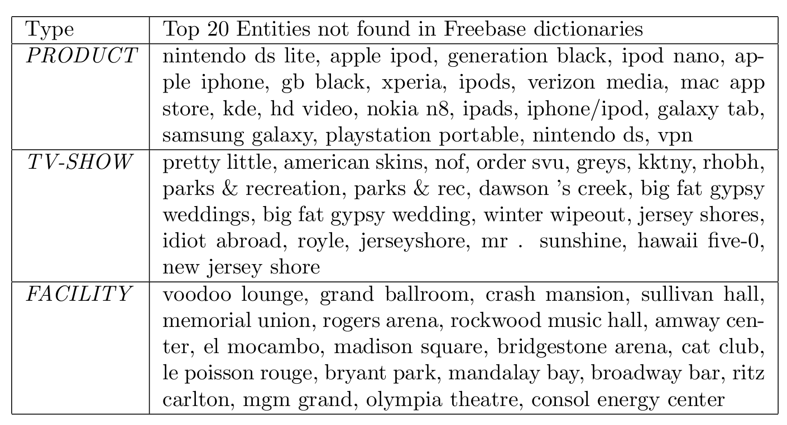
Type Lists
Notes:
In order to demonstrate that this model is doing something useful, here I’m showing example type lists for 3 of the 10 types (types which are the more difficult, infrequent ones).
For each type, I’m listing the top 20 entities which assign highest probability to that type, and also weren’t found in FB.
For the most part I think these look pretty good, for example if we look at “product”, we get things like …
There are a few segmentation errors, but mostly these are either entities which are too new to have been added to FB, or are spelling variants which have not been added.

Slide 42
Type Lists
KKTNY = Kourtney and Kim Take New York
RHOBH = Real Housewives of Beverly Hills
Notes:
In addition there are some of these creative spellings which Twitter users like to use, and which we wouldn’t expect to be found in Freebase, but our model is able to correctly classify them.

Slide 43
Evaluation
Manually Annotated the 2,400 tweets with the 10 entity types
Only used for testing purposes
No labeled examples for LLDA & Cotraining
Notes:
In order to evaluate how well our model is able to classify entities in context, we manually annotated the 2400 tweets with the 10 NE types. I just want to emphasize that these annotations are only used for evaluation purposes, and aren’t used to train the model, which relies solely on the Freebase dictionaries as a source of supervision.
**************************************************************************
For evaluation purposes only we annotated the 2,400 tweets I mentioned earlier with the 10 entity types (LabeledLDA doesn’t require any manually annotated training data, but we need something to evaluate performance against.

Slide 44
Classification Results: 10 Types (Gold Segmentation)
Notes:
Here I’m showing classification results (including a bunch of baselines). Starting on the left, we see that the majority baseline (always predicting the most frequent class, PERSON) gets an F1 score of about 0.3. We also tried a simple heuristic baseline using the Freebase dictionaries, which only makes predictions if the entity appears unambiguous (that is appears in only one dictionary).
*************************************************************************
Here I’m showing results of NE classification using the gold segmentations provided in the data (later I have results on seg+class). First of all the majority baseline of always predicting the most frequent class “PERSON” gets an F1 score of about 0.3. Next we have a baseline which only makes predictions if the entity appears totally unambiguous according to Freebase; this does a little bit better, but the important thing to note here is that this is fairly high-precision (used for seeding the Co-training baseline, and also LabeledLDA). Next we have a fully-supervised baseline which uses a maximum entropy classifier trained using 4-fold cross-validation over the manually annotated data. Finally LabeledLDA gets almost 0.7 F1 score on this task.

Slide 45
Classification Results: 10 Types (Gold Segmentation)
Precision =0.85
Recall=0.24
Notes:
While the Freebase baseline is very low precision, it is fairly high recall.
Next we tried a simple supervised baseline where we train a MaxEnt classifier on the manually annotated data (using cross-validation). This does well on frequent classes like PERSON and LOCATION, but overall it’s performance isn’t that great. The strongest baseline we compare against is the co-training approach of Collins and Singer, which makes use of the high-confidence Freebase baseline predictions as seeds for the co-training. Finally, our topic-modeling based approach which uses the Freebase dictionaries as constraints performs best.
**********************************************************************
Here I’m showing results of NE classification using the gold segmentations provided in the data (later I have results on seg+class). First of all the majority baseline of always predicting the most frequent class “PERSON” gets an F1 score of about 0.3. Next we have a baseline which only makes predictions if the entity appears totally unambiguous according to Freebase; this does a little bit better, but the important thing to note here is that this is fairly high-precision (used for seeding the Co-training baseline, and also LabeledLDA). Next we have a fully-supervised baseline which uses a maximum entropy classifier trained using 4-fold cross-validation over the manually annotated data. Finally LabeledLDA gets almost 0.7 F1 score on this task.

Slide 46
Classification Results: 10 Types (Gold Segmentation)
Notes:
Here I’m showing results of NE classification using the gold segmentations provided in the data (later I have results on seg+class). First of all the majority baseline of always predicting the most frequent class “PERSON” gets an F1 score of about 0.3. Next we have a baseline which only makes predictions if the entity appears totally unambiguous according to Freebase; this does a little bit better, but the important thing to note here is that this is fairly high-precision (used for seeding the Co-training baseline, and also LabeledLDA). Next we have a fully-supervised baseline which uses a maximum entropy classifier trained using 4-fold cross-validation over the manually annotated data. Finally LabeledLDA gets almost 0.7 F1 score on this task.

Slide 47
Why is LDA winning?
Share type info. across mentions
Unambiguous mentions help to disambiguate
Unlabeled examples provide entity-specific prior
Explicitly models ambiguity
Each “entity string” is modeled as (constrained) distribution over types
Takes better advantage of ambiguous training data
Notes:
So why is it that LDA is winning here? I think there are 2 main reasons. The first is that it is able to share information about an entitiy’s types across mentions. This is very helpful in cases where there isn’t enough context to figure out it’s type. The second reason why LDA is performing better is that it’s able to better exploit the ambiguous Freebase training data by using it to generate constraints in the model, rather than making hard assignments.
**********************************************************************
Why is it that LDA is winning?
One thing is that Labeled LDA is able to share information about an entity’s possible types across it’s mentions. If one mention is relatively unambiguous, this can help to disambiguate the type of other more ambiguous mentions.
Another thing is that LabeledLDA is better able to take advantage of the ambiguous training data provided by Freebase. It doesn’t rely only on the “unambiguous” entities.

Slide 48
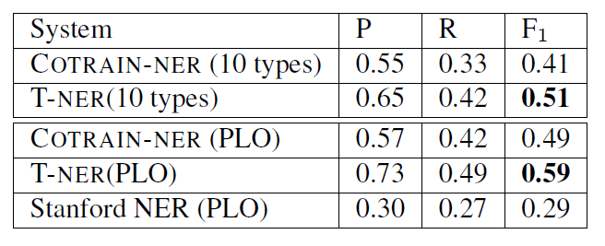
Segmentation + Classification
Notes:
Putting everything together now (segmentation + classification), on the 10 types we get an F1 score of about 0.5, and if we collapse everything down to PLO in order to compare against the stanford tagger, we get an F1 score of about 0.6.

Slide 49


Shallow Syntax in Tweets: Difficult
But:
Tweets are self contained
Short (usually not very complicated)
Meant to be understood in isolation
Don’t require full machine understanding of entire document
Still able to build useful applications even though performance isn’t as high as in edited text
Notes:
From what I’ve said so far this may seem a bit discouraging, because all of these tasks have lower performance than we expect in news articles, so this might give the impression that NLP on Twitter is more difficult.
I think this is definitely true for shallow syntactic tasks like POS tagging and NER, however I suspect other things will actually be easier on Twitter because tweets are short and self contained.
Most tweets are really meant to be understood in isolation, so we don’t have as many discourse-level issues to deal with.
Even though performance on these tasks is lower than expected, I still think it’s good enough to enable some interesting applications, for example the calendar demo.

Slide 50
Related Work
Named Entity Recognition
(Liu et. al. 2011)
POS Tagging
(Gimpel et. al. 2011)
Notes:
I should also point out some related work which was done independently from ours. There were two papers at ACL this year on POS tagging and NER in Tweets. I think the main thing we’re doing differently is this approach to weakly supervised classification based on topic models.

Slide 51
Contributions
Analysis of challenges in noisy text
Adapted NLP tools to Twitter
http://github.com/aritter/twitter_nlp
Calendar Demo
http://statuscalendar.com
Distant Supervision using Topic Models
Thanks!
Notes:
Wrapping up, I’ve presented an analysis of challenges involved in adapting NLP tools to noisy text like twitter
I talked about our Twitter-specific tools, which are available for download
I presented a demo of extracting a calendar of popular events which are happening in the near future, which you can check out (linked of my webpage)
I also presented an approach to distant supervision using topic models
And finally I mentioned our work on SMT applied to response generation

