Slide 1

Open Domain Event Extraction from Twitter
Alan Ritter
Mausam, Oren Etzioni, Sam Clark
University of Washington

Slide 2

Goal: Realtime Stream of Structured Information About Events
Q: which set of events do we want to know about?
iPad
TYPE: Launch
DATE:
Mar 7
Steve Jobs
TYPE:
Death
DATE:
Oct 6
Yelp
TYPE:
IPO
DATE:
March 2
Q: How soon can we know about an event?
TIME
Notes:
Our goal is to extract a structured representation of events taking place in the world.
I’d like to raise two important questions up front:
The first is which set of events do we want to know about? For the purposes of this talk we’re interested in important or popular events which are “newsworthy”. And not mundane events from users’ everyday lives such as what they ate for breakfast.
The second question is how soon can we know about an event? I think here it’s clear that it’s preferable to know about events as early as possible, preferably before they even take place…

Slide 3
Q: Where might we find information about events unfolding in the world?
Structured / Semi-Structured data sources?
Facebook / Eventbrite
HTML / Wrapper induction
Natural Language / Text?
News articles
Status Messages / Twitter
Claim: This is worth investigating
Notes:
OK, so where might we find information about current events taking place in the world?
There are some structured data sources of events available like Facebook Events and eventbrite. These are interesting and useful, but the fact of the matter is that people are more likely to mention events in natural language text than fill out structured data records describing the event, so we’re likely to discover a wider variety of events and hear about them sooner by extracting events from text.
There has been lots of previous work on extracting events from newswire text, but recently social media has become an important source of info on current events. My claim is that event extraction from social media is worth investigating since this is a relatively new and unexplored area.
------------------------------------------------------------------------------
I’d like to highlight up front that there are some structured datasources on events (e.g. Facebook/Eventbrite), but I’m not going to talk about these much here, other than to say that people are more likely to mention an event using natural language than to fill out structured records describing it, and therefore we’re most likely to hear about new events first in text.
There has been a lot of previous work on extracting events from news articles, and recently social media, specifically twitter has become an important competing source of similar information, but is much less explored. Anyway, my claim here is that social media is worth exploring as a source for extracting structured data on realtime events since there are many users discussing these events, and new events are often first reported in social media.
------------------------------------------------------------------------------
I’m not really going to talk very much about structured vs. unstructured data sources, other to say that in general people communicate most naturally in natural language, and so they are more likely to mention an event than fill out structured databases representing it. Thus NL text contains broader coverage of significant events, and events are typically first mentioned in text.
Of course some kinds of events will show up first in structured databases, such as error logs automatically generated by computers, but these don’t really fit our criteria for significant events…
If there is any domain where information extraction is going to be useful, it has to be current events because they’re changing so rapidly (e.g. unlike generally accepted facts which can be entered into Freebase once by a person and don’t change).

Slide 4
Calendar Demo
Extract Named Entities
1% sample of global Twitter stream
2.5 Million / Day
Using NER trained on Labeled Tweets
[Ritter et. al. EMNLP 2011]
Extract and Resolve Temporal Expressions
For example “Next Friday” = 09-09-11
Count Entity/Day co-occurrences
G² Log Likelihood Ratio
Plot Top K Entities for Each Day
_{http://statuscalendar.com}
Notes:
In order to make what we’re doing clear, I’d like to start with a quick demo. Basically what I’m doing here is to extract named entities from millions of tweets each day using a NER system trained on in-domain Twitter data which I’ll talk about more shortly. We also extract and resolve temporal expressions such as “next Friday” to determine when the events take place, and we simply count the number of times each named entity co-occurs with a reference to each calendar date and display the most strongly associated events with each date on a calendar.
…
Anyway, hopefully this helps to provide some motivation for why we’d want to do natural language processing and information extraction from Twitter.
--------------------------------------------------------------------------------
In order to help motivate why doing information extraction and NLP on Twitter is worth our effort, I’d like to start out by showing a demo, where we automatically extract a calendar of popular events which are occurring in the near future.
What we’re doing here is actually quite simple. We first extract named entities from Tweets using a NER system which we’ve trained on some in-domain annotated Twitter data (and which I’ll have more to say about shortly). We also extract and resolve temporal expressions. Then we simply count the number of times each entity co-occurs with a reference to each calendar day, and plot the top k entities for each day on a calendar.

Slide 5
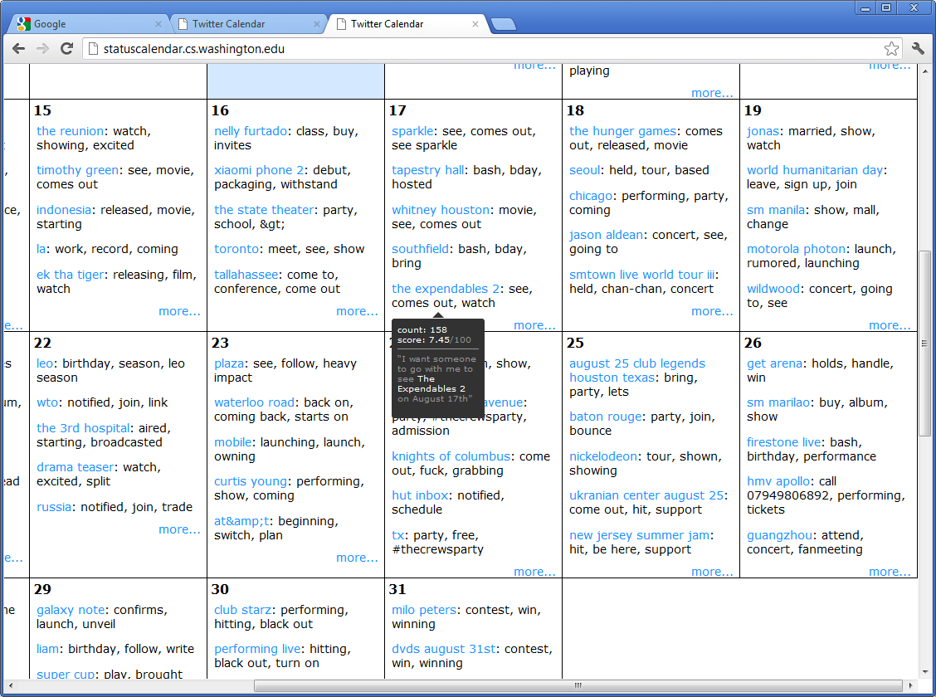
TODO: Screenshots (backup)
Notes:
So today is august 15th, and you can see on the 17th (this Friday) many people are talking about the expendables 2 (a new movie which is coming out)

Slide 6
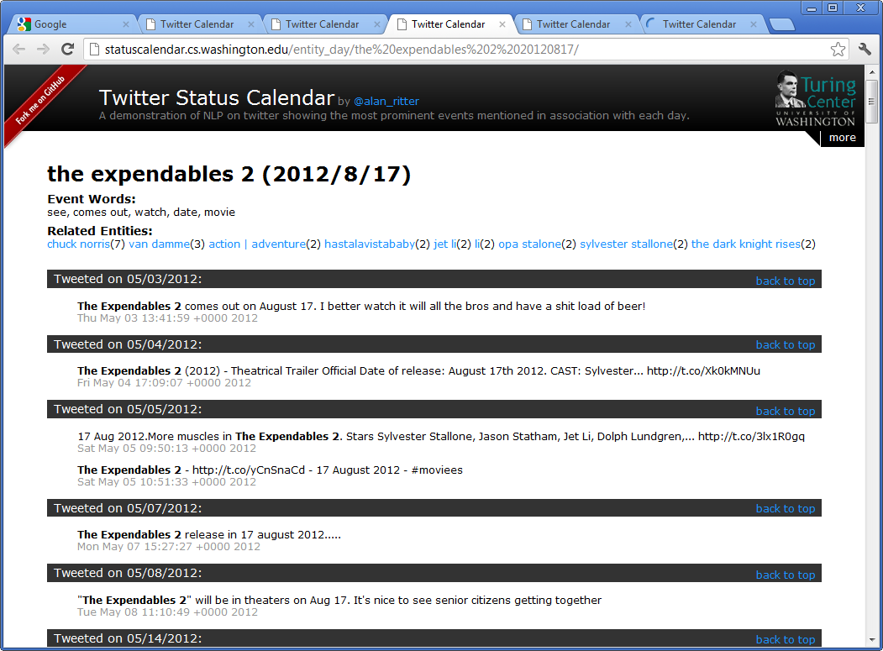
Notes:
By clicking on the calendar entry we can drill down to see individual tweets which mention “the expendables 2” in addition to a reference to august 17.

Slide 7
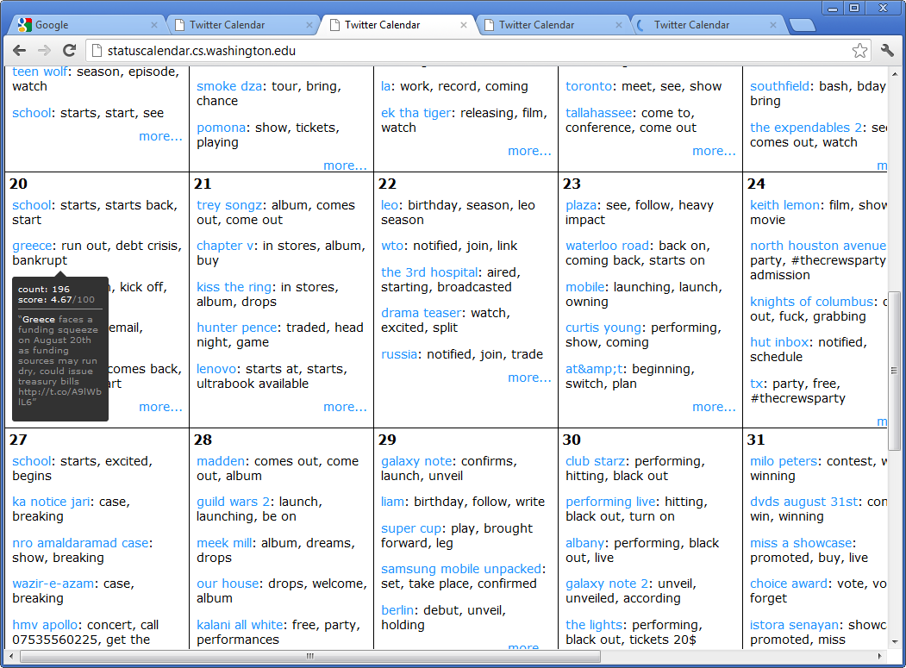
Notes:
As another example, Greece is apparently runing out of funding on august 20

Slide 8
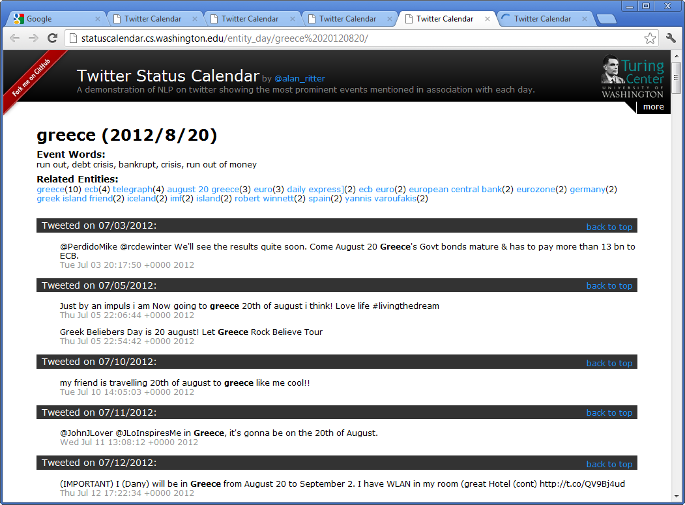

Slide 9
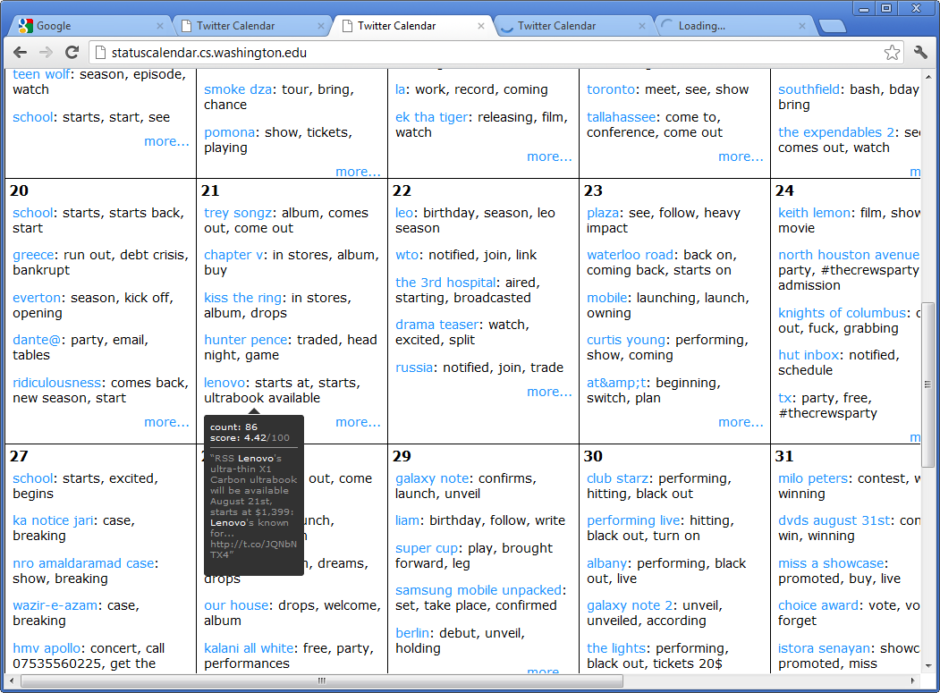
Notes:
Lenovo is releasing a new ultrabook laptop on the 21st (next Tuesday)

Slide 10
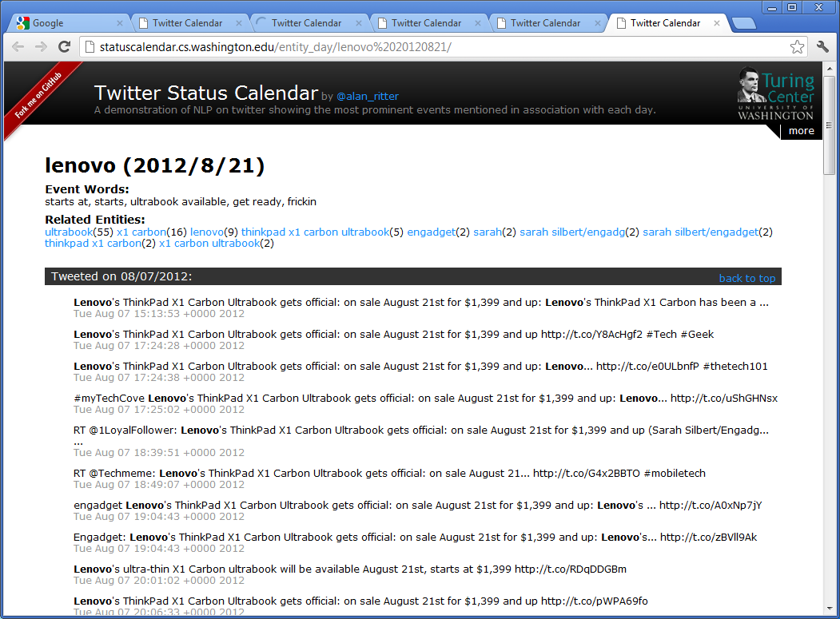

Slide 11
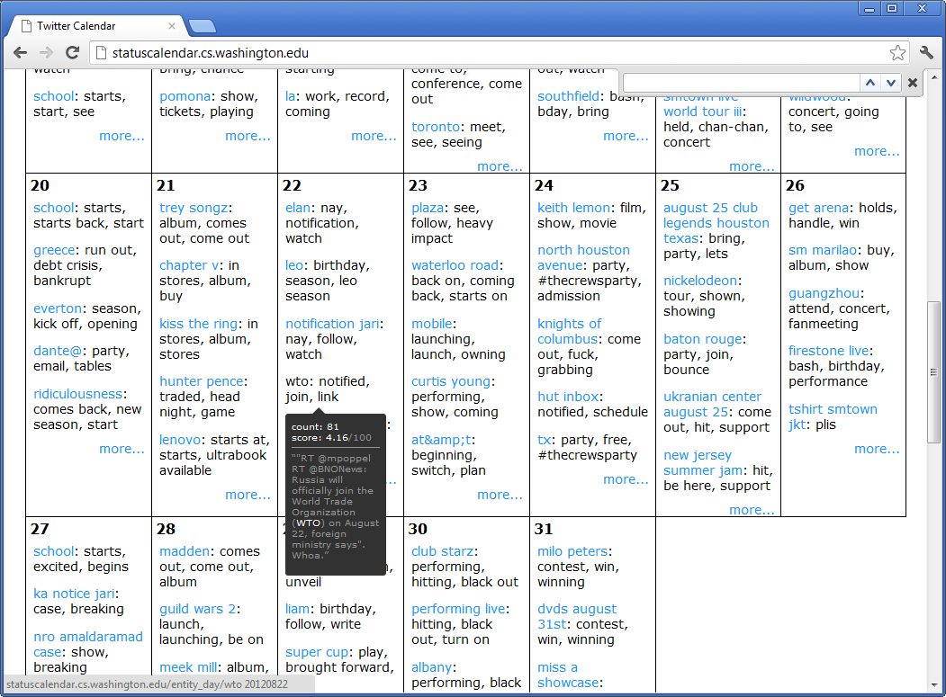
Notes:
And finally many people are mentioning some event involving the WTO on August 22

Slide 12
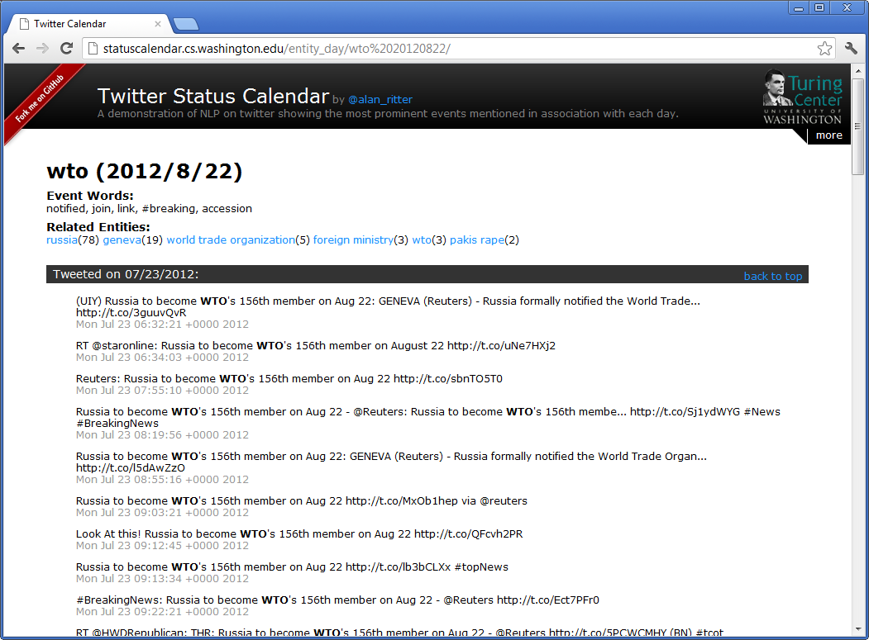
Notes:
After drilling down we can see that Russia is joining the WTO on august 22nd (coming Wednesday).

Slide 13
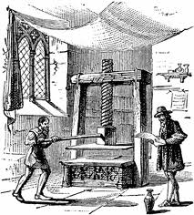

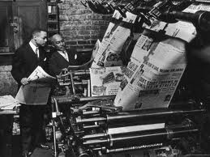
Background: Event Extraction from Newswire
Historically, the most important source of info on current events
Since spread of printing press
Lots of previous work on Newswire
Timebank
MUC & ACE competitions
Limited to narrow domains
Performance is still not great
Notes:
Like I mentioned previously, there has been tons of previous work on extracting events from newswire text.
This makes sense because historically news has been the best source of information on current events.
Examples include the Timebank corpus and the MUC and ACE competitions

Slide 14


Social Media
Competing source of info on current events
Status Messages
Short
Easy to write (even on mobile devices)
Instantly and widely disseminated
Double Edged Sword
Many irrelevant messages
Many redundant messages
Information Overload
Notes:
Recently social media has emerged as an important competing source of information on current events. Status messages have several unique characteristics as compared with news, they are short, easy for anyone to write even on mobile devices, and are also instantly and widely disseminated. For these reasons Twitter often contains the most up-to-date info on current events.
Lowering the barrier to publication is kind of a double edged sword, however because this also leads to many irrelevant and redundant messages. No person can sit down and read all of the millions of Tweets written every day leading to a situation of information overload. In contrast it’s easy to sit down with a newspaper and get a good overall summary of important current events.
Anyway, I think this lack of organization provides very strong motivation for developing automatic techniques to extract and aggregate the most important information from Twitter.

Slide 15
NLP in News vs. Twitter: Thought Experiment
Task 1
Read each sentence from today’s New York times
Except, first randomly permute the sentences
Answer basic questions about today’s news
Task 2
Read a random sample of tweets
From high-quality sources
Order is picked randomly
Answer basic questions about today’s news
Claim:
Task 2 is easier than task 1.
Notes:
In addition to providing a fresher source of information on current events than news (journalists often follow twitter to keep up to date on developing stories), I believe there is reason to be optimistic that despite numerous challenges, open-domain event extraction from Twitter may in fact be easier than from news.
To illustrate this, I’d like to propose a thought experiment. Suppose I ask you to read each sentence from today’s new york times, except that first I’m going to randomly permute the order in which the sentences occur. Then I’ll ask you to answer basic questions about today’s news. My claim is that this simulates the process by which computers “read” news articles since for the most part current NLP systems treat sentences as exchangeable (with a few exceptions of course)
For task 2, I’ll ask you to read a random sample of tweets from high quality sources, again scrambling the order.
My claim is that task 2 will in fact be easier than task 1, because tweets don’t really assume any context in which they are read, and the “bag of sentences assumption” is much more reasonable for Twitter than news.
The point I’m trying to illustrate here is that, Tweets have very simple discourse structure, and discourse is one of the things that current NLP systems don’t handle well.
********************************************************************************
-For the most part this is how current NLP technologies view sentences as exchangeable (e.g. their order doesn’t matter).
--There are some obvious exceptions, e.g. coref systems, but for the most part this is true…
-Moved from “bag of words” to “bag of sentences”, but still haven’t made the leap to “bag of documents”

Slide 16
Noisy Text: Challenges
Lexical Variation (misspellings, abbreviations)
`2m', `2ma', `2mar', `2mara', `2maro', `2marrow', `2mor', `2mora', `2moro', `2morow', `2morr', `2morro', `2morrow', `2moz', `2mr', `2mro', `2mrrw', `2mrw', `2mw', `tmmrw', `tmo', `tmoro', `tmorrow', `tmoz', `tmr', `tmro', `tmrow', `tmrrow', `tmrrw', `tmrw', `tmrww', `tmw', `tomaro', `tomarow', `tomarro', `tomarrow', `tomm', `tommarow', `tommarrow', `tommoro', `tommorow', `tommorrow', `tommorw', `tommrow', `tomo', `tomolo', `tomoro', `tomorow', `tomorro', `tomorrw', `tomoz', `tomrw', `tomz‘
Unreliable Capitalization
“The Hobbit has FINALLY started filming! I cannot wait!”
Unique Grammar
“watchng american dad.”
Notes:
OK, so I’ve given some arguments for why Twitter is a promising source of information on current events, now I’m going to illustrate some of the challenges involved in processing Twitter text, and how we’ve dealt with them.
Because tweets are short, and informal, their style is often “noisy”.
I think there are 3 main challenges for NLP tools on Tweets:
First of all, people are really creative with how they spell things in tweets, as an example, we did some distributional clustering over words appearing in a large # of tweets, and I picked out one cluster and cleaned it up to show how many different ways people can refer to the word “tomorrow”.
Another problem is unreliable capitalization – People often capitalize words simply for emphasis or don’t capitalize proper nouns. This is a big problem for recognizing named entities
Finally twitter has a different style of grammar than is found for example in news articles.

Slide 17
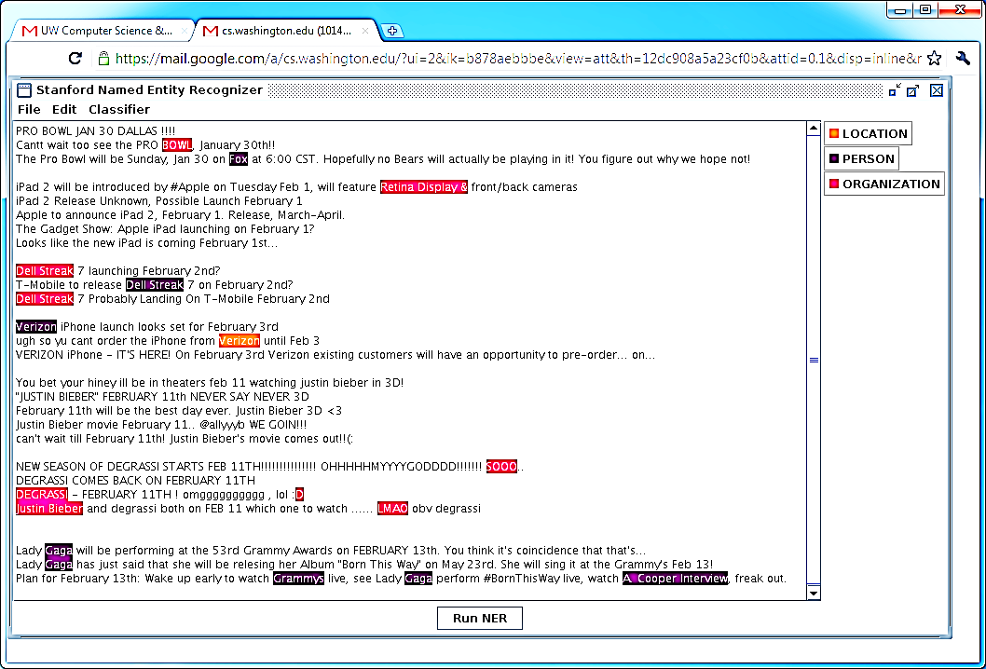
Off The Shelf NLP Tools Fail
Notes:
For these reasons if we just take off-the-shelf tools designed to process edited texts and apply them to Twitter, they perform very poorly. As an example, here I’ve pasted a bunch of tweets into the Stanford Named Entity recognizer, and as you can see it’s making a lot of mistakes.

Slide 18
Off The Shelf NLP Tools Fail
Twitter Has Noisy & Unique Style
Notes:
The reason for this is that Twitter has a noisy and unique style which tools designed to process edited texts such as news articles weren’t meant to handle.

Slide 19
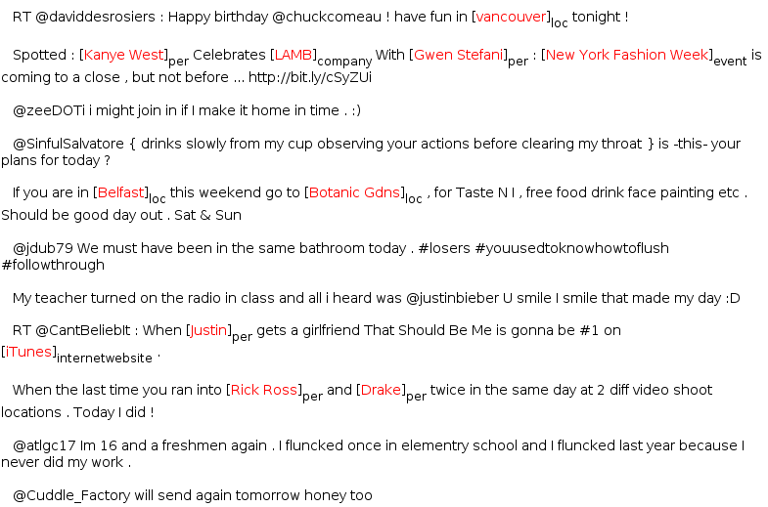
Annotating Named Entities
Annotated 2400 tweets (about 34K tokens)
Train on in-domain data
Notes:
To deal with these issues, I manually annotated a corpus of 2400 weets with named entities for use as in-domain training data.
--------------------------------------------------
To address this we manually annotated 2,400 tweets with named entities as in-domain training data. Also, it’s probably worth mentioning, that I tried to include some out-of domain training data from the MUC competitions, but found that it actually lowered performance. I think what’s going on here is that the way people refer to Named Entities in Twitter is just very different.

Slide 20
Learning
Sequence Labeling Task
IOB encoding
Conditional Random Fields
Features:
Orthographic
Dictionaries
Contextual
Word | Label
T-Mobile | B-ENTITY
to | O
release | O
Dell | B-ENTITY
Streak | I-ENTITY
7 | I-ENTITY
on | O
Feb | O
2nd | O
Notes:
We treat named entity extraction as a sequence-labeling task using conditional random fields for learning and inference. We’re using a fairly standard set of features including orthographic features of the words (prefixes/suffixes) large dictionaries of named entities, in addition to contextual features of the text.
******************************************************************
Treat this in a fairly standard way:
-Sequence labeling task (decide if each word begins, is included in, or is outside of an entity
-Again use CRFs for classification
-Standard set of features (orthographic, dictionaries, contextual)

Slide 21
Performance (NE Segmentation)
Notes:
Here I’m showing our performance at segmenting named entities as compared to the Stanford Named Entity tagger. The Stanford tagger actually gets fairly reasonable precision, although it’s recall is quite low. We’re able to get both better precision and recall and thus a higher overall F1 score. I should note that the performance reported here is much lower than we typically see on edited texts such as news articles. In general I think performance at these kinds of shallow syntactic tasks will always be lower due to twitters noisy style.
----------------------------------------------------------------------
Here I’m showing performance at segmenting named entities. The stanford Named entity tagger gets an F1 score of about 0.44. Just by training on in-domain data we’re able to get it up to about 0.63. And by adding additional features (including POS features) we’re able to get up almost to about 0.7 F1.
Of course this is lower than the performance we might expect on edited texts, but I think performance at these kinds of tasks will always be lower on Twitter due to it’s noisy and unique style. Also Twitter’s simple discourse structure means that once we get past these noisy text issues, many things will become easier.
*************************************************************
Looking at performance we see the Stanford NE tagger gets an F1 score of about 0.5.
By training on 30k tokens of in-domain data we’re able to get about a 40% increase in F1
Adding in features based on the POS tags, gives us another nice boost in performance

Slide 22
Event-Referring Phrases
Useful to display in connection with events
E.g. “Steve Jobs” + “died” + “October 6”
Helpful in categorizing Events into Types
Examples:
Apple to Announce iPhone 5 on October 4th! YES!
iPhone 5 announcement coming Oct 4th
WOOOHOO NEW IPHONE TODAY! CAN’T WAIT!
Notes:
In addition to extracting named entities, we’re also extracting event-referring phrases. These provide useful context for events; for example assuming we know there is an important event involving Steve Jobs on October 6th, it’s helpful to know that he died (unfortunately) on that date.
These phrases are also useful for categorizing the extracted events into high-level types as I’ll talk about shortly
Event phrases can consist of many different types of words including verbs, nouns and adjectives.

Slide 23
Event Phrases: Annotation/Learning
Annotated 1,000 tweets (19,484 tokens)
Similar to EVENT tags in TimeBank
Sequence-labeling problem
IOB Encoding
Conditional Random Fields
Notes:
Here we follow a similar approach to what we did for named entity extraction. I first manually annotated a corpus of 1,000 tweets for use as in-domain training data using annotation guidelines similar to those developed for the timebank corpus.
Again we treat this like a sequence labeling task using conditional random fields for learning and inference.
---------------------------------------------------
In order to extract event phrases, we again treat this as a sequence labeling task using in-domain annotated training data. I manually annotated 1,000 tweets with event phrases following annotation guidelines similar to those used for the Timebank Corpus. We follow a similar approach to segmentation as was used for named entities using CRFs for learning and inference.

Slide 24
Event Phrases: Features
Contextual features
POS tags
Adjacent words
Dictionary Features
Event words gathered from WordNet
Brown Clusters
Orthographic Features
Prefixes, suffixes

Slide 25
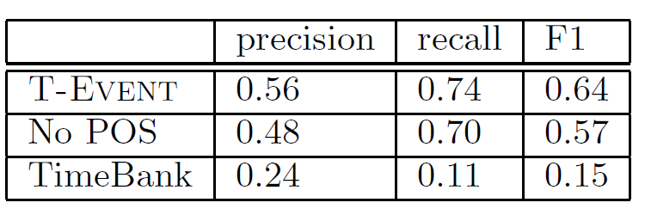
Event Segmentation Results
Notes:
Here I’m showing results at event phrase segmentation. As a baseline we compare against our system trained on out-of-domain data from the timebank corpus.
As you can see in-domain training data is really required to do well here.
-------------------------------------------------------
Here are results at segmenting event phrases. We’re comparing against the baseline of training our system on out-of-domain newswire text from the timebank corpus. The main point to take away here is that in-domain annotated twitter data is really necessary in order to get reasonable performance.

Slide 26
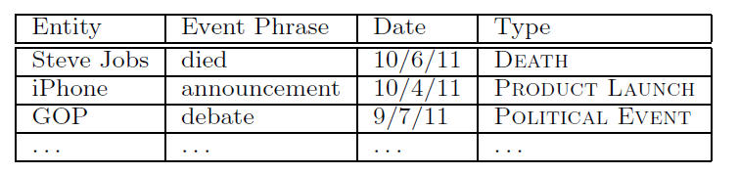
Event Representation
Notes:
OK, so at this point our representation for events looks something like so. For each extracted event we have a named entity, event phrase, in addition to the date on which the event took place. Next I’m going to talk about categorizing the extracted types into high-level categories such as sporting events, product releases, movie premieres and so on.
-----------------------------------------------------
At this point our representation of events looks something like this. For each extracted event we have a named entity, event phrase, and date on which the event takes place.
Next, we’d like to categorize the extracted events into high-level types such as product releases, sporting events, concerts, etc…

Slide 27
Categorizing Event Types
Would like to categorize events into types, for example:
Sports
Politics
Product releases
…
Benefits:
Allow more customized calendars
Could be useful in upstream tasks
Notes:
Categorizing the events will have several important benefits.
Most obviously, event types could be useful for displaying more customized calendars which are adapted to user’s interests. For example you might want to see a calendar of upcoming movie releases or sports events…
In addition these high-level types could be useful for a variety of upstream tasks such as summarization.

Slide 28
Classifying Events: Challenges
Many Different Types
Not sure what is the right set of types
Set of types might change
Might start talking about different things
Might want to focus on different groups of users
Notes:
Categorizing event open-domain events from twitter presents several challenges.
Most importantly there is a huge variety of different types which are important to capture.
In addition it’s not even clear apriori which set of types are appropriate, and the set of important types could shift over time as different topics become more or less popular.
Also for a specific group of users different types might be appropriate.

Slide 29
Solution: Unsupervised Event Type Induction
Latent Variable Models
Generative Probabilistic Models
Advantages:
Discovers types which match the data
No need to annotate individual events
Don’t need to commit to a specific set of types
Modular, can integrate into various applications
Notes:
To address these issues we’re proposing an approach to unsupervised event type induction based on latent variable models.
This approach has several advantages; we’re able to automatically induce an appropriate set of event types which match the data, there is no need for expensive annotation, we don’t need to commit to a specific set of event types in advance, and finally because our approach is based on a generative probabilistic model it’s modular and thus easy to integrate into a wide variety of different applications in a relatively principled way.

Slide 30
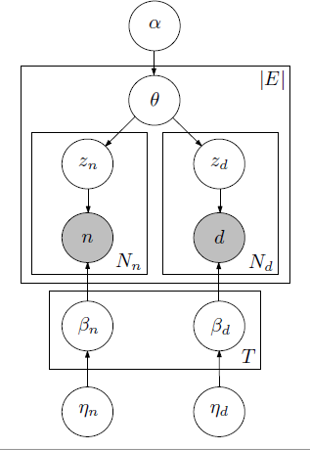
Each Event Phrase is modeled as a mixture of types
P(SPORTS|cheered)= 0.6
P(POLITICS|cheered)= 0.4
Each Event phrase is modeled as a mixture of types
Each Event Type is Associated with a Distribution over Entities and Dates
Notes:
Here I’m showing a graphical model representation of our data.
I’m going to cover this at a pretty high level.
The shaded nodes represent observed named entities and dates.
These hidden variables determine the types associated with each event.
We group together all events with the same event phrase.
Each unique event phrase in our data is modeled as a mixture of event types.
For example the phrase “cheered” might sometimes be part of a SPORTS event and sometimes part of a POLITICS event.
Each event type is associated with a distribution over named entities and dates involved in instances that type of event.
This is just describing the “generative story” for our data; we apply bayesian inference techniques to infer values for the hidden variables.

Slide 31
Details…
Gathered about 65M (entity, event, date) tuples
Collapsed Gibbs Sampling
1,000 iterations of burn in
Parallelized sampling (approximation) using MPI
[Newman et. al. 2009]
100 Event Types
Notes:
OK, so a few details…
We gathered 65M events and inferred event types using collapsed Gibbs sampling.
Actually we used a parallelized approximation to the Gibbs sampling procedure which allows us to scale up to more data, and we found to work well in practice.
And we used 100 event types

Slide 32
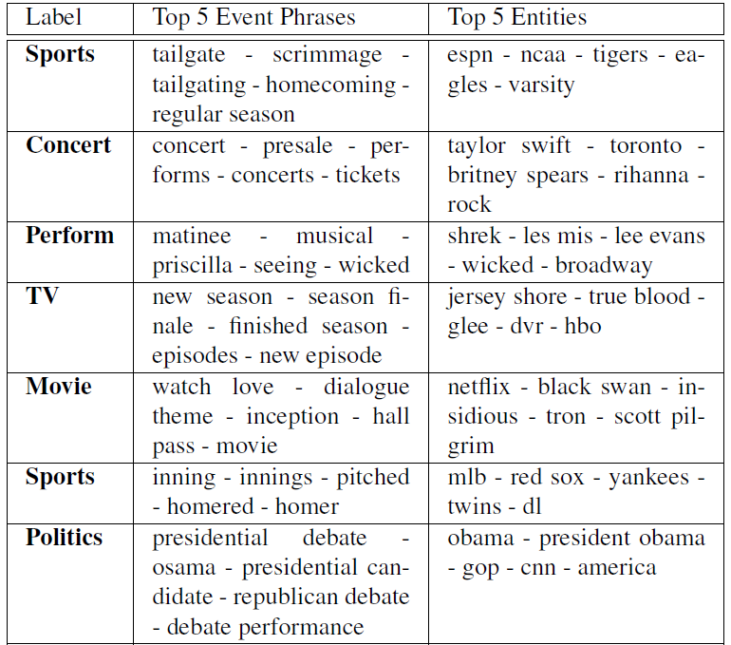
Notes:
Here are a few examples of event types automatically discovered by our model. For example you can see a clear “sports” event which includes event words such as “tailgate”, “scrimmage”, “homecoming”, and entities such as “ESPN”, “NCAA”, “Tigers”, “Eagles”, etc…

Slide 33
Experiment: Categorizing Events
Randomly Sampled 500 (entity, date) pairs
Annotated with event types
Using types discovered by the topic model
Baseline:
Supervised classification using 10-fold cross validation
Treat event phrases like bag of words
Notes:
We also did some experiments to demonstrate that our model can be effectively used to categorize extracted events in context.
To do this we randomly sampled 500 calendar entries, which I manually annotated with the event types automatically discovered by our model.
We compare against a supervised baseline which makes use of the annotated examples using 10 fold cross validation, and treats the extracted event phrases as a bag of words.

Slide 34
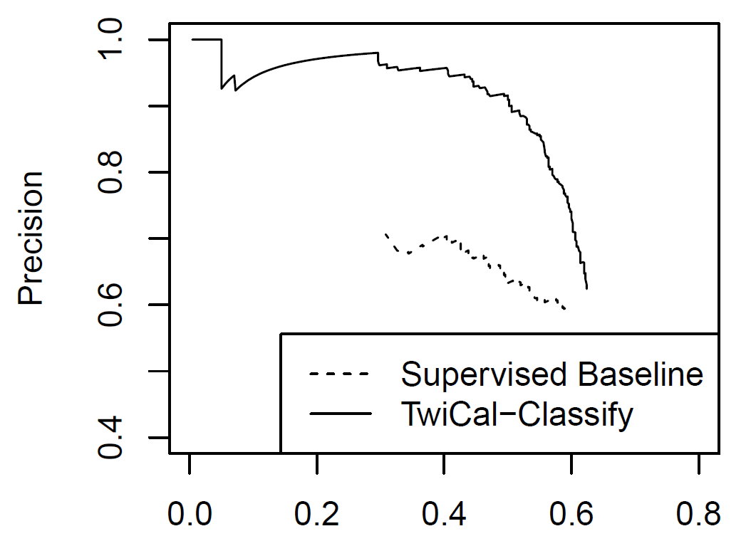
Event Classification Performance
Notes:
Here I’m showing precision recall curves for event type categorization. As you can see our approach is doing much better than the supervised baseline, since it’s able to use large amounts of unlabeled data whereas the supervised baseline only has access to 500 labeled examples.

Slide 35
Ranking Events
Twitter users often mention mundane events
What they ate for lunch
Can’t just list by frequency
Entities such as McDonalds would be frequent on most days
Use Statistical Test between entities and dates
Only show if entities appear more than expected

Slide 36
End-to-end Evaluation
Evaluate end-to-end calendar entries
Collect tweets up to cutoff date
Extract Named Entities, Event Phrases, Temporal Expressions
Classify Event Type
Rank Events
Pick top K events occurring in a 2 week future window
Evaluate Precision
Notes:
We also did an end-to-end evaluation where we evaluated the overall extracted events.
To do this we collected millions of tweets up to a specific cutoff date, then extracted named entities, event phrases, resolved temporal expressions and categorized the extracted events into high-level types. In addition we ranked the events using a significance test which is described in detail in the paper. We picked the top K events within a 2-week future window, and I evaluated precision.

Slide 37
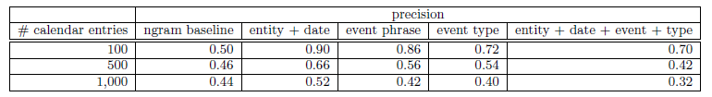
End-to-end Evaluation
Ngram Baseline
No Named Entity Recognition
Rely on significance test to rank ngrams
A few extra heuristics (filter out temporal expressions etc…)
Notes:
Here I’m showing the results from the end-to-end evaluation. I should mention that we compared against an ngram baseline which doesn’t make use of any of our NLP tools.
Basically you can see that the highest-confidence ngram events are only about half correct, whereas by using our named entity extraction system we’re able to get about 90% precision.

Slide 38
Future Work
Clustering Events (Event Reference Resolution)
Group Tweets which refer to the same event
Group Named entities involved in the same event
Schema Discovery
Induce Roles for each type
Classify entities into roles
Concert:
Music Artist
City
Venue

Slide 39


Shallow Syntax in Tweets: Difficult
Performance Lower than News:
Entity Segmentation
Event Phrase Segmentation
But:
Tweets are self contained
Short (usually not very complicated)
Simple discourse structure
Meant to be understood in isolation
More data
Notes:
One point I’d like to highlight before wrapping up: performance at shallow syntactic tasks like named entity segmentation and event phrase extraction is more difficult in Twitter than in news (the numbers I’ve reported for these tasks are substantially lower than what you would expect to see for grammatical texts such as news articles). I think these tasks are just more difficult in Twitter due to it’s noisy style.
But I think that once we get past these “noisy text issues” many things actually become much easier. In particular tweets are short and self contained, and don’t require any discourse context in order to be understood.
In contrast, building a timeline of events from a news article typically means you have to read and understand the entire text and perform complex reasoning about relations between events. Discourse tasks are currently very challenging for state of the art NLP systems, however twitter’s short style allows us to sidestep a many of these issues.
--------------------------------------------
From what I’ve said so far this may seem a bit discouraging, because all of these tasks have lower performance than we expect in news articles, so this might give the impression that NLP on Twitter is more difficult.
I think this is definitely true for shallow syntactic tasks like POS tagging and NER, however I suspect other things will actually be easier on Twitter because tweets are short and self contained.
Most tweets are really meant to be understood in isolation, so we don’t have as many discourse-level issues to deal with.
Even though performance on these tasks is lower than expected, I still think it’s good enough to enable some interesting applications, for example the calendar demo.

Slide 40
Contributions
Analysis of challenges in noisy text
Adapted NLP tools to Twitter
http://github.com/aritter/twitter_nlp
Calendar Demo
http://statuscalendar.com
Unsupervised Event Categorization
Discovers types which match the data
Thanks!
Notes:
Wrapping up, I’ve presented an analysis of challenges involved in adapting NLP tools to noisy text like twitter
I talked about our Twitter-specific tools, which are available for download
I presented a demo of extracting a calendar of popular events which are happening in the near future, which you can check out (linked of my webpage)
I also presented an approach to distant supervision using topic models
And finally I mentioned our work on SMT applied to response generation

