Slide 1


Data Driven Response Generation in Social Media
Alan Ritter
Colin Cherry
Bill Dolan

Slide 2
Task: Response Generation
Input: Arbitrary user utterance
Output: Appropriate response
Training Data: Millions of conversations from Twitter

Slide 3
Parallelism in Discourse (Hobbs 1985)
STATUS:
I am slowly making this soup and it smells gorgeous!
RESPONSE:
I’ll bet it looks delicious too!

Slide 4
Parallelism in Discourse (Hobbs 1985)
STATUS:
I am slowly making this soup and it smells gorgeous!
RESPONSE:
I’ll bet it looks delicious too!

Slide 5
Parallelism in Discourse (Hobbs 1985)
STATUS:
I am slowly making this soup and it smells gorgeous!
RESPONSE:
I’ll bet it looks delicious too!

Slide 6
Parallelism in Discourse (Hobbs 1985)
STATUS:
I am slowly making this soup and it smells gorgeous!
RESPONSE:
I’ll bet it looks delicious too!

Slide 7
Parallelism in Discourse (Hobbs 1985)
STATUS:
I am slowly making this soup and it smells gorgeous!
RESPONSE:
Can we “translate” the status into an appropriate response?
I’ll bet it looks delicious too!

Slide 8
Why Should SMT work on conversations?
Conversation and translation not the same
Source and Target not Semantically Equivalent
Can’t learn semantics behind conversations
We Can learn some high-frequency patterns
“I am” -> “you are”
“airport” -> “safe flight”
First step towards learning conversational models from data.

Slide 9
SMT: Advantages
Leverage existing techniques
Perform well
Scalable
Provides probabilistic model of responses
Straightforward to integrate into applications

Slide 10
Data Driven Response Generation: Potential Applications
Dialogue Generation (more natural responses)

Slide 11
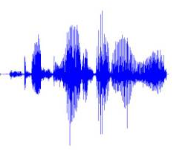
Data Driven Response Generation: Potential Applications
Dialogue Generation (more natural responses)
Conversationally-aware predictive text entry
Speech Interface to SMS/Twitter (Ju and Paek 2010)
Status:
Response:
Response:
I’m feeling sick
=
Hope you feel better
+

Slide 12

Twitter Conversations
Most of Twitter is broadcasting information:
iPhone 4 on Verizon coming February 10th ..

Slide 13
Twitter Conversations
Most of Twitter is broadcasting information:
iPhone 4 on Verizon coming February 10th ..
About 20% are replies
I 'm going to the beach this weekend! Woo! And I'll be there until Tuesday. Life is good.
Enjoy the beach! Hope you have great weather!
thank you ☺

Slide 14
Data
Crawled Twitter Public API
1.3 Million Conversations
Easy to gather more data

Slide 15
Data
Crawled Twitter Public API
1.3 Million Conversations
Easy to gather more data
No need for disentanglement
(Elsner & Charniak 2008)

Slide 16
Approach: Statistical Machine Translation
 | SMT | Response Generation
INPUT: | Foreign Text | User Utterance
OUTPUT | English Text | Response
TRAIN: | Parallel Corpora | Conversations

Slide 17
Approach: Statistical Machine Translation
 | SMT | Response Generation
INPUT: | Foreign Text | User Utterance
OUTPUT | English Text | Response
TRAIN: | Parallel Corpora | Conversations

Slide 18
Phrase-Based Translation
STATUS:
who wants to come over for dinner tomorrow?
RESPONSE:

Slide 19
Phrase-Based Translation
STATUS:
who wants to come over for dinner tomorrow?
RESPONSE:
Yum ! I

Slide 20
Phrase-Based Translation
STATUS:
who wants to come over for dinner tomorrow?
RESPONSE:
Yum ! I
want to

Slide 21
Phrase-Based Translation
STATUS:
who wants to come over for dinner tomorrow?
RESPONSE:
Yum ! I
want to
be there

Slide 22
Phrase-Based Translation
STATUS:
who wants to come over for dinner tomorrow?
RESPONSE:
Yum ! I
want to
be there
tomorrow !

Slide 23
Phrase Based Decoding
Log Linear Model
Features Include:
Language Model
Phrase Translation Probabilities
Additional feature functions….
Use Moses Decoder
Beam Search

Slide 24
Challenges applying SMT to Conversation
Wider range of possible targets
Larger fraction of unaligned words/phrases
Large phrase pairs which can’t be decomposed

Slide 25
Challenges applying SMT to Conversation
Wider range of possible targets
Larger fraction of unaligned words/phrases
Large phrase pairs which can’t be decomposed
Source and Target are not Semantically Equivelant

Slide 26
Challenge: Lexical Repetition
Source/Target strings are in same language
Strongest associations between identical pairs
Without anything to discourage the use of lexically similar phrases, the system tends to “parrot back” input
STATUS: I’m slowly making this soup ...... and it smells gorgeous!
RESPONSE: I’m slowly making this soup ...... and you smell gorgeous!

Slide 27
Lexical Repitition: Solution
Filter out phrase pairs where one is a substring of the other
Novel feature which penalizes lexically similar phrase pairs
Jaccard similarity between the set of words in the source and target

Slide 28
Word Alignment: Doesn’t really work…
Typically used for Phrase Extraction
GIZA++
Very poor alignments for Status/response pairs
Alignments are very rarely one-to-one
Large portions of source ignored
Large phrase pairs which can’t be decomposed

Slide 29
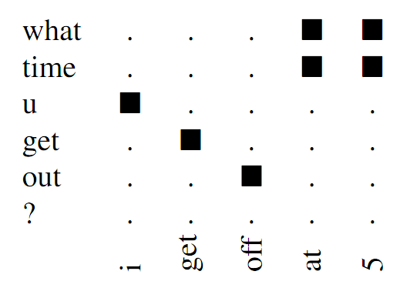
Word Alignment Makes Sense Sometimes…

Slide 30
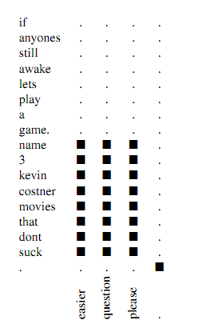
Sometimes Word Alignment is Very Difficult

Slide 31
Sometimes Word Alignment is Very Difficult
Difficult Cases confuse IBM Word Alignment Models
Poor Quality Alignments

Slide 32
Solution: Generate all phrase-pairs (With phrases up to length 4)
Example:
S: I am feeling sick
R: Hope you feel better

Slide 33
Solution: Generate all phrase-pairs (With phrases up to length 4)
Example:
S: I am feeling sick
R: Hope you feel better
O(N*M) phrase pairs
N = length of status
M = length of response

Slide 34
Solution: Generate all phrase-pairs (With phrases up to length 4)
Example:
S: I am feeling sick
R: Hope you feel better
O(N*M) phrase pairs
N = length of status
M = length of response
Source | Target
I | Hope
I | you
I | feel
… | …
feeling sick | feel better
feeling sick | Hope you feel
feeling sick | you feel better
I am feeling | Hope
I am feeling | you
… | …

Slide 35
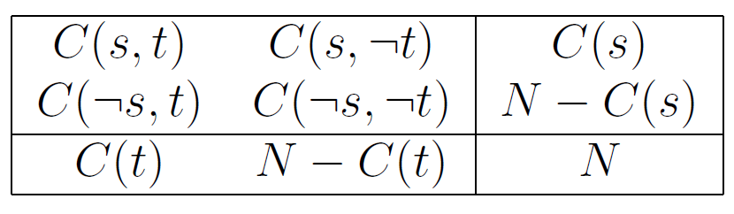
Pruning: Fisher Exact Test (Johson et. al. 2007) (Moore 2004)
Details:
Keep 5Million highest ranking phrase pairs
Includes a subset of the (1,1,1) pairs
Filter out pairs where one phrase is a substring

Slide 36
Example Phrase-Table Entries
Source | Target
how are | good
wish me | good luck
sick | feel better
bed | dreams
interview | good luck
how are you ? | i 'm good
to bed | good night
thanks for | no problem
r u | i 'm
my dad | your dad
airport | have a safe
can i | you can

Slide 37
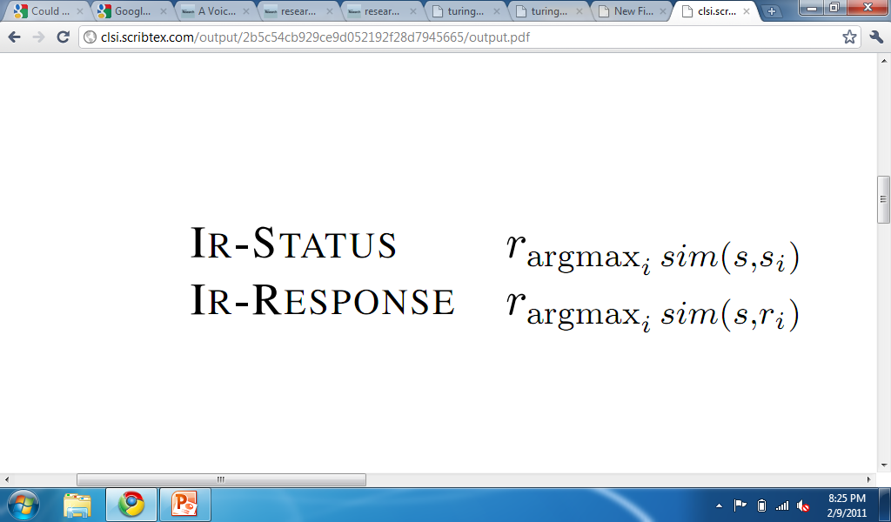
Baseline: Information Retrieval/ Nearest Neighbor (Swanson and Gordon 2008) (Isbell et. al. 2000) (Jafarpour and Burgess)
Find the most similar response in training data
2 options to find response for status :

Slide 38
Mechanical Turk Evaluation
Pairwise Comparison of Output (System A & B)
For Each Experiment:
Randomly select 200 status messages
Generate response using systems A & B
Ask Turkers which response is better
Each HIT is submitted to 3 different workers

Slide 39
Results
System A | System B | Fraction A | Agreement (S)
MT-Chat | IR-Status | 0.645 | 0.347
MT-Chat | IR-Response | 0.593 | 0.330
MT-Chat | Human | 0.145 | 0.433

Slide 40
Results
System A | System B | Fraction A | Agreement (S)
MT-Chat | IR-Status | 0.645 | 0.347
MT-Chat | IR-Response | 0.593 | 0.330
MT-Chat | Human | 0.145 | 0.433
Summary:
MT outperforms IR
Direct comparison is better
Looses to humans
But, generates better response in 15% of cases

Slide 41
Cases where MT output was preferred
Status | MT-Chat | Human
I want to go to a bonfire right about now | That does sound fun bonfire I wan na go! | Did my tweet bring that upon you? hehe
I’m the invisible man. | Man, you could never be invisible | I can still see your face surrounded in blue!
Put ya number in my phone …and ima call you up | Call me when u do that in your phone call ☺ for what’s up? | O well hw kum u dnt eva call or txt me ☺?!?! Lolz jpn hw r ya tho ☺?!?!
Gray Maynard with hair? I did not approve this. | Maynard with grey hair! | I take it back the hair isn’t working for Maynard.

Slide 42
Demo
www.cs.washington.edu/homes/aritter/mt_chat.html

Slide 43
Contributions
Proposed SMT as an approach to Generating Responses
Many Challenges in Adapting Phrase-Based SMT to Conversations
Lexical Repetition
Difficult Alignment
Phrase-based translation performs better than IR
Able to beat Human responses 15% of the time

Slide 44
Contributions
Proposed SMT as an approach to Generating Responses
Many Challenges in Adapting Phrase-Based SMT to Conversations
Lexical Repetition
Difficult Alignment
Phrase-based translation performs better than IR
Able to beat Human responses 15% of the time
Thanks!

Slide 45
Phrase-Based Translation
STATUS:
who wants to get some lunch ?
RESPONSE:

Slide 46
Phrase-Based Translation
STATUS:
who wants to get some lunch ?
RESPONSE:
I wan na

Slide 47
Phrase-Based Translation
STATUS:
who wants to get some lunch ?
RESPONSE:
I wan na
get me some

Slide 48
Phrase-Based Translation
STATUS:
who wants to get some lunch ?
RESPONSE:
I wan na
get me some
chicken

