Slide 1


Unsupervised Modeling of Twitter Conversations
Alan Ritter (UW)
Colin Cherry (NRC)
Bill Dolan (MSR)

Slide 2

Twitter
Most of Twitter looks like this:
I want a cuban sandwich extra bad!!
About 10-20% are replies
I 'm going to the beach this weekend! Woo! And I'll be there until Tuesday. Life is good.
Enjoy the beach! Hope you have great weather!
thank you ☺
Notes:
What do twitter conversations look like?
Most are not conversational
-People just broadcasting information about themselves
10-20% are in reply to some other post
-These tend to form short conversations.

Slide 3
Gathering Conversations
Twitter Public API
Public Timeline
20 randomly selected posts per minute
Use to get random sample of twitter users
Query to get all their posts
Follow any that are replies to collect conversations
No need for disentanglement
[Elsner & Charniak 2008]

Slide 4
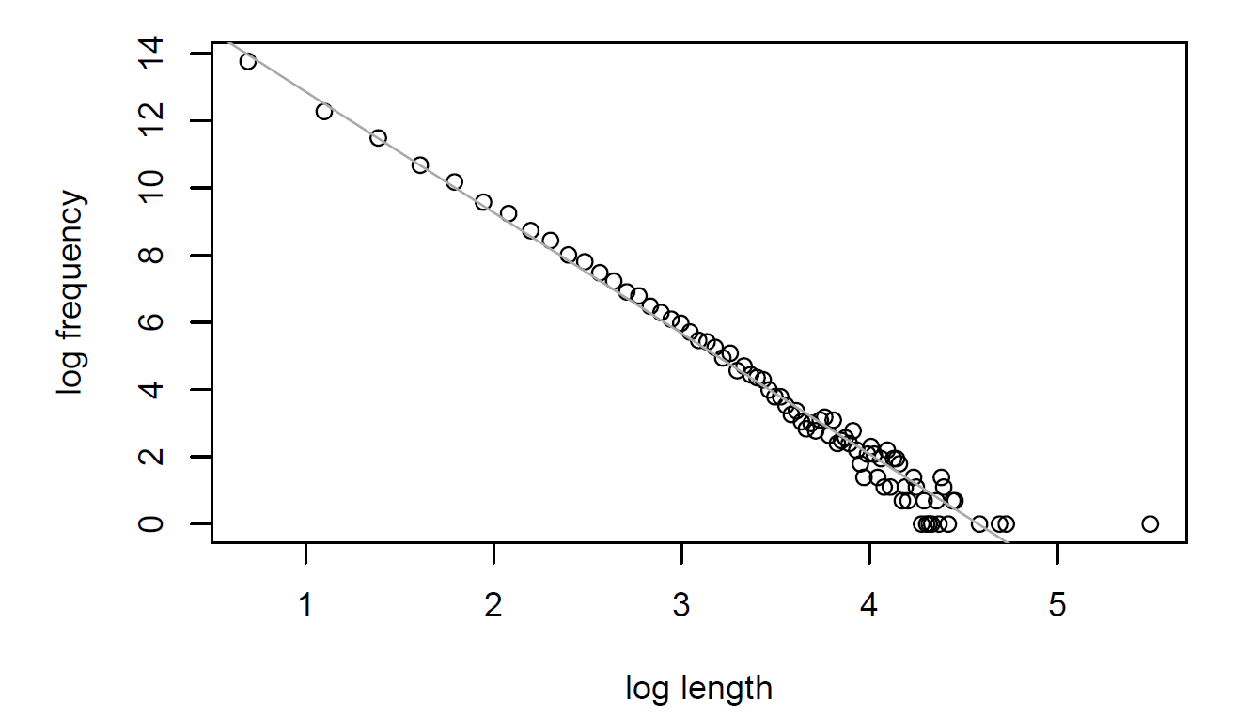
Conversation Length (number of Tweets)
Length | Frequency
2 | 952603
3 | 214787
4 | 97533
5 | 43447
6 | 26349
7 | 14432
8 | 10277
9 | 6180
10 | 4614
11 | 3004
12 | 2450
13 | 1764
14 | 1377
15 | 1000
16 | 888
17 | 652
18 | 541
… | …

Slide 5
Modeling Latent Structure: Dialogue Acts
Status
I 'm going to the beach this weekend! Woo! And I'll be there until Tuesday. Life is good.
Enjoy the beach! Hope you have great weather!
thank you ☺
Comment
Thanks
Notes:
Our goal is to model latent structure in conversations
Traditionally referred to as “Dialogue Acts” or “Speech Acts”
Tag each utterance with a label describing it’s role in the conversation

Slide 6
Dialogue Acts: Many Useful Applications
Conversation Agents [Wilks 2006]
Dialogue Systems [Allen et al. 2007]
Dialogue Summarization [Murray et al. 2006]
Flirtation Detection [Ranganath et al. 2009]
…
Notes:
Dialogue Acts provide an initial level of semantic representation.
They have been shown useful in many applications:
-Conversational Agents & Dialogue Systems need to know whether user is asking a question, or giving command.
-Also been shown useful in Summarization
-Flirtation Detection (maybe interesting application to Twitter?)

Slide 7
Traditional Approaches
Gather Corpus of Conversations
focus on speech data
Telephone Conversations - [Jurafsky et. al. 1997]
Meetings - [Dhillon et. al. 2004] [Carletta et. al. 2006]
Annotation Guidelines
Manual Labeling
Expensive
Notes:
Traditionally, Dialogue Act Taggers have been built using the “Annotate, Train, Test” pradigm
Lots of Manual Labeling – Very expensive
Traditionally focused on conversational speech:
-Telephone conversations
-Recorded meetings

Slide 8
Dialogue Acts for Internet Conversations
Lots of Variety
Email [Cohen et. al. 2004]
Internet Forums [Jeong et. al. 2009]
IRC
Facebook
Twitter
…
More on the horizon?
Tags from speech data not always appropriate
Includes: Backchannel, distruption, floorgrabber
Missing: Meeting request, Status post, etc…
Notes:
Much wider variety of conversations on the Internet
Tags from speech not always appropriate
Difficult to design a set of domain-independent dialogue acts (always missing something from some domain).

Slide 9
Our Contributions
Unsupervised Tagging of Dialogue Acts
First application to open domain
Dialogue Modeling on Twitter
Potential for new language technology applications
Lots of data available
Release a dataset of Twitter conversations
Collected over several months
http://research.microsoft.com/en-us/downloads/8f8d5323-0732-4ba0-8c6d-a5304967cc3f/default.aspx
Notes:
To address these challenges we’ve been investigating unsupervised dialogue act tagging
-Automatically Discover dialogue acts which best describe the domain
First application to “open domain” conversations where users can talk about any topic
-Strong tendency to cluster together posts on the same topic

Slide 10
Modeling Latent Structure: Dialogue Acts
Status
I 'm going to the beach this weekend! Woo! And I'll be there until Tuesday. Life is good.
Enjoy the beach! Hope you have great weather!
thank you ☺
Comment
Thanks
Notes:
Predictable transitions

Slide 11
Discourse constraints
Status
I 'm going to the beach this weekend! Woo! And I'll be there until Tuesday. Life is good.
Enjoy the beach! Hope you have great weather!
thank you ☺
Comment
Thanks
Notes:
Predictable transitions

Slide 12
Words indicate dialogue act
Status
I 'm going to the beach this weekend! Woo! And I'll be there until Tuesday. Life is good.
Enjoy the beach! Hope you have great weather!
thank you ☺
Comment
Thanks
Notes:
Latent structure
Animate labels

Slide 13
Conversation Specific Topic Words
Status
I 'm going to the beach this weekend! Woo! And I'll be there until Tuesday. Life is good.
Enjoy the beach! Hope you have great weather!
thank you ☺
Comment
Thanks
Notes:
Latent structure
Animate labels

Slide 14
Content Modeling [Barzilay & Lee 2004]
Summarization
Model order of events in news articles
Very specific topics: e.g. Earthquakes
Model
Sentence Level HMM
states emit whole sentences
Learn parameters with EM
Where, when
Rictor scale
Damage
Notes:
The Content Modeling work from Summarization, looks pretty close to what we want
-Modeling news events in news articles

Slide 15
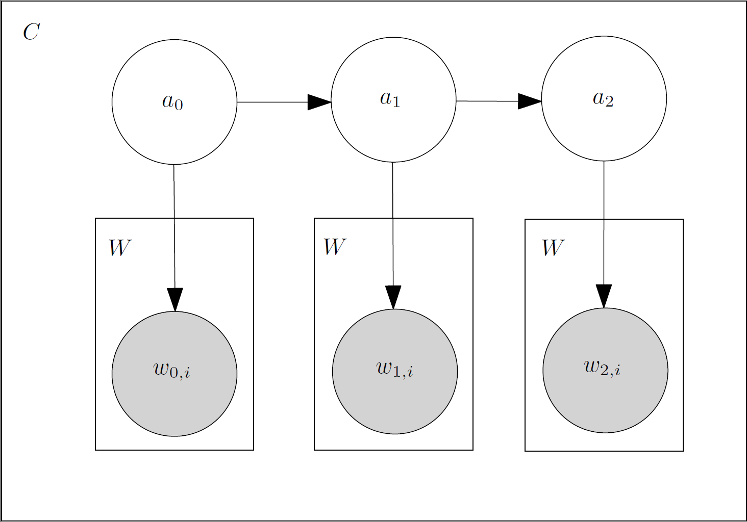
Adapt CM to Unsupervised DA Tagging
Notes:
Adapt content modeling approach to unsupervised dialogue act tagging
-Rename hidden states acts
Just a Hidden Markov model where each hidden state generates a bag of words as opposed to a single word in an HMM POS tagger.

Slide 16
Content Models: Pros/Cons
Pros:
Models Transitions Between Dialogue Acts
Unsupervised
Cons:
Topic Clusters
Barzilay & Lee masked out named entities to focus on general (not specific) events
This is more difficult on Twitter
Notes:
Content modeling is attractive because it is unsupervised, and models discourse constraints, however when directly applied it tends to discover clusters of posts which represent a common topic, and not any particular dialogue act.
Conversations on Twitter can occur on any topic, so there are strong clusters of topically-related posts.

Slide 17
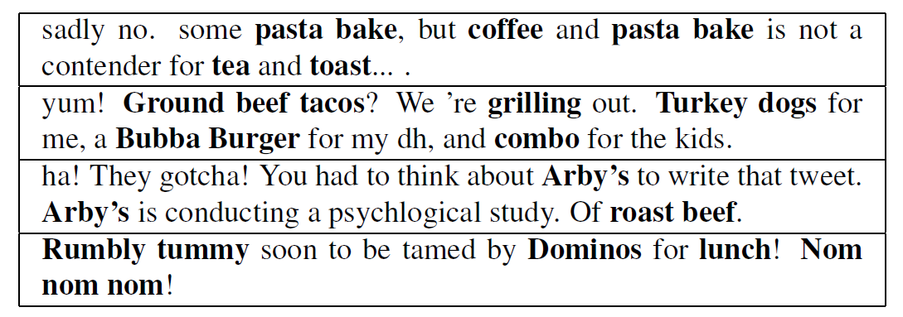
Problem: Strong Topic Clusters
We want:
Not:
Status
Technology
Comment
Food
Thanks
Notes:
We want a set of dialogue acts which give a shallow semantic representation of the conversation.
Not a set of topic clusters which self-transition with high probability and partition conversations into topics.

Slide 18
Goal: separate content/dialogue words
Dialogue act words
Conversation specific words
LDA-style topic model
Each word is generated from 1 of 3 sources:
General English
Conversation Topic Specific Vocabulary
Dialogue Act specific Vocabulary
Similar to:
[Daume III and Marcu, 2006]
[Haghighi & Vanderwende 2009]

Slide 19

Conversation Model
Notes:
Just a reminder, the content-modeling framework is a sentence-level HMM where the hidden states emit a bag of words.

Slide 20
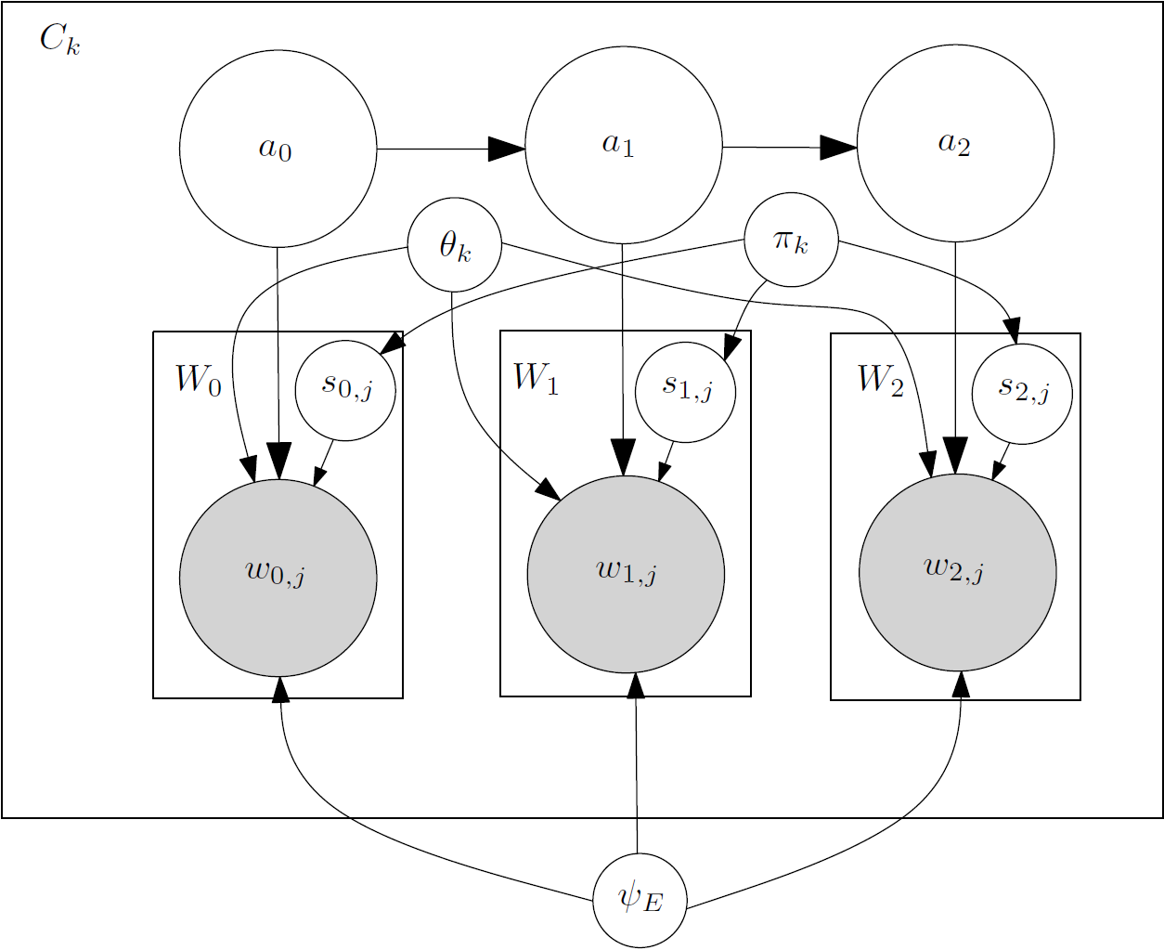
Conversation+Topic Model
Notes:
We’re proposing to add a set of hidden variables:
-One for each word
-They determine the source from which the word is drawn:
-A multinomial over words representing the topic of conversation
-General English
-A multinomial associated with the dialogue act.

Slide 21
Inference
Collapsed Gibbs sampling
Sample each hidden variable conditioned on assignment of all others
Integrate out parameters
But, lots of hyperparameters to set
Act transition multinomial
Act emission multinomial
Doc-specific multinomal
English multinomial
Source distribution multinomial
Slice Sampling Hyperparameters [Neal 2003]
Notes:
EM in this model becomes problematic
-Can’t efficiently sum out hidden variables using dynamic programming
We decided to move to a sampling-based approach to inference
-Collapsed Gibbs
But, there are a lot of multinomials in our model, so rather than set them to some arbitrary value, we use slice sampling, and treat them like additional hidden variables.

Slide 22
Probability Estimation
Problem:
Need to evaluate the probability of a conversation
Integrate out hidden variables
Use as a language model
Chibb-style Estimator [Wallach et. al 2009] [Murray & Salakhutdinov 2009]
Notes:
Because we can’t do efficient dynamic programming, we need to fall back to an approximation in order to evaluate the probability of held-out test dataChibbb
Chibb-Style estimator:
-Alternative to things like Harmonic Mean Method
-More accurate
Chibb-Style estimator:
-We have some data and hidden variables
-Pick an arbitrary assignment to the hidden variables
-Can easily compute the joint probability of the data and hidden variables
-This reduces the problem to computing the conditional probability of the hidden variables given the data (can be done using sampling)

Slide 23
Chibb Style Estimator [Wallach et. al 2009] [Murray & Salakhutdinov 2009]
Just Need to estimate:

Slide 24
Qualitative Evaluation
Trained on 10,000 Twitter conversations of length 3 to 6 tweets

Slide 25
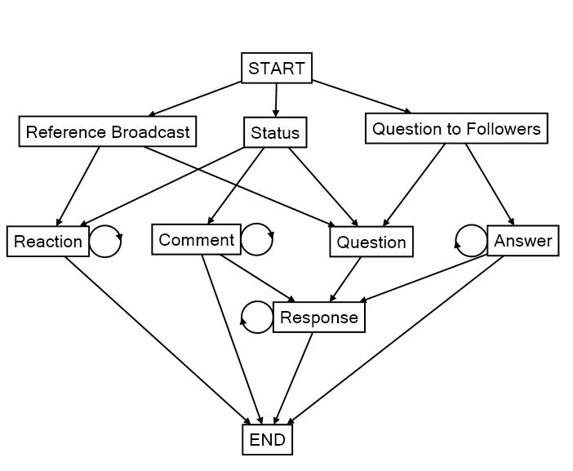
Conversation+Topic model Dialogue act transitions
Notes:
The Conversation+Topic model discovered the most interpretable set of dialogue acts, and didn’t’ include any “topic” clusters.
Visualization of the transition matrix from the HMM
-Hidden states are labeled with my interpretation of the acts.

Slide 26

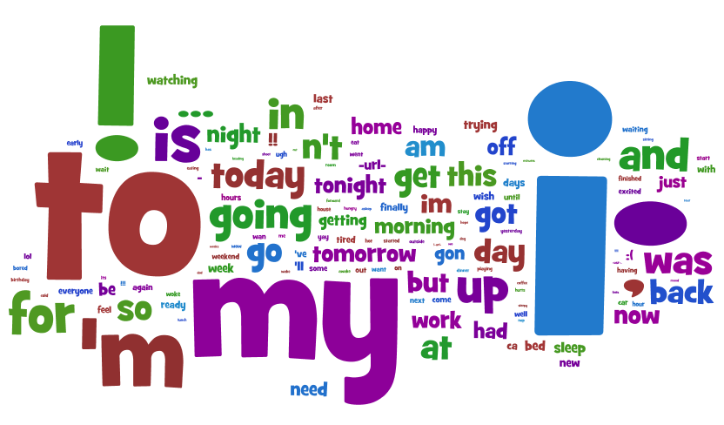
Status
Notes:
Word clouds represent the dialogue acts.
Each word’s size is proportional to it’s probability given the act.

Slide 27
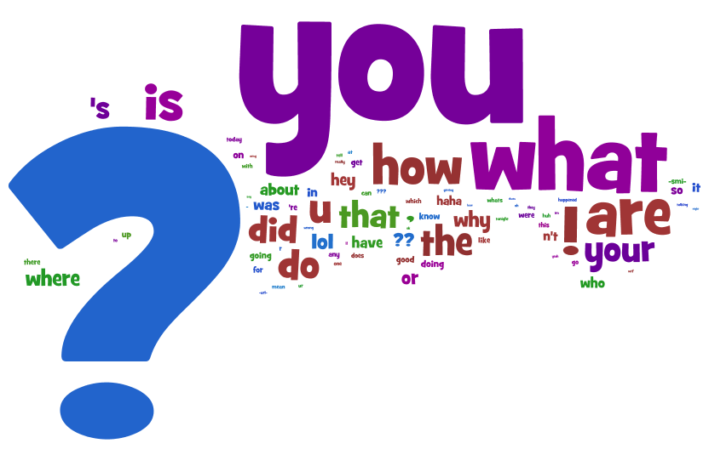
Question

Slide 28
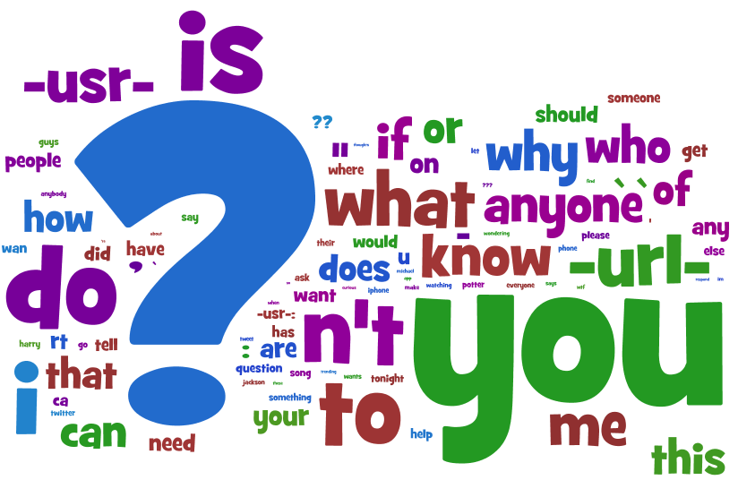
Question to Followers

Slide 29
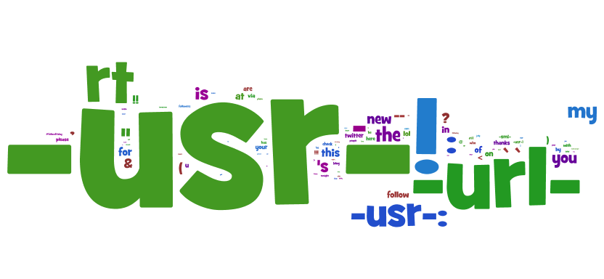
Reference Broadcast

Slide 30
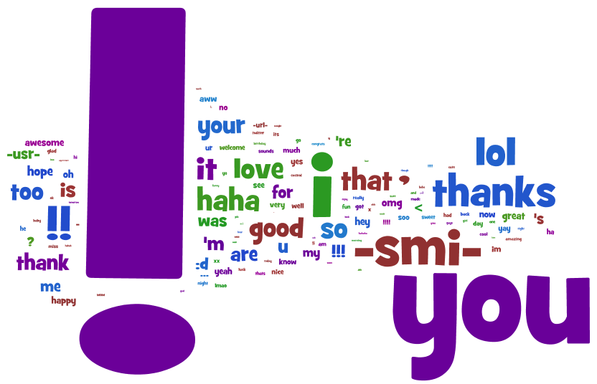
Reaction

Slide 31
Evaluation
How do we know which works best?
How well can we predict sentence order?
Generate all permutations of a conversation
Compute probability of each
How similar is highest ranked to original order?
Measure permutation similarity with Kendall Tau
Counts number of swaps needed to get desired order
Notes:
Evaluation is difficult
-We don’t have a set of gold-labeled conversations
-We want to remain agnostic about the right set of dialogue acts
-Allow each model to discover a set of dialogue acts
Tau is based on the number of exchanged pairs
ranges from -1 to 1
Reverse order is -1
Correct order is +1

Slide 32
Experiments – Conversation Ordering
Notes:
EM Conversation Model does much better than simple Bigram LM baseline.

Slide 33
Experiments – Conversation Ordering
Notes:
Conversation+Topic does better, but these models are using different methods for inference

Slide 34
Experiments – Conversation Ordering
Content words help predict sentence order
-Adjacent sentences contain similar content words
Notes:
We implemented a sampler for Conversation Model, and it performs a bit better
-But acts include topic clusters we wanted to avoid.
Content words can help to predict sentence order
-Adjacent sentences contain similar content words – provides useful constraints for sentence ordering

Slide 35
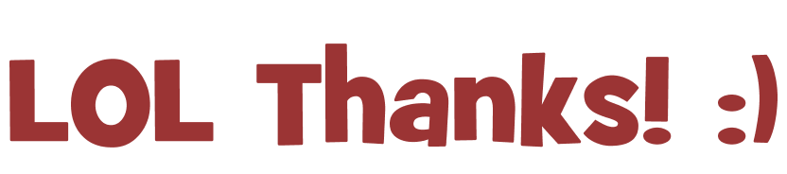
Conclusions
Presented a corpus of Twitter Conversations
http://research.microsoft.com/en-us/downloads/8f8d5323-0732-4ba0-8c6d-a5304967cc3f/default.aspx
Conversations on Twitter seem to have some common structure
Strong topic clusters are a problem for open-domain unsupervised DA tagging
Presented an approach to address this
Gibbs Sampling/Full Bayesian inference seems to outperform EM on Conversation Ordering

