Slide 1


Named Entity Recognition In Tweets: An Experimental Study
Alan Ritter
Sam Clark
Mausam
Oren Etzioni
University of Washington

Slide 2


Information Extraction: Motivation
Status Updates = short realtime messages
Low Overhead: Can be created quickly
Even on mobile devices
Realtime: users report events in progress
Often the most up-to date source of information
Huge Volume of Users
People Tweet about things they find interesting
Can use redundancy as a measure of importance

Slide 3
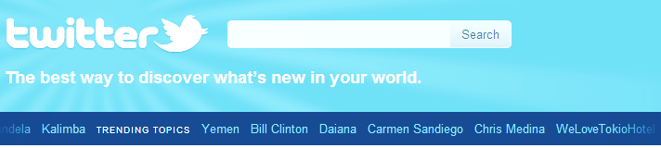
Information Extraction: Motivation
Status Updates = short realtime messages
Low Overhead: Can be created quickly
Even on mobile devices
Realtime: users report events in progress
Often the most up-to date source of information
Huge Volume of Users
People Tweet about things they find interesting
Can use redundancy as a measure of importance

Slide 4
Related Work (Applications)
Extracting music performers and locations
(Benson et. al 2011)
Predicting Polls
(O’Connor et. al. 2010)
Product Sentiment
(Brody et. al. 2011)
Outbreak detection
(Aramaki et. al. 2011)

Slide 5
Outline
Motivation
Error Analysis of Off The Shelf Tools
POS Tagger
Named Entity Segmentation
Named Entity Classification
Distant Supervision Using Topic Models
Tools available: https://github.com/aritter/twitter_nlp

Slide 6
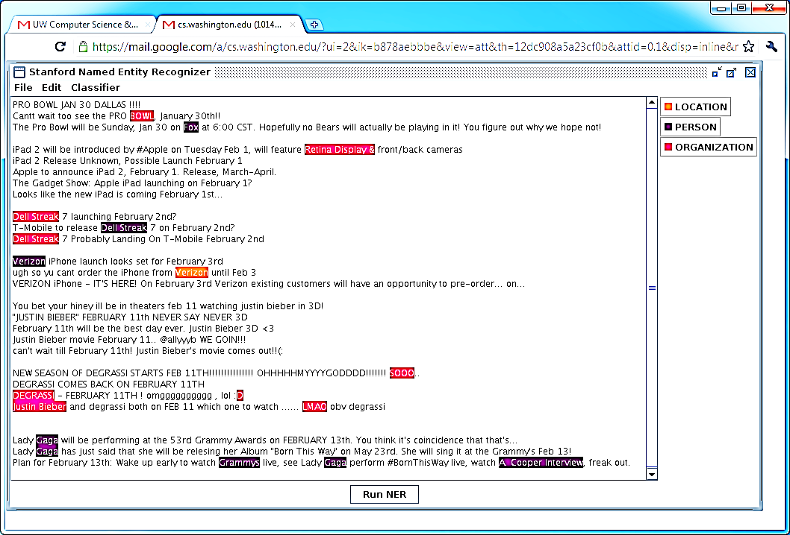
Off The Shelf NLP Tools Fail

Slide 7
Off The Shelf NLP Tools Fail
Twitter Has Noisy & Unique Style

Slide 8
Noisy Text: Challenges
Lexical Variation (misspellings, abbreviations)
`2m', `2ma', `2mar', `2mara', `2maro', `2marrow', `2mor', `2mora', `2moro', `2morow', `2morr', `2morro', `2morrow', `2moz', `2mr', `2mro', `2mrrw', `2mrw', `2mw', `tmmrw', `tmo', `tmoro', `tmorrow', `tmoz', `tmr', `tmro', `tmrow', `tmrrow', `tmrrw', `tmrw', `tmrww', `tmw', `tomaro', `tomarow', `tomarro', `tomarrow', `tomm', `tommarow', `tommarrow', `tommoro', `tommorow', `tommorrow', `tommorw', `tommrow', `tomo', `tomolo', `tomoro', `tomorow', `tomorro', `tomorrw', `tomoz', `tomrw', `tomz‘
Unreliable Capitalization
“The Hobbit has FINALLY started filming! I cannot wait!”
Unique Grammar
“watchng american dad.”

Slide 9
Part of speech tagging

Slide 10
Part Of Speech Tagging: Accuracy Drops on Tweets
Most Common Tag : 76% (90% on brown corpus)
Stanford POS : 80% (97% on news)

Slide 11
Part Of Speech Tagging: Accuracy Drops on Tweets
Most Common Tag : 76% (90% on brown corpus)
Stanford POS : 80% (97% on news)
Most Common Errors:
Confusing Common/Proper nouns
Misclassifying interjections as nouns
Misclassifying verbs as nouns

Slide 12
POS Tagging
Labeled 800 tweets w/ POS tags
About 16,000 tokens
Also used labeled news + IRC chat data (Forsyth and Martell 07)
CRF + Standard set of features
Contextual
Dictionary
Orthographic

Slide 13
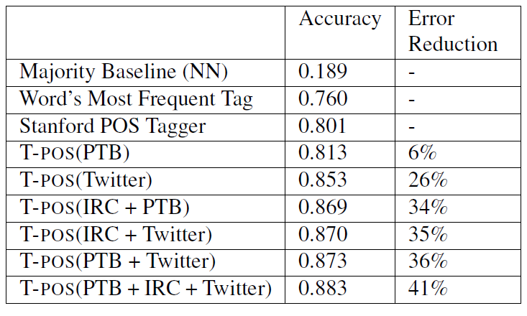
Results

Slide 14
XX/YY = XX is misclassified as YY

Slide 15
Named Entity Segmentation
Off the shelf taggers perform poorly
Stanford NER: F1=0.44
not including classification

Slide 16
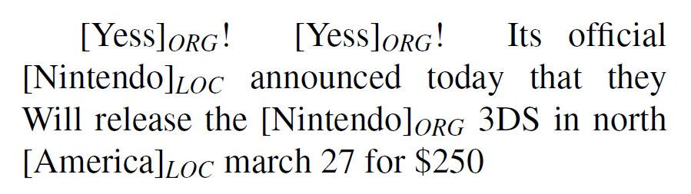
Named Entity Segmentation
Off the shelf taggers perform poorly
Stanford NER: F1=0.44
not including classification

Slide 17
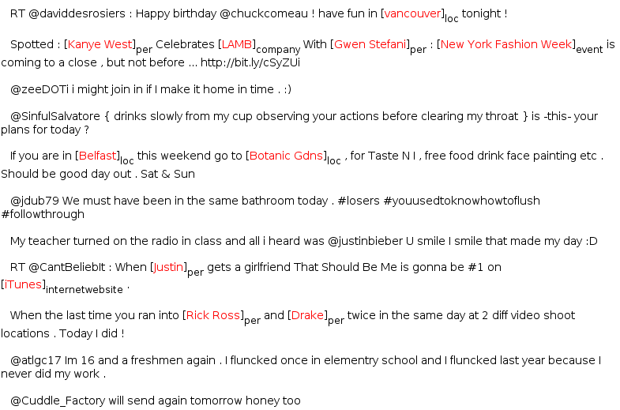
Annotating Named Entities
Annotated 2400 tweets (about 34K tokens)
Train on in-domain data

Slide 18
Learning
Sequence Labeling Task
IOB encoding
Conditional Random Fields
Features:
Orthographic
Dictionaries
Contextual
Word | Label
T-Mobile | B-ENTITY
to | O
release | O
Dell | B-ENTITY
Streak | I-ENTITY
7 | I-ENTITY
on | O
Feb | O
2nd | O

Slide 19
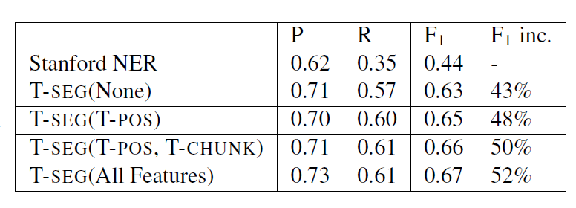
Performance (Segmentation Only)

Slide 20
Named Entity Classification

Slide 21
Challenges
Plethora of distinctive, infrequent types
Bands, Movies, Products, etc…
Very Little training data for these
Can’t simply rely on supervised classification
Very terse (often contain insufficient context)

Slide 22
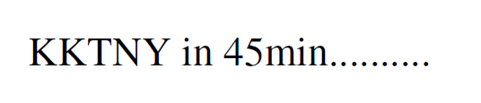
Challenges
Plethora of distinctive, infrequent types
Bands, Movies, Products, etc…
Very Little training data for these
Can’t simply rely on supervised classification
Very terse (often contain insufficient context)

Slide 23
Weakly Supervised NE Classification (Collins and Singer 99) (Etzioni et. al. 05) (Kozareva 06)
Freebase lists provide a source of supervision
But entities often appear in many different lists, for example “China” could be:
A country
A band
A person (member of the band “metal boys”)
A film (released in 1943)

Slide 24
Weakly Supervised NE Classification (Collins and Singer 99) (Etzioni et. al. 05) (Kozareva 06)
Freebase lists provide a source of supervision
But entities often appear in many different lists, for example “China” could be:
A country
A band
A person (member of the band “metal boys”)
A film (released in 1943)
We need Some way to disambiguate

Slide 25
Distant Supervision With Topic Models
Treat each entity as a “document”
Words in document are those which co-occur with entity
LabeledLDA (Ramage et. al. 2009)
Constrained Topic Model
Each entity is associated with a distribution over topics
Constrained based on FB dictionaries
Each topic is associated with a type (in Freebase)

Slide 26
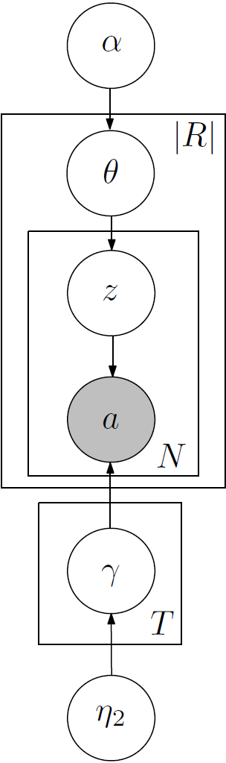
Generative Story

Slide 27
Generative Story
For each type, pick a random distribution over words

Slide 28
Generative Story
For each type, pick a random distribution over words
Type 1: TEAM
P(victory|T1)= 0.02
P(played|T1)= 0.01
…
Type 2: LOCATION
P(visiting|T2)=0.05
P(airport|T2)=0.02
…

Slide 29
Generative Story
For each entity, pick a distribution over types (constrained by Freebase)
For each type, pick a random distribution over words
Type 1: TEAM
P(victory|T1)= 0.02
P(played|T1)= 0.01
…
Type 2: LOCATION
P(visiting|T2)=0.05
P(airport|T2)=0.02
…

Slide 30
Generative Story
For each entity, pick a distribution over types (constrained by Freebase)
Seattle
P(TEAM|Seattle)= 0.6
P(LOCATION|Seattle)= 0.4
For each type, pick a random distribution over words
Type 1: TEAM
P(victory|T1)= 0.02
P(played|T1)= 0.01
…
Type 2: LOCATION
P(visiting|T2)=0.05
P(airport|T2)=0.02
…

Slide 31
Generative Story
For each entity, pick a distribution over types (constrained by Freebase)
Seattle
P(TEAM|Seattle)= 0.6
P(LOCATION|Seattle)= 0.4
For each position, first pick a type
For each type, pick a random distribution over words
Type 1: TEAM
P(victory|T1)= 0.02
P(played|T1)= 0.01
…
Type 2: LOCATION
P(visiting|T2)=0.05
P(airport|T2)=0.02
…

Slide 32
Generative Story
For each entity, pick a distribution over types (constrained by Freebase)
Seattle
P(TEAM|Seattle)= 0.6
P(LOCATION|Seattle)= 0.4
For each position, first pick a type
Is a TEAM
For each type, pick a random distribution over words
Type 1: TEAM
P(victory|T1)= 0.02
P(played|T1)= 0.01
…
Type 2: LOCATION
P(visiting|T2)=0.05
P(airport|T2)=0.02
…

Slide 33
Generative Story
For each entity, pick a distribution over types (constrained by Freebase)
Seattle
P(TEAM|Seattle)= 0.6
P(LOCATION|Seattle)= 0.4
For each position, first pick a type
Is a TEAM
Then pick an word based on type
For each type, pick a random distribution over words
Type 1: TEAM
P(victory|T1)= 0.02
P(played|T1)= 0.01
…
Type 2: LOCATION
P(visiting|T2)=0.05
P(airport|T2)=0.02
…

Slide 34
Generative Story
For each entity, pick a distribution over types (constrained by Freebase)
Seattle
P(TEAM|Seattle)= 0.6
P(LOCATION|Seattle)= 0.4
For each position, first pick a type
Is a TEAM
Then pick an word based on type
victory
For each type, pick a random distribution over words
Type 1: TEAM
P(victory|T1)= 0.02
P(played|T1)= 0.01
…
Type 2: LOCATION
P(visiting|T2)=0.05
P(airport|T2)=0.02
…

Slide 35
Generative Story
For each entity, pick a distribution over types (constrained by Freebase)
Seattle
P(TEAM|Seattle)= 0.6
P(LOCATION|Seattle)= 0.4
For each position, first pick a type
Is a TEAM
Is a LOCATION
Then pick an word based on type
victory
For each type, pick a random distribution over words
Type 1: TEAM
P(victory|T1)= 0.02
P(played|T1)= 0.01
…
Type 2: LOCATION
P(visiting|T2)=0.05
P(airport|T2)=0.02
…

Slide 36
Generative Story
For each entity, pick a distribution over types (constrained by Freebase)
Seattle
P(TEAM|Seattle)= 0.6
P(LOCATION|Seattle)= 0.4
For each position, first pick a type
Is a TEAM
Is a LOCATION
Then pick an word based on type
victory
airport
For each type, pick a random distribution over words
Type 1: TEAM
P(victory|T1)= 0.02
P(played|T1)= 0.01
…
Type 2: LOCATION
P(visiting|T2)=0.05
P(airport|T2)=0.02
…

Slide 37
Data/Inference
Gather entities and words which co-occur
Extract Entities from about 60M status messages
Used a set of 10 types from Freebase
Commonly occur in Tweets
Good coverage in Freebase
Inference: Collapsed Gibbs sampling:
Constrain types using Freebase
For entities not in Freebase, don’t constrain

Slide 38
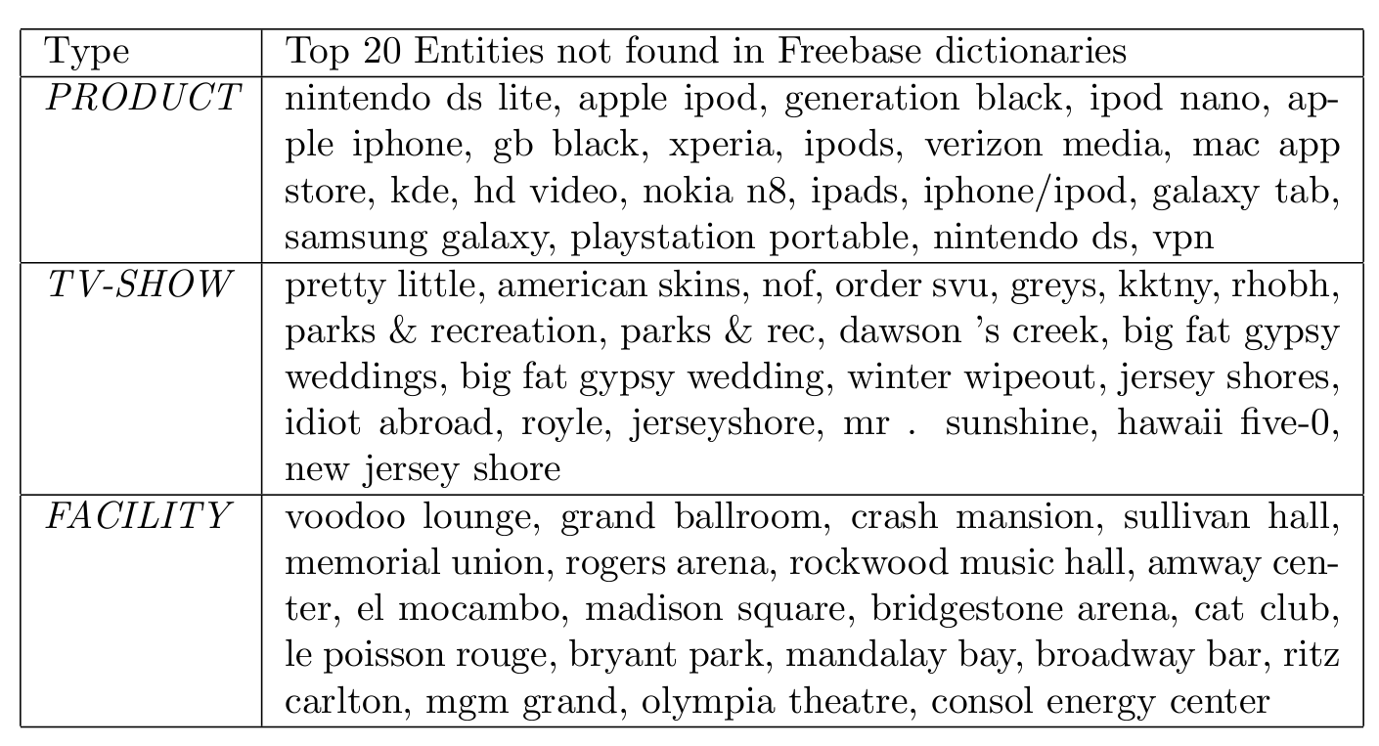
Type Lists

Slide 39
Type Lists
KKTNY = Kourtney and Kim Take New York
RHOBH = Real Housewives of Beverly Hills

Slide 40
Evaluation
Manually Annotated the 2,400 tweets with the 10 entity types
Only used for testing purposes
No labeled examples for LLDA & Cotraining

Slide 41
Classification Results: 10 Types (Gold Segmentation)

Slide 42
Classification Results: 10 Types (Gold Segmentation)
Precision =0.85
Recall=0.24

Slide 43
Classification Results: 10 Types (Gold Segmentation)

Slide 44
Why is LDA winning?
Share type info. across mentions
Unambiguous mentions help to disambiguate
Unlabeled examples provide entity-specific prior
Explicitly models ambiguity
Each “entity string” is modeled as (constrained) distribution over types
Takes better advantage of ambiguous training data

Slide 45
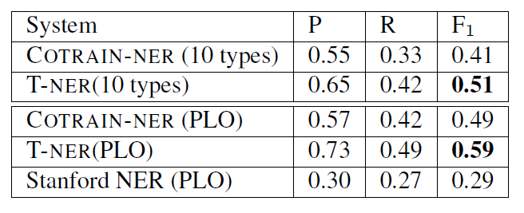
Segmentation + Classification

Slide 46
Related Work
Named Entity Recognition
(Liu et. al. 2011)
POS Tagging
(Gimpel et. al. 2011)

Slide 47
Calendar Demo
Extract Entities from millions of Tweets
Using NER trained on Labeled Tweets
Extract and Resolve Temporal Expressions
For example “Next Friday” = 02-24-11
Count Entity/Day co-occurrences
G² Log Likelihood Ratio
Plot Top 20 Entities for Each Day
_{http://statuscalendar.com}

Slide 48
Contributions
Analysis of challenges in noisy text
Adapted NLP tools to Twitter
Distant Supervision using Topic Models
Tools available: https://github.com/aritter/twitter_nlp

Slide 49
Contributions
Analysis of challenges in noisy text
Adapted NLP tools to Twitter
Distant Supervision using Topic Models
Tools available: https://github.com/aritter/twitter_nlp
Thanks!

Slide 50
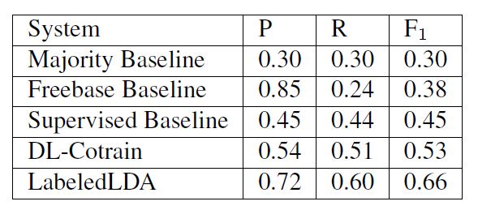
Classification Results (Gold Segmentation)

Slide 51
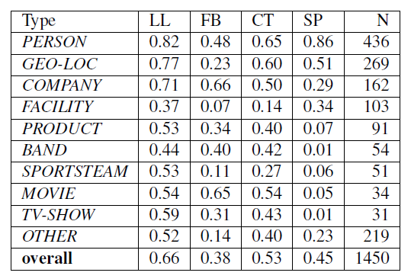
Classification Results By Type (Gold Segmentation)

Slide 52
Performance (Segmentation Only)

Slide 53
Part Of Speech Tagging: Accuracy Drops on Tweets
Most Common Tag : 76% (90% on brown corpus)
Stanford POS : 80% (97% on news)

