Slide 1
Mixture Models and the EM Algorithm
Alan Ritter

Slide 2
Latent Variable Models
Previously: learning parameters with fully observed data
Alternate approach: hidden (latent) variables

Slide 3
Latent Cause
Q: how do we learn parameters?

Slide 4
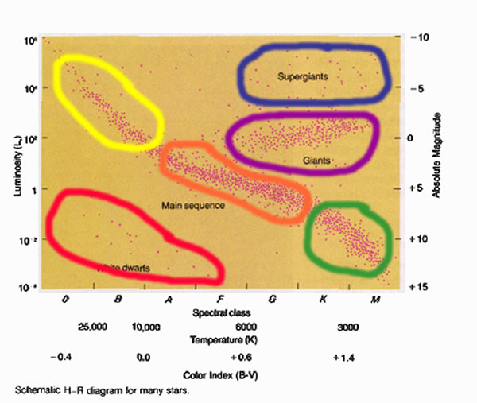
Unsupervised Learning
Also known as clustering
What if we just have a bunch of data, without any labels?
Also computes compressed representation of the data

Slide 5
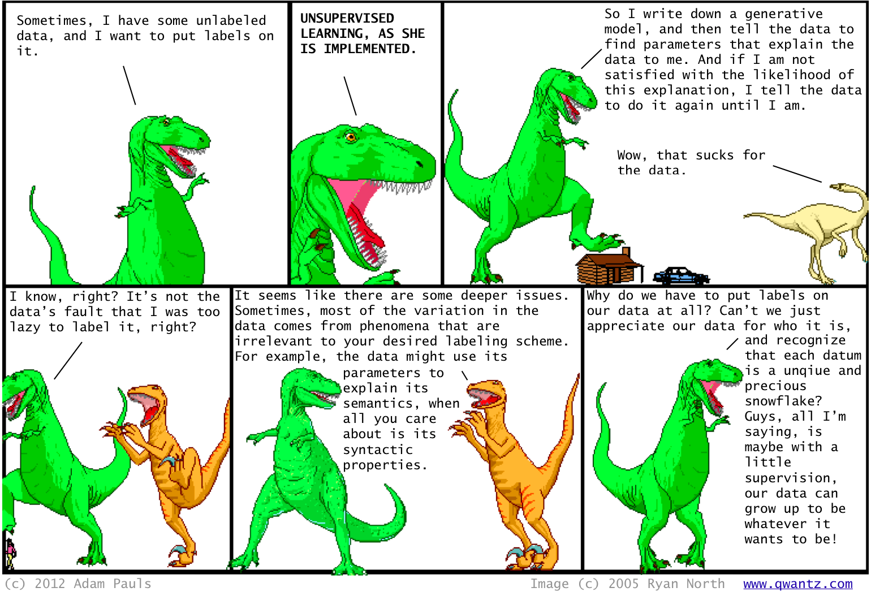

Slide 6
Mixture Models: Motivation
Standard distributions (e.g. Multivariate Gaussian) are too limited.
How do we learn and represent more complex distributions?
One answer: as mixtures of standard distributions
In the limit, we can represent any distribution in this way
Also a good (and widely used) clustering method

Slide 7
Mixture models: Generative Story
Repeat:
Choose a component according to P(Z)
Generate the X as a sample from P(X|Z)
We may have some synthetic data that was generated in this way.
Unlikely any real-world data follows this procedure.

Slide 8
Mixture Models
Objective function: log likelihood of data
Naïve Bayes:
Gaussian Mixture Model (GMM)
is multivariate Gaussian
Base distributions, ,can be pretty much anything

Slide 9
Previous Lecture: Fully Observed Data
Finding ML parameters was easy
Parameters for each CPT are independent

Slide 10
Learning with latent variables is hard!
Previously, observed all variables during parameter estimation (learning)
This made parameter learning relatively easy
Can estimate parameters independently given data
Closed-form solution for ML parameters

Slide 11
Mixture models (plate notation)

Slide 12
Gaussian Mixture Models (mixture of Gaussians)
A natural choice for continuous data
Parameters:
Component weights
Mean of each component
Covariance of each component

Slide 13
GMM Parameter Estimation

Slide 14
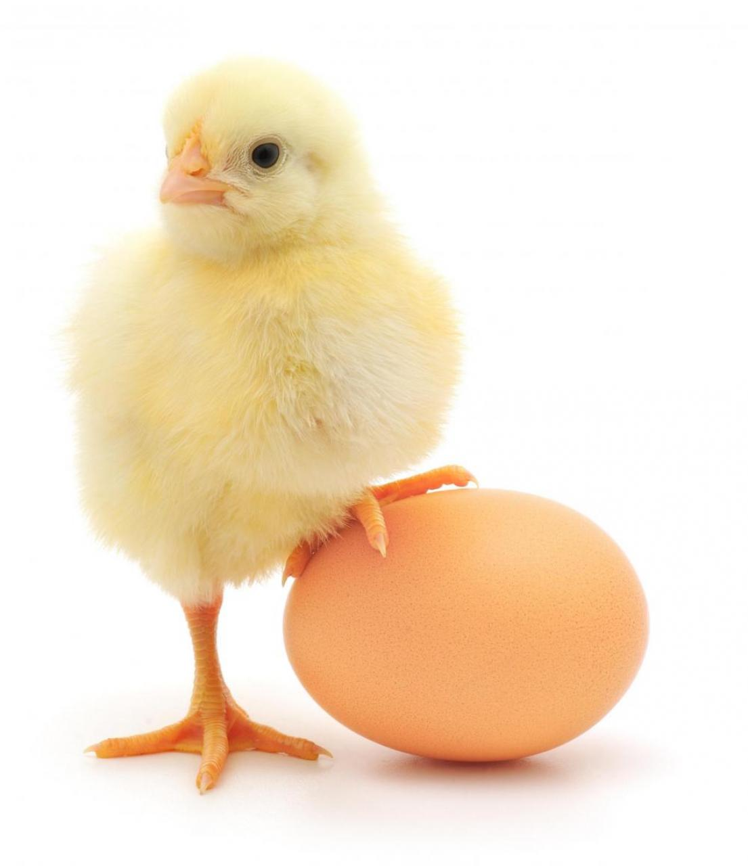
Q: how can we learn parameters?
Chicken and egg problem:
If we knew which component generated each datapoint it would be easy to recover the component Gaussians
If we knew the parameters of each component, we could infer a distribution over components to each datapoint.
Problem: we know neither the assignments nor the parameters

Slide 18
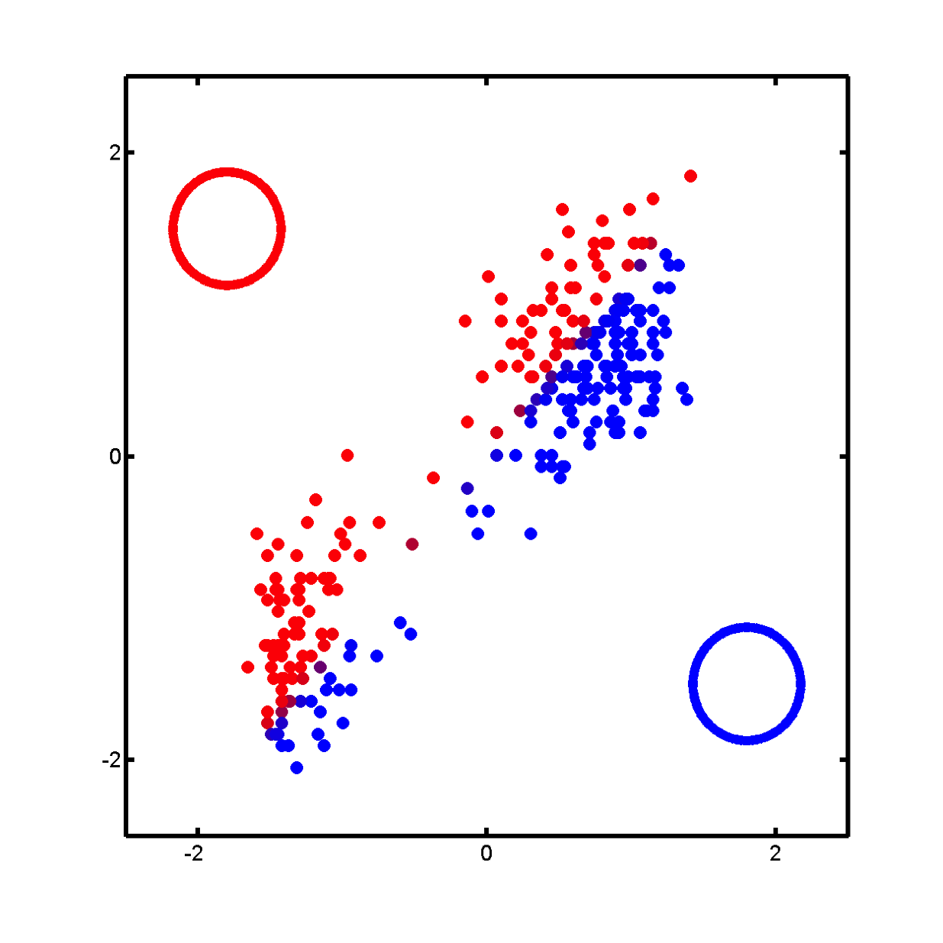

Slide 19
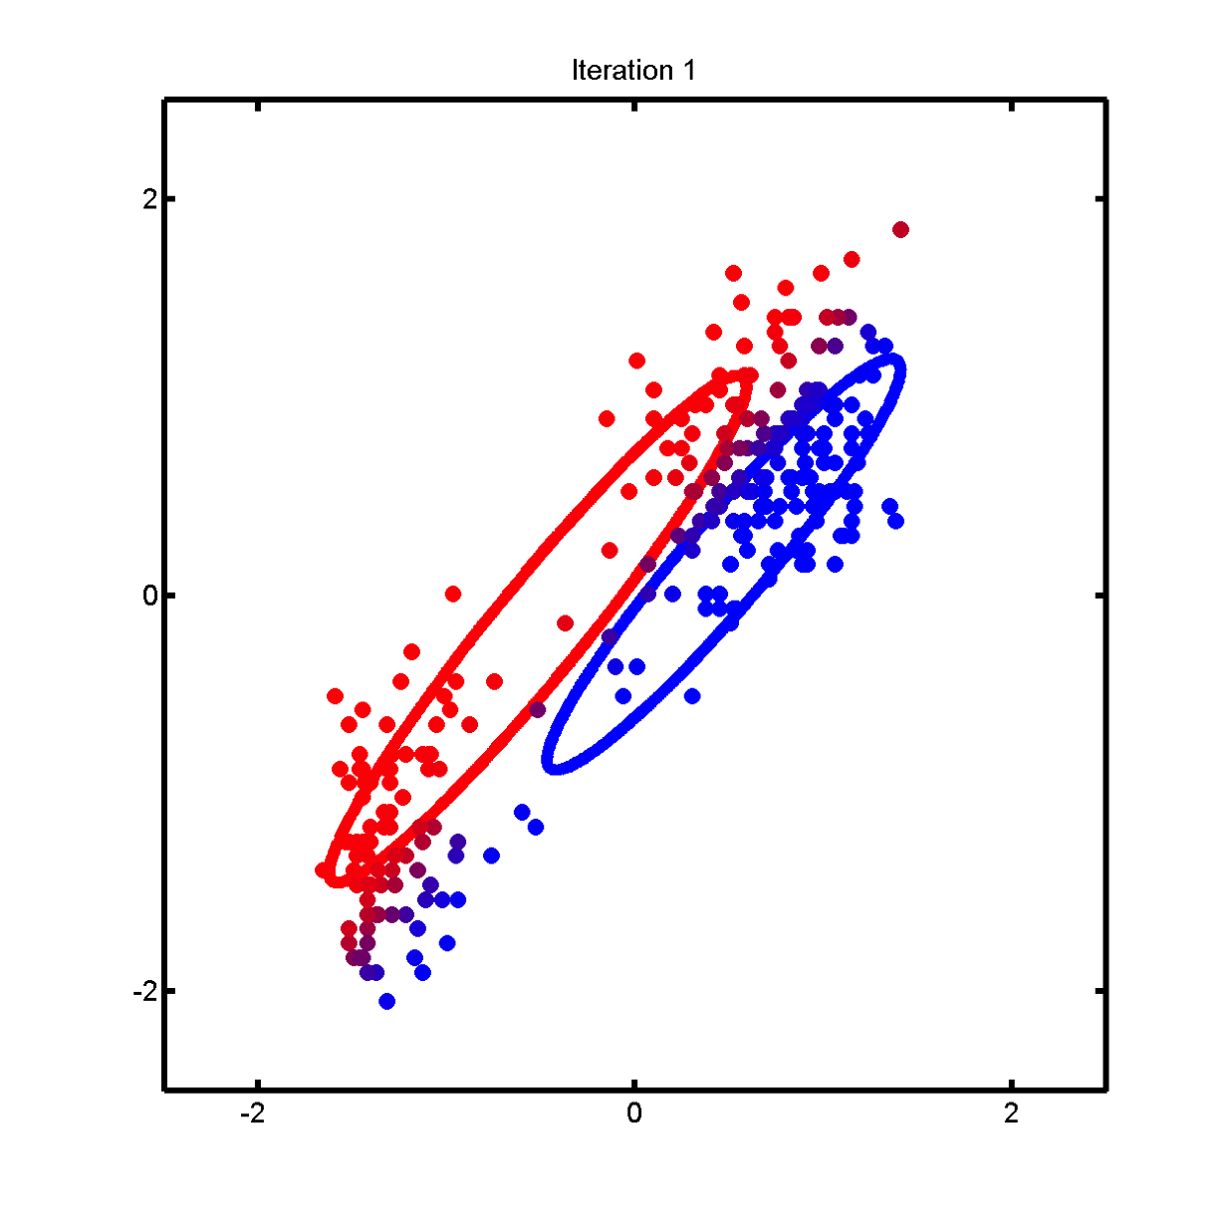

Slide 20


Slide 21
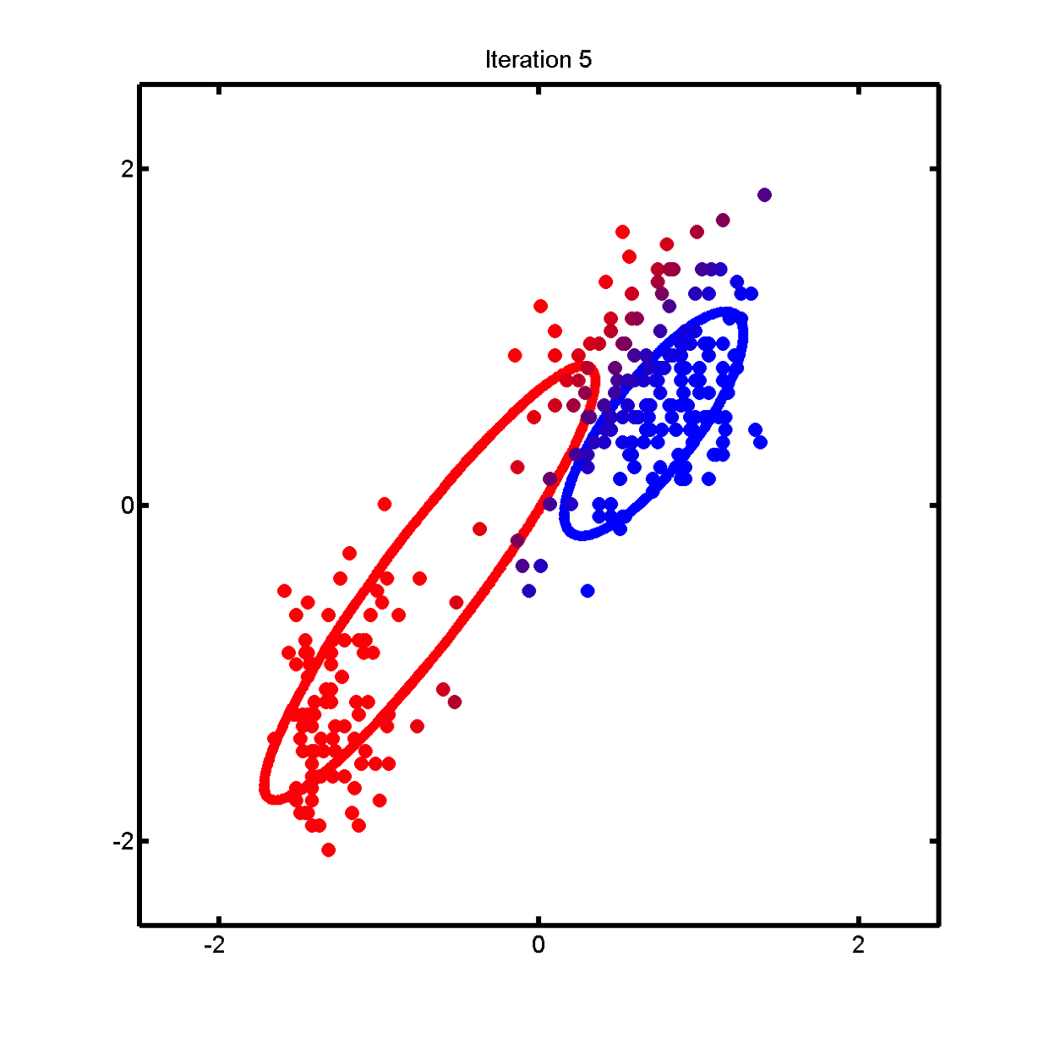

Slide 22
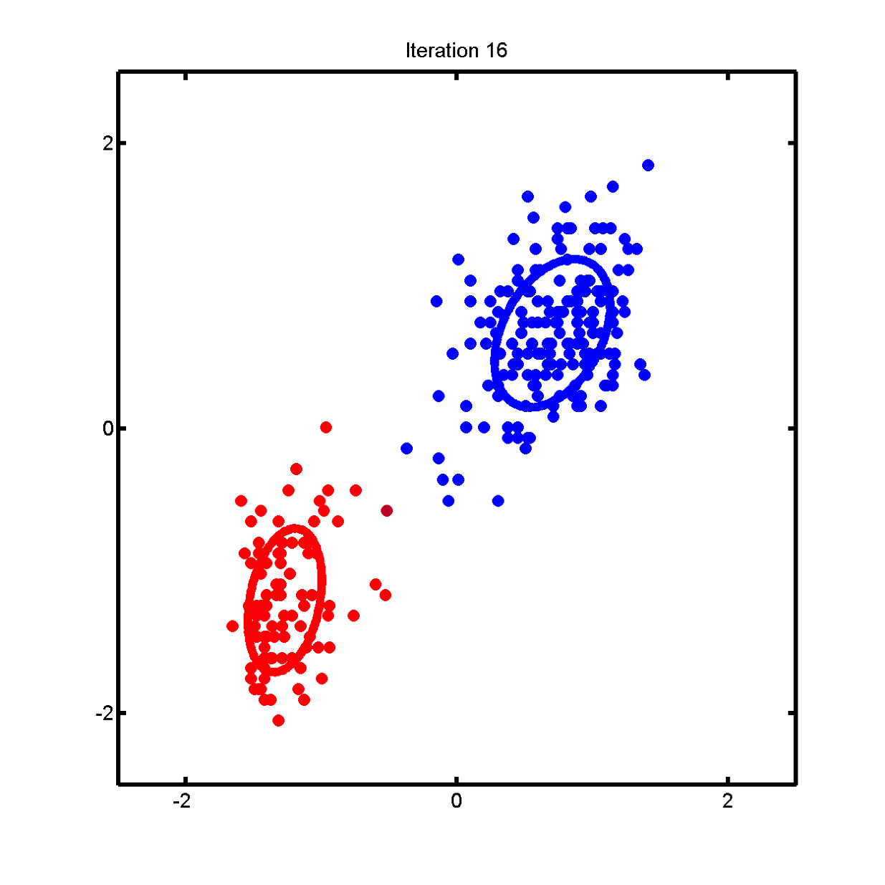

Slide 23
Why does EM work?
Monotonically increases observed data likelihood until it reaches a local maximum

Slide 24
EM is more general than GMMs
Can be applied to pretty much any probabilistic model with latent variables
Not guaranteed to find the global optimum
Random restarts
Good initialization

Slide 25
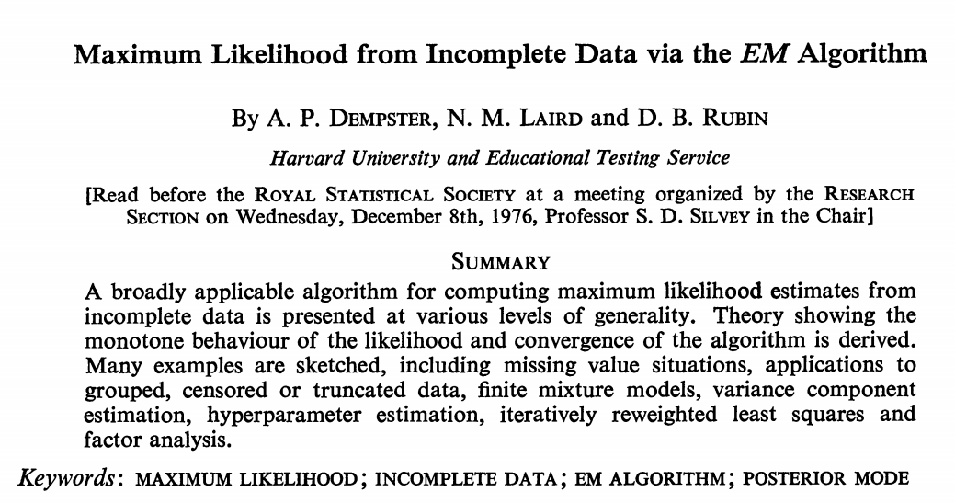
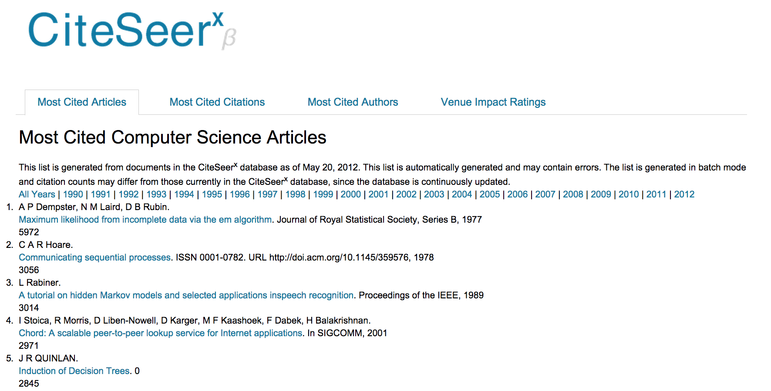

Slide 26
Important Notes For the HW
Likelihood is always guaranteed to increase.
If not, there is a bug in your code
(this is useful for debugging)
A good idea to work with log probabilities
See log identities http://en.wikipedia.org/wiki/List_of_logarithmic_identities
Problem: Sums of logs
No immediately obvious way to compute
Need to convert back from log-space to sum?
NO! Use the log-exp-sum trick!

Slide 27
Numerical Issues
Example Problem: multiplying lots of probabilities (e.g. when computing likelihood)
In some cases we also need to sum probabilities
No log identity for sums
Q: what can we do?

Slide 28
Log Exp Sum Trick: motivation
We have: a bunch of log probabilities.
log(p1), log(p2), log(p3), … log(pn)
We want: log(p1 + p2 + p3 + … pn)
We could convert back from log space, sum then take the log.
If the probabilities are very small, this will result in floating point underflow

Slide 29
Log Exp Sum Trick:

Slide 30
K-means Algorithm
Hard EM
Maximizing a different objective function (not likelihood)

