Slide 1
Basics of Statistical Estimation
Alan Ritter
rittera@cs.cmu.edu

Slide 2
Parameter Estimation
How to estimate parameters from data?
Maximum Likelihood Principle:
Choose the parameters that maximize the probability of the observed data!

Slide 3

Maximum Likelihood Estimation Recipe
Use the log-likelihood
Differentiate with respect to the parameters
Equate to zero and solve

Slide 4
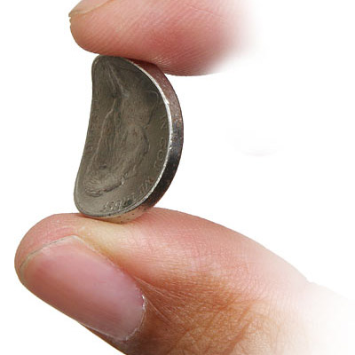
An Example
Let’s start with the simplest possible case
Single observed variable
Flipping a bent coin
We Observe:
Sequence of heads or tails
HTTTTTHTHT
Goal:
Estimate the probability that the next flip comes up heads
Notes:
Before I get into talking about modeling words and documents, I’d like to start out with a bit of background on estimating parameters in Bayesian networks.
Let’s start with the simplest possible case, which is flipping a coin.
This is the general setup: we perform a sequence of coin flip experiments and record whether the result is heads or tails. For example, maybe we flip a coin 10 times and get this sequence of heads and tails.
Our (general) goal is to estimate the probability that the next flip comes up heads.

Slide 5
Assumptions
Fixed parameter
Probability that a flip comes up heads
Each flip is independent
Doesn’t affect the outcome of other flips
(IID) Independent and Identically Distributed
Notes:
There are a couple of important assumptions that make sense here, specifically that there is a fixed parameter \theta_H (which is the probability a flip comes up heads) – this doesn’t change, for example we don’t switch coins in the middle, or bend the coin more during the experiment.
The other assumption is that each flip is independent. The outcome of one flip doesn’t affect the outcome of others.
These assumptions are often referred to as “IID” – Independent and Identically distributed.

Slide 6
Example
Let’s assume we observe the sequence:
HTTTTTHTHT
What is the best value of ?
Probability of heads
Intuition: should be 0.3 (3 out of 10)
Question: how do we justify this?
Notes:
Going back to our example sequence of coin flips, what should our best guess be about the probability the coin lands heads?

Slide 7
Maximum Likelihood Principle
The value of which maximizes the probability of the observed data is best!
Based on our assumptions, the probability of “HTTTTTHTHT” is:
This is the Likelihood Function

Slide 8
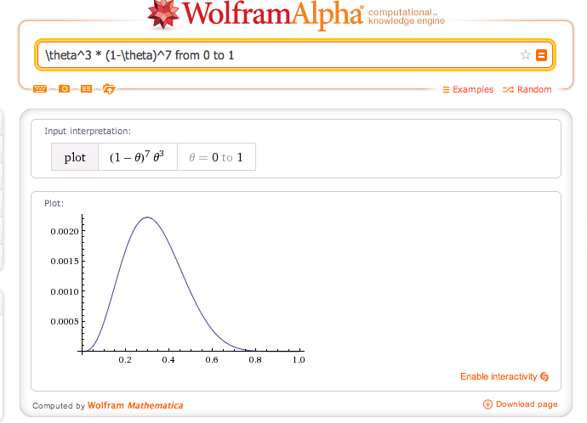
Maximum Likelihood Principle
Probability of “HTTTTTHTHT” as a function of
Θ=0.3

Slide 9
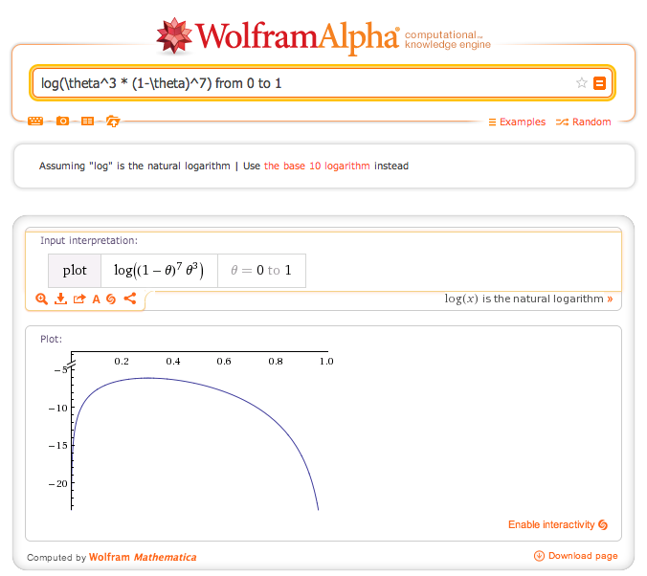
Maximum Likelihood Principle
Probability of “HTTTTTHTHT” as a function of
Θ=0.3

Slide 10
Maximum Likelihood value of
Log Identities

Slide 11
Maximum Likelihood value of

Slide 12
The problem with Maximum Likelihood
What if the coin doesn’t look very bent?
Should be somewhere around 0.5?
What if we saw 3,000 heads and 7,000 tails?
Should this really be the same as 3 out of 10?
Maximum Likelihood
No way to quantify our uncertainty.
No way to incorporate our prior knowledge!
Q: how to deal with this problem?

Slide 13
Bayesian Parameter Estimation
Let’s just treat like any other variable
Put a prior on it!
Encode our prior knowledge about possible values of using a probability distribution
Now consider two probability distributions:
Notes:
Use probability to reason about our uncertainty about the parameter,

Slide 14
Posterior Over

Slide 15
How can we encode prior knowledge?
Example: The coin doesn’t look very bent
Assign higher probability to values of near 0.5
Solution: The Beta Distribution
Gamma is a continuous generalization of the Factorial Function
Notes:
Now we have these new parameters alpha and beta which are referred to as “hyperparameters”. And as you can imagine, we can put additional prior distributions on them ☺
Beta Distribution looks similar to the likelihood
conjugate prior to the Bernoulli distribution
Gamma function can be understood as a continuous generalization of the factorial function.

Slide 16
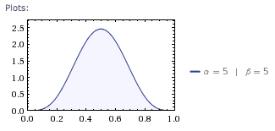
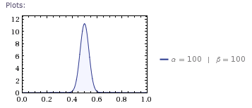
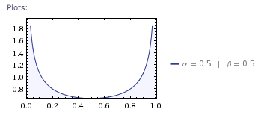
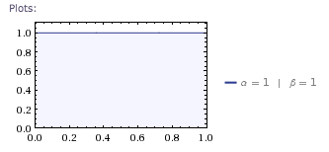
Beta Distribution
Beta(5,5)
Beta(100,100)
Beta(0.5,0.5)
Beta(1,1)

Slide 17
Marginal Probability over single Toss
Beta prior indicates α imaginary heads and β imaginary tails

Slide 18
More than one toss
If the prior is Beta, so is posterior!
Beta is conjugate to the Bernoulli likelihood

Slide 19
Prediction
What is the probability the next coin flip is heads?
?
But is really unknown.
We should consider all possible values
Notes:
OK, so now we know how to find a distribution over \theta_H, so how do we predict the probability the next coin flip will be heads?
One option is just to pick the value of \theta_H which maximizes likelihood (like we discussed previously). This is referred to as a “point estimate”.
But \theta_H is really unknown, so if we’re going to be really detailed (bayesian) about this, the thing to do is to consider all possible values of theta in our estimate.

Slide 20
Prediction
Integrate the posterior over to predict the probability of heads on the next toss.

Slide 21
Prediction

Slide 22
Marginalizing out

Slide 23
Marginalizing out Parameters (cont)
Beta Integral
Notes:
We can use this to answer the question: what’s the probability the next flip comes up heads?

Slide 24
Prediction
Immediate result
Can compute the probability over the next toss:
Notes:
We can use the previous result to predict

Slide 25
Summary: Maximum Likelihood vs. Bayesian Estimation
Maximum likelihood: find the “best”
Bayesian approach:
Don’t use a point estimate
Keep track of our beliefs about
Treat like a random variable
In this class we will mostly focus on Maximum Likelihood

Slide 26

Modeling Text
Not a sequence of coin tosses…
Instead we have a sequence of words
But we could think of this as a sequence of die rolls
Very large die with one word on each side
Multinomial is n-dimensional generalization of Bernoulli
Dirichlet is an n-dimensional generalization of Beta distribution

Slide 27
Multinomial
Rather than one parameter, we have a vector
Likelihood Function:

Slide 28
Dirichlet
Generalizes the Beta distribution from 2 to K dimensions
Conjugate to Multinomial

Slide 29

Example: Text Classification
Problem: Spam Email classification
We have a bunch of email (e.g. 10,000 emails) labeled as spam and non-spam
Goal: given a new email, predict whether it is spam or not
How can we tell the difference?
Look at the words in the emails
Viagra, ATTENTION, free

Slide 30
Naïve Bayes Text Classifier
By making independence assumptions we can better estimate these probabilities from data

Slide 31
Naïve Bayes Text Classifier
Simplest possible classifier
Assumption: probability of each word is conditionally independent given class memberships.
Simple application of Bayes Rule

Slide 32
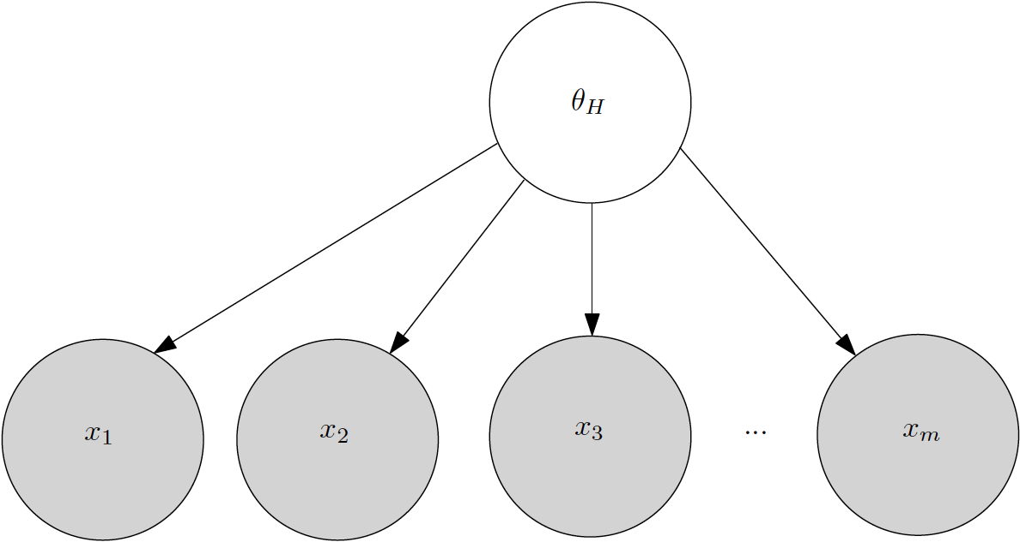
Bent Coin Bayesian Network
Probability of Each coin flip is conditionally independent given Θ

Slide 33
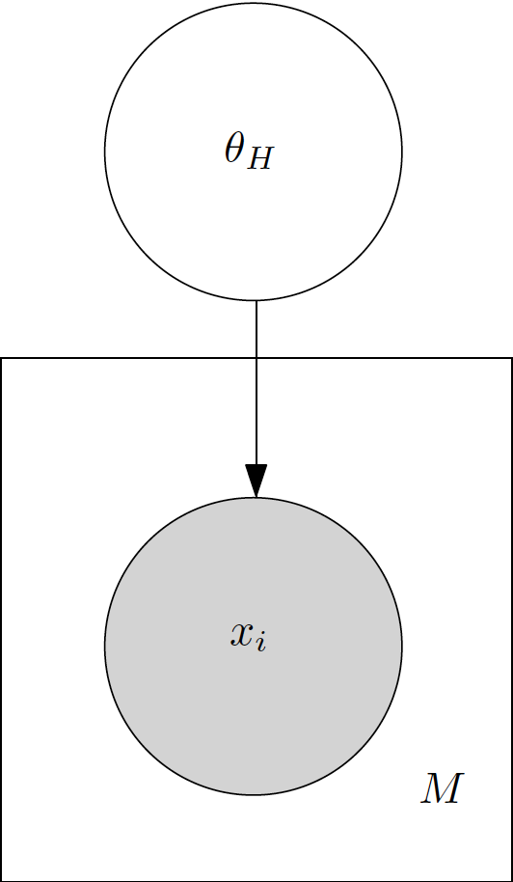
Bent Coin Bayesian Network (Plate Notation)

Slide 34
Naïve Bayes Model For Text Classification
Data is a set of “documents”
Z variables are categories
Z’s Observed during learning
Hidden at test time.
Learning from training data:
Estimate parameters (θ,β) using fully-observed data
Prediction on test data:
Compute P(Z|w1,…wn) using Bayes’ rule

Slide 35
Naïve Bayes Model For Text Classification
Q: How to estimate θ?
Q: How to estimate β?

